Slide 1
LET’S BE A
GREAT TEAM!
This is for ALL CLIMBERS!

Slide 2
These are the Climbers you are joining . . .

Slide 3
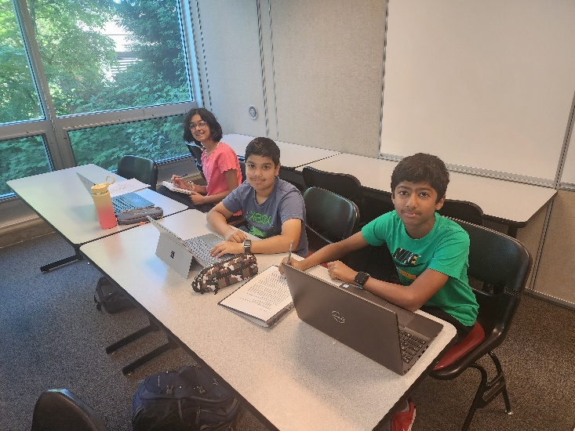
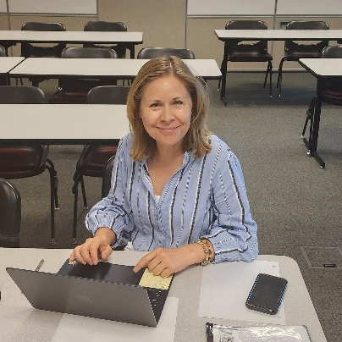
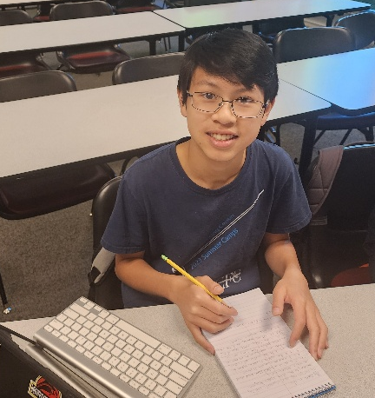
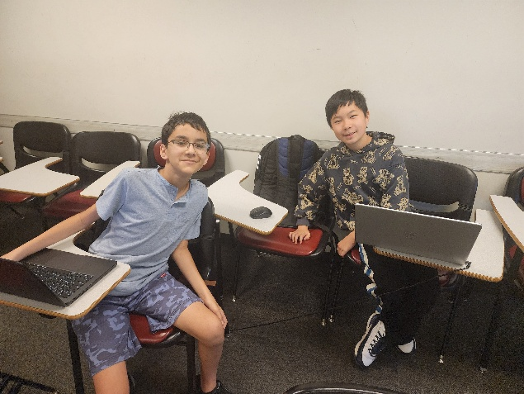
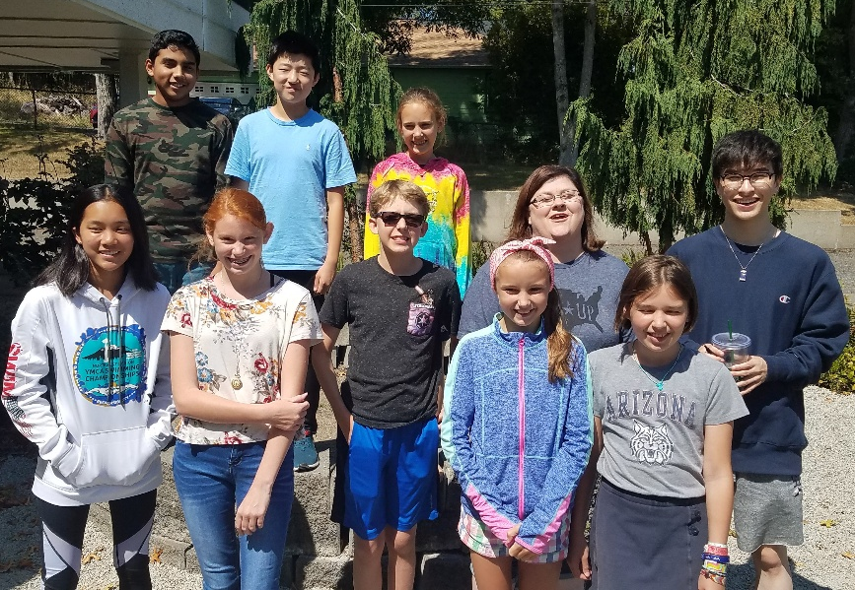
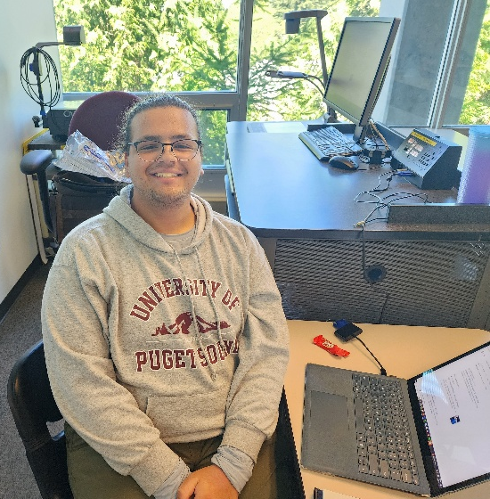
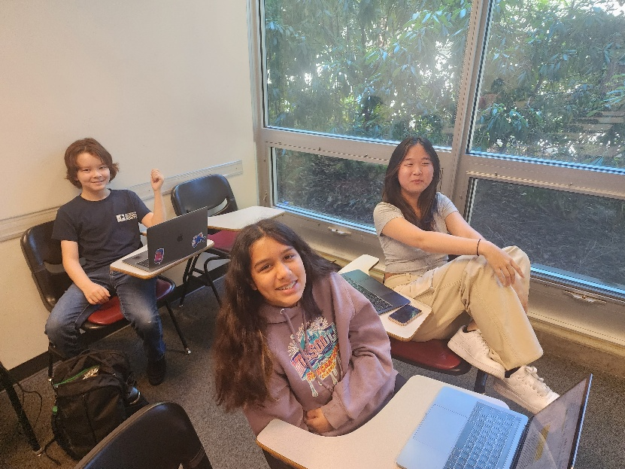
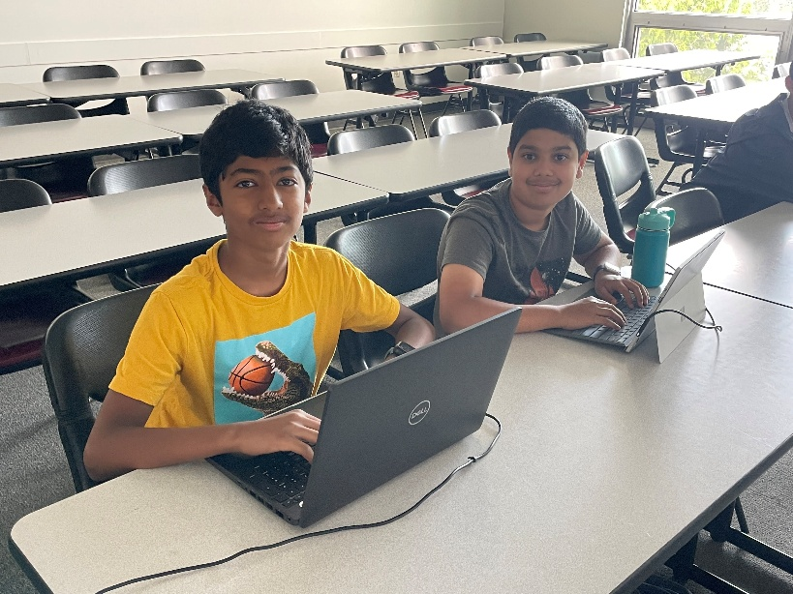
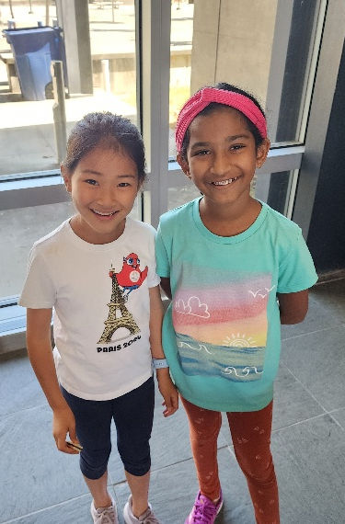
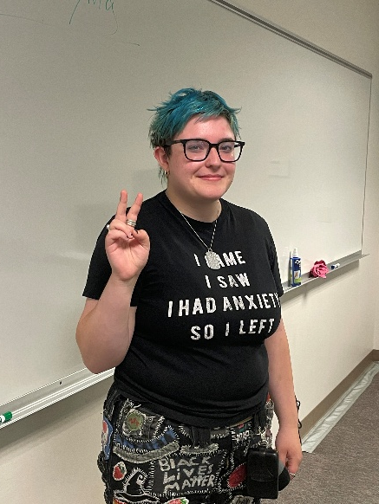
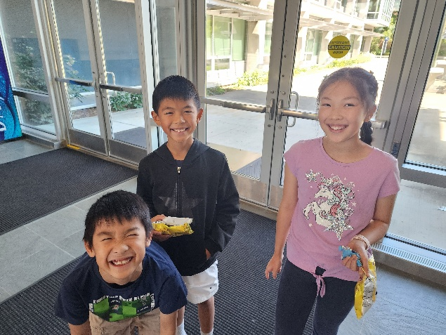

Slide 4
Treat each other right
Support each other
Respect each other’s space
Reach out to others with kindness

Slide 5
Avoid . . .
Saying mean things to others
Sexualized comments and inappropriate conduct
Disrupting instruction and learning
Being disrespectful with others.

Slide 6
Encourage Everyone as participants
  Black-White-Latino-Asian-Biracial-
  Multiracial, etc.
  Men-Women-Transgender-Androgynous-Non-binary-etc.
  Republican-Democrat-Libertarian-etc.
  Christian, Agnostic, Catholic, Mormon (LDS), Jewish, Wicca, Muslim, etc.
  Lesbian-Gay-Straight-Bi-Queer
  Disabilities--diagnosed or otherwise
  Military service
  EVERYONE.

Slide 7
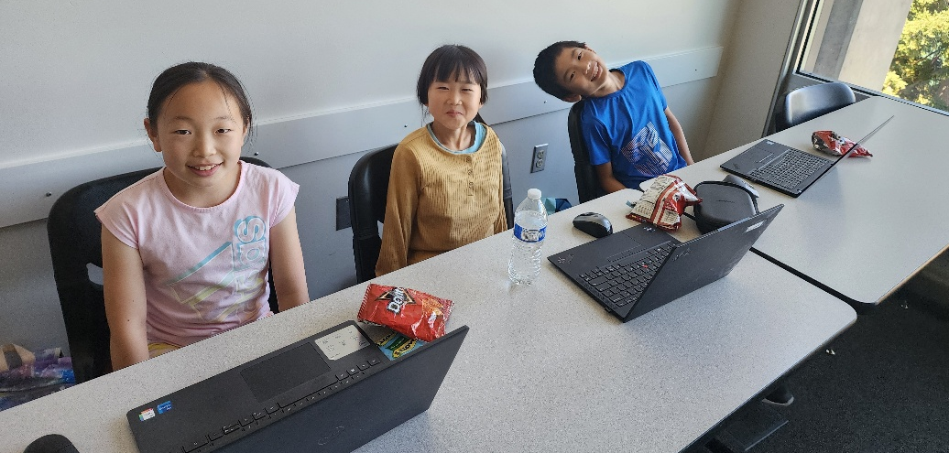
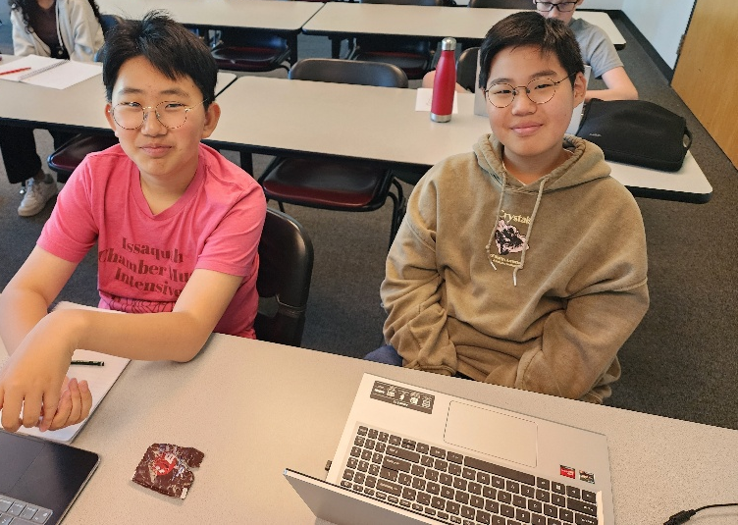
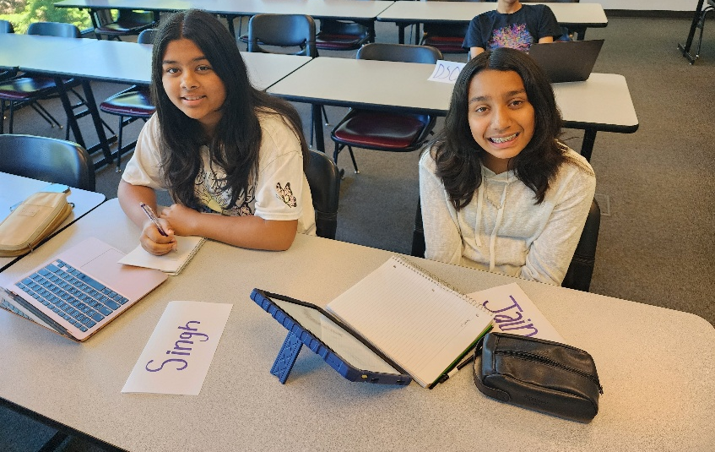
Encourage Everyone as participants
  Shy or outgoing
  Intense or laid back
  Strong advocate or willing to compromise
  Loud or quiet
  Smart or struggling
  Respect and support people trying their best
  EVERYONE.

Slide 8
Treat Everyone with support and respect

Slide 9
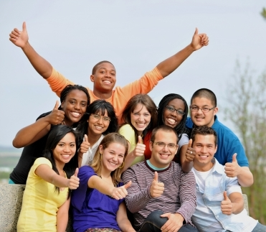
Participants should . . .
express their opinions about issues
not attack groups of people
not attack other individuals.
Argue about ideas—not disrespect people.

Slide 10
If you see or hear someone mistreating someone. . .
BY ANYONE—coach, observer, student, judge
Stop it if possible
Share the information about it . . .
with your parent, your instructor and/or Jim Hanson
We are NOT interested in punishment
We’ll work to make things better.

Slide 11
As a speaker and debater . . .
People look up to you.
You are setting the stage for this Speech and Debate Community.
Other speakers and debaters are going to emulate you.

Slide 12
Be the speaker people talk about as . . .
“Yea, Mick’s cool; gave a great rebuttal.”
“I respect them a lot. They can argue like nobody’s business and they reached out to younger debaters and made them feel included.”
“She’s wicked smart but also really, really nice.”

Slide 13
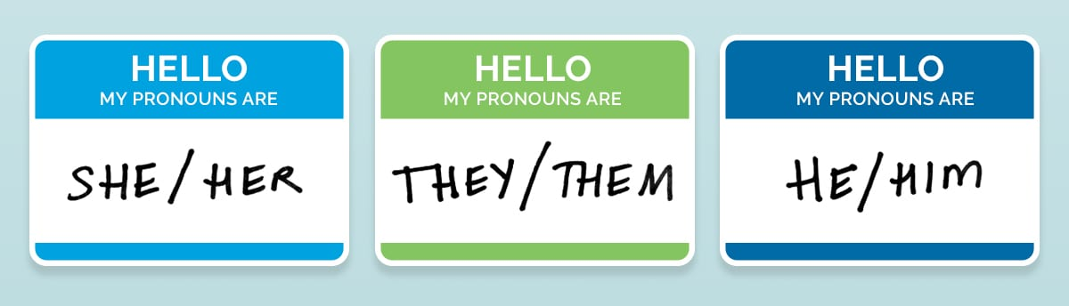
All Genders are part of our community . . .
Refer to others by their name “Betty”, speaker position (“First Pro Debater”), or use “they.”
You can also ask students for names/anything important including pronouns at the beginning of class.

Slide 14
Don’t assume . . .
A participant is a representative of a group
“You know what it’s like right . . . (pointing to student of color).
Don’t assume everyone is white/ middle class/ straight/ liberal/ Hispanic/ non-religious, etc.
“Well, I mean, people can afford that.”
“The people in this room don’t experience discrimination.”

Slide 15
SOCIALIZE—CONNECT! : )
Please socialize—talk with your teammates/coaches in your debate room!
Though don’t interrupt other people : )
AND IT IS OKAY TO BE SHY! (many debaters are!)

Slide 16
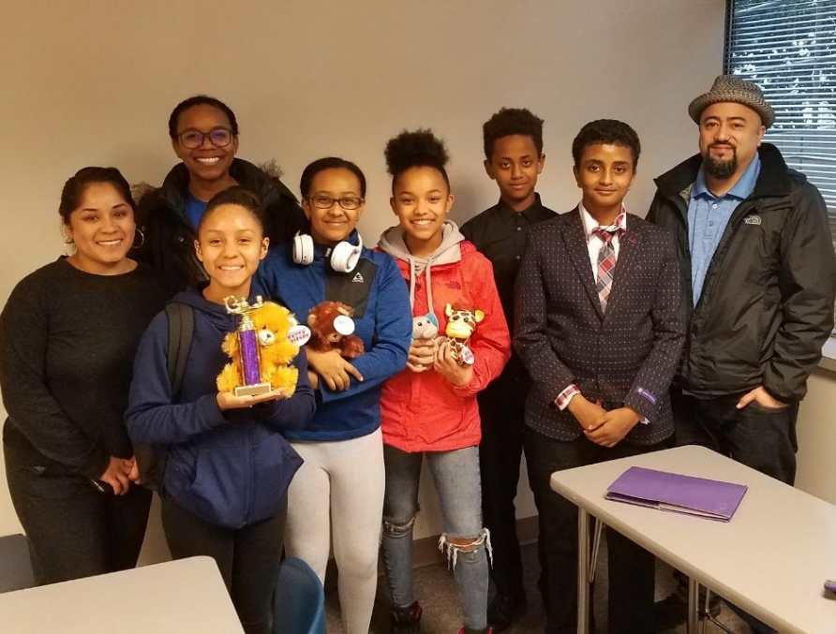
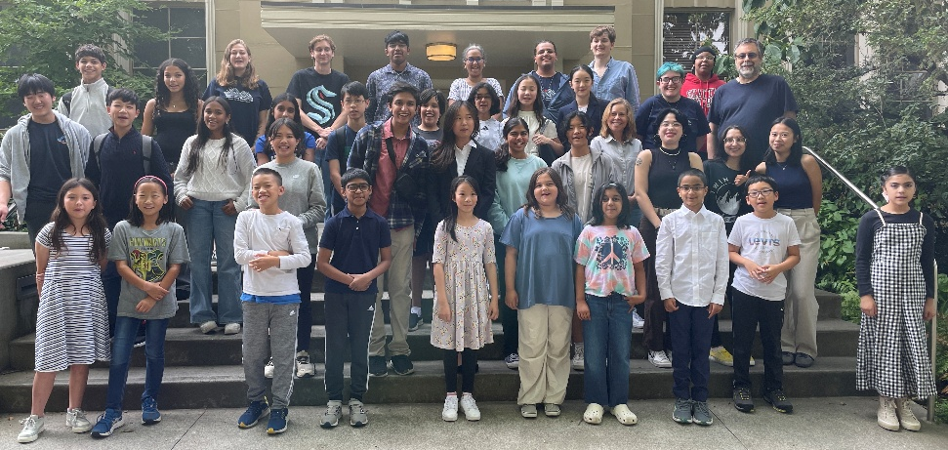
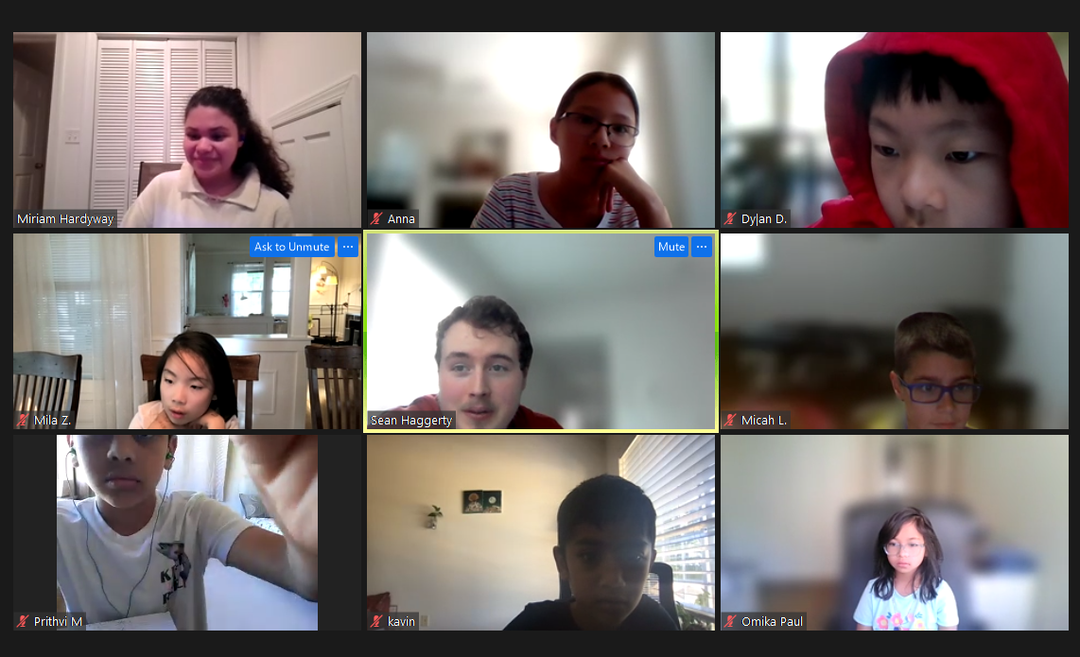
Make this Community Great!
Treat each other with respect
Support each other
Share Information when there is a problem
Promote good interactions
Be a great communicator who cares for others
and your community!

