Slide 1
CLIMB INSTRUCTOR GUIDELINES
This is for Climb Instructors, Greeters, Assistants in all of our programs (camp, afterschool, tournaments, clinics, etc.).

Slide 2
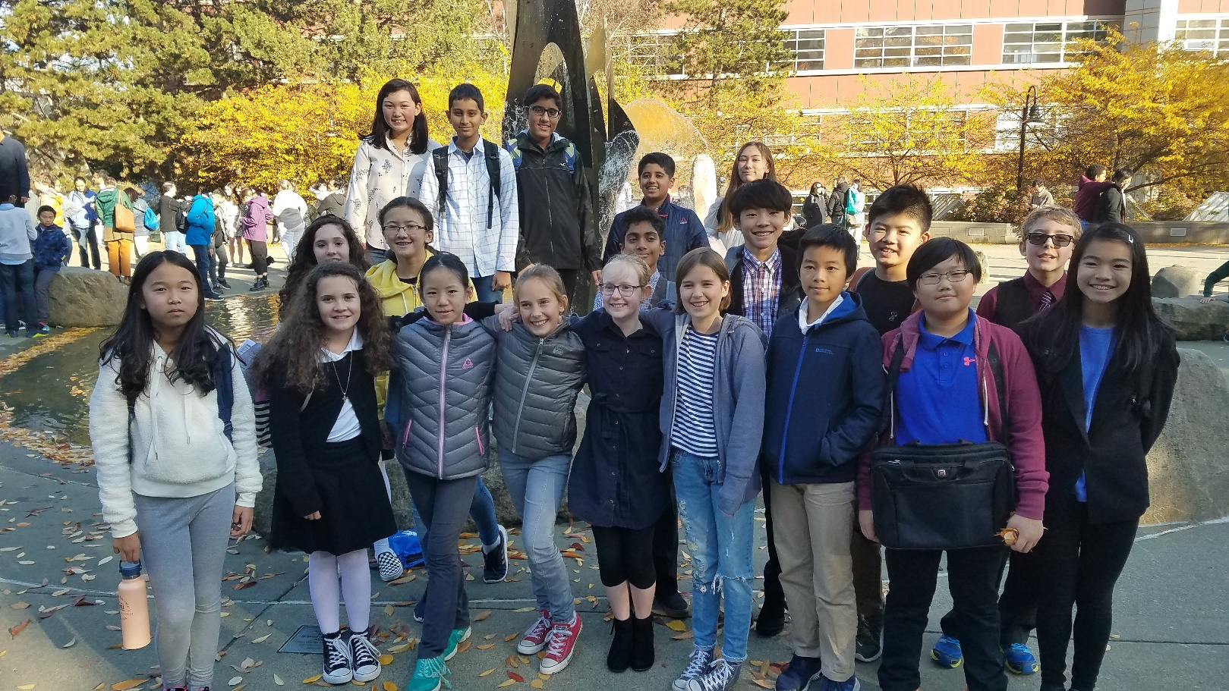
Welcome to our Community
We hope you have a fun and
educational time

Slide 3
Present Yourself Professionally
Your mind should be alert and sober
Be dressed for public view
Wear clean clothes that do not endorse/reject a political party nor make hateful comments about individuals. Your clothing should professionally reflect your style.
Note that you should not make comments about others’ dress unless you are 100% certain the comment will be taken positively.
Online? Act appropriately in front of the camera and mic (turn them off if you need privacy).

Slide 4

Be on time
Check the Schedule—ARRIVE EARLY
Use Bathroom when
class/debate isn’t happening
Start Classes/Speeches ON TIME
When you wait for a kid to show, you hurt the other students—time will run out. Avoid this.
Keep the students on task to complete the instruction/round.
Judging? EMAIL REPLY TO THE BALLOT YOU RECEIVED with who won and the speaker points nearly immediately after the debate ends.
(Then give verbal feedback, then fill out the online comments form).

Slide 5
Interact with others professionally
As a Climb staff member, you aren’t a student anymore
Be Professional and caring
Students require you to act like an adult.

Slide 6
Interact with others professionally
It is illegal and wrong to make advances toward a student
Do NOT Pay too much attention to one person
This applies to everywhere: In Classrooms, Online Rooms, Chatting, in Email and Messaging
Do NOT be in a room alone with a student for more than a fleeting moment
If there is a situation with just one student—notify Jim Hanson or our Greeter/Camp Assistant immediately (we’ll explain what to do)
NOTE: Jim Hanson and other Climb staff will enter rooms unannounced at times.

Slide 7
Encourage Everyone as participants
  Lesbian-Gay-Straight-Bi-Queer
  Black-White-Latino-Asian-Biracial-
  Multiracial, etc.
  Men-Women-Transgender-Androgynous-Non-binary-etc.
  Republican-Democrat-Libertarian-etc.
  Christian, Agnostic, Catholic, Mormon (LDS), Jewish, Wicca, Muslim, etc.
  Disabilities--diagnosed or otherwise
  Military service
  Other identities
Treat every student, coach, and judge with respect and support.

Slide 8

Participants should . . .
express their opinions about issues
not attack groups of people
not attack other individuals.
Argue about ideas—not disrespect people.

Slide 9
As a Climb teacher and judge . . .
Your students look up to you
Other judges, coaches, and observers look up to you.
They are going to emulate you.

Slide 10
Be the judge-coach people talk about as . . .
“Yea, Elda rocks; helped me out a lot with that decision.”
“I respect him a lot. He can explain framework debates like nobody’s business and he reached out to younger debaters and made them feel included.”
“They are wicked smart but also really, really nice—super helpful judge especially for strategic ideas.”

Slide 11
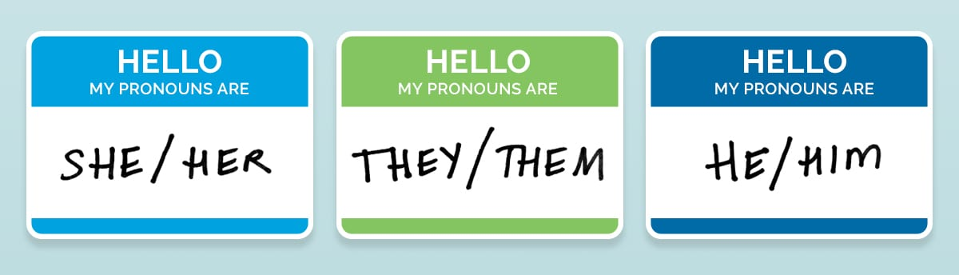
All Genders are part of our community . . .
Don’t assume Betty is “she”
Get out of the habit of “She said . . . He made a good point . . .”
Refer to others by their name “Betty”, speaker position (“First Aff Debater”), or default to “they.”
You should also ask students for names/anything important including, it they wish, pronouns at the beginning of classes and debates.

Slide 12
Don’t assume . . .
A student is a representative of a group
“You know what it’s like right . . . (pointing to student of color).
Don’t assume everyone is white/ middle class/ straight/ liberal/ Hispanic/ non-religious, etc.
“Well, I mean, people can afford that.”
“The people in this room don’t experience discrimination.”

Slide 13
As a teacher and judge watching. . .
You have an obligation to assure a comfortable environment
For _all_ participants.

Slide 14
If you see or hear about harassment . . .
Done by ANYONE—coach, student, judge, observer
Stop it if possible
Say “Stop it” or “Hey, let’s move on to . . .”
Share the information about it . . .
with Jim
We’ll work to make things better.

Slide 15
And if you have reasonable suspicion of child abuse . . .
Do NOT investigate
Do NOT ask the student for details on what happened
Always show you care for the student
Report it to Jim Hanson IMMEDIATELY
Report it to Police and/or Child Protective Services IMMEDIATELY
Unclear? Concerned but not certain? Ask Jim as soon as possible
YOU ARE A MANDATED REPORTER and if you fail to report—you are letting down a kid AND you can be charged.

Slide 16
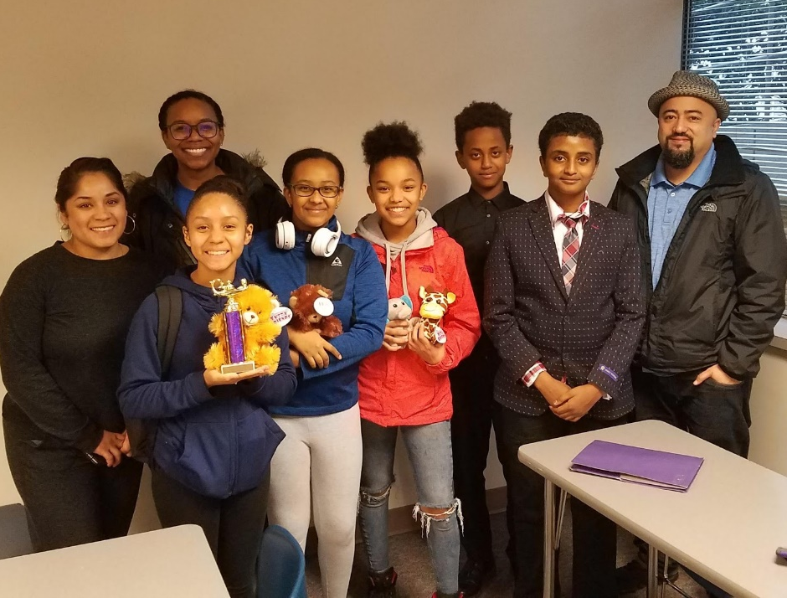
Make this Community Great!
Treat each other with respect
Support each other
Share Information when there is a problem
Promote good interactions
Make your teaching and judging a helpful benefit to students . . .
and your community!

