Slide 1
My Hero
Joana Alves
CMME 2010-02

Slide 3
How many of you can picture a world with no sound whatsoever?

Slide 4
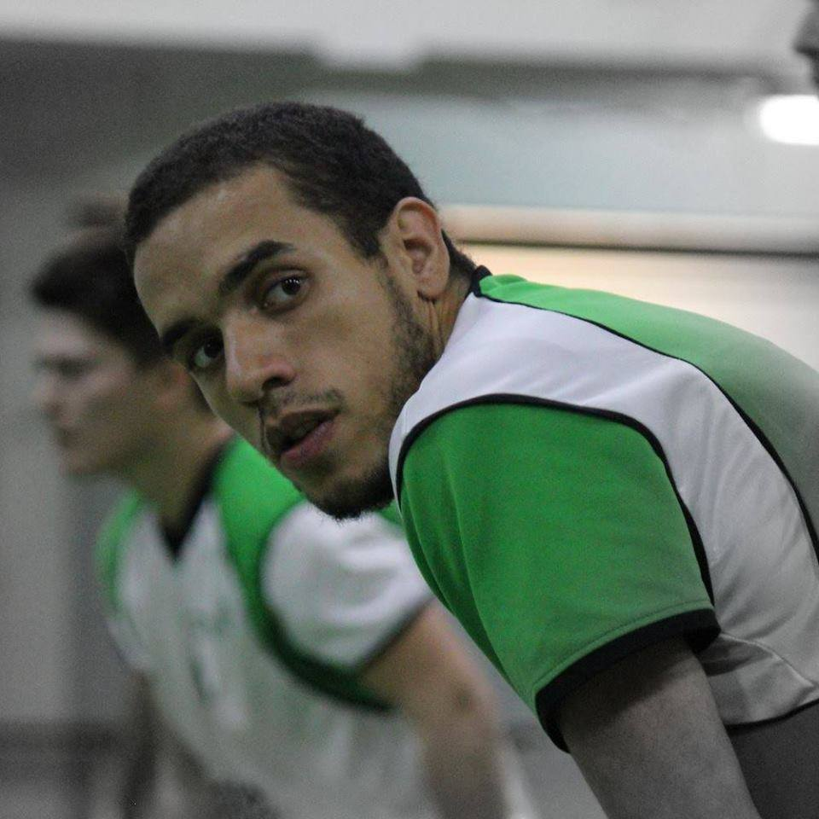
I will show you my hero...
...and his perspective of the world being partially deaf.

Slide 5
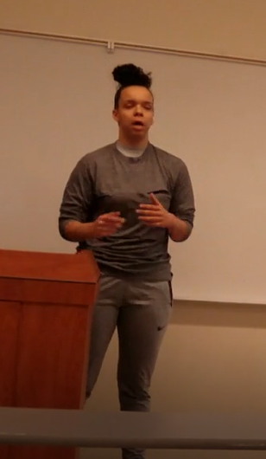
I am close with people who are deaf

Slide 6
Do you have hearing loss?
Do you know someone who is deaf?

Slide 7
I will look at
Who is David?
What happened to him?
How does the world sound to him?
Why is he my hero?

Slide 8
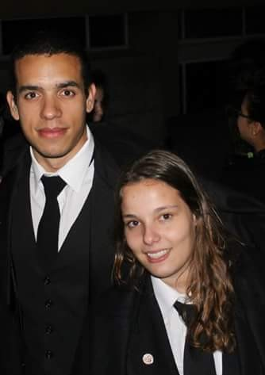
Who is David?
He was born on December 4th 1989
He is majoring in Chemical Engineering

Slide 9
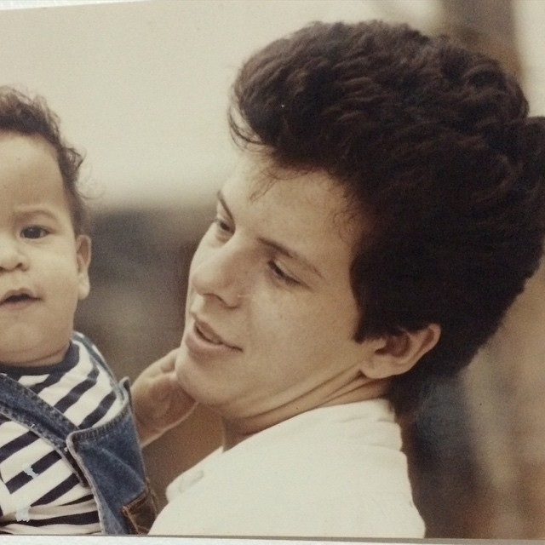
What happened?
David says: “My mom found out there was something wrong when i was like 2 years old and was sitting on the couch watching TV, she kept calling my name repeatedly but I never turned around. When she took me to the doctor he said “Your son is deaf’.”

Slide 10
How does he hear the world
80% hearing loss on the left side, 65-70% on the right side.

Slide 11
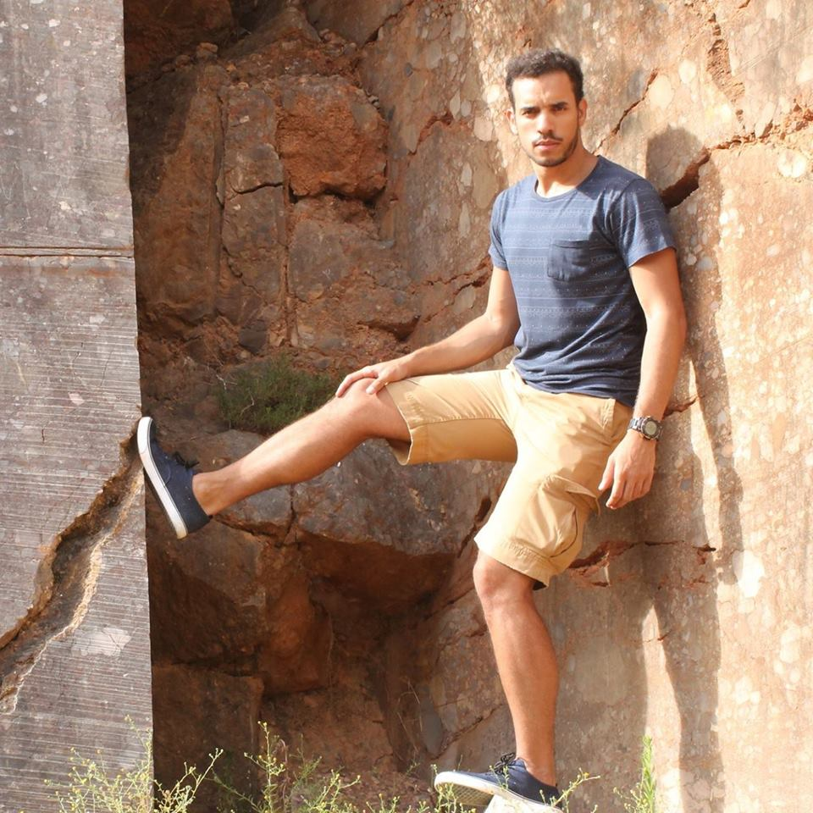
“It is annoying to keep asking for people to repeat what they said, and I know it frustrates them too, but I have to keep doing it in order to be sure I understand what is going on around me.”

Slide 12
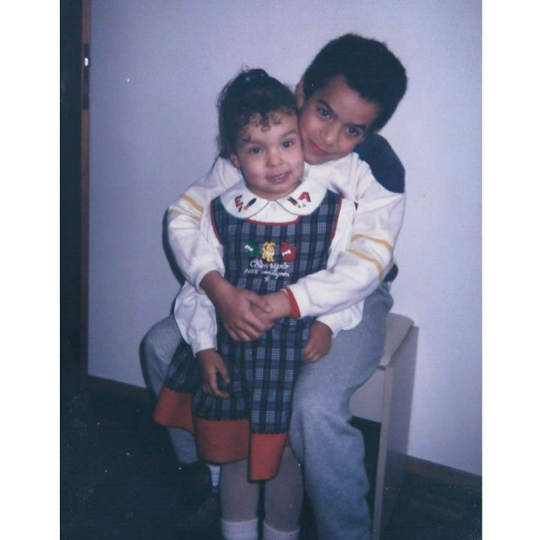
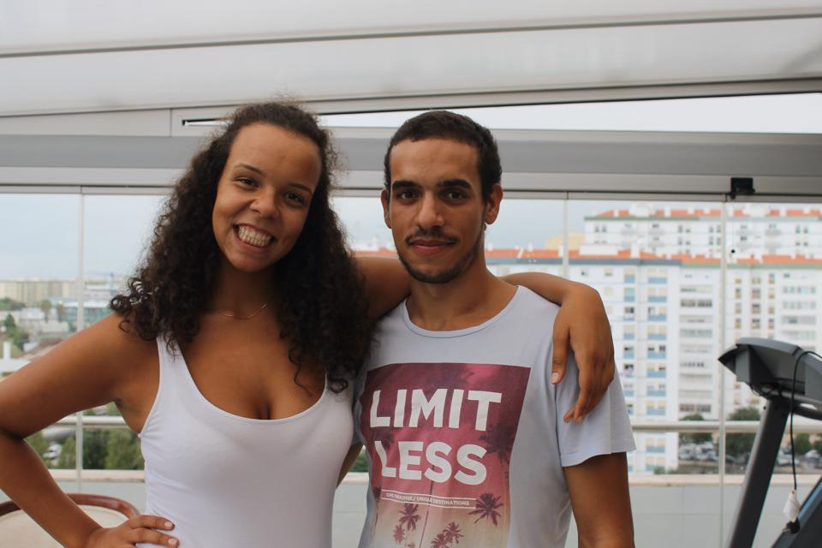
Why is David my hero?

Slide 13
Brian Sodoma, the Miracle Ear, 2016
“For the 48 million Americans battling hearing loss, there are many amazing hearing-impaired, or even deaf, athletes who can serve as symbols of hope and courage.”

Slide 14
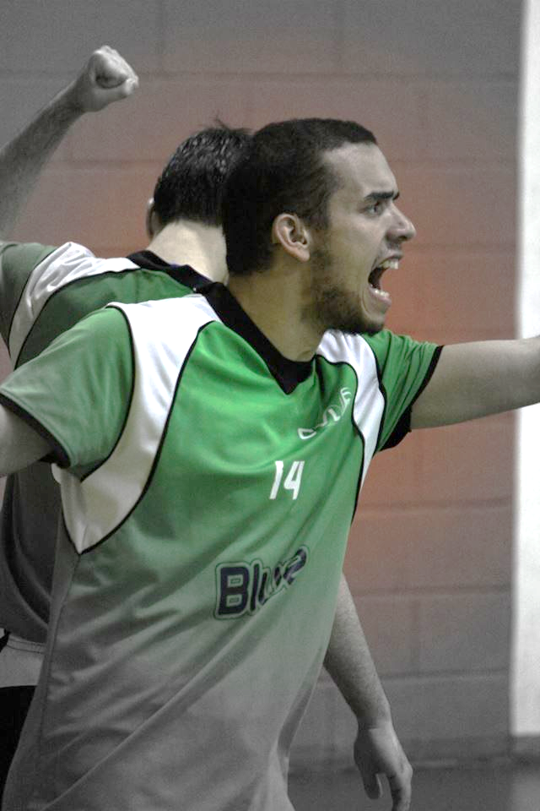
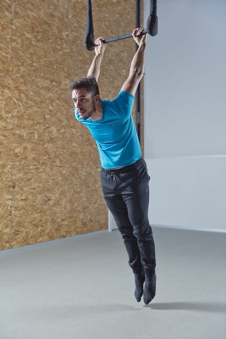

Slide 15

David just keeps going
He does not give up
When he went to College he . . .

Slide 16
David is my hero because of
Who he is
He continues to overcome what happened to him
He thrives even with the little he can hear

Slide 17
Knowing about David
Has made me more empathetic
Has been a lot of fun
I’ve learned—I hope you have too.

Slide 18


