Slide 1
Let’s debate!
Jim Hanson

Slide 2
WE ARE STILL A TEAM!
We are working together
We are a team and we support each other
Share your names and something important to you.

Slide 3
You will be doing public forum debate
This debate format is used throughout the United States
It focuses on well researched arguments
And . . .

Slide 4
Public forum debate is similar
Sides in a Debate? Pro and Con
Flowing? Yes
Contentions? Yes
Weighing? Yes
So . . .

Slide 5
What is different about PUBLIC FORUM DEBATE?
1. Teams of 2
2. Speaking Order is different
3. Debate Arguments—no more AREI
4. The Topic
5. Crossfire instead of POIs.

Slide 6
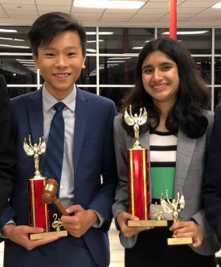
1. Two person teams
You will be in teams of 2 students
Each student gives 2 speeches.

Slide 7
2. Public forum speaking order
1 Pro Case: Present Pro Contentions
1 Con Case: Present Con Contentions
Crossfire between 1s
2 Pro Rebuttal: Respond to Con Case Contentions
2 Con Rebuttal: Respond to Pro Case Contentions
Crossfire between 2s
1 Pro Summary: Defend Pro Case
1 Con Summary: Defend Con Case
Grand Crossfire for all debaters
2 Pro Final Focus: We win pro and con contentions and weigh the args
2 Con Final Focus: We win pro and con contentions and weigh the args
Yes—each speaker gives two speeches!

Slide 8
3. Public forum arguments
AREI is still used but it isn’t called that
Two kinds of Public Forum Arguments
Documented Arguments (used mostly in the speeches in the first half of the debate)
Analysis Arguments (used mostly in the speeches in the second half of the debate)

Slide 9
Documented Arguments in public forum debate
Tag (Claim)
Source (Citation)
Evidence (Quotation)
Importance (Impact)
Student don’t forget lessons with Year Round Schools
Grace Chen, educator and researcher, April 06, 2018
Students forget knowledge and skills they acquired during the previous academic year. Several studies support this notion, as children show losses in math and language arts knowledge over the long summer break. . . . (Y)ear-round school increases retention rates, as students in year-round schools have demonstrated higher scores on some standardized tests.
So, year round school helps learning.

Slide 10
TRY IT!
Check out this quotation . . .
Add a tag and an importance to this evidence (quotation)
Then show us your work.

Slide 11
TRY IT!

Slide 12
Analysis Arguments in public forum debate
Claim
Support (Reason or Warrant)
Importance (Impact)
Year Long Schooling makes school less stressful
It means not cramming everything in 9 nearly non-stop months; instead, you get 9 weeks of classes and then a 3 week break four times a year
That’s important to get time off and reduce school stress

Slide 13
4. The topic
The Topic is chosen by coaches
Used in all debates—go in-depth
In our league . . .
Resolved: On balance, standardized testing is beneficial to K-12 education in the United States.

Slide 14
5. crossfire
No more POIs—you don’t speak during opponent speeches
After each 2 speeches—you get time to ask and answer questions
“May I have the first question . . .”
“You can have the first question . . .”
You can ask 2 questions in a row; then you switch to the other debater to ask questions.

Slide 15
WHAT YOU NEED FOR PUBLIC FORUM DEBATE

Slide 16
You need CONTENTIONS
An argument, even with documentation or support, isn’t as convincing as it could be
So, you prepare contentions . . .
Contentions are arguments supported by arguments.

Slide 17
pro CONTENTIONS
PROBLEM-Show a problem exists
THE TOPIC SOLVES-Show the topic solves
IMPACT-Show solving the problem helps people a lot
PROBLEM-20 minute lunch time is too short
THE TOPIC SOLVES-40 minute lunch gives enough time
IMPACT-Longer lunch reduces stress and upset stomachs from eating too fast.
Now you Do it!

Slide 18
con CONTENTIONS
LINK-THE TOPIC CAUSES OR INCREASES A PROBLEM
IMPACT-Show this problem would hurt people a lot.
LINK-Longer lunch means shorter classes
IMPACT-Shorter classes mean less learning and more stress before tests.
Now you Do it!

Slide 19
Check out the evidence packet
Go to the Climb Afterschool Page:
http://www.nwforensics.org/climb-afterschool/middle-school-pubforum/index.htm
Each week—do the 5 Prep Steps (was just 4 for today)
Pick a Pro Contention
Pick a Con Contention
What did you pick?
Can you use contentions with quotations you research? YES!

Slide 20
You need rebuttals
You need documented responses to your opponents’ contentions
In this kind of debate—responses are called “rebuttals”
Check out the rebuttals in the evidence packet
When you respond you use analysis and documented arguments
1 minimum analysis, 2 minimum documented.

Slide 21
FLOWSHEETS
You MUST USE FLOWSHEETS for your debates
To follow the speakers in the order they present . . .
1 Pro Case | 1 Con Case | 2 Pro Rebuttal | 2 Con Rebuttal | 1 Pro Summary | 1 Con Summary | 2 Pro Final Focus | 2 Con Final Focus

Slide 22
You flow . . .
Your speeches
Your partner’s speeches
Your opponent’s speeches
You take notes on ALL the arguments in the debate!

Slide 23
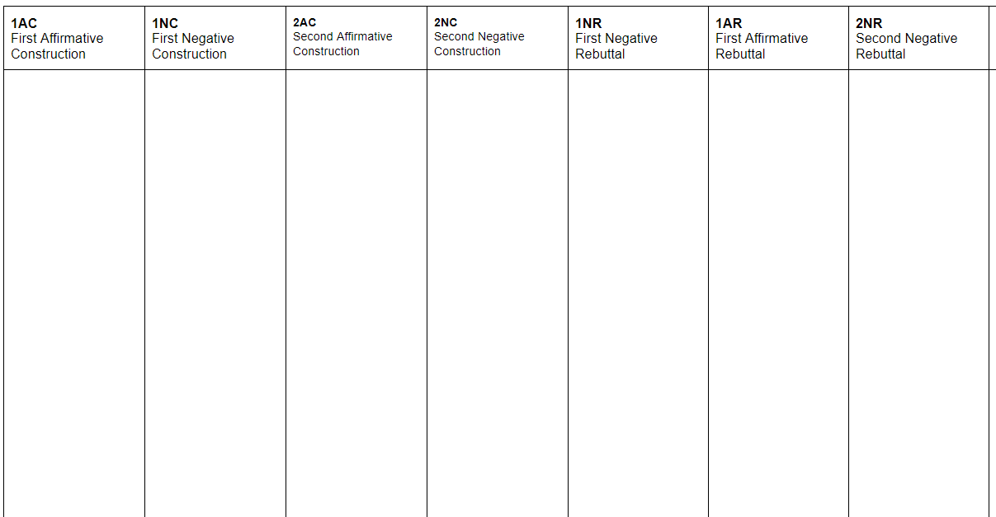
1 Pro Case
Contention
2 Con Rebuttal
Respond to Pro Contention
1 Pro Summary
Defend Pro Contention
2 Pro Final Focus
We won the Pro Contention
2 Con Final Focus
We defeated the Pro Contention
Pro Case - Con Responses Flowsheet
For Pro Arguments
And
Con Responses to the Pro arguments

Slide 24
1 Con Case
Con Contention
--
2 Pro Rebuttal
Respond to Con Contention
1 Con Summary
Defend Con Contention
2 Pro Final Focus
We defeated the Con Contention
2 Con Final Focus
We won the Con Contention
Con Case - Pro Responses Flowsheet
For Con Arguments
And
Pro Responses to the Con arguments

Slide 25
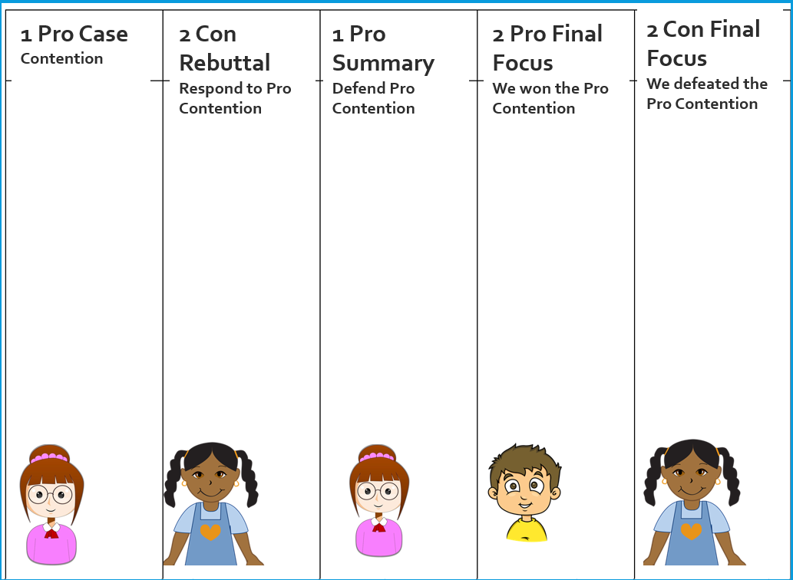
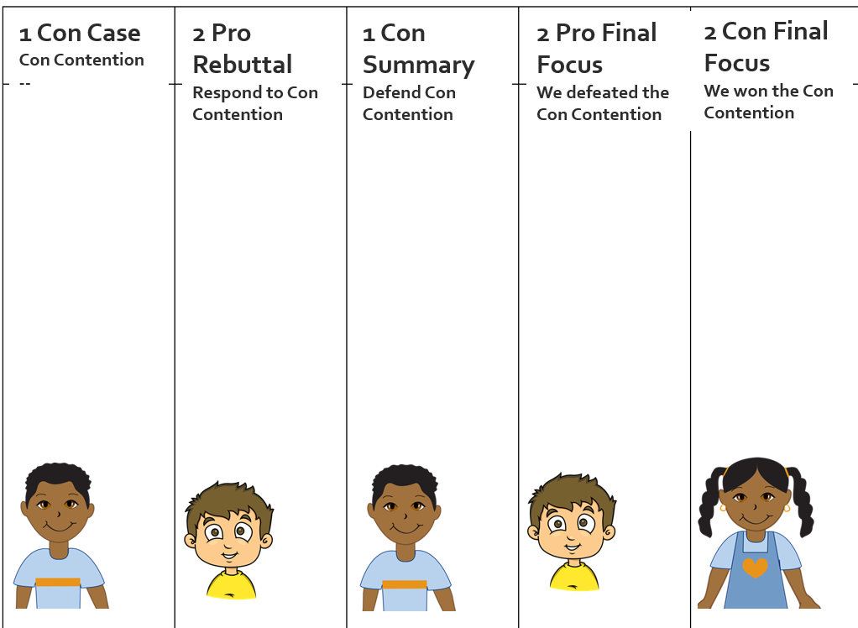
SET UP YOUR FLOWSHEET!
Pro Case Flowsheet
Con Case Flowsheet

Slide 26
WE WANT YOU TO DEBATE!
WE WANT YOU TO ATTEND THE SUN. APRIL 3 TOURNAMENT AT SEATTLE UNIVERSITY
You’ll debate other middle schoolers
Meet some great people
Really improve your speaking and debating!

Slide 27
Create temporary teams
Teams of 2 (can have 3 if needed temporarily).

Slide 28
Begin a one contention Public Forum debate
Get the Scripts from the Climb Afterschool Web Page
Use them during the Debate
2 minute cases and 2 minute rebuttals
1.5 minute summaries and final focuses
1.5 minute crossfires.

