Slide 1
PREPARE PUBLIC FORUM CASES AND RESPONSES
Jim Hanson

Slide 2
Instructor timeline
PREPARE CASES 20 MINUTES
PREPARE RESPONSES 20 MINUTES
FINISH UP 5 MINUTES.

Slide 3
Preparing CASES
Starting with . . .

Slide 4
TODAY, YOU ARE DEBATING THE TOPIC
The United States federal government should substantially expand its surveillance infrastructure along its southern border.

Slide 5
WHAT ARE PRO AND Con ARGUMENTS FOR THE TOPIC?
PRO ARGUMENTS
Arg 1
Arg 2
CON ARGUMENTS
Arg 1
Arg 2

Slide 6
LET’S DEVELOP A PRO ARGUMENT AND MAKE IT A CONTENTION!
As you hopefully remember . . .
PRO Contentions make these three arguments:
Show there is a Problem
China is smuggling lethal amounts of fentanyl through the southern border.
Show the Topic Solves the Problem
Enhanced surveillance tech would disrupt the trafficking of illegal goods.
Show the harms/impact of the Problem
Fentanyl kills tens of thousands of people every year.

Slide 7
WE NEED MORE TO MAKE A GOOD CONTENTION . . .
THIS IS A GOOD PRO CONTENTION:
--China is smuggling fentanyl through the southern border.
--Enhanced surveillance tech would interrupt the flow.
--Fentanyl kills tens of thousands of people annually.
BUT IT LACKS EVIDENCE AND SUPPORT
We need to give evidence and reasons!
WE NEED TO DO SOME RESEARCH!

Slide 8
RESEARCHING IS NOT EASY
Over time, you will get better and better
And have an amazing skill that will give you a HUGE heads up over others
This will help you whether you are Pro or Con
Here’s how to do it . . .

Slide 9
SEARCH FOR AN ARGUMENT
Go to Google (or Bing etc.)
Don’t just type in the topic e.g. “Surveillance Infrastructure”
Instead type in words from your argument
Example: You are looking for “Surveillance Infrastructure stops Smuggling”
Type in: Surveillance Infrastructure stops Smuggling Southern Border
What did you find?

Slide 10
USE QUALITY SOURCES
Use reputable sources! (Time, CNN, academic studies, etc.)
DO NOT use social media (Facebook, Instagram, TikTok, X, etc.) – this information isn’t fact checked; so it is not reliable.
In most cases, try to use recent information (usually no older than 4 or 5 years old).

Slide 11
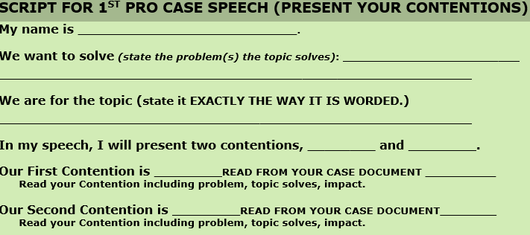
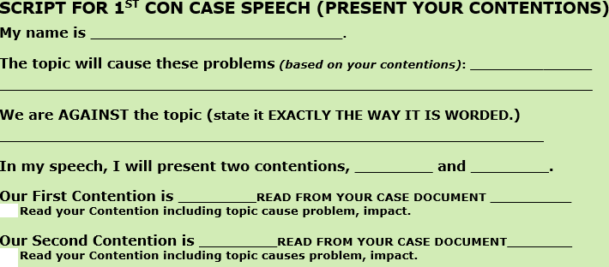
Get your scripts!

Slide 12
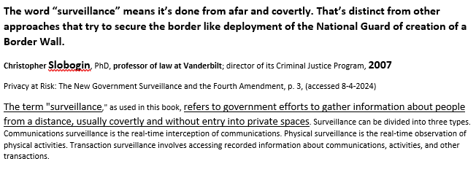
USING WHAT YOU FIND
On your script, Make your argument
Then, include a citation/source
Author, qualifications, Date
Followed by the reasons/facts provided in the article.

Slide 13
NOW YOU DO IT!
PRO DEBATERS
Look up “China smuggles drugs southern border”
Look up “Increased surveillance on southern border stops fentanyl entering US”
Look up “fentanyl kills many people every year.”
CON DEBATERS
Look up “Surveillance make migrants use dangerous routes ”
Look up “Migrants die taking dangerous routes into the US”
Look up “Surveillance infrastructure increases structural violence.”
WHAT DID YOU GET? (each student should provide one source citation support)

Slide 14
Public FORM DEBATE RELIES ON RESPONSES WITH EVIDENCE!
IF YOU DON’T HAVE CITED INFORMATION AS A BASIS OF ARGUMENT—YOU LIKELY HAVE A WEAK ARGUMENT.

Slide 15
EACH PRO DEBATER CHOOSES A PRO CONTENTION THEY WANT TO DO
Open up the Case Helper File on the Public Forum Student Prep Page AND have your Script ready to fill out.
We need a Pro Debater to do a Pro Contention on . .
Fentanyl
Elections
Overwhelmed social services
Who is doing which?

Slide 16
NOW—PREPARE YOUR PRO CONTENTION!
USE YOUR SCRIPT AND INCLUDE
Problem
Topic Solves Problem
Impact of the Problem
Use Sources
Use your own Reasons
We will work to get our cases done! I am here to help you, and we are here to help each other!

Slide 17
EACH CON DEBATER CHOOSES an CON CONTENTION THEY WANT TO DO
Open up the Case Helper File on the Public Forum Student Prep Page AND have your Script ready to fill out.
We need a Con Debater to do 1 Con Contention on . .
Funneling
Privacy
High cost
Who is doing which?

Slide 18
NOW—PREPARE YOUR CON CONTENTION!
USE YOUR SCRIPT AND INCLUDE
Problem currently is okay/fine
Topic Causes/Increases Problem
Impact of the Problem
Use Sources
Use your own Reasons
We will work to get our cases done! I am here to help you, and we are here to help each other!

Slide 19
LET’S HEAR . . .
ONE PRO CONTENTION
ONE CON CONTENTION.

Slide 20
Preparing RESPONSES
Starting with . . .

Slide 21
You can and should prepare responses before you debate
If you are Con-what Pro Arguments will they make?
--Funneling in the status quo/happens now
--Surveillance does not use facial recognition
--Others?
FOR MOST DEBATES, YOU SHOULD HAVE 2 OR 3 RESPONSES READY FOR EACH OF THESE ARGUMENTS

Slide 22
AVOID WEAK responses!
“Surveillance technology is bad.” (debater stops and moves on to a different argument)
WHAT IS WRONG WITH THIS ARGUMENT?
--No reason or evidence support.
“All borders should be open.”
WHAT IS WRONG WITH THAT AS A RESPONSE?
That isn’t a response—that is shifting to another issue.

Slide 23
AVOID WEAK responses!
“Surveillance technology won’t catch all smugglers, only a few.”
WHAT IS WRONG WITH THIS ARGUMENT?
--You have mostly admitted they do help research.
INSTEAD . . .

Slide 24
Have good responses!
THE BEST WAY TO RESPOND TO MOST ARGUMENTS IS TO SAY THE OPPOSITE
“Funneling happens now so increased surveillance won’t stop it.” followed by reasons/evidence.
YOU CAN ALSO POINT OUT A BETTER WAY . . .
“The US & China should work together to stop fentanyl smuggle.” followed by reasons/evidence.

Slide 25
Have good responses!
YOU CAN ALSO MINIMIZE THE ARGUMENT
“Surveillance technology is only increased at the southern border, not across the entire country.” followed by reasons/evidence.
PREPARE RESPONSES LIKE THAT.

Slide 26
LET’S HEAR THE CONTENTIONS THAT YOU WILL RESPOND TO . . .
PRO DEBATERS: WHAT ARE YOUR CONTENTIONS?
--Instructor assign each CON debater to respond to a different contention
CON DEBATERS: WHAT ARE YOUR CONTENTIONS?
--Instructor assign each PRO debater to respond to a different contention

Slide 27
What responses did you come up with?
Each debater—share one response (in 1-2 sentences).
Make sure your reponse cites evidence.
Instructor—give feedback on the quality of the response.

Slide 28
DURING A DEBATE
You have to use and present your responses along with any you can think of on the spot . . .

Slide 29
When you hear their contention, write it on your FLOWSHEET!
Remember to abbreviate and shorthand what they say
AND . . .
Spend 90% of your time writing out your responses.

Slide 30
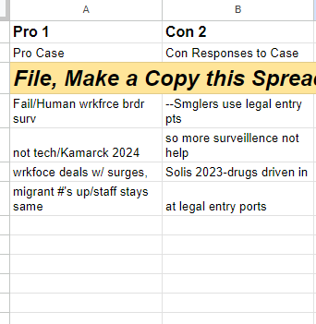
WRITE OUT YOUR RESPONSES

Slide 31
GET YOUR SCRIPT FOR RESPONSES
If you are Pro
If you are Con

Slide 32
When you GET UP TO SPEAK—YOU PRESENT . . . .
USE YOUR SCRIPT
My opponent argued surveillance is out of date because it’s done by people, not technology
My response is . . . (use your script)

Slide 33
Let’s do a case and response debate!
USE YOUR CASE AND RESPONSE SCRIPTS and the RESPONSES YOU PREPARED
You’ll present your case, take ONE question, and you’ll ask your opponent ONE question, and you’ll respond to your opponent’s case.
Hang on to your flows/notes because we will use them in the next part of the class

