Slide 1
Let’s debate!
Jim Hanson

Slide 2
PREPARING FOR DEBATES!
It is important for you to do the left column on the Climb web page
Before each class.
Who is the 1 and who is the 2?

Slide 3
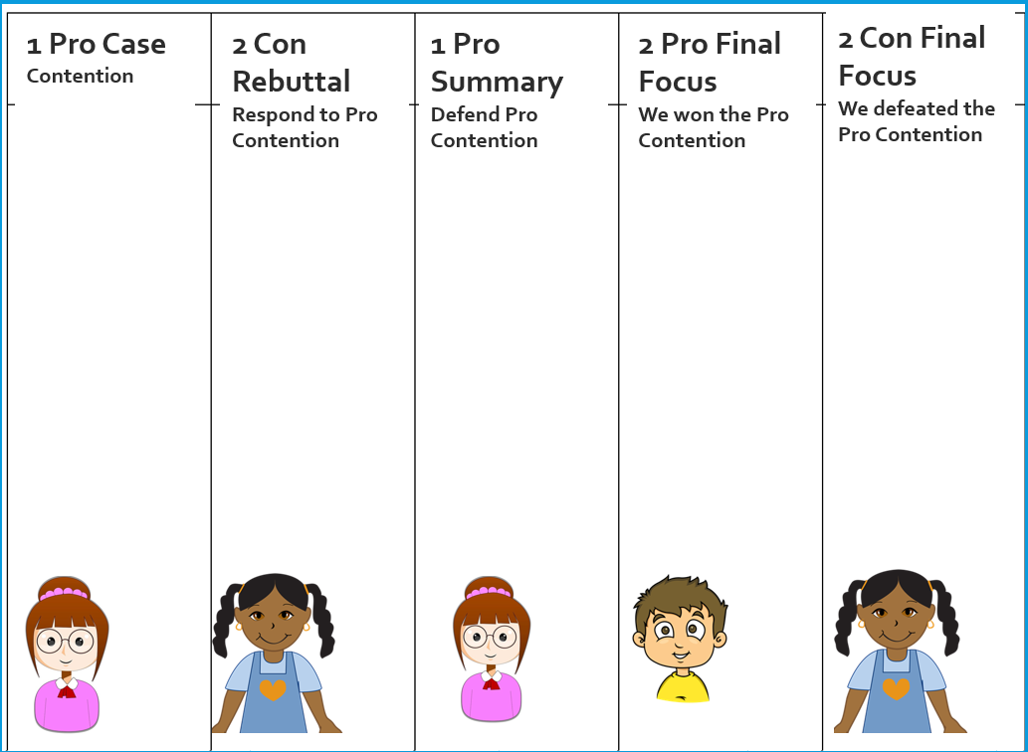
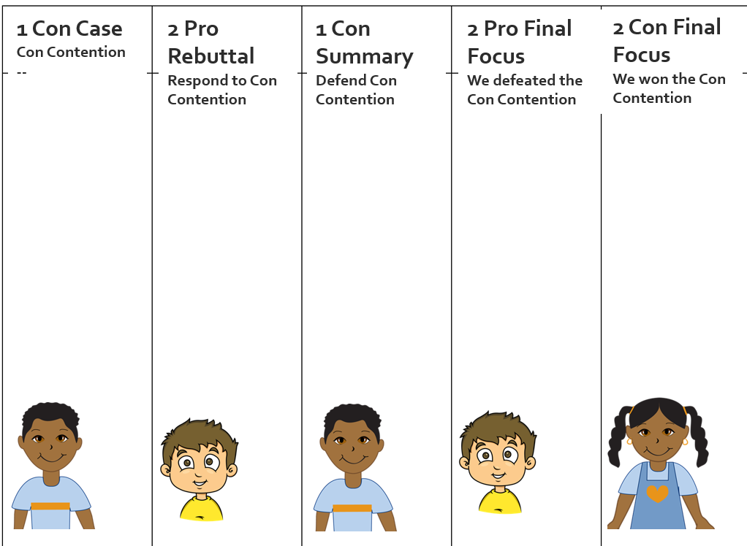
1. SHOW YOUR FLOWSHEET!
Pro Case Flowsheet
Con Case Flowsheet

Slide 4
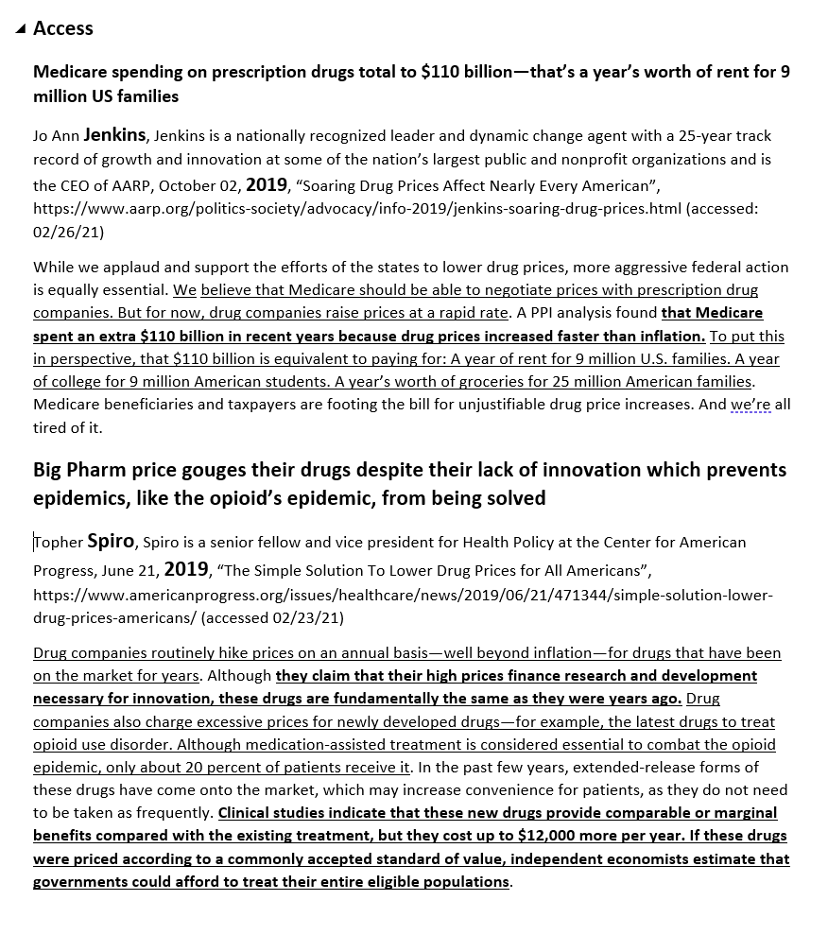
2. SHOW YOUR CASES AND REBUTTALS!
Not done?
Get the Short File—you are hereby using the Contentions and Rebuttals in that file.

Slide 5
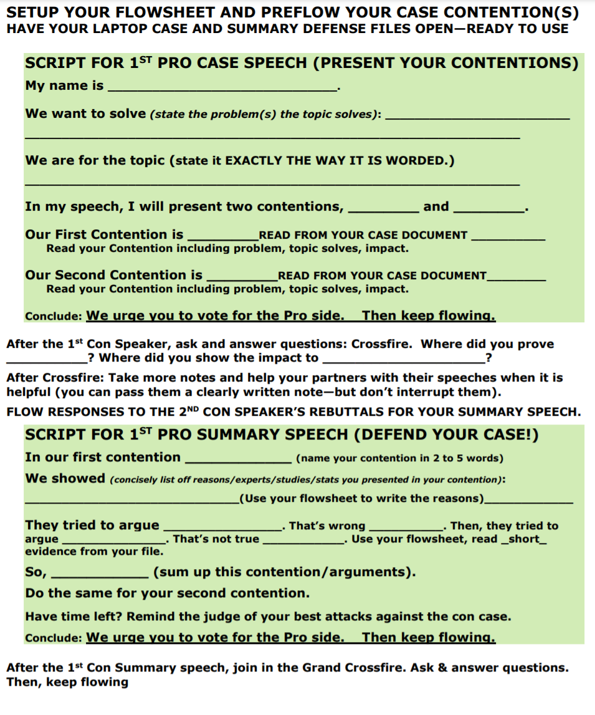
3. SHOW YOUR SCRIPTS!

Slide 6
BEFORE WE START THE FOLLOW THE FLOW DEBATES . . .
WE ARE GOING TO LEARN AND PRACTICE CROSSFIRE.

Slide 7
CROSSFIRE IS TIME IN PUBLIC FORUM DEBATE TO Ask and answer questions
3 minutes where . . .
FIRST CROSSFIRE: The 1’s ask and answer each other’s questions
SECOND CROSSFIRE: The 2’s ask and answer each other’s questions
GRAND CROSSFIRE: Everyone can ask and answer each other’s questions.

Slide 8
YOU’RE GOING TO DO IT!
1 Pro—present one argument (not contention) . . .
1 Con—present one argument (not contention) . . .
FOR THIS EXERCISE—EVERYONE CAN ASK AND ANSWER (KIND OF A GRAND CROSSFIRE).

Slide 9
HOW TO DO IT!
Debater says
“May I ask the first question?”
OR “You can have the first question.”
Then—ask and the debater answers
YES—you can ask a follow-up question
After that, the debater that’s been answering says ”May I ask the next question?”
Then ask and answer.

Slide 10
Now--DO IT!
“May I ask the first question?”

Slide 11
TIPS FOR ASKING
Ask about weaknesses/missing things in their argument
“You don’t have proof testing harms students in your speech do you?”
Avoid asking questions that let your opponent give long, good answers
NO: “Why is testing a good idea.”
Best way to ask “Where in your speech did you prove __________?”

Slide 12
TIPS FOR answering
Answer as soon as possible (long pauses often imply lack of knowledge or hesitancy)
Use arguments in your speech to answer questions
“Yes, Deena Jones in our first contention showed ______”
Tough Question? Answer quickly—then talk about good arguments for your side
“I don’t think so. What I do know is our second contention showed ______________.”

Slide 13
Do it again!
Second speakers—rebuttal the arguments you heard with ONE analysis, ONE quotation
Then Grand Crossfire
Using the Tips.

Slide 14
Begin a one contention Public Forum debate
2 minute cases and 2 minute rebuttals
1.5 minute crossfires
1.5 minute summaries and final focuses.

Slide 15
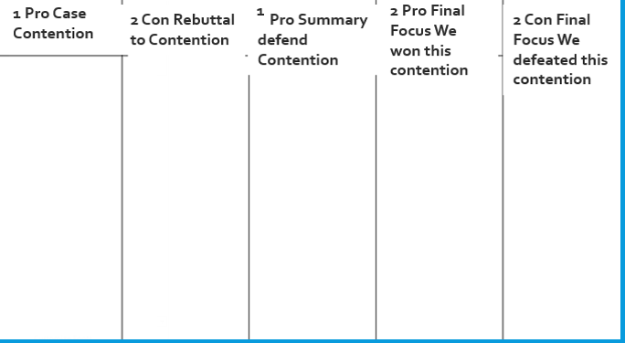
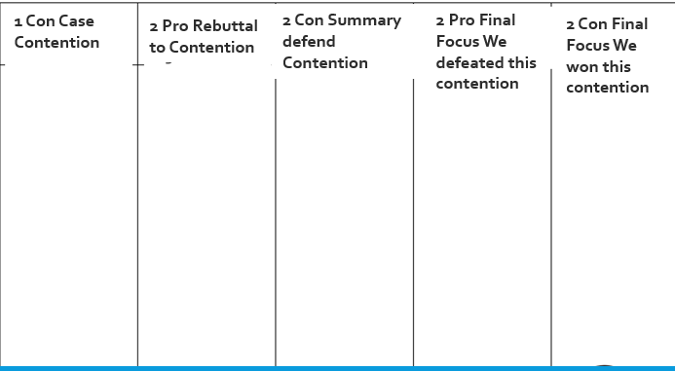
1 PRO AND 1 CON: PRE-FLOW YOUR CONTENTION
YOU’VE GOT 2 MINUTES TO SHOW ME YOUR FLOWSHEET!
2 PRO AND 2 CON—FIND AND BE READY WITH REBUTTALS
1

Slide 16
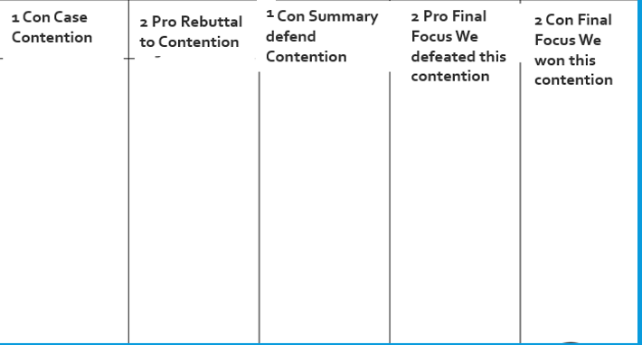
1 PRO PRESENT YOUR PRO CONTENTION
while 2 CON—FLOW YOUR RESPONSES: 90%!

Slide 17
1 CON PRESENT YOUR CON CONTENTION
While 2 PROP—FLOW YOUR RESPONSES: 90%!

Slide 18
CROSSFIRE!
1 PRO AND 1 CON
“May I have the first question?”
“You can have the first question.”

Slide 19
2 PRO RESPOND TO CON CONTENTION
While 1 CON PREP RESPONSES TO DEFEND CONTENTION: 90%!

Slide 20
2 CON RESPOND TO PRO CONTENTION
1 PRO—PREP RESPONSES TO DEFEND CONTENTION: 90%!

Slide 21
CROSSFIRE!
2 PRO AND 2 CON
“May I have the first question?”
“You can have the first question.”

Slide 22
After the crossfire of the 2’s
We’re now going to talk about doing the summary and final focus speeches in the debate
They are the toughest speeches to give in Public Forum Debate
Especially to do them right.

Slide 23
Summary—look at your script
In our first contention ____________ (name your contention in 2 to 5 words)
We showed (concisely list off reasons/experts/studies/stats you presented in your contention): ________________(Use your flowsheet to write the reasons)____________
They tried to argue ________________. That’s wrong __________.
Then, they tried to argue ______________. That’s not true ___________.
Use your flowsheet, read _short_ evidence from your file.
So, ___________ (sum up this contention/arguments).

Slide 24
FINAL FOCUS—look at your script
We win our first contention ________ (name your contention in 2 to 5 words)
We showed (concisely list off reasons/experts/studies/stats you presented in your contention): _____________________________(Use your flowsheet to write the reasons) As you do this—show you beat their best responses. Keep it short so you have time to weigh!
We defeated their first contention ___ (name their contention in 2 to 5 words)
We showed (concisely list off your best response(s) to the contention including with reasons/ experts/studies/stats you presented in your contention): ________________________(Use your flowsheet to write the reasons) As you do this—show you beat their arguments.
Weigh: “Even if they win _______ (their best argument), we still win because __________ (explain why your argument has more impact or is stronger).

Slide 25
NOW BACK TO THE DEBATE

Slide 26
1 PRO DEFEND YOUR PRO CONTENTION
2’S—FLOW SO YOU CAN RESPOND
Note Everyone should continue to flow all of the speeches to the very end!

Slide 27
1 CON DEFEND YOUR CON CONTENTION
2’S—FLOW SO YOU CAN RESPOND

Slide 28
2 PRO SHOW YOUR PREVIOUS ARGUMENTS WIN EACH CONTENTION (avoid new arguments)
2 CON—FLOW SO YOU CAN RESPOND

Slide 29
2 CON SHOW YOUR PREVIOUS ARGUMENTS WIN EACH CONTENTION (avoid new arguments)

Slide 30
TIME FOR FEEDBACK AND REDOS!

