Slide 1
Debate!
Jim Hanson

Slide 2
CLIMBING review
What is a Tag?
The main claim (point) of an argument.
What is Importance?
Shows why an argument matters.
What is a Contention?
Arguments supported by more arguments.

Slide 3
DURING A DEBATE, YOU NEED TO TAKE notes . . .
FLOW THIS ARGUMENT . . .
When I say stop, you have to stop—drop your pen!

Slide 4
flowing better
Flow the tag/claim
Flow the source
Flow the support for the tagline/claim.
Example Flowed Argument
Climate Change causes wildfires
National Geographic 2020
Higher Temps, Lower Precipitation

Slide 5
ABBREVIATE
Shrtn wrds w/o vwls
Endgrd Spcs
Or just the first letters of longer words
Treat Dang Qual
Example Flowed Argument
Clmt Chng causes wldfrs
Nat Geog 2020
Hghr Tmps, Lower Precip

Slide 6
Shorthand
Endangered Species = ES
Zoos = Z
Increases = ↑
Solves = S
Example Flowed Argument
CC = wldfrs
Nat Geog 2020
↑Tmps, ↓ Precip
NOTICE: How much less you have to write!

Slide 7
EXAMPLE FLOWED ARGUMENT
Z hrt anmls
Jeffre ‘18
Z gv bad diet
Z too smll spc
Using abbreviations and shorthand . . .
TRY FLOWING AGAIN—FLOW THIS ARGUMENT

Slide 8
Now, it gets tougher!

Slide 9
Flowing WHEN RESPONDING
Create two columns
I will present an argument
You write responses to my argument in the second column
TRY IT . . .
How many responses did you get?
Argument
Responses

Slide 10
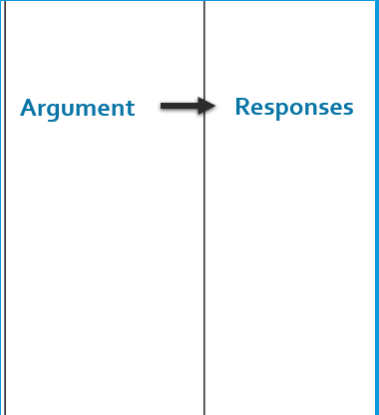
BETTER Flowing WHEN RESPONDING
Flow just the tag (claim)
Then spend 90% of your time writing your responses
LET’S TRY IT AGAIN.
I will present an argument—WRITE RESPONSES!
Now, how many responses did you write?
90%
10%

Slide 11
NOTE—THIS IS ABOUT TO GET COMPLICATED!
Flowing takes time to understand
It will probably make more sense after your second or third class
Feel free to ask questions
Just do your best to follow . . .

Slide 12
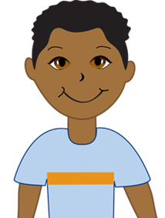
FLOWSHEETS
You MUST USE FLOWSHEETS for your debates
To follow the speakers in the order they present . . .
1 Pro Case | 1 Con Case | 2 Pro Rebuttal | 2 Con Rebuttal | 1 Pro Summary | 1 Con Summary | 2 Pro Final Focus | 2 Con Final Focus

Slide 13
You flow . . .
Your speeches
Your partner’s speeches
Your opponent’s speeches
You take notes on ALL the arguments in the debate!
YES—IT IS IRRITATING AT FIRST BUT . . .
YOU GET USED TO IT AND IT IS VERY IMPORTANT TO DOING DEBATE WELL.

Slide 14
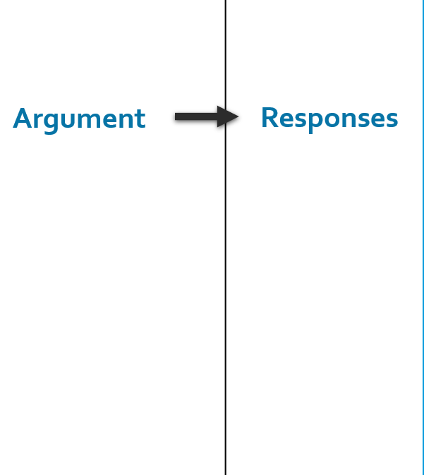
the idea behind flowsheets
You make a column to flow
For each speaker’s arguments
From left to right.
Rebuild
Etc.

Slide 15
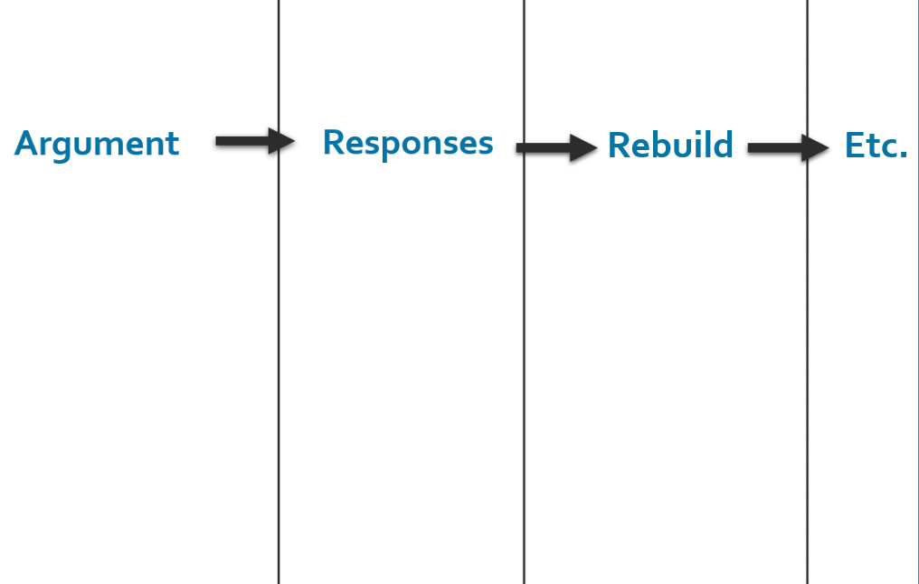
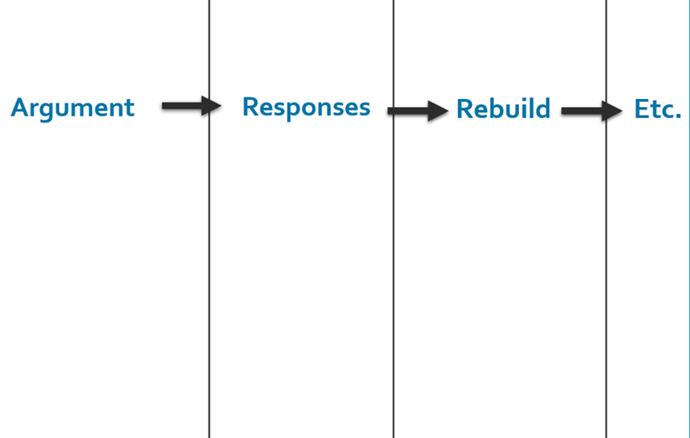
THE DEBATERS MAKE TWO FLOWSHEETS
One for Arguments and Responses about the Pro Case
One for Arguments and Responses about the Con Case
Pro Case
Con Case
Pro Case Flowsheet
Con Case Flowsheet

Slide 16
AND THE FLOWSHEETS HAVE A COLUMN FOR EACH SPEECH IN THE DEBATE
1 PRO CASE: Present a Pro Contention
1 CON CASE: Present a Con Contention
2 PRO REBUTTAL: Respond to the Con Contention
2 CON REBUTTAL: Respond to the Pro Contention
1 PRO SUMMARY: Defend your Pro Contention
1 CON SUMMARY: Defend your Con Contention
2 PRO FINAL FOCUS: We win the contentions
2 CON FINAL FOCUS: We win the contentions.

Slide 17
In full Here are the two flowsheets . . .

Slide 18
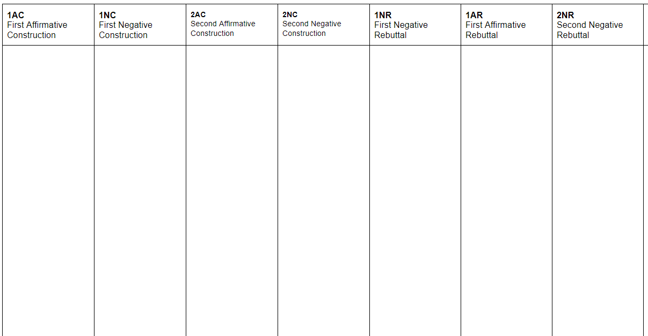
1 Pro-Case with contention(s)
2 Con-Rebuttals to the pro contention(s)
1 Pro Summary defend the contention(s)
2 Pro Final Focus
We win the contention(s)
2 Con Final Focus
We defeated the contention(s)
Pro Case & Con Responses Flowsheet
For Pro Contentions
And
Con Responses to the Pro contentions

Slide 19
1 Con-Case with contention(s)
--
2 Pro-Rebuttals to the contention(s)
1 Con Summary defend the contention(s)
2 Pro Final Focus We defeated the contention(s)
2 Con Final Focus
We won the contention(s)
Con Case & Pro Responses Flowsheet
For Con Contentions
And
Pro Responses to the Con contentions

Slide 20
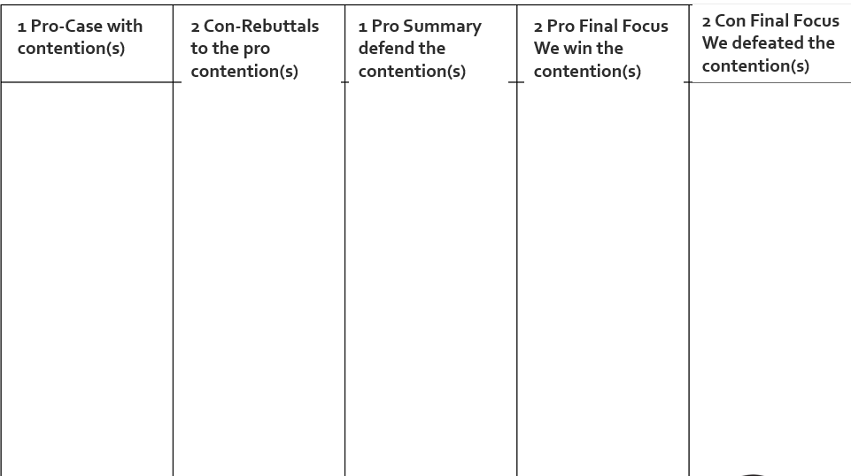
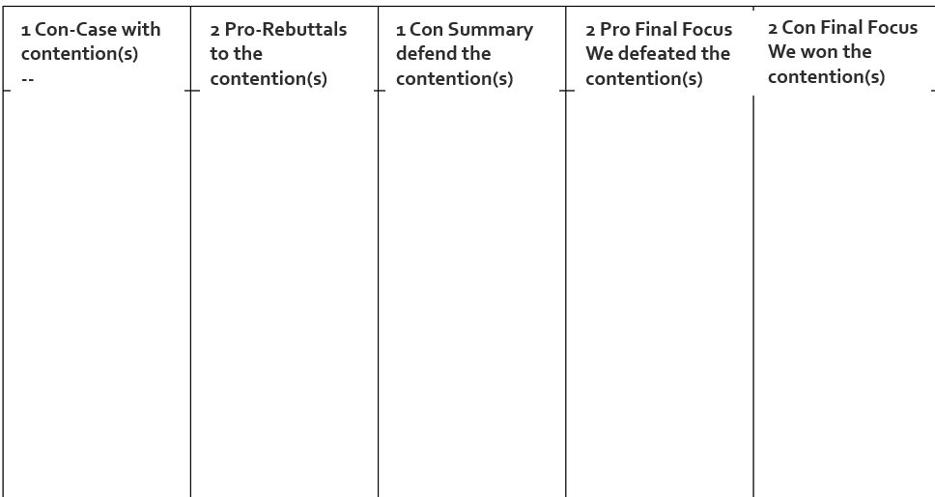
Now Prepare your own Flowsheets
Then, Show your Two Flowsheets to me.
Pro Case and Responses Flowsheet
Con Case and Responses Flowsheet

Slide 21
LET’S PRETEND YOU ARE FLOWING A DEBATE . . .
So, in the coming slides . . .
for each speaker . . .
Show me where you think you take notes on which flowsheet.

Slide 22
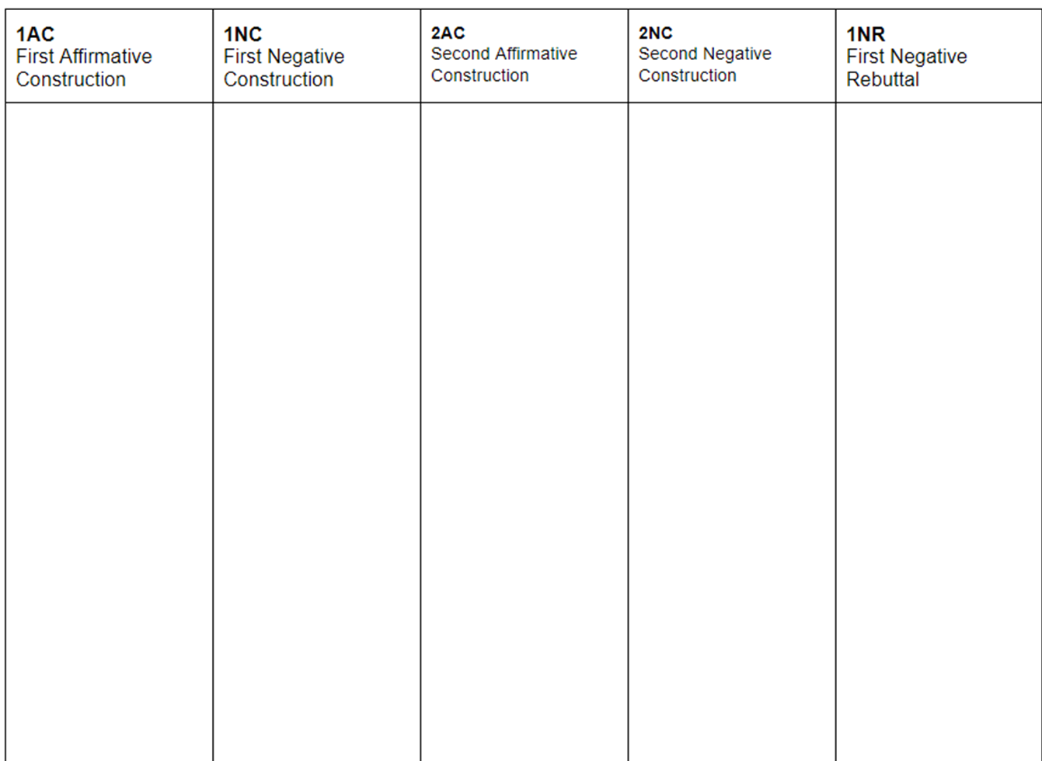
1 Pro
Presents case
Where do you flow the 1 Pro speaker?
1 Pro Case
2 Con Rebuttal
1 Pro Summary
2 Pro Final Focus
2 Con Final Focus
1 Con Case
2 Pro Rebuttal
1 Con Summary
2 Pro Final Focus
2 Con Final Focus
1. Zoos give animals too little space
2. Zoos don’t feed animals well

Slide 23
1 Con
Presents case
Where do you flow the 1 Con speaker?
1 Pro Case
2 Con Rebuttal
1 Pro Summary
2 Pro Final Focus
2 Con Final Focus
1 Con Case
2 Pro Rebuttal
1 Con Summary
2 Pro Final Focus
2 Con Final Focus
1. Zoos give animals too little space
2. Zoos don’t feed animals well
1. Zoos protect and repair hurt animals
2. Zoos help endangered animals

Slide 24
2 Pro
Rebuttals Con Case
Where do you flow the 2 Pro speaker?
1 Pro Case
2 Con Rebuttal
1 Pro Summary
2 Pro Final Focus
2 Con Final Focus
1 Con Case
2 Pro Rebuttal
1 Con Summary
2 Pro Final Focus
2 Con Final Focus
1. Zoos give animals too little space
2. Zoos don’t feed animals well
1. Zoos protect and repair hurt animals
2. Zoos help endangered animals
1. Zoos help very few animals
2. Nature Reserves are better for endangeredanimals

Slide 25
2 Con
Rebuttals Pro Case
Where do you flow the 2 Con speaker?
1 Pro Case
2 Con Rebuttal
1 Pro Summary
2 Pro Final Focus
2 Con Final Focus
1 Con Case
2 Pro Rebuttal
1 Con Summary
2 Pro Final Focus
2 Con Final Focus
1. Zoos give animals too little space
2. Zoos don’t feed animals well
1. Zoos now provide natural, large habitats
2. Zoos provide excellent care and food
1. Zoos protect and repair hurt animals
2. Zoos help endangered animals
1. Zoos help very few animals
2. Nature Reserves are better for endangeredanimals

Slide 26
Where do you flow the 1 Pro Summary speaker?
1 Pro Summary
Defends Pro Case
1 Pro Case
2 Con Rebuttal
1 Pro Summary
2 Pro Final Focus
2 Con Final Focus
1 Con Case
2 Pro Rebuttal
1 Con Summary
2 Pro Final Focus
2 Con Final Focus
1. Zoos give animals too little space
2. Zoos don’t feed animals well
1. Zoos now provide natural, large habitats
2. Zoos provide excellent care and food
1. Zoos new habitats are still too small
2. Zoo food and care is uneven—animals don’t eat well
1. Zoos protect and repair hurt animals
2. Zoos help endangered animals
1. Zoos help very few animals
2. Nature Reserves are better for endangeredanimals

Slide 27
Where do you flow the 1 Con Summary speaker?
1 Con Summary
Defends Con Case
1 Pro Case
2 Con Rebuttal
1 Pro Summary
2 Pro Final Focus
2 Con Final Focus
1 Con Case
2 Pro Rebuttal
1 Con Summary
2 Pro Final Focus
2 Con Final Focus
1. Zoos give animals too little space
2. Zoos don’t feed animals well
1. Zoos now provide natural, large habitats
2. Zoos provide excellent care and food
1. Zoos new habitats are still too small
2. Zoo food and care is uneven—animals don’t eat well
1. Zoos protect and repair hurt animals
2. Zoos help endangered animals
1. Zoos help very few animals
2. Nature Reserves are better for endangeredanimals
1. Zoos help thousands of animals
2. Zoos and nature reserves can both help endangered animals

Slide 28
Where do you flow the 2 Pro Final Focus speaker?
2 Pro Final Focus
We win the arguments
1 Pro Case
2 Con Rebuttal
1 Pro Summary
2 Pro Final Focus
2 Con Final Focus
1 Con Case
2 Pro Rebuttal
1 Con Summary
2 Pro Final Focus
2 Con Final Focus
1. Zoos give animals too little space
2. Zoos don’t feed animals well
1. Zoos now provide natural, large habitats
2. Zoos provide excellent care and food
1. Zoos new habitats are still too small
2. Zoo food and care is uneven—animals don’t eat well
1. Zoos small habitats hurt animals
2. Zoo food just isn’t good enough—the animals are hurt
1. Zoos protect and repair hurt animals
2. Zoos help endangered animals
1. Zoos help very few animals
2. Nature Reserves are better for endangeredanimals
1. Zoos help thousands of animals
2. Zoos and nature reserves can both help endangered animals
1. Zoos don’t help enough—the animals should go elsewhere
2. Nature reserves are better—that’s where hurt and endangered animals should go

Slide 29
Where do you flow the 2 Con Final Focus speaker?
2 Con Final Focus
We win the arguments
1 Pro Case
2 Con Rebuttal
1 Pro Summary
2 Pro Final Focus
2 Con Final Focus
1 Con Case
2 Pro Rebuttal
1 Con Summary
2 Pro Final Focus
2 Con Final Focus
1. Zoos give animals too little space
2. Zoos don’t feed animals well
1. Zoos now provide natural, large habitats
2. Zoos provide excellent care and food
1. Zoos new habitats are still too small
2. Zoo food and care is uneven—animals don’t eat well
1. Zoos small habitats hurt animals
2. Zoo food just isn’t good enough—the animals are hurt
1. Zoos habitats are more than good for animals
2. Zoo food keep animals in good care for years
1. Zoos protect and repair hurt animals
2. Zoos help endangered animals
1. Zoos help very few animals
2. Nature Reserves are better for endangeredanimals
1. Zoos help thousands of animals
2. Zoos and nature reserves can both help endangered animals
1. Zoos don’t help enough—the animals should go elsewhere
2. Nature reserves are better—that’s where hurt and endangered animals should go
1. Zoos do protect and repair—they are good.
2. Zoos help—nature reserves can’t handle all animals

Slide 30
LET’S DO OUR OWN FOLLOW THE FLOW DEBATE
GET INTO TEAMS of 2
BE SUPPORTIVE OF EACH OTHER
WE’LL SET MORE PERMANENT TEAMS LATER . . .
WHO’S PRO AND WHO’S CON? LET’S SET THAT NOW.

Slide 31
TEAMS PICK SPEAKER POSITIONS
ONE DEBATER IS THE “1”
THE OTHER DEBATER IS THE “2”
1 = PRESENT CASE AND DEFEND CASE
2 = REBUTTAL OPPONENT CASE AND WEIGH ISSUES
WHAT DO EACH OF YOU DO TO PREPARE FOR YOUR DEBATE?

Slide 32
WHAT DO EACH OF YOU DO TO PREPARE FOR YOUR DEBATE?
GET THE SHORT FILE FOR WEEK 2 ON THE WEB PAGE
1S: BE READY WITH YOUR CONTENTION
2S: BE READY WITH YOUR REBUTTALS.

Slide 33
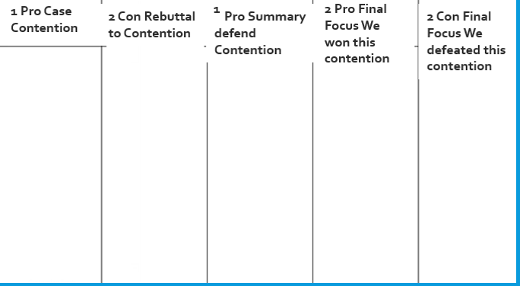
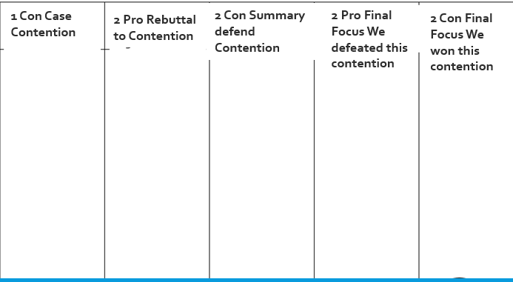
1S: PRE-FLOW YOUR CONTENTION
Pre-Flowing means to write notes before you speak.
1

Slide 34
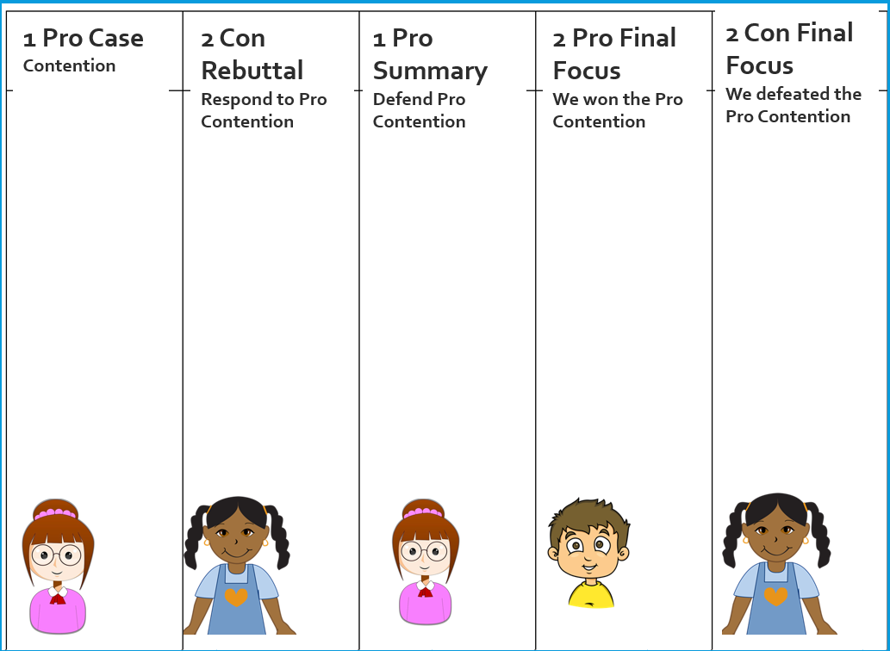
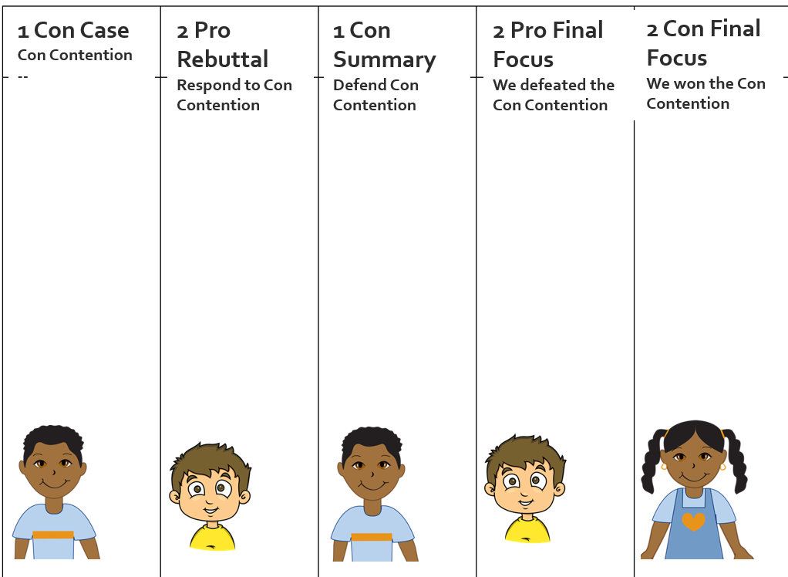
1. SHOW YOUR FLOWSHEET!
Pro Case Flowsheet
Con Case Flowsheet

Slide 35
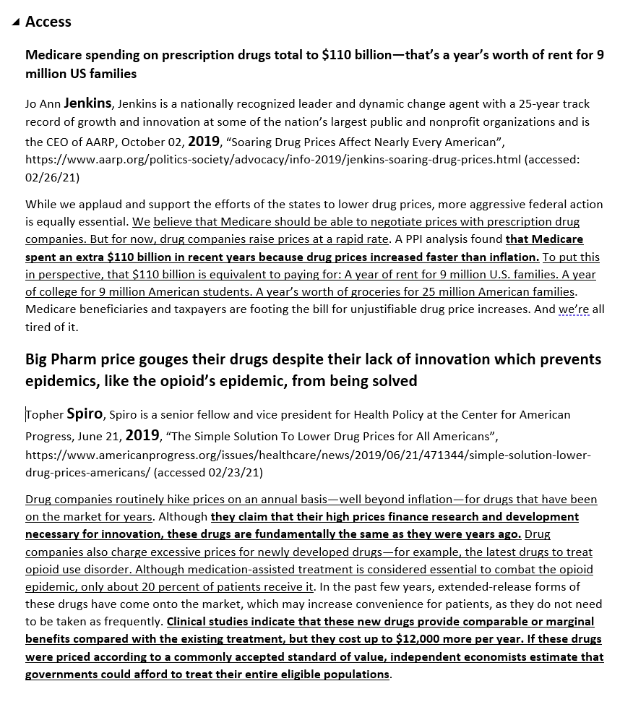
2. SHOW YOUR CASES AND REBUTTALS!

Slide 36
DO A SHORT PUBLIC FORUM DEBATE! USING FLOWSHEETS AND SCRIPTS.
1 to 1.5 minute speeches
1 PRO CASE: Present a Pro Contention
1 CON CASE: Present a Con Contention
2 PRO REBUTTAL: Respond to the Con Contention
2 CON REBUTTAL: Respond to the Pro Contention
1 PRO SUMMARY: Defend your Pro Contention
1 CON SUMMARY: Defend your Con Contention
2 PRO FINAL FOCUS: We showed we won our pro contention, we showed we defeated the con contention
2 CON FINAL FOCUS: We showed we won our con contention, we showed we defeated the pro contention

Slide 37
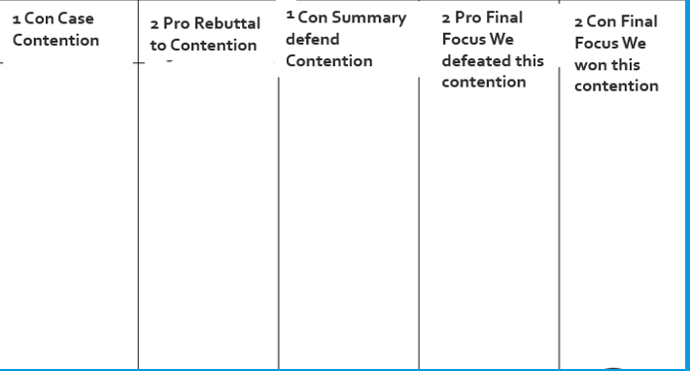
1 PRO PRESENT YOUR PRO CONTENTION
while 2 CON—FLOW YOUR RESPONSES: 90%!
My Name is _____________
Then Read your Contention
You read the bolded words.

Slide 38
1 CON PRESENT YOUR CON CONTENTION
While 2 PROP—FLOW YOUR RESPONSES: 90%!
My Name is _____________
Then Read your Contention
You read the bolded words.

Slide 39
2 PRO RESPOND TO CON CONTENTION
While 1 CON PREP RESPONSES TO DEFEND CONTENTION: 90%!
My Name is _____________
Then say “Against their __________ Contention”
Then read your rebuttals
You read the bolded words.

Slide 40
2 CON RESPOND TO PRO CONTENTION
1 PRO—PREP RESPONSES TO DEFEND CONTENTION: 90%!
My Name is _____________
Then say “Against their __________ Contention”
Then read your rebuttals
You read the bolded words.

Slide 41
1 PRO DEFEND YOUR PRO CONTENTION
2’S—FLOW SO YOU CAN RESPOND
My Name is _____________
Then say “In our Contention we showed ________”
Then say “They tried to argue ____, but __ respond __________.”
Note Everyone should continue to flow all of the speeches to the very end!

Slide 42
1 CON DEFEND YOUR CON CONTENTION
2’S—FLOW SO YOU CAN RESPOND
My Name is _____________
Then say “In our Contention we showed ________”
Then say “They tried to argue ____, but __ respond __________.”

Slide 43
2 PRO SHOW THAT THE ARGUMENTS YOU AND YOUR PARTNER PRESENTED WIN EACH CONTENTION (avoid new arguments)
2 CON—FLOW WITH 90% TIME ON YOUR RESPONSES
My Name is _____________
“We won our contention because we showed _____”
“We defeated their contention because we showed _____”

Slide 44
2 CON SHOW THAT THE ARGUMENTS YOU AND YOUR PARTNER PRESENTED WIN EACH CONTENTION (avoid new arguments)
My Name is _____________
“We won our contention because we showed _____”
“We defeated their contention because we showed _____”

Slide 45
CONGRATS—YOU JUST DID YOUR FIRST REAL DEBATE!
CONFUSED SOME? AGAIN—TAKES PRACTICE TO GET USED TO IT
NEXT CLASS SESSION
YOU’LL DO A LONGER FOLLOW THE FLOW DEBATE
THAT WILL BE ALMOST LIKE A REAL DEBATE
GET READY TO ARGUE LIKE THE BEST MIDDLE SCHOOL DEBATERS!

Slide 46
DEBATE PARTNERS
RIGHT NOW, BEFORE YOU GO—FILL OUT THIS FORM . . .
https://tinyurl.com/cz2pm6w

