Slide 1
Let’s debate!
Jim Hanson

Slide 2
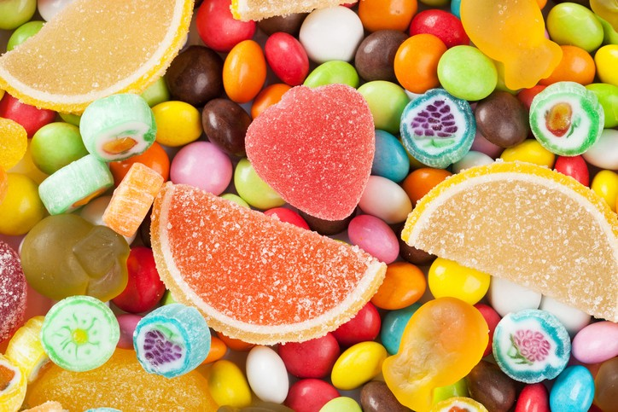
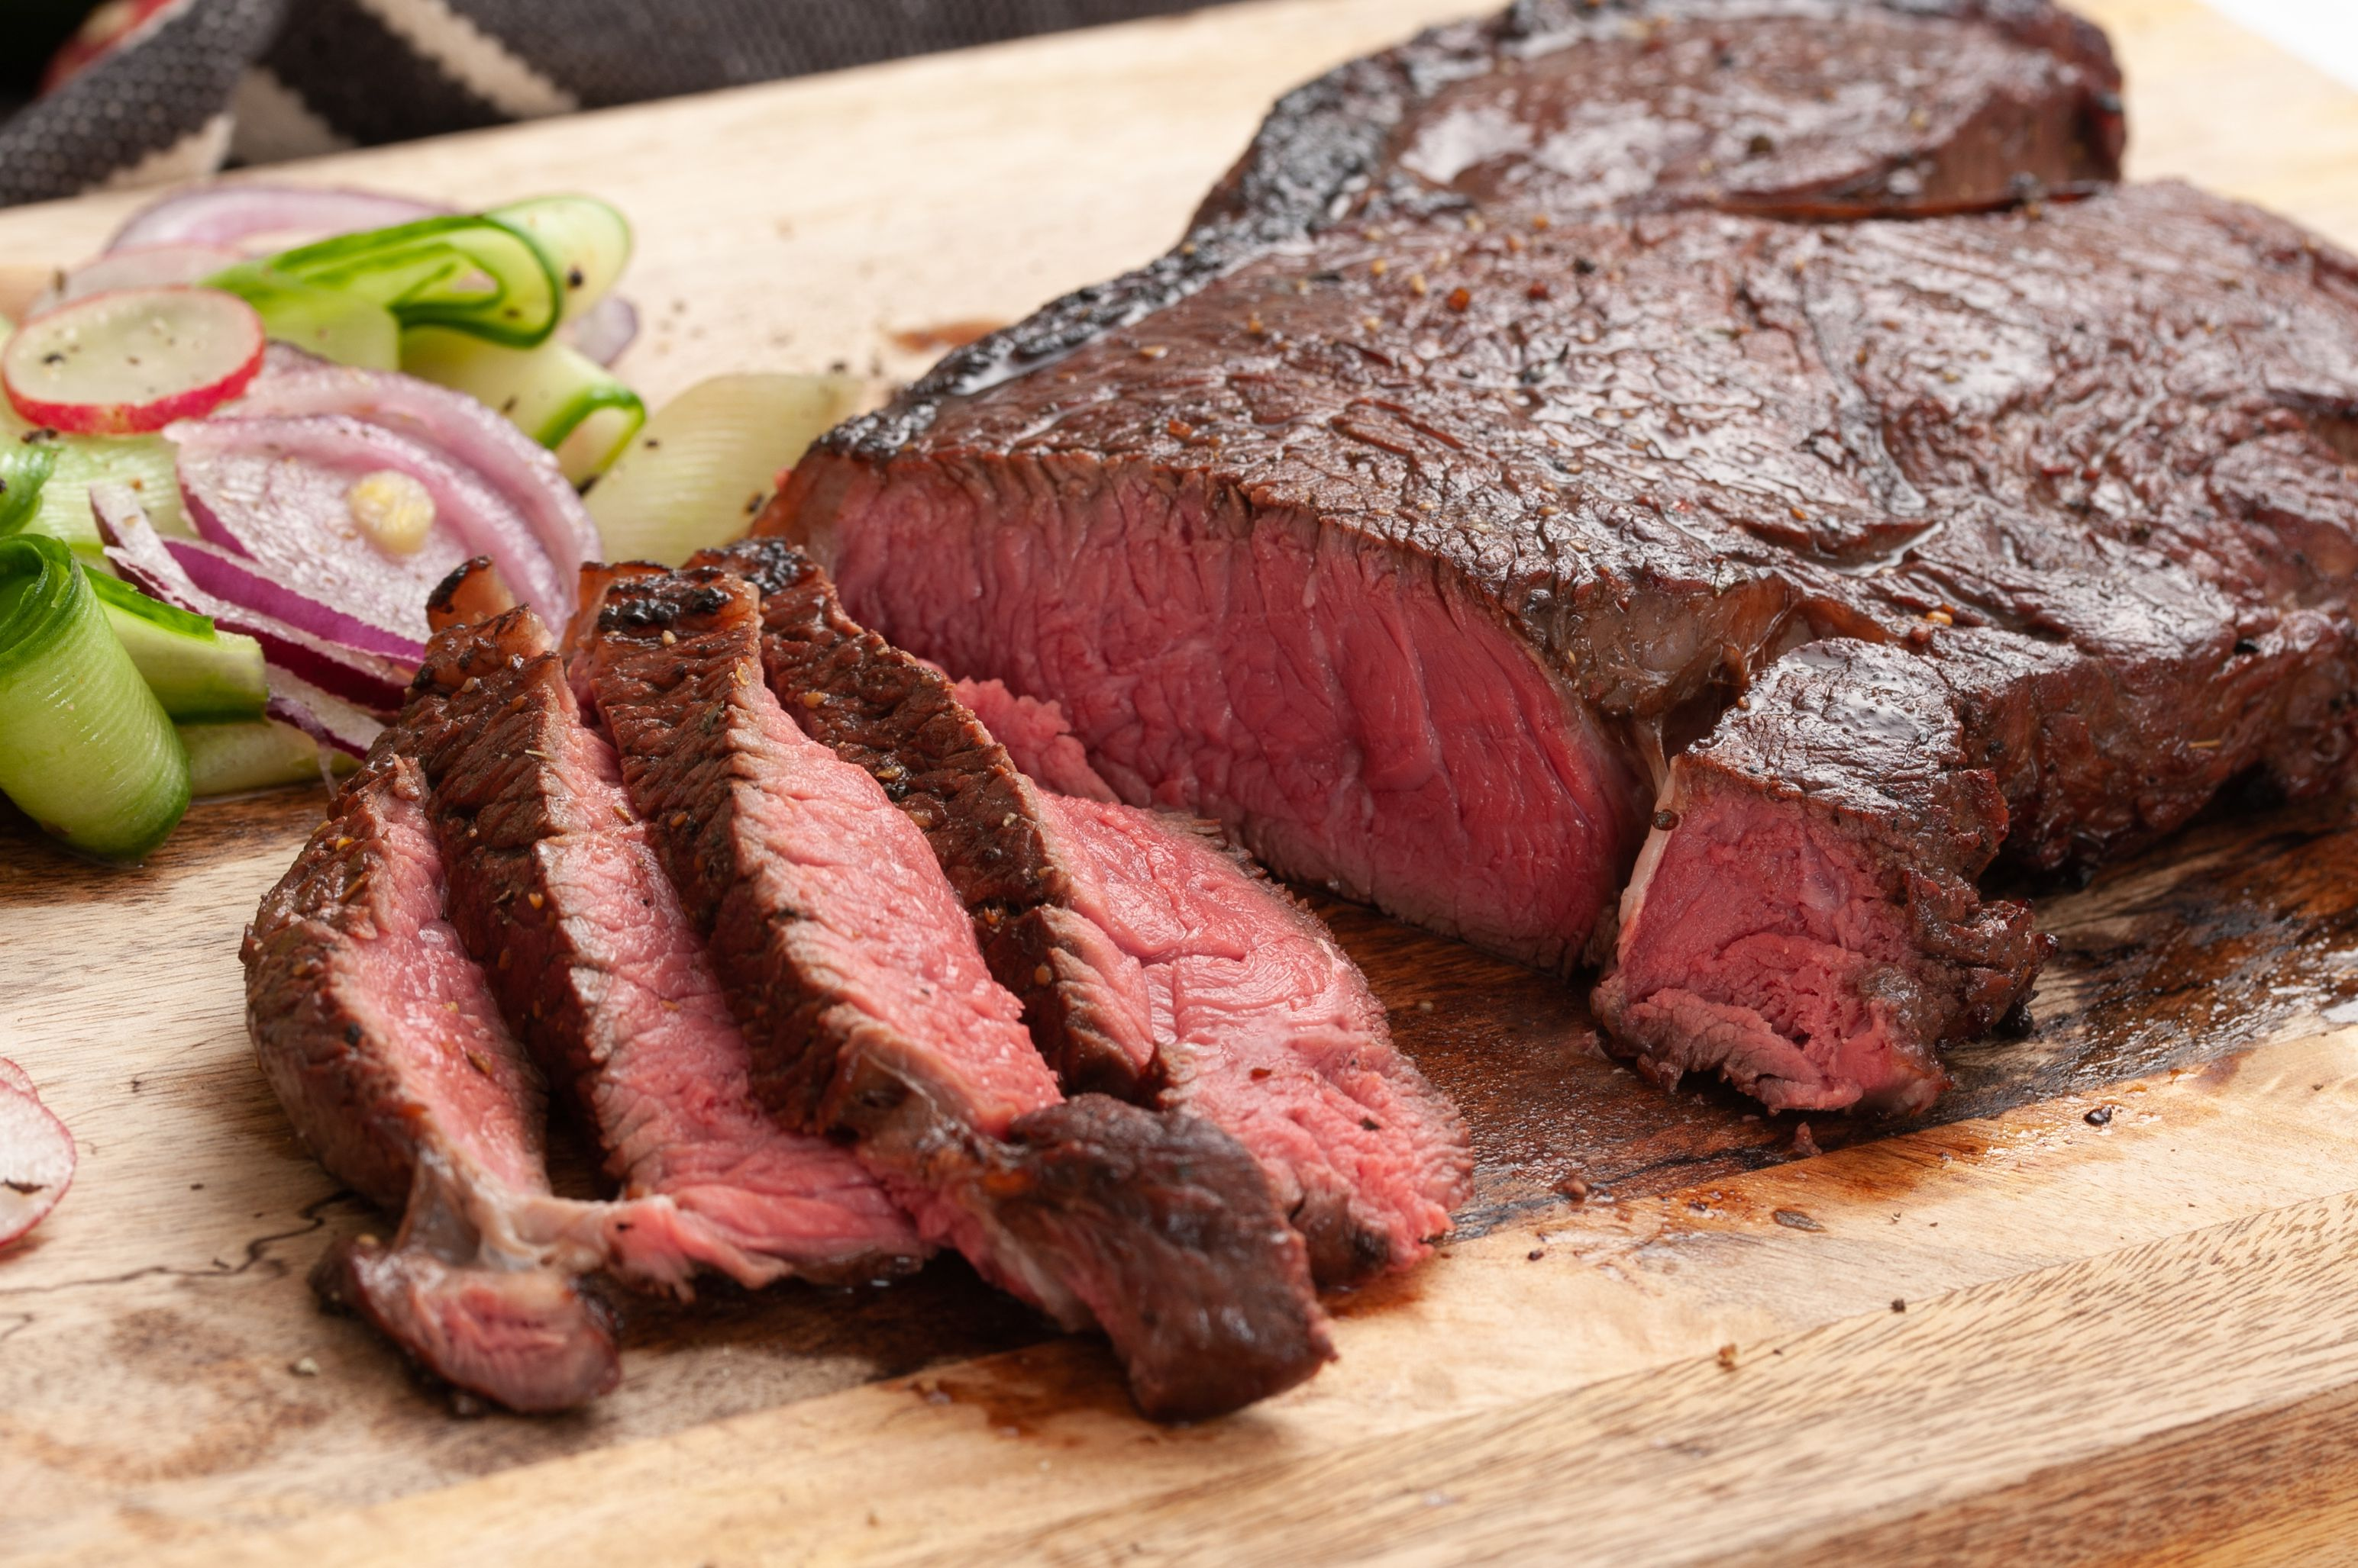
Do you like the food showN?

Slide 3
We have our opinions
We are working together
We don’t completely agree with each other
We are a team and we support each other
Share your name
Pronoun/anything important if you wish to share
Your favorite game.

Slide 4
Making A basic argument
Claim (the main point)
Support (reasons for the claim)
Bananas are a great food
They are delicious and healthy with lots of potassium

Slide 5
Ready to make an argument about . . .
The best hobby?
School Start Time too early?
The best Video Game?
Something else?
Prepare your own argument
With Claim (1 sentence) and Support (1 to 2 sentences).

Slide 6
Two people share your argument to the class . . .
Claim (main point)
Support (reasons for the claim)
Debate isn’t just giving an argument . . .

Slide 7
Debate involves respectful disagreement
When a debater says steak is the best food . . .
You can argue . . .
“steak is NOT that good tasting”
“steak means harming animals—that’s not the best”
“Sushi is more delicious”

Slide 8
Now . . . I disagree game
One person presents their argument
The other person then says “I disagree because ____________”
We’ll go through everyone
You give an argument, you respond to an argument.

Slide 9
Now . . . It’s time for . . .
The World’s most important debate topic . . .

Slide 10
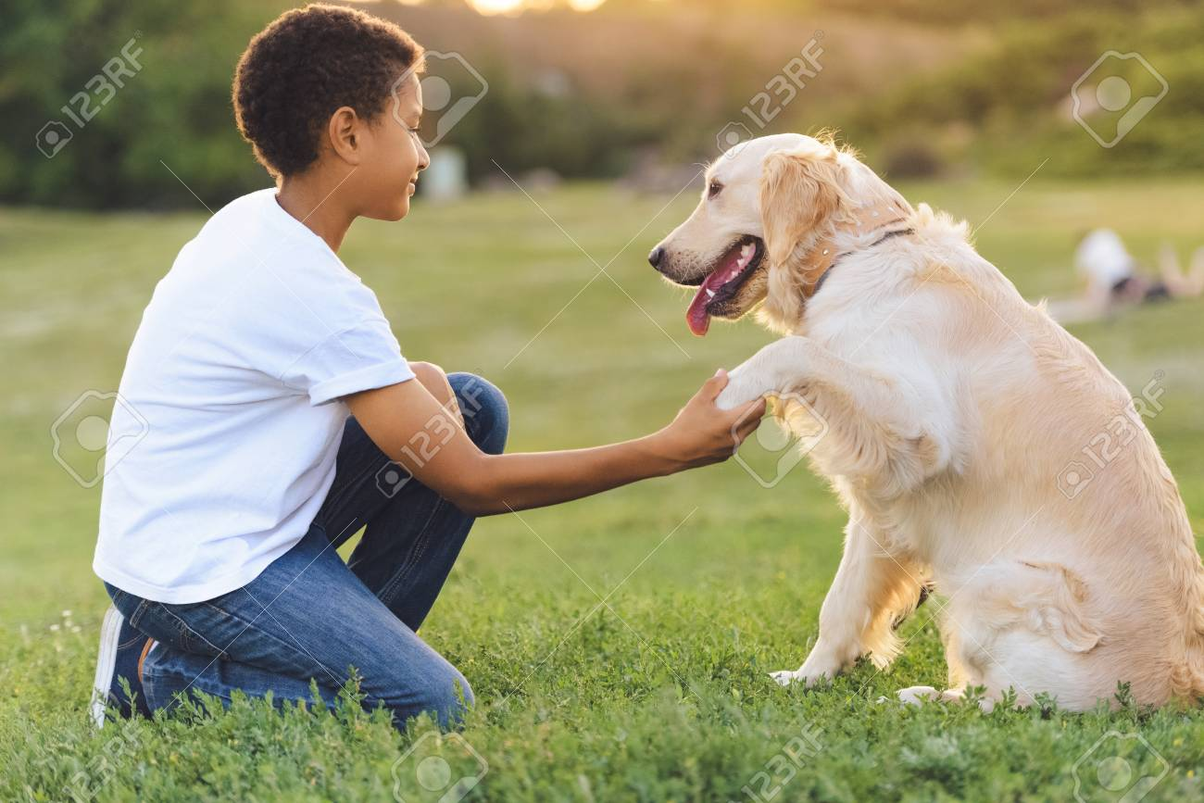
Dogs or cats?
Some people love dogs
Some people love cats

Slide 11
Some people don’t like either

Slide 12
TOPIC: dogs are better than cats
One side is Pro—and favors the topic.
THE PRO ON THIS TOPIC IS FOR DOGS
The other side is Con—and is against the topic
THE CON ON THIS TOPIC IS FOR CATS.

Slide 13
TOPIC: dogs are better than cats
Pick now which side you will be on
Sometimes, you don’t get your preferred choice.

Slide 14
TOPIC: dogs are better than cats
PRO FIRST SPEAKER prepare an argument (Claim-Support) for the topic
PRO ADDITIONAL SPEAKERS be ready to disagree with arguments the con might present and to defend the first speaker’s argument
CON FIRST SPEAKER prepare an argument (Claim-Support) for the topic
CON ADDITIONAL SPEAKERS be ready to disagree with arguments the pro might present and to defend the first speaker’s argument
EACH SPEAKER GETS APPROX. 45 SECONDS TO SPEAK--SHORT.

Slide 15
NOW: MINI-DEBATE
45 second Pro Speech (present your argument using Claim-Support)
45 second Con Speech (present your argument using Claim-Support)
45 second Additional Pro Speeches (respond to the con arguments and defend your pro speech argument)
45 second Additional Con Speeches (defend your con speech argument and respond again to the pro arguments)

Slide 16
How did it go?

Slide 17
You will be doing public forum debate
This debate format is used throughout the USA
It features two person teams debating each other
It focuses on well researched arguments
And really delves into a topic deeply.

Slide 18
Making A DEBATE argument
Tagline (Claim—says the point of the quotation)
Source (author, quals, date)
Evidence (Quotation)
Importance (why this matters)
Student don’t forget lessons with Year Round Schools
Grace Chen, educator and researcher, April 06, 2018
Students forget knowledge and skills they acquired during the previous academic year. Several studies support this notion, as children show losses in math and language arts knowledge over the long summer break. . . . (Y)ear-round school increases retention rates, as students in year-round schools have demonstrated higher scores on some standardized tests.
So, year round school helps learning.

Slide 19
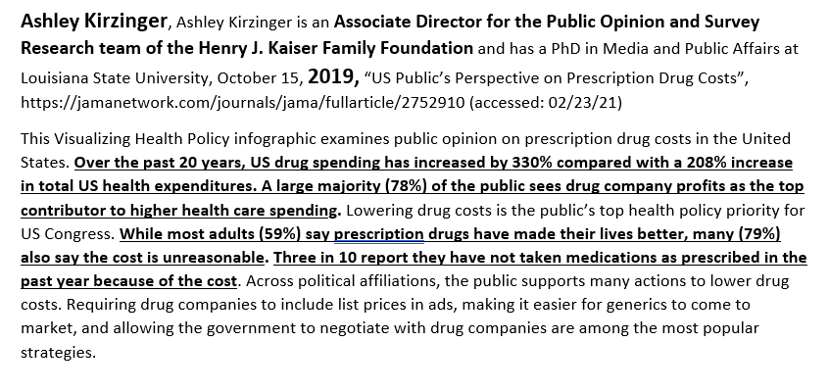
TRY IT! ADD A TAG AND IMPORTANCE TO THIS QUOTATION
The Tag is a concise statement of the main point of the quotation
The Importance is why this argument makes a good point.

Slide 20
ARGUMENTS WITH QUOTATIONS ARE GREAT . . .
But when you want to make a convincing case to your judge (who decides who wins a debate!) . . .

Slide 21
You need CONTENTIONS
Contentions are arguments supported by arguments
They make a persuasive case for your side of the topic
The topic you are debating is:
The United States Federal Government should impose price controls on the pharmaceutical industry.

Slide 22
pro CONTENTIONS
PROBLEM-Show a problem exists
THE TOPIC SOLVES-Show the topic solves
IMPACT-Show solving the problem helps people a lot
PROBLEM-20 minute lunch time is too short
THE TOPIC SOLVES-40 minute lunch gives enough time
IMPACT-Longer lunch reduces stress and upset stomachs from eating too fast.
Now you Do it on the Topic!

Slide 23
con CONTENTIONS
LINK-THE TOPIC CAUSES OR INCREASES A PROBLEM
IMPACT-Show this problem would hurt people a lot.
LINK-Longer lunch means shorter classes
IMPACT-Shorter classes mean less learning and more stress before tests.
Now you Do it on the Topic!

Slide 24
Check out the evidence packet
Go to the Climb Apr-May Middle School Web Page
Look for PF Topic File—click and download/open
Pick a Pro Contention
Pick a Con Contention.

Slide 25
You need rebuttals
You need documented responses to your opponents’ contentions
Check out the rebuttals in the evidence packet
When you respond you use analysis and documented arguments
1 minimum analysis, 2 minimum documented.

Slide 26
TIME FOR IT? SHORT CONTENTION AND REBUTTAL
One Student: Present a Pro Contention
Another Student: Present Con Rebuttals
Rest of the Students: Judge—which is the stronger argument on this contention?
--are students reading the source citations and quotation right (bold-highlighted parts)?
--are students presenting the tag then the source then quotation then the important?
Student Judges—Which side do you vote for? What is the specific argument that convinces you?

Slide 27
The next sessions
Review the Evidence File posted on the April-May Climb Web Page
You will learn more about good arguments
You will engage in debating
At a higher level of knowledge!

