Slide 1
TOPIC OVERVIEW

Slide 2
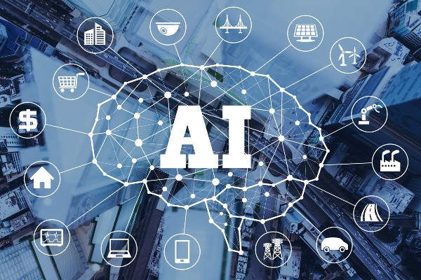
THE TOPIC IS: Artificial intelligence is, on balance, a good thing.

Slide 3
Why this topic?
Some people believe AI can improve human health and save lives. (Pro)
Some people believe AI will expose people’s private information, leaving them vulnerable to cyber-attacks.(Con)

Slide 4
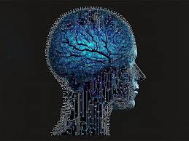
What is the Topic?
“Artificial intelligence” or “AI” is the simulation of human intelligence in machines that are programmed to think like humans and mimic their actions.

Slide 5
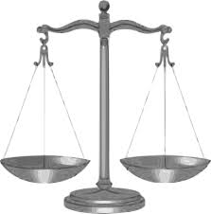
What is the Topic?
on balance” as “when all things are considered

Slide 6
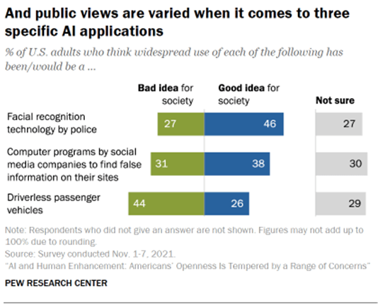
What do people think artificial intelligence?
People are concerned, but also excited, about AI’s possibilities.

Slide 7
What are some arguments FOR artificial intelligence?
Students answer first before showing the list.
AI promote productivity, which makes the economy improve.
AI advances will improve healthcare and save lives.
AI can solve climate change and reduce harms and poverty.
AI can do dangerous jobs safely (ex.-mining) and save miner’s lives.

Slide 8
What are some arguments AGAINST artificial intelligence?
Students answer first before showing the list.
AI could develop into something dangerous and harmful.
AI could take over and make humans useless and lose their jobs.
AI can be discriminatory and increase the harms of racism.
AI could expose people’s data, leading to cyber attacks.

Slide 9
What do YOU think specifically . . .
What do you think of AI?
Have you used AI?
Is AI used in any of your dailyt activities? (classes, computer usage, etc.)

