Slide 1
Let’s START debate!
Jim Hanson

Slide 2
Now—let’s get prepared to debate
I need to assign half of you to the Prop Side
And half of you to the Opp Side
Here are the names of the people on the 2 sides.
Get prepared for your side with a case.
To do that . . .

Slide 3

GET YOUR LAPTOP OR TABLET

Slide 4
go to your web browser

Slide 5
OPEN THE CLIMB MIDDLE SCHOOL STUDENT PREP PAGE
Climb STUDENT PREP PAGE
https://www.nwforensics.org/climb-program/middle-school/0-student-page.htm
You can Google/Bing for “Climb Middle School Student Prep” (make sure it shows the current session eg Summer 2025 at the top of the page)

Slide 6
MAKE SURE YOU HAVE THE PREP PAGE BOOKMARKED/FAVORITED
You will use that page each week to prepare before class
You should spend 30 to 45 minutes preparing BEFORE each class
Show your Instructor the page and that you have bookmarked/favorited it.

Slide 7
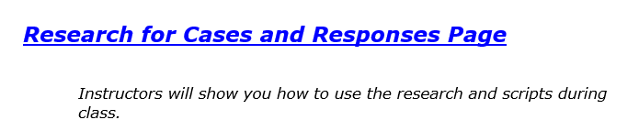
Now—click the research FOR CASES AND RESPONSES LINK

Slide 8
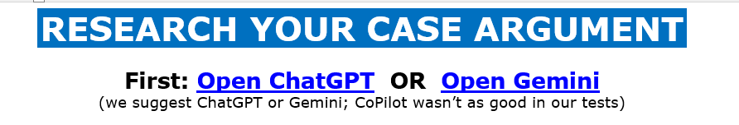
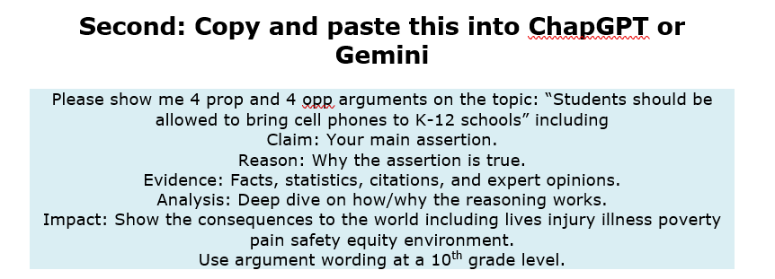

Slide 9
What arguments did you get?
One Prop Person: Tell me one argument you got.
One Opp Person: Tell me one argument you got.

Slide 10
DID YOU NOTICE . . .
we searched for AREI but . . .
Assertion is called Claim when you AI it
We added Analysis to give more depth to the argument.

Slide 11
Ai doublechecks
As of Summer 2025, ChatGPT and Gemini make pretty good arguments
BUT they make mistakes
--Citations are sometimes wrong, even made up
--AI can mix-up Facts and statistics
--Very specific details/facts can be very wrong
Doublecheck such things.

Slide 12
What you do with your argument ideas & ai research!
You keep it (print it for tournaments)
And for actual debates . . .
You write your AI and argument ideas on your flowsheet
You do that for your own speeches and for listening to other debaters
Let’s go through how that works . . .

