Slide 1
Let’s START debate!
Jim Hanson

Slide 2
Instructor timeline
START/AREI 12 MINUTES
I DISAGREE GAME 12 MINUTES
MINI-DEBATE 12 MINUTES
TOPIC OVERVIEW 8 MINUTES
RESEARCH THE TOPIC 8 MINUTES
FLOWING 12 MINUTES
FINISH UP 5 MINUTES

Slide 3
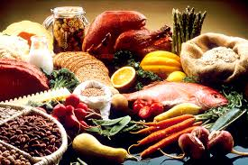
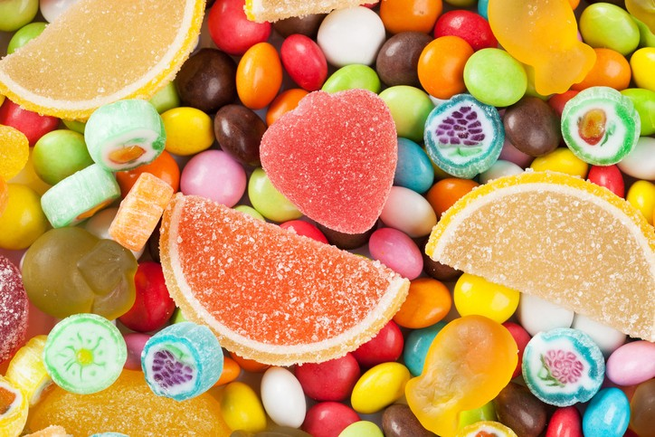
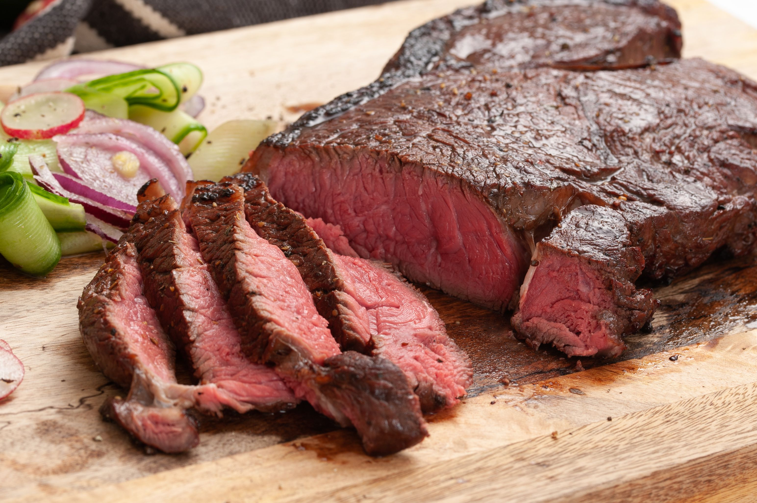
What’s your favorite food?

Slide 4
We have our opinions
We are working together
We are a team and we support each other.

Slide 5
Communicate it!
Each person, tell your group . . .
Your name and anything important to you
And your favorite food.

Slide 6
Making an argument: AREI
Assertion/Claim your main point
Reason-because ___
Evidence-proof
Importance-why this matters
Sugary beverages harm health
Because they increase diabetes
High sugar consumption is linked to diabetes in studies
So, we should try to reduce consumption of sugary beverages.

Slide 7
Ready to make an argument about . . .
Your favorite show?
School start times?
The best Video Game?
Something else?

Slide 8
prepare an argument with AREI
Assertion—your point
Reason—because ___
Evidence—show proof
Importance—why this matters

Slide 9
One or two students: share out loud your argument

Slide 10
Debate involves respectful disagreement
When a debater says steak is the best food . . .
You can argue “steak is NOT that good tasting”
You can argue “steak means harming animals—that’s not the best”
You can argue “Sushi is more delicious”

Slide 11
Now . . . I disagree game
One person presents their argument
The next person I call then says “I disagree because ____________”
We’ll hear an argument and a response from each person.

Slide 12
Let’s do a mini-debate!
You know how to make an argument
You know how to disagree
So let’s put those skills into a debate!

Slide 13
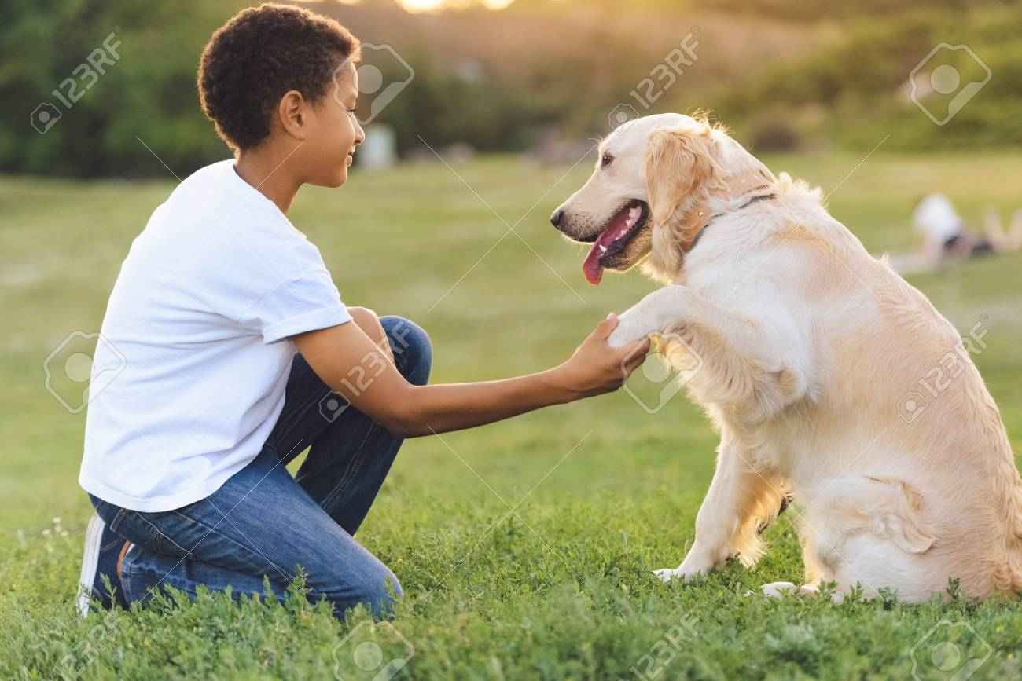
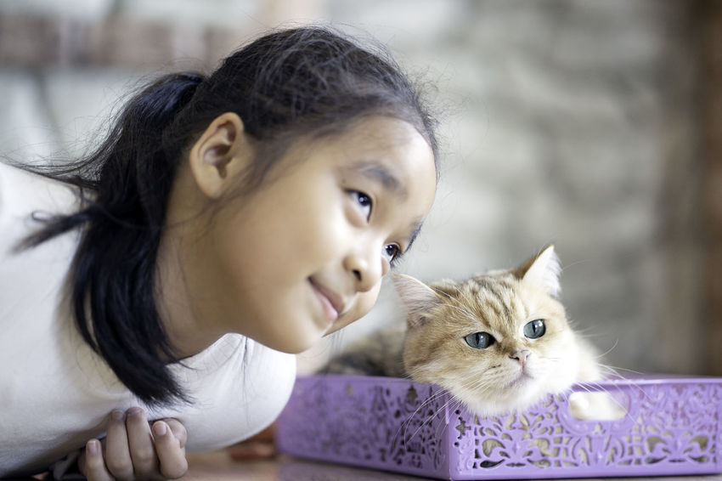
Dogs or cats?
Some people love dogs
Some people love cats

Slide 14

Some people don’t like either

Slide 15
TOPIC: dogs are better than cats
One team is Proposition—and favors the topic.
The other team is Opposition—and is against the topic
We’ll create 2 teams (normally, you have 3 person teams in this kind of debate)
Pick now which side you will be on but . . .
sometimes, you don’t get your preferred choice.

Slide 16
TOPIC: dogs are better than cats
PROP prepare an argument (AREI) for the topic—and be ready to disagree with arguments the opp might present.
OPP prepare an argument (AREI) against the topic—and be ready to disagree with arguments the prop might present.
You will present 1 minute speeches in a short debate with each other.

Slide 17
NOW: MINI-DEBATE ONE ON ONE
1 minute Prop Speech (present your argument using AREI)
1 minute Opp Speech (present your argument using AREI AND respond to the Prop Arguments)
1 minute Prop Speech (respond to the Opp arguments and defend your arguments)
1 minute Opp Speech (defend your arguments and respond again to the Prop arguments)
Continue until everyone has presented.

Slide 18
How did it go?

Slide 19
WHAT IS OUR FIRST debate TOPIC?

Slide 20

THE TOPIC IS Students should be allowed to use cell phones in K-12 schools.

Slide 21
SHARE 2 assertions/claims for the topic.

Slide 22
SHARE 2 assertions/claims AGAINST the topic.

Slide 23
MakE sure YOUR arguments are relevant

Slide 24
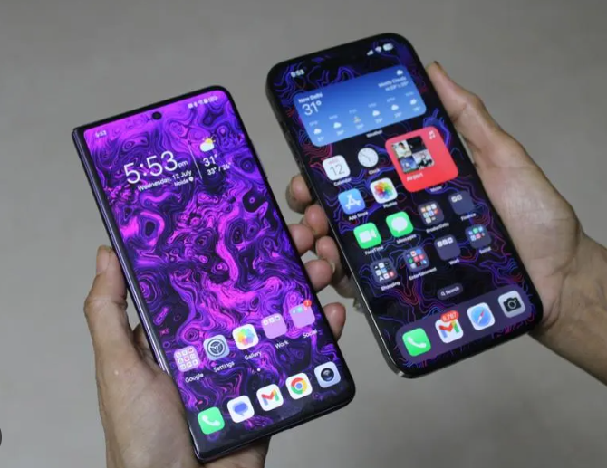

Arguments must be about cell phones
You know cell phones
and that does not include tablets or computers

Slide 25

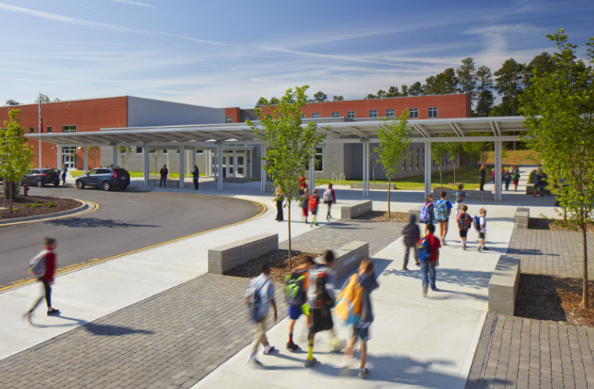
Arguments must be about k-12 schools
Focus on Elementary, Middle, and High Schools.
Obviously, not Colleges.

Slide 26

One more thing on the Topic . . .
Cell Phones should be allowed in schools – the topic does not cover usage OUTSIDE of school.

Slide 27
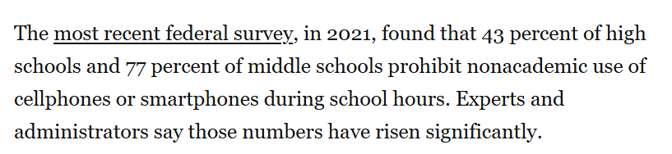
What are school policies on cell phone use?
From the Washington Post . . .

Slide 28
Now—let’s get prepared to debate
I need to assign half of you to the Prop Side
And half of you to the Opp Side
Here are the names of the people on the 2 sides.
Get prepared for your side with a case.
To do that . . .

Slide 29

GET YOUR LAPTOP OR TABLET

Slide 30
go to your web browser

Slide 31
OPEN THE CLIMB MIDDLE SCHOOL STUDENT PREP PAGE
Climb STUDENT PREP PAGE https://www.nwforensics.org/climb-program/middle-school/0-student-page.htm
You can Google/Bing for
“Climb Middle School Student Prep”
(make sure it shows the current session eg Fall 2025 at the top of the page)

Slide 32
MAKE SURE YOU HAVE THE PREP PAGE BOOKMARKED/FAVORITED
You will use that page each week to prepare before class
You should spend 30 to 45 minutes preparing BEFORE each class
Show your Instructor the page and that you have bookmarked/favorited it.

Slide 33
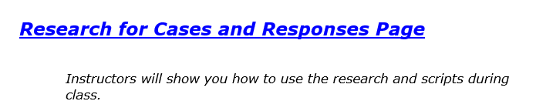
Now—click the research FOR CASES AND RESPONSES LINK

Slide 34
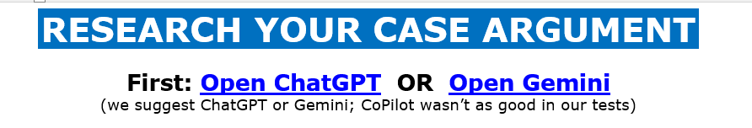
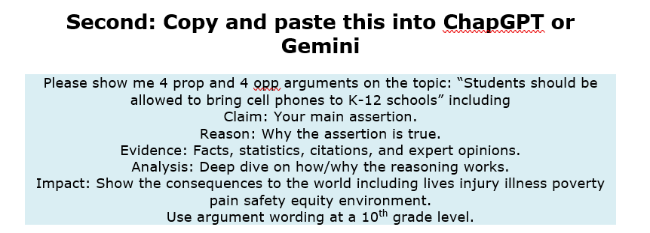

Slide 35
What arguments did you get?
One Prop Person: Tell me one argument you got.
One Opp Person: Tell me one argument you got.

Slide 36
DID YOU NOTICE . . .
we searched for AREI but . . .
Assertion is called Claim when you AI it
We added Analysis to give more depth to the argument.

Slide 37
Ai doublechecks
As of Summer 2025, ChatGPT and Gemini make pretty good arguments
BUT they make mistakes
--Citations are sometimes wrong, even made up
--AI can mix-up Facts and statistics
--Very specific details/facts can be very wrong
Doublecheck such things.

Slide 38
What you do with your argument ideas & ai research!
You keep it (print it for tournaments)
And for actual debates . . .
You write your AI and argument ideas on a sheet of paper debaters use for taking notes in a debate
You do that for your own speeches and for listening to other debaters
Let’s go through how that works . . .

Slide 39
WHEN A DEBATER PRESENTS AN ARGUMENT, YOU Take notes . . .
TAKING NOTES IN DEBATE IS CALLED. . .
FLOWING
RIGHT NOW, I WANT YOU TO FLOW MY ARGUMENT . . .
When I say stop, you have to stop—drop your pen!
Instructor present argument at normal speaking rate then say “Stop. Hold up your hands in the air!”
What did you write down?

Slide 40
It is impossible to take REGULAR notes as fast as a person speaks . . .
But if you Flow the correct way, you can do it.

Slide 41
SO LET’S flow better
Flow the assertion
Flow the reason/evidence supporting the assertion.
Example Flowed Argument on a Zoos topic
Zoos save animals
Zoos protect hurt injured animals and allow animal to engage in breeding

Slide 42
ABBREVIATE
Shrtn wrds w/o vwls
Endgrd Spcs
Or just the first letters of longer words
Treat Dang Qual
Example Flowed Argument
Zs sv anmls
Nat Geog 2020
Prtct hrt anmls, allw brding

Slide 43
Shorthand
Endangered Species = ES
Zoos = Z
Increases =
Solves = S
Example Flowed Argument
Z sv A
Prtct hrt A, allw brding
NOTICE: How much less you have to write!

Slide 44
EXAMPLE FLOWED ARGUMENT
Z hrt anmls
Z gv bad diet
Z too smll spc
TRY FLOWING AGAIN—Here is another argument.

Slide 45
Now—let’s do it real!
Someone present their SHOULD ALLOW PHONES argument
Everyone: Flow it!

Slide 46
Now, it gets tougher!

Slide 47

Flowing WHEN RESPONDING
Create two columns
I will present an argument
You write responses
TRY IT . . .
How many responses did you get?
Argument
Responses

Slide 48
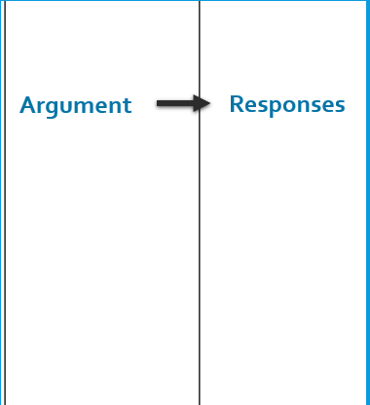
BETTER Flowing WHEN RESPONDING
Flow just the assertion
Then spend 90% of your time writing your responses
TRY IT AGAIN.
I will present an argument—WRITE RESPONSES!
How many responses did you flow?
90%
10%

Slide 49
Now—let’s do it real!
Someone present their Should require argument
Flow your Responses!
How many Responses did you get?
Who’s willing to present their responses?

Slide 50
YOU SHOULD WATCH A DEBATE AFTER CLASS TODAY
Try to flow it
There is a link to the debate on the Climb MS Prep Page
Please note the debate includes arguments about animal testing and discusses harm to animals.

Slide 51
As we debate, treat each other right
We argue Ideas
We don’t argue against People.

Slide 52
LOOK AROUND THE ROOM
These are your team members—show you support each other
If at anytime you are not being treated right—tell the lab leader, your parent, or Jim Hanson
If you see someone being mistreated—you are encouraged to put a stop to it. “Hey Stop that.” “Hey, let’s do something else.” “Yep, I’m going to contact Jim Hanson.”

