Slide 1
Let’s debate!
Jim Hanson

Slide 2
BEFORE WE START THE half DEBATES . . .
WE ARE GOING TO LEARN HOW DEBATES ARE JUDGED
Knowing how judging works helps your own debating.

Slide 3
WHEN YOU Watch the Debate
Listen and take notes—USE TWO FLOWSHEETS!
Be thinking which specific arguments convince you most
Be thinking which specific responses against arguments convince you most
Keep your own ideas and arguments to yourself—you aren’t judging your own thoughts—YOU ARE JUDGING THE DEBATER’S ARGUMENTS
Be thinking what is each debaters doing well
Be thinking what could each debater do to improve.

Slide 4
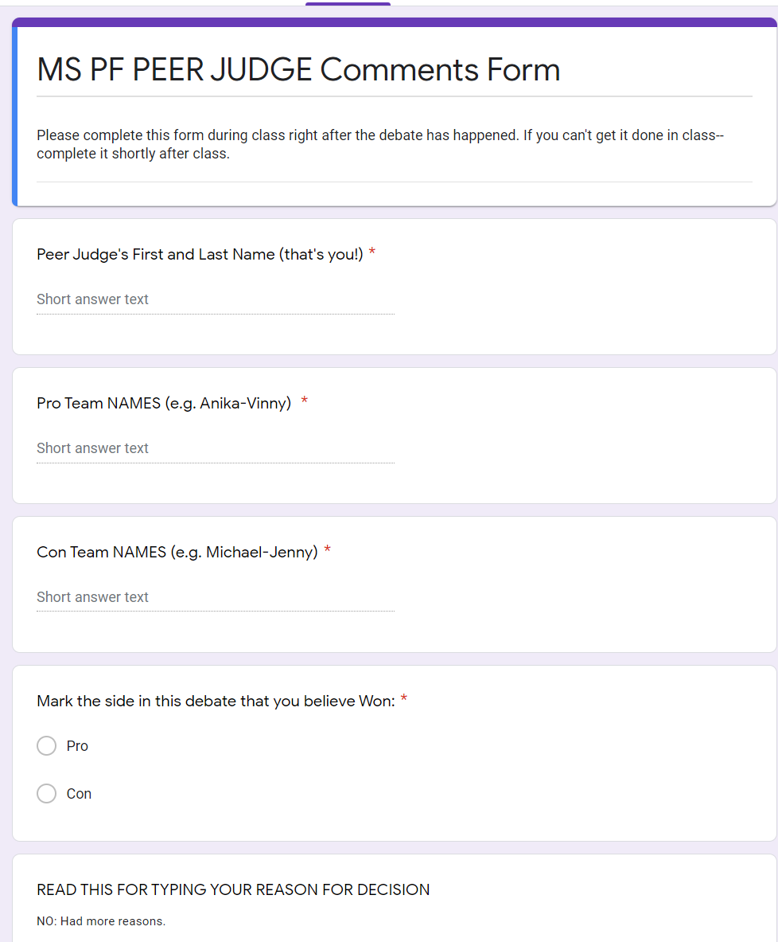
AFTER THE LAST SPEECH IN THE DEBATE:
Fill out the Peer Judge Comments Form
Your comments are HIGHLY PRIZED and really wanted
Please provide specific, detailed but concise feedback
You can also win an award for Best Peer Judging.

Slide 5
Making a decision
What topic specific argument convinced you to vote?
Pro wins better access for people with serious illnesses who need drugs--by having price caps.
What response convinced you to not vote for the losing team’s best arguments?
Con tried to say price caps reduce development of new drugs. Pro showed the caps would just stop high profits-not new drugs-and even if fewer drugs are developed--at least they are affordable.

Slide 6
EXAMPLES OF NOT SO GOOD/GOOD DECISIONS
NOT SO GOOD: “I voted pro because they had more arguments that were stronger.”
--which specific arguments? In what way were they stronger? Which responses convinced you to not vote for the losing team’s best argument?
GOOD JOB: “The pro showed drug prices would drop because of competition—that means more access for poor people and thus less disease. The con did have a good point on companies hurt by the price caps—but as the pro responded—they can handle the reduced profits and the companies are in some cases abusing the prices. So I voted pro.”

Slide 7
GIVING FEEDBACK TO DEBATERS
Give them Compliments!
You have a great voice!
Your response to the access contention was strong.
Give them Improvement Suggestions!
Practice reading more so you say it more fluently.
You should practice better responses in question and answer.
Improvement Comments show you care about the speaker!

Slide 8
EXAMPLES OF NOT SO GOOD/GOOD COMMENTS
NOT SO GOOD: “You were good but need to speak better.”
--what specifically was good? what aspect of speaking needs to be better? What should the debater do to speak better?
GOOD IMPROVE: “You have excellent rebuttals—directly answering each of their contention with evidence.”
GOOD IMPROVE: “You need to speak louder—push your voice to do that.”
GOOD IMPROVE: “You need a stronger impact to your price caps hurt companies argument. Show how that will affect employment, company’s ability to produce new drugs that can help people, etc.”

Slide 9
At the end of the debate . . .
Instructor/Judge will give feedback
During Redos . . . Peer Judges fill out the Peer Judge Online Form: https://tinyurl.com/x46w6mze

