Slide 1
Ld: follow the flow debate!
Jim Hanson

Slide 2
CLIMBING review
What is a Tag?
The main claim (point) of an argument.
What is Importance?
Shows why an argument matters.
What is a Contention?
Arguments supported by more arguments.

Slide 3
What is your ld topic?
Posted on the Camp web page
Resolved: _______________.
What do you think are good aff arguments?
Good neg arguments?
Thoughts on the topic?

Slide 4
YOUR AFF AND NEG CONTENTIONS
RIGHT NOW: YOU NEED ONE AFF AND ONE NEG CONTENTION
SEE YOUR SCRIPTS!
THEY ARE ON THE PREPARE SECTION ON THE CLIMB AFTERSCHOOL WEB PAGES
https://www.nwforensics.org/climb-program/high-school/index.htm
Tell each other your contentions.

Slide 5
DO YOU HAVE RESPONSES?
THINK ABOUT WHAT YOUR OPPONENT’S CONTENTION IS
WHAT RESPONSES WILL YOU MAKE?
NOW—ONE OF YOUR RESPONSES NEEDS A QUOTATION—DO YOU HAVE ONE?

Slide 6
DURING A DEBATE, YOU NEED TO TAKE notes . . .
FLOW THIS ARGUMENT . . .
When I say stop, you have to stop—drop your pen!

Slide 7
flowing better
Flow the tag/claim
Flow the source
Flow the support for the tagline/claim.
Example Flowed Argument
Climate Change causes wildfires
National Geographic 2020
Higher Temps, Lower Precipitation

Slide 8
ABBREVIATE
Shrtn wrds w/o vwls
Endgrd Spcs
Or just the first letters of longer words
Treat Dang Qual
Example Flowed Argument
Clmt Chng causes wldfrs
Nat Geog 2020
Hghr Tmps, Lower Precip

Slide 9
Shorthand
Endangered Species = ES
Zoos = Z
Increases = ↑
Solves = S
Example Flowed Argument
CC = wldfrs
Nat Geog 2020
↑Tmps, ↓ Precip
NOTICE: How much less you have to write!

Slide 10
EXAMPLE FLOWED ARGUMENT
Z hrt anmls
Jeffre ‘18
Z gv bad diet
Z too smll spc
Using abbreviations and shorthand . . .
TRY FLOWING AGAIN—FLOW THIS ARGUMENT

Slide 11
Now, it gets tougher!

Slide 12
Flowing WHEN RESPONDING
Create two columns
I will present an argument
You write responses to my argument in the second column
TRY IT . . .
How many responses did you get?
Argument
Responses

Slide 13
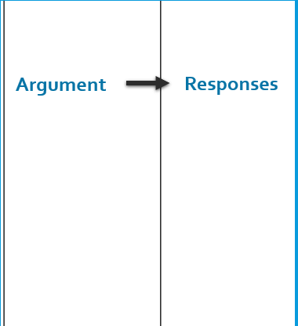
BETTER Flowing WHEN RESPONDING
Flow just the tag (claim)
Then spend 90% of your time writing your responses
LET’S TRY IT AGAIN.
I will present an argument—WRITE RESPONSES!
Now, how many responses did you write?
90%
10%

Slide 14
NOTE—THIS IS ABOUT TO GET COMPLICATED!
Flowing takes time to understand
It will probably make more sense after your second or third class
Feel free to ask questions
Just do your best to follow . . .

Slide 15
FLOWSHEETS
You MUST USE FLOWSHEETS for your debates
To follow the speakers in the order they present . . .
Aff Case | Neg Case & Responses | 1st Aff Rebuttal | Neg Rebuttal | 2nd Aff Rebuttal

Slide 16
You flow . . .
Your speeches
Your opponent’s speeches
You take notes on ALL the arguments in the debate!
YES—IT IS IRRITATING AT FIRST BUT . . .
YOU GET USED TO IT AND IT IS VERY IMPORTANT TO DOING DEBATE WELL.

Slide 17
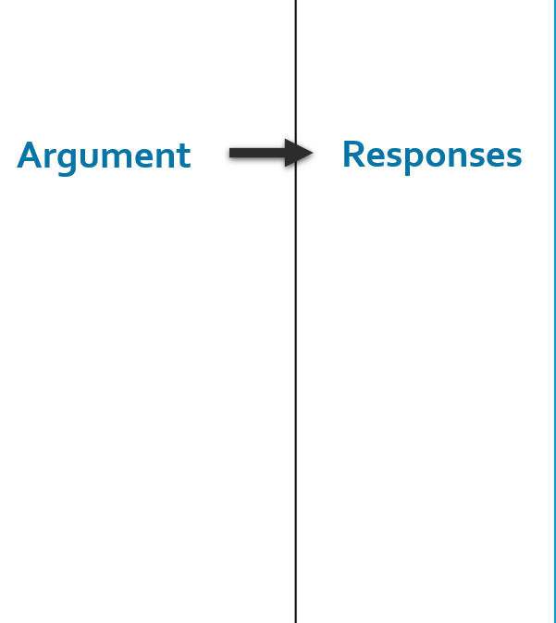
the idea behind flowsheets
You make a column to flow
For each speaker’s arguments
From left to right.
Rebuild
Etc.

Slide 18
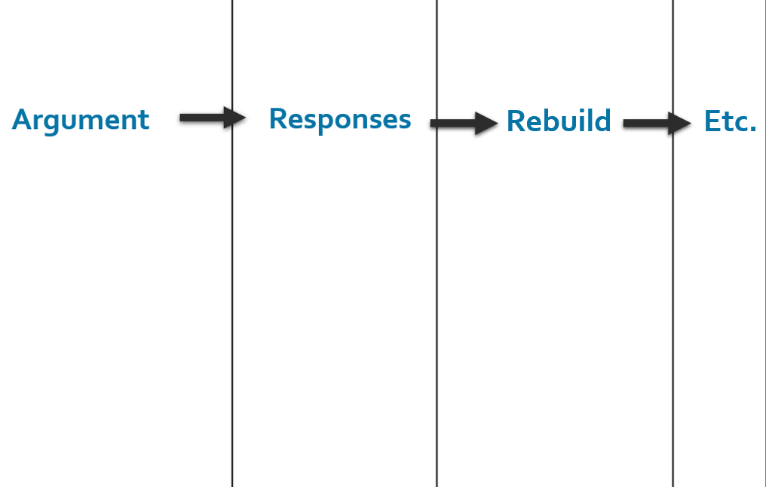
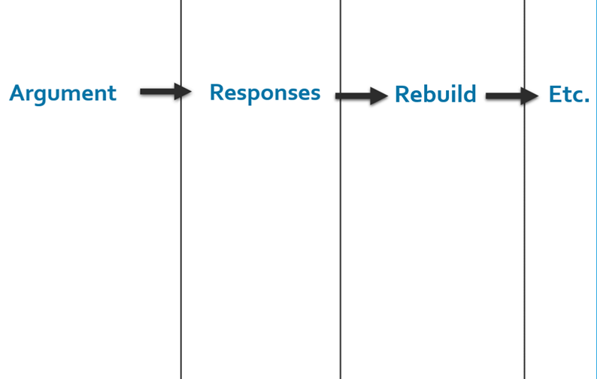
THE DEBATERS MAKE TWO FLOWSHEETS
One for Arguments and Responses about the Aff Case
One for Arguments and Responses about the Neg Case
Aff Case
Neg Case
Aff Case Flowsheet
Neg Case Flowsheet

Slide 19
AND THE FLOWSHEETS HAVE A COLUMN FOR EACH SPEECH IN THE DEBATE
1 AFF CASE: Present One Aff Contention (skip value-criteria)
1 NEG CASE: Present One Neg Contention (skip value criteria) and respond to the aff case
1 AFF REBUTTAL: Respond to the Neg Contention and Defend your Aff Contention.
NEG REBUTTAL: Show you won your Neg Contention and Defeated the Aff Contention (mostly no new arguments!)
2 AFF REBUTTAL: Show you won your Aff Contention and Defeated the Neg Contention (mostly no new arguments!).

Slide 20
In full Here are the two flowsheets . . .

Slide 21
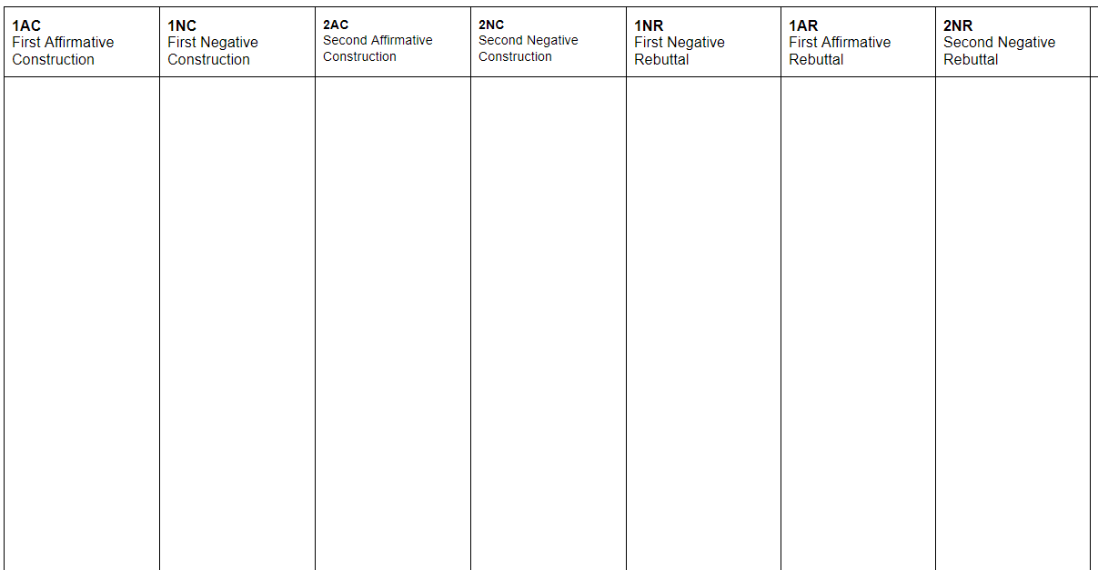
Aff-Case with contention(s)
Neg-Responses to the Aff contention(s)
1st Aff Rebuttal-Defend the Aff contention(s)
Neg Rebuttal
I defeated the Aff contention(s)
2nd Aff Rebuttal- I won the Aff contention(s)
Aff Case & Neg Responses Flowsheet
For Aff Case Contentions
And
Neg Responses to the Aff contentions

Slide 22
Neg-Case with contention(s)
--
1st Aff Rebuttal-
Responses to the Neg contention(s)
Negative Rebuttal-
I won the Neg contention(s)
2nd Aff Rebuttal-
I defeated the Neg Contentions
Neg Case & Aff Responses Flowsheet
For Neg Case Contentions
And
Aff Responses to the Neg contentions

Slide 23
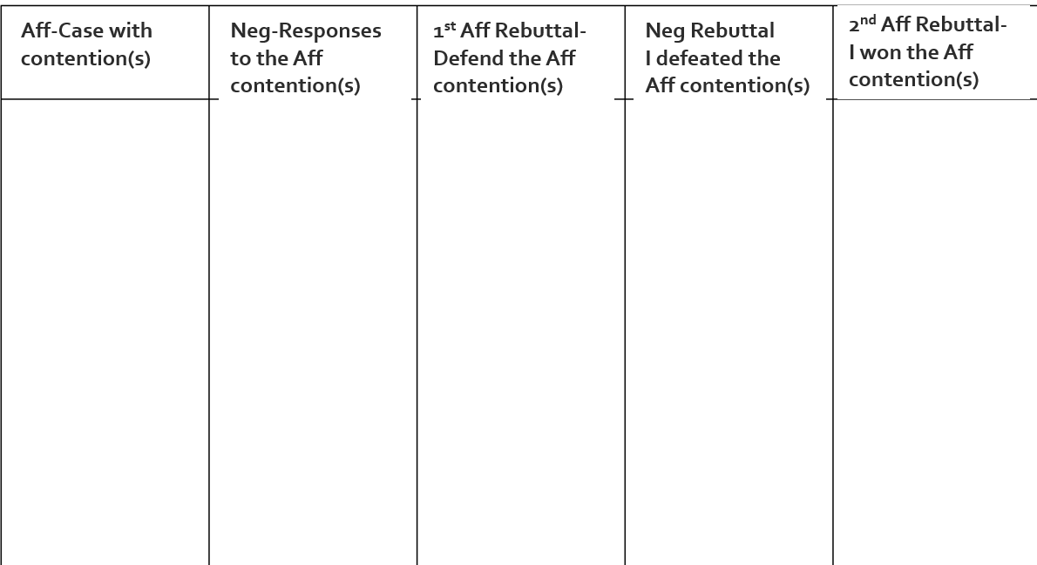
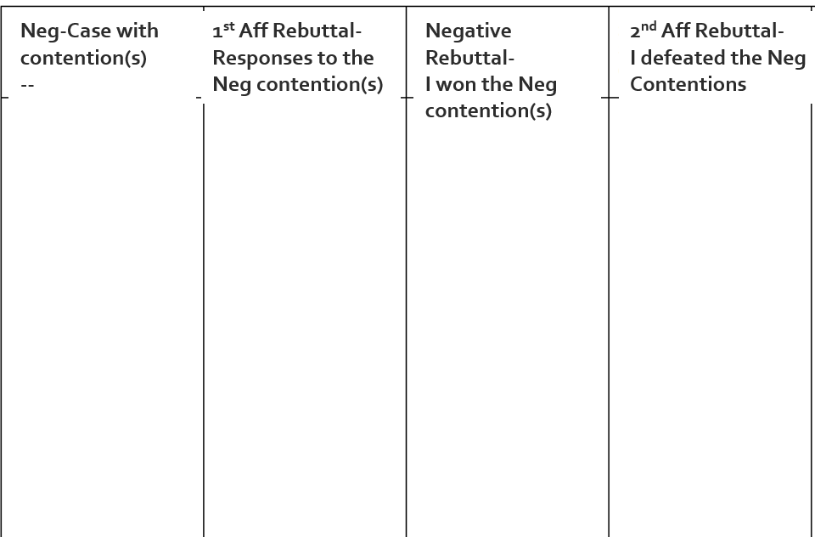
Now Prepare your own Flowsheets
Then, Show your Two Flowsheets to me.
Aff Case and Responses Flowsheet
Neg Case and Responses Flowsheet

Slide 24
LET’S PRETEND YOU ARE FLOWING A DEBATE . . .
So, in the coming slides . . .
for each speaker . . .
Show me where you think you take notes on which flowsheet.

Slide 25
1 Aff
Presents case
Where do you flow the 1 Aff speaker?
1. Zoos give animals too little space
2. Zoos don’t feed animals well

Slide 26
1 Neg
Presents case & Responds
Where do you flow the 1 Neg speaker?
1. Zoos give animals too little space
2. Zoos don’t feed animals well
1. Zoos now provide natural, large habitats
2. Zoos provide excellent care and food
1. Zoos protect and repair hurt animals
2. Zoos help endangered animals

Slide 27
Where do you flow the 1 Aff Rebuttal?
1 Aff Rebuttal
Responds to Neg Case
Defends Aff Case
1. Zoos give animals too little space
2. Zoos don’t feed animals well
1. Zoos now provide natural, large habitats
2. Zoos provide excellent care and food
1. Zoos new habitats are still too small
2. Zoo food and care is uneven—animals don’t eat well
1. Zoos protect and repair hurt animals
2. Zoos help endangered animals
1. Zoos help very few animals
2. Nature Reserves are better for endangeredanimals

Slide 28
Where do you flow the Neg Rebuttal?
Neg Rebuttal
I won Neg Case
I defeated Aff Case
1. Zoos give animals too little space
2. Zoos don’t feed animals well
1. Zoos now provide natural, large habitats
2. Zoos provide excellent care and food
1. Zoos new habitats are still too small
2. Zoo food and care is uneven—animals don’t eat well
1. I showed zoo habitats are more than good for animals
2. I showed Zoo food keeps animals in good care for years
1. Zoos protect and repair hurt animals
2. Zoos help endangered animals
1. Zoos help very few animals
2. Nature Reserves are better for endangeredanimals
1. I showed Zoos help thousands of animals
2. I showed Zoos and nature reserves can both help endangered animals

Slide 29
Where do you flow the 2nd Aff Rebuttal?
2nd Aff Rebuttal
I defeated Neg Case
I won Aff Case
1. Zoos give animals too little space
2. Zoos don’t feed animals well
1. Zoos now provide natural, large habitats
2. Zoos provide excellent care and food
1. Zoos new habitats are still too small
2. Zoo food and care is uneven—animals don’t eat well
1. Zoos habitats are more than good for animals
2. Zoo food keeps animals in good care for years
1. I showed Zoos too small
2. I showed Zoo food and care is not good
1. Zoos protect and repair hurt animals
2. Zoos help endangered animals
1. Zoos help very few animals
2. Nature Reserves are better for endangeredanimals
1. I showed Zoos don’t help enough
2. I showed Nature reserves are better
1. Zoos help thousands of animals
2. Zoos and nature reserves can both help endangered animals

Slide 30
LET’S DO OUR OWN FOLLOW THE FLOW DEBATE
I need an Aff Debater
I need a Neg Debater

Slide 31
WHAT DO EACH OF YOU DO TO PREPARE FOR YOUR DEBATE?
BE READY WITH YOUR CONTENTION
BE READY WITH YOUR RESPONSES.

Slide 32
DEBATERS: PRE-FLOW YOUR CONTENTION
Pre-Flowing means to write notes before you speak.

Slide 33
1. SHOW YOUR FLOWSHEET!
Aff Case Flowsheet
Neg Case Flowsheet

Slide 34
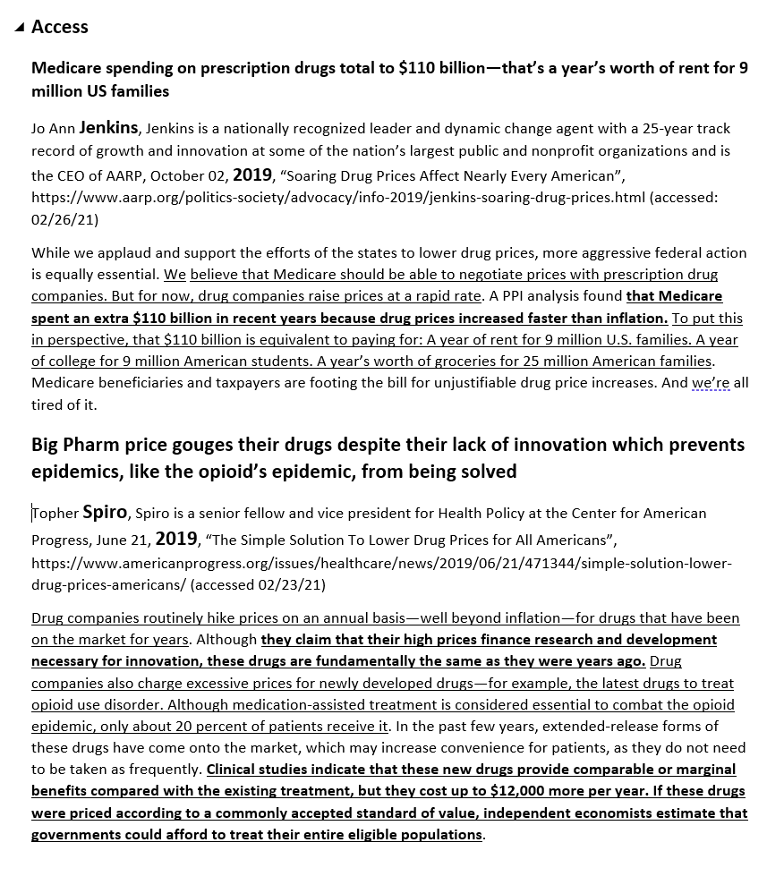
2. SHOW YOUR CASES AND REBUTTALS!

Slide 35
DO A SHORT LD DEBATE! USING FLOWSHEETS AND SCRIPTS.
2 to 2.5 minute speeches
1 AFF CASE: Present One Aff Contention (skip value-criteria)
1 NEG CASE: Present One Neg Contention (skip value criteria) and respond to the aff case
1 AFF REBUTTAL: Respond to the Neg Contention and Defend your Aff Contention.
NEG REBUTTAL: Show you won your Neg Contention and Defeated the Aff Contention (mostly no new arguments!)
2 AFF REBUTTAL: Show you won your Aff Contention and Defeated the Neg Contention (mostly no new arguments!).

Slide 36
1 AFF PRESENT YOUR AFF CONTENTION
while NEG—FLOW YOUR RESPONSES: 90%!
Read your Contention
You read the bolded words.

Slide 37
1 NEG PRESENT YOUR CONTENTION AND RESPONSES TO THE AFF CONTENTION
While AFF—FLOW YOUR RESPONSES: 90%!
“Against the Aff Contention . . .” (respond)
Read your Contention
You read the bolded words.

Slide 38
1 AFF REBUTTAL RESPOND TO NEG CASE AND DEFEND AFF CASE
While NEG PREPS RESPONSES: 90%!
“Against their __________ Contention” (respond)
My aff contention ____ still stands (respond to neg args and defend your contention)

Slide 39
NEG REBUTTAL SHOW YOU WON NEG CASE AND DEFEATED AFF CASE
While AFF PREPS RESPONSES: 90%!
My Name is _____________
“I won our contention because I showed _____”
“I defeated the Aff contention because I showed _____”

Slide 40
2 AFF REBUTTAL SHOW YOU WON AFF CASE AND DEFEATED NEG CASE
My Name is _____________
“I won the aff contention because I showed _____”
“I defeated the neg contention because I showed _____”

Slide 41
CONGRATS—YOU JUST DID YOUR FIRST REAL DEBATE!
CONFUSED SOME? AGAIN—TAKES PRACTICE TO GET USED TO IT
TIME ENOUGH—HAVE OTHER DEBATERS DEBATE NOW—SAME SETUP.

Slide 42
NEXT CLASS SESSION
WE’LL DISCUSS VALUE-CRITERIA
YOU’LL DO A LONGER FOLLOW THE FLOW DEBATE
THAT WILL BE ALMOST LIKE A REAL DEBATE
GET READY TO ARGUE LIKE THE BEST HIGH SCHOOL DEBATERS!

