Slide 1
Let’s GET STARTED IN debate!
Jim Hanson

Slide 2
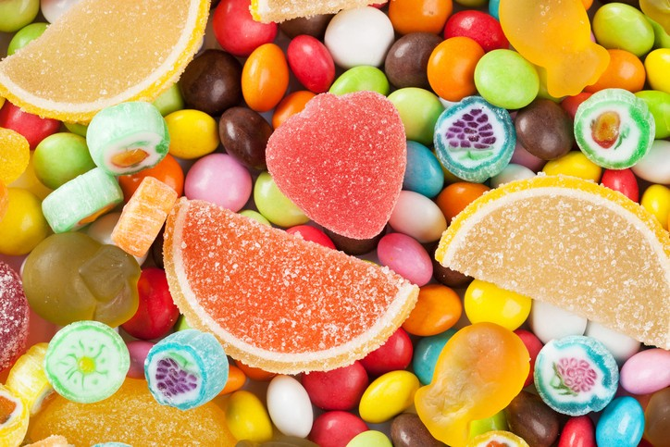
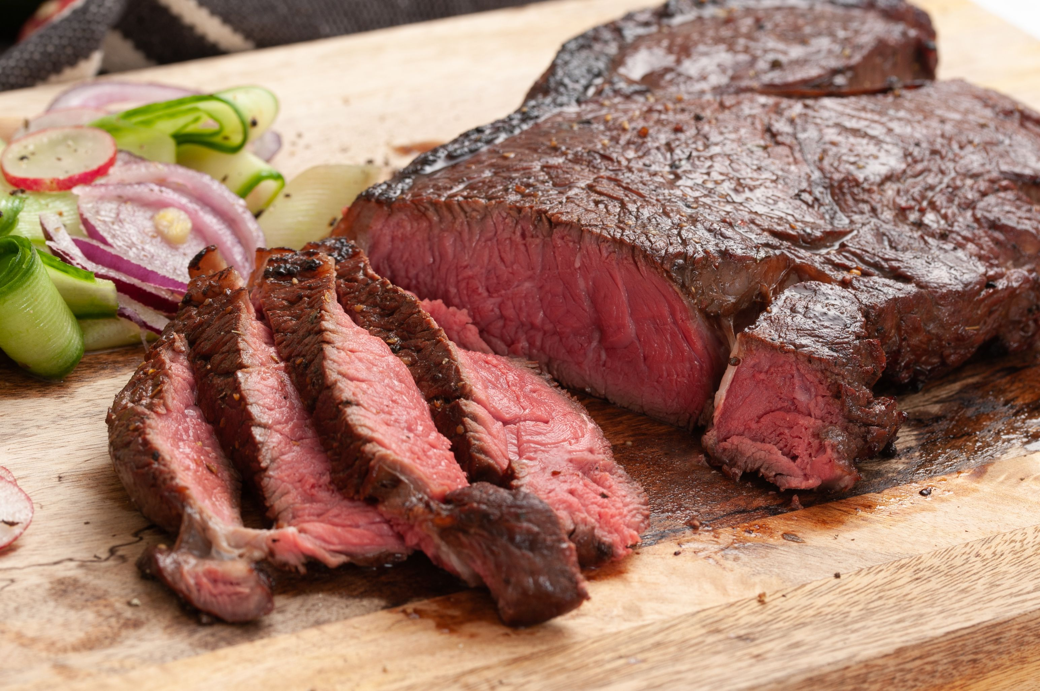
Do you like the food showN?

Slide 3
We have our opinions
We are working together
We don’t completely agree with each other
We are a team and we support each other
Share your name
Pronoun/anything important if you wish to share
Your favorite game.

Slide 4
Making A basic argument
Claim (the main point)
Support (reasons for the claim)
Bananas are a great food.
They are delicious and healthy with lots of potassium.

Slide 5
Ready to make an argument about . . .
The best hobby?
School Start Time too early?
The best Video Game?
Something else?
Prepare your own argument
With Claim (1 sentence) and Support (1 to 2 sentences).

Slide 6
Two people share your argument to the class . . .
Claim (main point)
Support (reasons for the claim)
Debate isn’t just giving an argument . . .

Slide 7
Debate involves respectful disagreement
When a debater says steak is the best food . . .
You can argue . . .
“Steak is NOT that good tasting.”
“Steak means harming animals—that’s not the best.”
“Sushi is more delicious.”

Slide 8
Now . . . I disagree game
One person presents their argument
The other person then says “I disagree because ____________”
We’ll go through everyone
You give an argument, you respond to an argument.

Slide 9
Now . . . It’s time for . . .
The World’s most important debate topic . . .

Slide 10
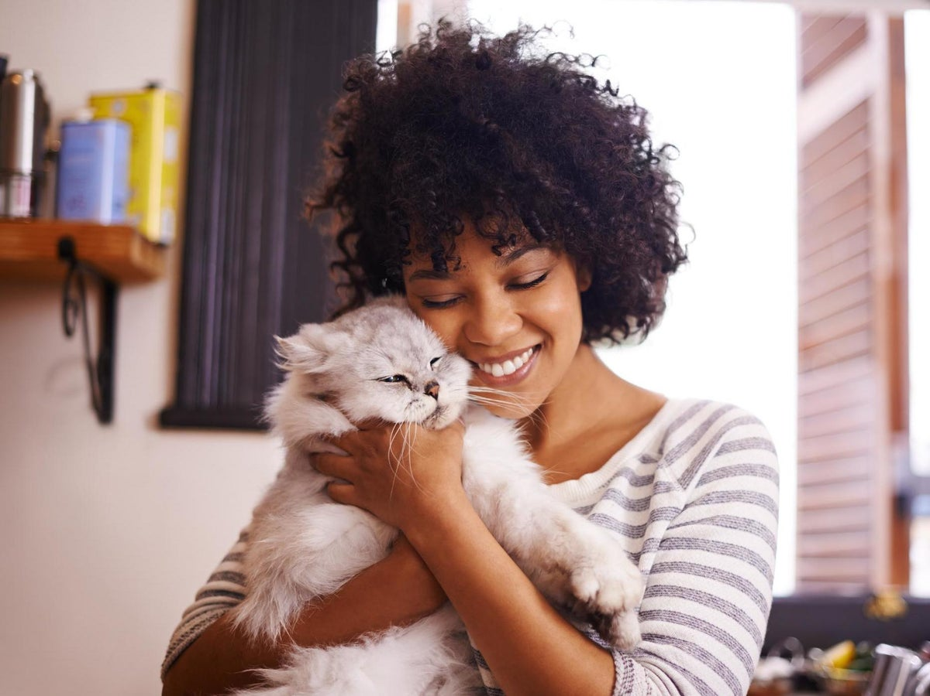
Dogs or cats?
Some people love dogs
Some people love cats

Slide 11
Some people don’t like either

Slide 12
TOPIC: dogs are better than cats
One side is Affirmative—and favors the topic.
THE AFF ON THIS TOPIC IS FOR DOGS
The other side is Negative—and is against the topic
THE NEG ON THIS TOPIC IS FOR CATS.

Slide 13
TOPIC: dogs are better than cats
Pick now which side you will be on
Sometimes, you don’t get your preferred choice.

Slide 14
TOPIC: dogs are better than cats
AFF FIRST SPEAKER prepare an argument (Claim-Support) for the topic
OTHER AFF SPEAKERS be ready to disagree with arguments the con might present and to defend the first speaker’s argument
NEG FIRST SPEAKER prepare an argument (Claim-Support) for the topic
OTHER NEG SPEAKERS be ready to disagree with arguments the pro might present and to defend the first speaker’s argument
EACH SPEAKER GETS APPROX. 45 SECONDS TO SPEAK--SHORT.

Slide 15
NOW: MINI-DEBATE
45 second Aff Speech (present your argument using Claim-Support)
45 second Neg Speech (present your argument using Claim-Support)
45 second Additional Aff Speeches (respond to the neg arguments and defend your aff speech argument)
45 second Additional Neg Speeches (defend your neg speech argument and respond again to the aff arguments)

Slide 16
How did it go?

Slide 17
You will be doing LINCOLN DOUGLAS debate
This debate format is used throughout the USA
It features one person debating another person
It focuses on well researched arguments
And delves into a topic deeply.

Slide 18
Documented Arguments in LD debate
Tag (Claim)
Source (Citation)
Evidence (Quotation)
Importance (Impact)
Student don’t forget lessons with Year Round Schools
Grace Chen, educator and researcher, April 06, 2018
Students forget knowledge and skills they acquired during the previous academic year. Several studies support this notion, as children show losses in math and language arts knowledge over the long summer break. . . . (Y)ear-round school increases retention rates, as students in year-round schools have demonstrated higher scores on some standardized tests.
So, year round school helps learning.

Slide 19
TRY IT!
Check out the quotation on the next page . . .
Add a tag/claim which is
4 to 9 word complete (noun and verb) sentence
that says what the evidence says (often using words in the quotation itself)
Then show us your work.

Slide 20
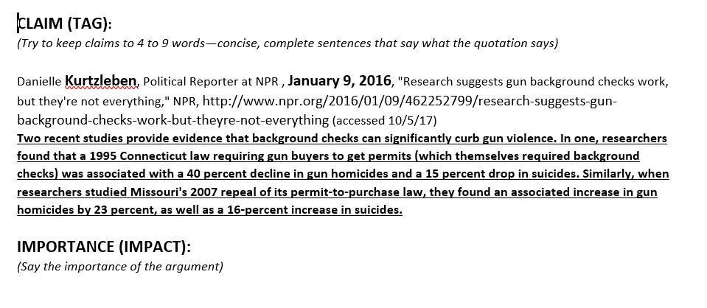
TAG IT! 4 TO 9 WORD SENTENCE THAT ACCURATELY SUMS UP THE EVIDENCE
What did you get?

Slide 21
NOW IMPACT IT—WHAT MAIN POINT DOES IT PROVE?
What is the importance?

Slide 22
Analysis Arguments in ld debate
Claim
Support (Warrant)
Importance (Impact)
Year Long Schooling makes school less stressful
It means not cramming everything in 9 nearly non-stop months; instead, you get 9 weeks of classes and then a 3 week break four times a year
That’s important to get time off and reduce school stress

Slide 23
TRY IT!
Give a logical argument for why background checks would be good (or bad)
Include a Claim, Support, Importance
What did you get?

Slide 24
INDIVIDUAL ARGUMENTS ARE GREAT . . .
But when you want to make a convincing case to your judge (who decides who wins a debate!) . . .

Slide 25
You need CONTENTIONS
Contentions are arguments supported by arguments
They make a persuasive case for your side of the topic
The topic you are debating is ___________ (see climb web page).
.

Slide 26
AFF CONTENTIONS
PROBLEM-Show a problem exists
THE TOPIC SOLVES-Show the topic solves
IMPACT-Show solving the problem helps people a lot
PROBLEM-20 minute lunch time is too short
THE TOPIC SOLVES-40 minute lunch gives enough time
IMPACT-Longer lunch reduces stress and upset stomachs from eating too fast.
Now you Do it on the Topic!

Slide 27
NEG CONTENTIONS
LINK-THE TOPIC CAUSES OR INCREASES A PROBLEM
IMPACT-Show this problem would hurt people a lot.
LINK-Longer lunch means shorter classes
IMPACT-Shorter classes mean less learning and more stress before tests.
Now you Do it on the Topic!

Slide 28
Check out the SCRIPTS WITH TOPIC ARGUMENTS
IT IS IN THE CLIMB HS LD PREPARE WEB PAGE
https://www.nwforensics.org/climb-program/high-school/index.htm
BOOKMARK/FAVORITE THAT WEB PAGE. You will go back to that page over and over during our program.

Slide 29
Check out the SCRIPTS WITH TOPIC ARGUMENTS
https://tinyurl.com/climb-afterschool-hs
Everybody confirm you are there!
Pick an Aff Contention
Pick a Neg Contention
Tell each other your contentions
Get your responses.

Slide 30
You need RESPONSES
You need documented responses to your opponents’ contentions
Check out the responses in the evidence packet
When you respond you use analysis and documented arguments
1 minimum analysis, 2 minimum documented against each main opponent argument.

Slide 31
TIME FOR IT? SHORT CONTENTION AND RESPONSES
One Student: Present a Aff Contention
Another Student: Present 2 or 3 Neg Responses
Rest of the Students: Judge—which is the stronger argument on this contention?
--are students reading the source citations and quotation right (bold-highlighted parts)?
--are students presenting the tag then the source then quotation then the importance?
Student Judges—Which side do you vote for? What is the specific argument that convinces you?

Slide 32
BUIDLING TOWARD YOUR DEBATES
You have scripts for the pro and con—with cases (contentions) and responses
YES—you can and should do your own research as well
You will learn more about good arguments
You will engage in debating
At a higher level of knowledge!

Slide 33
WE WANT YOU TO DEBATE!
WE WANT YOU TO ATTEND THE HIGH SCHOOL TOURNAMENTS!
You’ll debate other high schoolers
Meet some great people
Really improve your speaking and debating!
The next tournament is _______________.

