Slide 2
TOPIC OVERVIEW

Slide 3
THE TOPIC IS Students should be allowed to bring cell phones to K-12 schools.

Slide 4
Why this topic?
Some people believe phones help kids research and learn (Pro)
Some people believe phones are distracting and hurt education (Con)

Slide 5
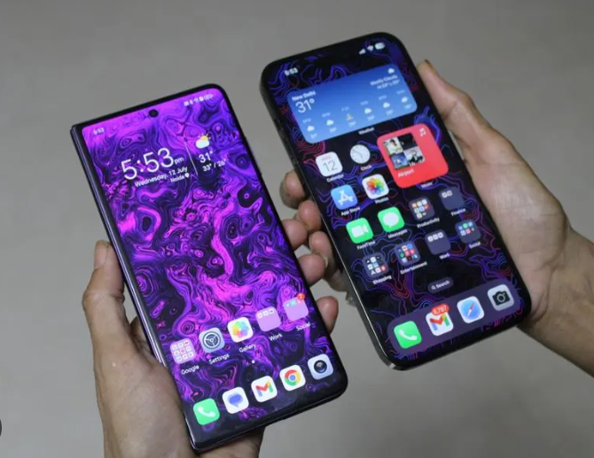
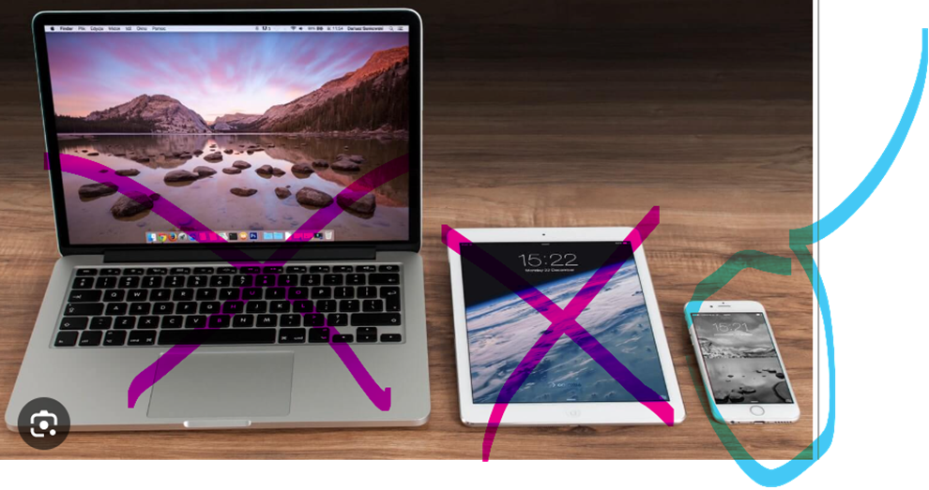
What is the Topic?
K-12 Schools Obviously, not Colleges. Elementary, Middle, and High Schools.
Cell Phones You know them and that does not include tablets or computers
Allowed to give permission for someone to do something.

Slide 6
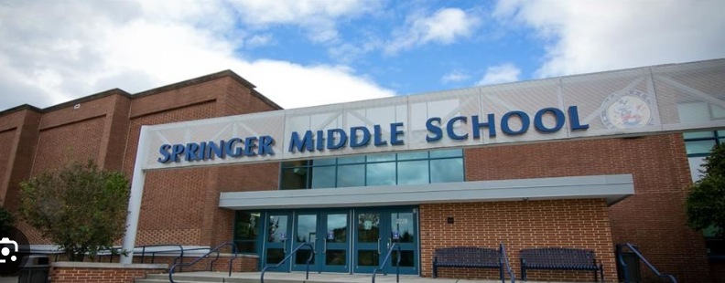
One more thing on the Topic . . .
Cell Phones should be allowed in schools – the topic does not cover usage OUTSIDE of school.

Slide 7
What are school policies on cell phone use?
Elaine Povich, StateLine

Slide 8
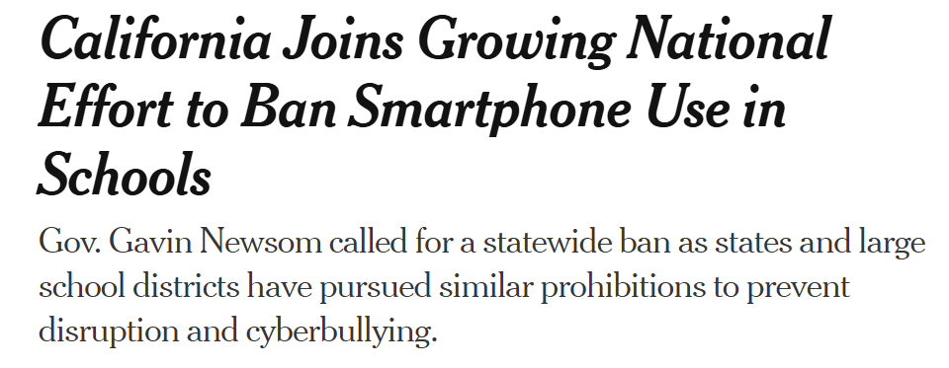
The New York Times says . . .

