Slide 1
Get ready, go!
Jim Hanson

Slide 2
Instructor timeline
TOPIC OVERVIEW ON THE NEW TOPIC (SEPARATE POWERPOINT) 10 MINUTES
PREPARE CASE SPEECHES 20 MINUTES
PREPARE RESPONSE SPEECHES 20 MINUTES
DO A CASE AND RESPONSE DEBATE 30 MINUTES
FINISH UP 5 MINUTES.

Slide 3
Preparing the CASE speeches
Starting with . . .

Slide 4
WHAT ARE PRO ARGUMENTS FOR THE TOPIC?
Arg 1
Arg 2

Slide 5
LET’S DEVELOP A PRO ARGUMENT AND MAKE IT A CONTENTION!
As you hopefully remember . . .
PRO Contentions make these three arguments:
Show there is a Problem
Students can’t look up information
Show the Topic Solves the Problem
Allowing cell phones gives students a chance to look up information
Show the harms/impact of the Problem
Not being able to look up information hurts kids’ knowledge, education and growth

Slide 6
WE NEED MORE TO MAKE A GOOD CONTENTION . . .
THIS IS A GOOD PRO CONTENTION:
--Students can’t look up information
--Allowing cell phones gives students a chance to look up information
--Not being able to look up information hurts kids’ knowledge, education and growth
BUT IT LACKS DEPTH AND SUPPORT
We need to give evidence and reasons!
WE NEED TO DO SOME RESEARCH!

Slide 7
RESEARCHING IS NOT EASY
Over time, you will get better and better
And have an amazing skill that will give you a HUGE heads up over others
This will help you whether you are Pro or Con
Here’s how to do it . . .

Slide 8
SEARCH FOR AN ARGUMENt
Go to Google (or Bing etc.)
Don’t just type in the topic e.g. “Cell Phones”
Instead type in words from your argument
Example: You are looking for “Cell Phones help research”
Type in: Cell Phones Help Research in School
What did you find?

Slide 9
USE QUALITY SOURCES
Use reputable sources! (Time, CNN, academic studies, etc.)
DO NOT use social media (Facebook, Instagram, TikTok, X, etc.) – this information isn’t fact checked; so it is not reliable.
In most cases, try to use recent information (usually no older than 4 or 5 years old).

Slide 10
USING WHAT YOU FIND
On your script, Make your argument
Then, include a citation/source
Author, qualifications, Date
Followed by the reasons/facts provided in the article.

Slide 11
NOW YOU DO IT!
PRO DEBATERS
Look up “Restaurant meals too much sodium”
Look up “Home cooked meals have less sodium”
Look up “Sodium harms people’s health (blood pressure, kidneys).”
CON DEBATERS
Look up “Some homes have bad cooking”
Look up “Restaurant food is better tasting”
Look up “Bad cooking hurts desire to eat and thus is unhealthy.”
WHAT DID YOU GET? (each student should provide one source citation support)

Slide 12
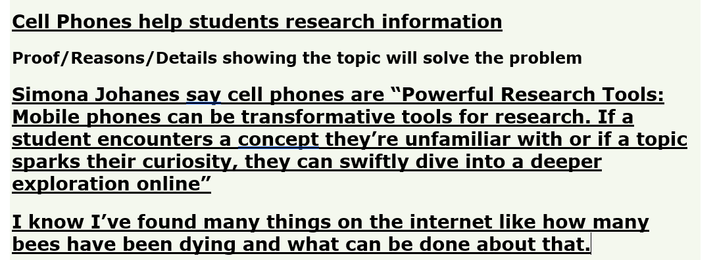
YOU CAN AND SHOULD ADD IN YOUR OWN REASONS!
Include your own reasons, experiences, your own logic.
Example is from Cell Phone topic.
.
IF YOU DON’T HAVE A CITED INFORMATION OR A GOOD REASON FOR EACH PART OF YOUR CONTENTION—YOU LIKELY HAVE A WEAK ARGUMENT.

Slide 13
EACH PRO DEBATER CHOOSES THE PRO CONTENTION THEY WANT TO DO
Open up the Case Helper File on the Elementary Student Prep Page AND have your Script ready to fill out.
We need a Pro Debater to do a Pro Contention on . .
(see Prep Helper Packet on the topic)
Who is doing which?

Slide 14
NOW—PREPARE YOUR PRO CONTENTION!
USE YOUR SCRIPT AND INCLUDE
Problem
Topic Solves Problem
Impact of the Problem
Use Sources
Use your own Reasons
We will work to get our cases done! I am here to help you, and we are here to help each other!

Slide 15
EACH CON DEBATER CHOOSES THE CON CONTENTION THEY WANT TO DO
Open up the Case Helper File on the Elementary Student Prep Page AND have your Script ready to fill out.
We need a Con Debater to do 1 Con Contention on . .
(see Prep Helper Packet on the topic)
Who is doing which?

Slide 16
NOW—PREPARE YOUR CON CONTENTION!
USE YOUR SCRIPT AND INCLUDE
Current situation is okay/fine
Topic Causes/Increases Problem
Impact of the Problem
Use Sources
Use your own Reasons
We will work to get our cases done! I am here to help you, and we are here to help each other!

Slide 17
LET’S HEAR . . .
ONE PRO CONTENTION
ONE CON CONTENTION.

Slide 18
Preparing the response speeches
Starting with . . .

Slide 19
You can and should prepare responses before you debate
If you are Con-what Pro Arguments will they make?
--List them out
FOR MOST DEBATES, YOU SHOULD HAVE 2 OR 3 RESPONSES READY FOR EACH OF THESE ARGUMENTS
Next Slides have examples of weak responses on the cell phone topic that can be better . . .

Slide 20
AVOID WEAK responses!
“Phones aren’t helpful.” (debater stops and moves on to a different argument)
WHAT IS WRONG WITH THIS ARGUMENT?
--No reason or evidence support.
“Phones can be used for good things too”
WHAT IS WRONG WITH THAT AS A RESPONSE?
That isn’t a response—that is shifting to another issue.

Slide 21
AVOID WEAK responses!
“Phones are used in just some cases to help research.”
WHAT IS WRONG WITH THIS ARGUMENT?
--You have mostly admitted they do help research.
INSTEAD . . .

Slide 22
Have good responses!
THE BEST WAY TO RESPOND TO MOST ARGUMENTS IS TO SAY THE OPPOSITE
“Cell Phones do NOT provide good research tools” followed by reasons/evidence.
YOU CAN ALSO POINT OUT A BETTER WAY . . .
“School laptops/tablets are better for research” followed by reasons/evidence.

Slide 23
Have good responses!
YOU CAN ALSO MINIMIZE THE ARGUMENT
“Most kids mess around with their phones and they don’t research nor learn on them” followed by reasons/evidence.
PREPARE RESPONSES LIKE THAT.

Slide 24
LET’S HEAR THE CONTENTIONS THAT YOU WILL RESPOND TO . . .
1ST Speakers: WHAT ARE YOUR CONTENTIONS?
--opposite side 1ST debater—prepare against the other 1’s contention
2nd Speakers: WHAT ARE YOUR CONTENTIONS
--opposite side 2ND debater—prepare against the other 2’s contention
3rd Speakers: WHAT ARE YOUR CONTENTIONS
--opposite side 3RD debater—prepare against the other 3’s contention

Slide 25
What responses did you come up with?
Each debater—share one response (in 1-2 sentences).
Instructor—give feedback on the quality of the response.

Slide 26
DURING A DEBATE
You have to use and present your responses along with any you can think of on the spot . . .

Slide 27
When you hear their contention, write it on your script!
Remember to abbreviate and shorthand what they say
AND . . .
Spend 90% of your time writing out your responses.

Slide 28
When you hear their contention, write it on your script!

Slide 29
When you GET UP TO SPEAK—YOU PRESENT . . . .
USE YOUR SCRIPT
My opponent argued cell phones cause cyberbullying.
My first response is . . . (use your script)

Slide 30
Let’s do a case and response debate!
USE YOUR CASE AND RESPONSE SCRIPTS and the RESPONSES YOU PREPARED
You’ll present your case, take ONE question, and you’ll ask your opponent ONE question, and you’ll respond to your opponent’s case.
I (your instructor) will give you help and feedback for each speech.

Slide 31
IF YOU HAVE TIME YOU COULD . . .

Slide 32
HOW TO MAKE YOUR SEARCHES EVEN BETTER
“Cell Phones Bullying” is a good search
BUT sometimes using synonyms can help!
A synonym is a word that has a meaning very close to another word’s meaning
EXAMPLE: “Mobile Phone” is a synonym to “Cell Phone”

Slide 33
HOW TO do synonyms
EXAMPLE: Cell Phone Mobile Phone Bully Cyberbully Intimidate Abuse
Tip 1: Type the word into MS Word/Google Docs, right click the word, Synonyms (MS Word) or Define (Google) and look for synonyms.
EXAMPLE: Cell Phone synonym is Telephone
Tip 2: Think: How would you word a sentence that made your argument? Use those words in your search
EXAMPLE: “Some students use Cell Phones to be mean.”
Add the word “mean” into your search.
What did you find?

