Slide 1
TAKING NOTES DEFENDING YOUR ARGUMENTS WEIGHING ARGUMENTS SET TEAMS AND BEGIN PREPARING FOR NEXT WEEK
Jim Hanson

Slide 2
instructors
Taking notes: 20 minutes (reminder, the kids mostly flow using their scripts)
Defending your Arguments: 20 minutes
Weighing Arguments: 20 minutes
Set teams and begin prepare for next class: 15 minutes.

Slide 3
LET’S GET STARTED . . .
How are you doing?
You should get your script from last class with your first and second speeches
We are going to finish the rest of this debate using the scripts.

Slide 4
Taking notes

Slide 5
WHEN A DEBATER PRESENTS AN ARGUMENT, YOU Take notes . . .
TAKING NOTES IN DEBATE IS CALLED. . .
FLOWING
FLOW MY ARGUMENT . . .
When I say stop, you have to stop—drop your pen!
Instructor present argument at normal speaking rate then say stop!
What did you write down?

Slide 6
flowing better
Flow the Claim
Flow the support.
Example Flowed Argument on a Zoos topic
Zoos save animals
Zoos protect hurt injured animals and allow animal to engage in breeding

Slide 7
ABBREVIATE
Shrtn wrds w/o vwls
Endgrd Spcs
Or just the first letters of longer words
Treat Dang Qual
Example Flowed Argument
Zs sv anmls
Prtct hrt anmls, allw brding

Slide 8
Shorthand
Endangered Species = ES
Zoos = Z
Increases =
Solves = S
Example Flowed Argument
Z sv A
Prtct hrt A, allw brding
NOTICE: How much less you have to write!

Slide 9
EXAMPLE FLOWED ARGUMENT
Z hrt A
Z gv bad diet
Z too smll spc
TRY FLOWING AGAIN—Here is another argument.

Slide 10
Now—let’s do it real!
Someone present their SHOULD BAN CELL PHONES argument
Flow it!

Slide 11
Now, it gets tougher!

Slide 12
Flowing WHEN RESPONDING
Create two columns
I will present an argument
You write responses (disagrees)
TRY IT . . .
How many responses did you flow?
Argument
Responses

Slide 13
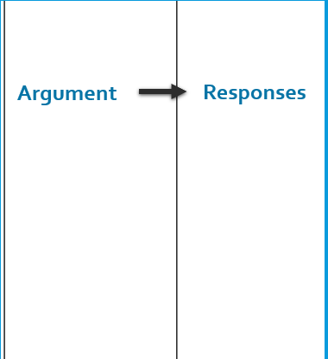
BETTER Flowing WHEN RESPONDING
Flow just the assertion
Then spend 90% of your time writing your responses
TRY IT AGAIN.
I’ll will present an argument—WRITE RESPONSES!
How many responses did you get this time?
90%
10%

Slide 14
Now—let’s do it real!
Someone present their Should NOT Ban argument
Flow your Responses!
How many Responses did you get?
Who’s willing to present their responses?

Slide 15
You flow . . .
ALL the arguments in the debate!
YES—IRRITATING AT FIRST BUT . . .
YOU GET USED TO IT AND YOU BENEFIT.

Slide 16
TAKE A LOOK AT YOUR SCRIPT
For YOUR arguments and responses to your arguments, use your scripts
For OTHER arguments, use the Flowsheet
Taking these notes—Flowing—will help you keep track of all the arguments in the debate
That way, you’ll do your best debating.

Slide 17
Defending your arguments

Slide 18
HOW THIS WORKS . . .
You presented your case in your first speech
Your opponent responded
Now—you need to defend your case against those responses.

Slide 19
THIS IS HARD . . .
You need to . . .
Remind the judge of your argument
Respond to their responses
Show what is still true about your argument and why that matters.

Slide 20
EXAMPLE . . .
In your first speech, you argued that “cell phones are needed in emergencies”
Your opponent responded that students can just tell a teacher
DEFEND YOUR ARGUMENT . . .
And No AI use for this—you have to use your own thinking.

Slide 21
EXAMPLE . . .
Remind the judge of your argument
“I SHOWED CELL PHONES ARE NEEDED IN EMERGENCIES”
Respond to their responses
“THEY SAID STUDENTS CAN TELL A TEACHER. BUT, WHAT IF A TEACHER ISN’T THERE? WHAT IF THE EMERGENCY INVOLVES YOUR PARENT? STUDENTS NEED A PHONE!”
Show what is still true about your argument and why that matters.
“SO PHONES ARE STILL NEEDED FOR EMERGENCIES WHEN TEACHERS AREN’T AVAILABLE.”

Slide 22
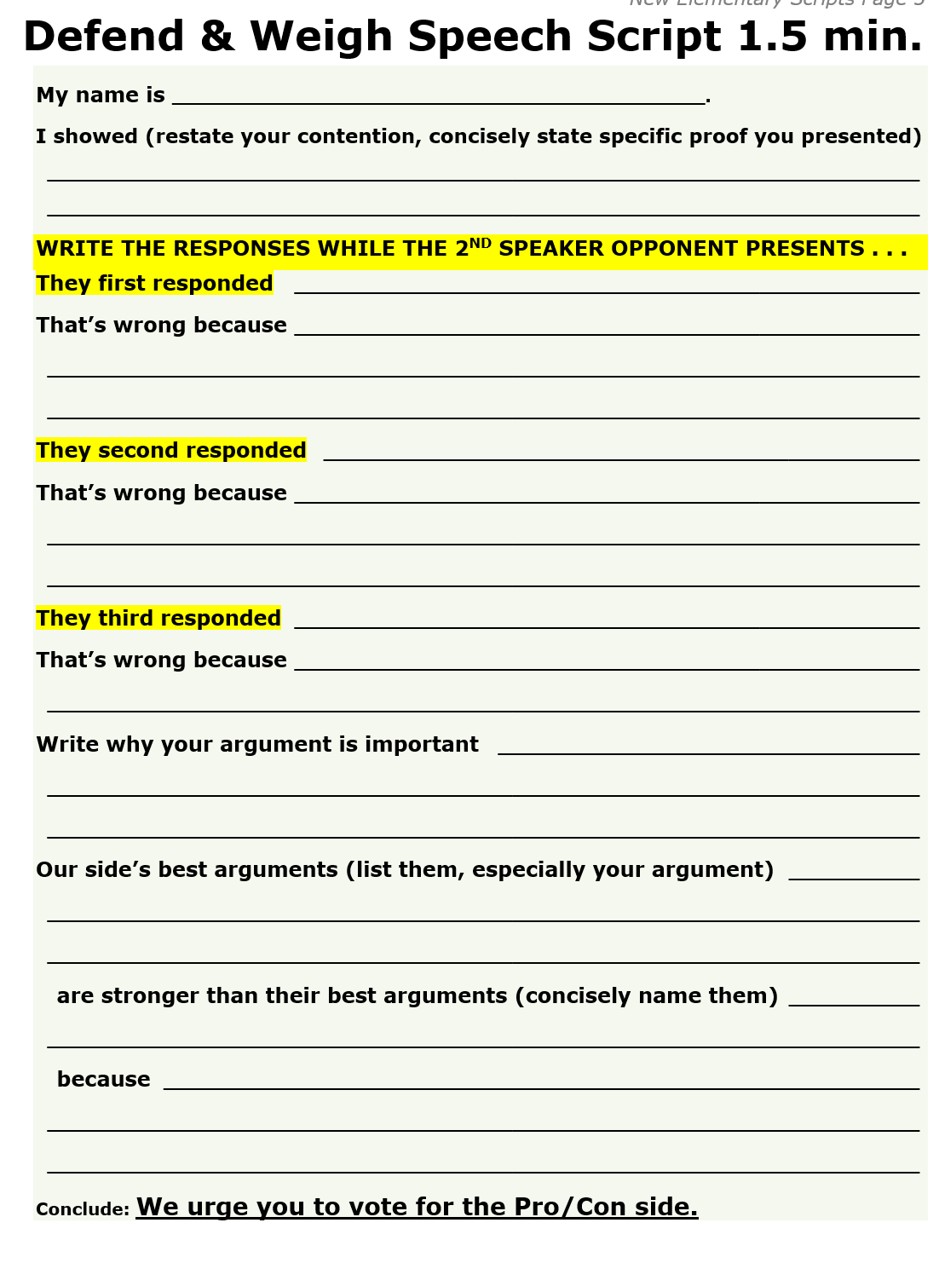
So, now prepare using your script
Get your Defend and Weigh Script
Prepare your defense of your case speech
You have 6 minutes now to write your responses to their responses.

Slide 23
Now, DEFEND using your script

Slide 24
Weighing arguments—show why you win
In the last 30 seconds of your Defend and Weigh speech, you’ll weigh the arguments in the debate.

Slide 25
HOW TO WEIGH IN YOUR DEBATE
You look at all the arguments presented in the debate (this is why you flow all the arguments)
You explain why your arguments and responses are stronger
And thus the judge should vote for your side.

Slide 26
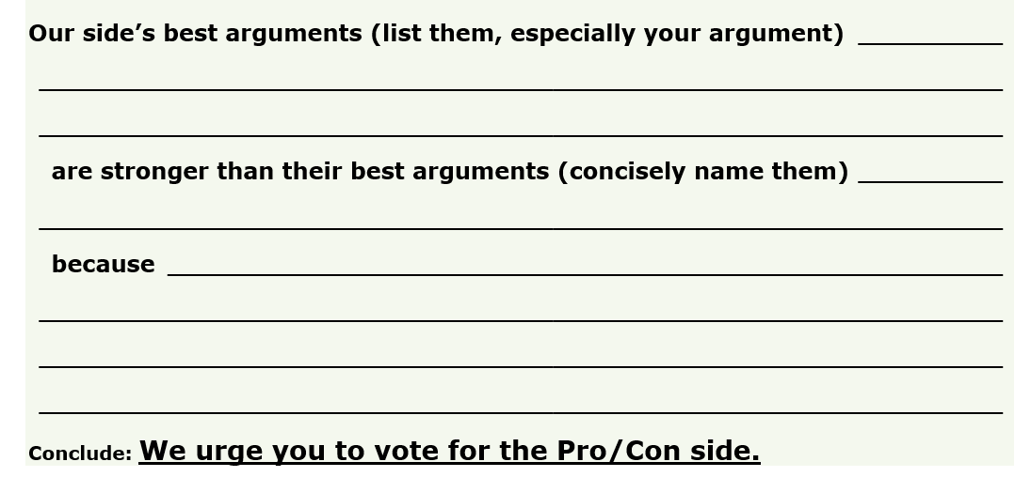
What you do . . .
On the last part of the Defend and Weigh Script . . .
Write down your side’s strongest 1 or 2 arguments (especially yours)
AND
Write down your opponent’s 1 or 2 strongest arguments
AND
Show why your arguments are stronger.

Slide 27
Short sample . . .
Our side showed cell phones distract and hurt education
They argued emergency situations
But there are other ways to solve emergency situations, they happen rarely, and cell phones distract and harm education very badly and that harm happens every single day.

Slide 28
What reasons can you give?
Your responses defeated their argument
Your argument Matters more
Your argument is More likely
Your argument is Better supported
Let’s look at these 4 . . .

Slide 29
DEFEATED THEIR ARGUMENT
Point out how your response to their argument defeats that argument.
EXAMPLE: “there are other ways like telling the teacher to solve emergency situations”

Slide 30
Matters More
If your side saves more lives versus a slight distraction in class, you can say lives matters more.
If your side shows kids learn more and grow as people, say that is more important than a few kids damaging their phones which can be replaced.
EXAMPLE: Cell Phones give kids a lifeline in emergencies and can save lives. Saving lives is far more important than students being momentarily distracted in class.

Slide 31
More Likely
If you show your side is more likely to save lives or to better learning, then explain why
If your opponent’s arguments aren’t that likely to happen, say your side’s benefits are more likely.
EXAMPLE: Cell phones at a school are almost never going to save a life—you can do that in another way. Cell phones do distract many many students and thus really hurt their learning and futures.

Slide 32
Better Supported
If your side’s arguments are supported by strong studies and experts versus just opinions for the other side’s arguments—say so with specifics.
EXAMPLE: Our argument is supported by an education expert, Sue Jones, and the long term Cordell study.

Slide 33
SKIP THESE KINDS OF WEIGHING
“We worked harder.” (instead, show your arguments are stronger)
“We explained better.” (instead, show the explanation)
“We spoke better.” (instead, show your arguments are stronger)
“Our analysis and reasoning was better.” (instead, state the analysis and the reasoning)
ALWAYS FOCUS ON THE SPECIFIC ARGUMENTS YOUR TEAM AND THE OTHER TEAM PRESENTED.

Slide 34
Make your WeighING Great
YOU’VE GOT 4 MINUTES TO PREPARE
Because _____ --Defeated their argument --Matters More --More Likely --Better supported
(be sure to give argument specifics)
NOW—PRESENT!

Slide 35
BE READY FOR NEXT CLASS!

Slide 36
TIME TO MAKE TEAMS
If you want to debate with someone (or not with someone), tell me now privately with a slip of paper or zoom chat just to me, the instructor.
Okay, here are the teams!
INSTRUCTOR: Be sure to register your teams (see instructor page).

Slide 37
PREPARE YOUR ARGUMENTS AND RESPONSES
What is the topic?
Prepare your Pro/Con Contention Argument and think about responses to their arguments
You’ll know which side you are on when you look at the pairing

Slide 38
You look at the pairings to see which side you are debating

Slide 39
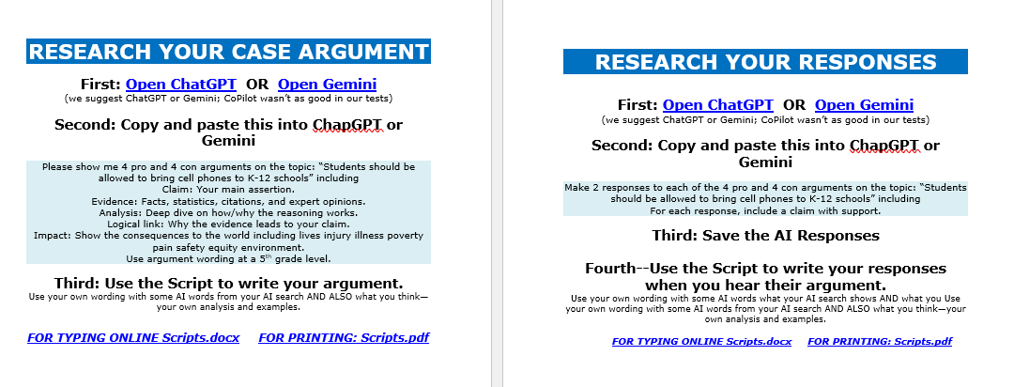
RESEARCH YOUR CASE AND RESPONSES
Do the Case and Responses Research Steps
Type/Write your Case Script
Be ready to use your responses in class.

Slide 40
Ai research means . . .
Doing the Search
AND!
Reading the Results
Doublecheck Them!
any key citations or information that seems very specific or “off”
Think how you will use those results in your debates.

Slide 41
TWO Final thingS
1. Be sure to take the Quiz before next class on the Climb Elementary Debate Prep Page.
CLIMB ELEMENTARY DEBATE PREP PAGE https://www.nwforensics.org/climb-program/elementary/index.htm
2. You have a special opportunity to participate in the Seattle U tournament.
Great experience to meet new people.
Please register for that. Look for an email from Jim Hanson.

Slide 42
For next class . . .
We are debating a new topic: ___
You will go Pro and Con on this topic
See the Pairings for which side next week
BEFORE CLASS, Prepare your First Speech and review responses you might make in your Second Speech!

