Slide 1
Let’s start debate!
Jim Hanson

Slide 2
Instructor timeline
MAKE ARGUMENTS 8 MINUTES
TOPIC OVERVIEW 8 MINUTES
CASE SPEECHES 14 MINUTES
I DISAGREE GAME & RESPONSE SPEECHES 20 MINUTES
QUESTION AND ANSWER 20 MINUTES
FINISH UP 5 MINUTES.

Slide 3
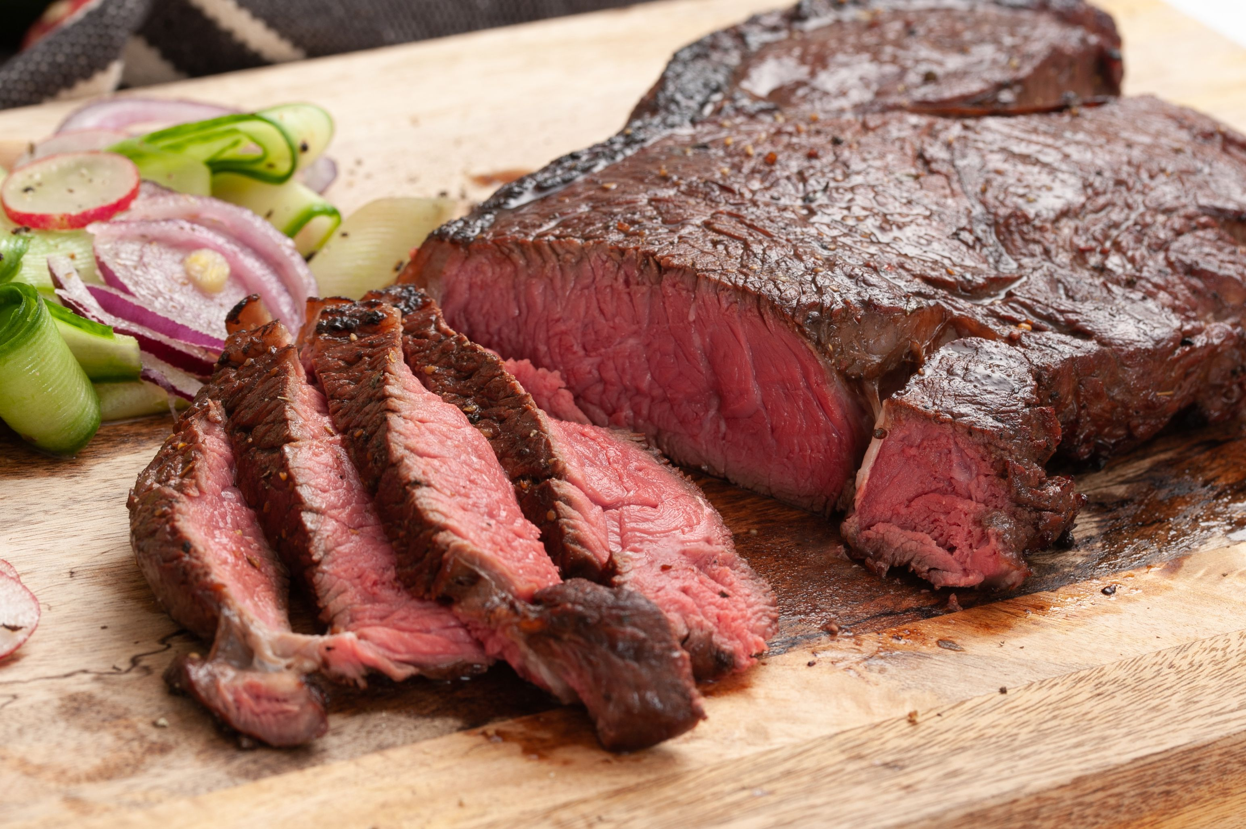
What’s your favorite food?

Slide 4
We have our opinions
We are working together
We are a team and we support each other.

Slide 5
Communicate it!
Each person, tell the class . . .
Your name and anything important to you
Your favorite food
Now get into a small group, tell each other your favorite game.

Slide 6
Preparing the first speeches
Starting with . . .

Slide 7
Making an argument
Claim—Your Point
Support your Point
Sugary beverages harm health
Because the sugar increases the chance of getting diabetes.

Slide 8
THE TOPIC WE USE FOR THE FIRST TWO CLASSES . . .
Students should be allowed to bring phones to school.
What’s your opinion?
Note that you don’t always get the side you want
We need half of you to be Pro (support the topic) and half of you to be Con (against the topic).
INSTRUCTOR: ASSIGN DEBATERS TO SIDES.

Slide 9
Prepare an argument with claim and support
Students should be allowed to bring phones to school.
Claim—Your Point: ______________________
Support your Point: ______________________
You’ve got 2 or 3 minutes to do this.

Slide 10
Now share your argument with another student(s)
Students can share in groups of 2 or 3.

Slide 11
NOW: ONE STUDENT . . . share out loud your argument
This is for the whole group to hear

Slide 12
TOPIC OVERVIEW

Slide 13
THE TOPIC IS Students should be allowed to bring cell phones to K-12 schools.

Slide 14
Why this topic?
Some people believe phones help kids research and learn (Pro)
Some people believe phones are distracting and hurt education (Con)

Slide 15
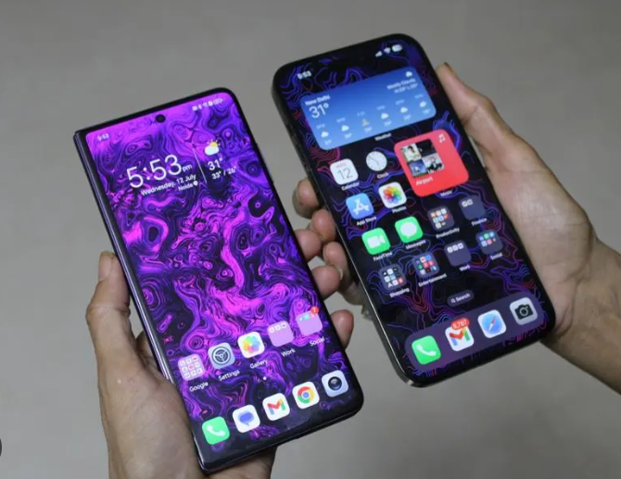
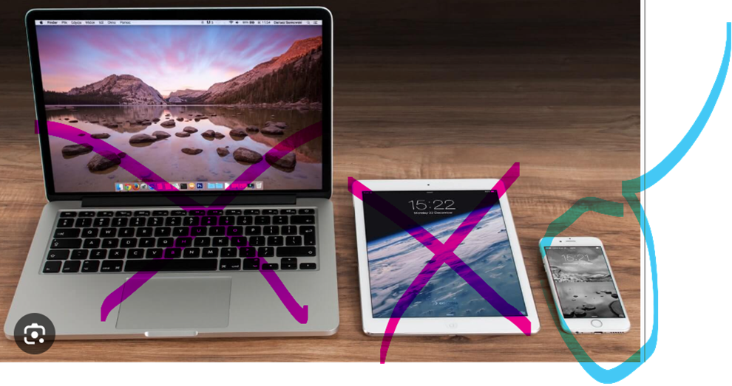
What is the Topic?
K-12 Schools Obviously, not Colleges. Elementary, Middle, and High Schools.
Cell Phones You know them and that does not include tablets or computers
Allowed to give permission for someone to do something.

Slide 16
One more thing on the Topic . . .
Cell Phones should be allowed in schools – the topic does not cover usage OUTSIDE of school.

Slide 17
What are school policies on cell phone use?
Elaine Povich, StateLine

Slide 18
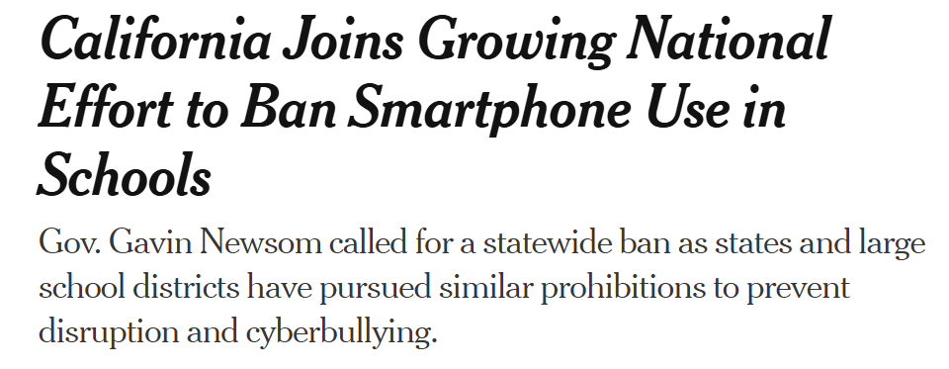
The New York Times says . . .

Slide 19
Now—GET YOUR SCRIPT
You can use a Printed Script
OR you can use an online one on the Climb PREP PAGE https://www.nwforensics.org/climb-program/elementary/index.htm
You can also Google/Bing for “Climb Elementary Prep” (look for “the new page”)
EVERYONE CONFIRM YOU HAVE THAT PAGE BOOKMARKED/FAVORITED.

Slide 20
MAKE SURE YOU HAVE THE PREP PAGE BOOKMARKED/FAVORITED
https://www.nwforensics.org/climb-program/elementary/index.htm
You will use that page each week to prepare before class
You should spend 30 to 45 minutes preparing BEFORE each class.

Slide 21
YOUR SCRIPT IS KEY
Your script tells you the arguments you need to make in your speeches
It is like Debate “Training Wheels”
As time goes on, you’ll be able to rely on the script less and less.

Slide 22
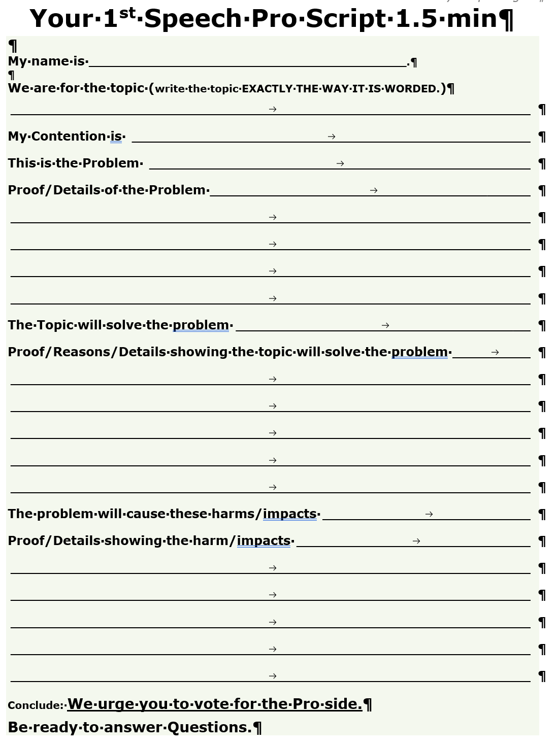
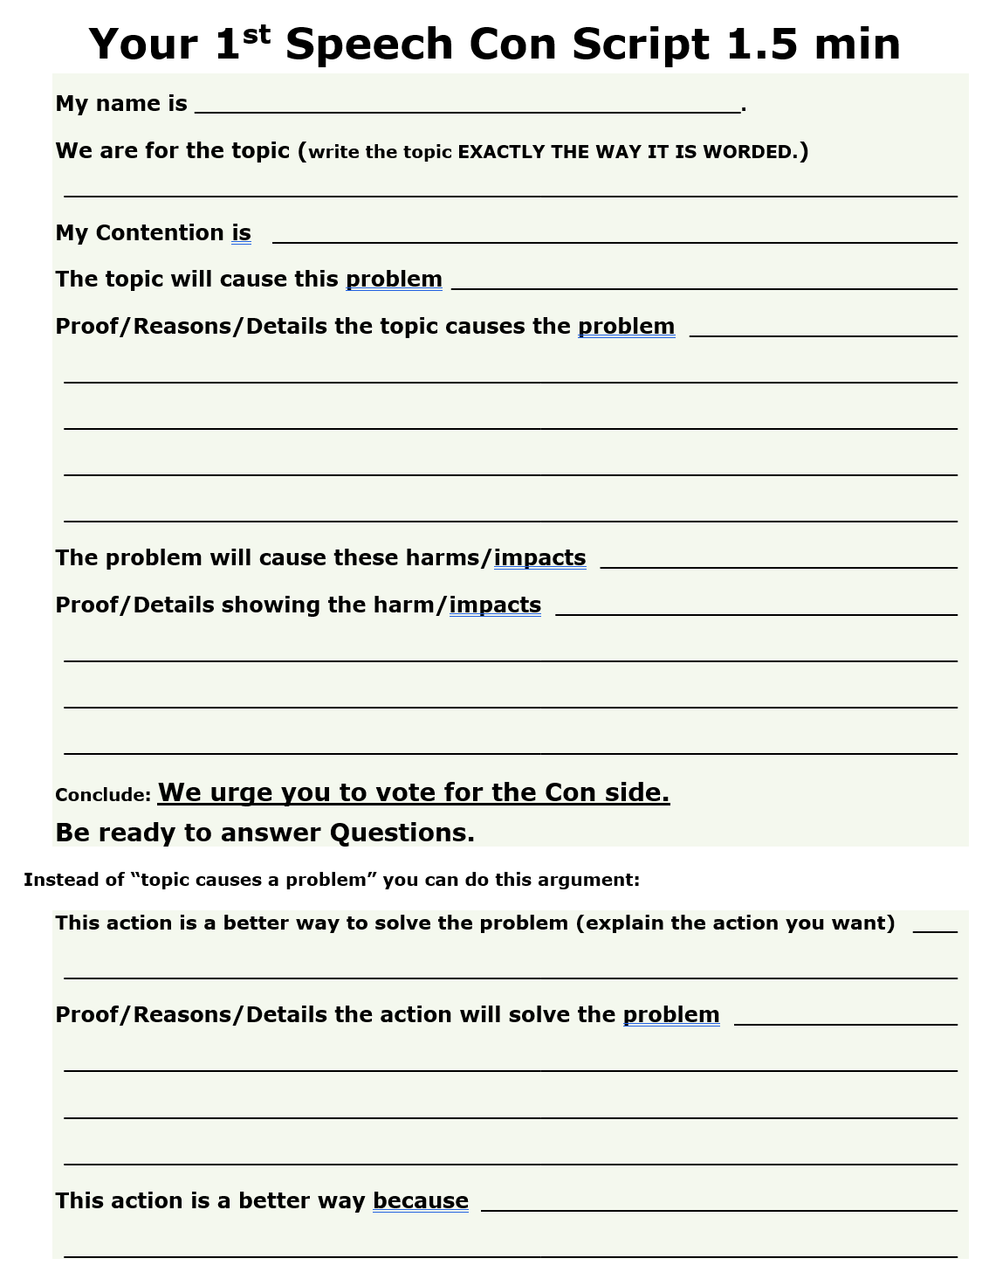
NOW—WE WANT YOU TO DEVELOP YOUR ARGUMENT INTO A CASE
You are going to do the things on the script.

Slide 23
THE key POINTS OF DOING a CASE
PRO 3 POINTS EXAMPLE:
Show there is Problem: Kids face urgent situations.
Show the Topic solves the Problems: Allowing phones at school gives kids a chance to call their parents.
Show solving the Problem is important: If kids can’t call, they could get hurt or really suffer.
CON 3 POINTS EXAMPLE:
Things are okay/good now
Students are not distracted by cell phones now.
Show the Topic will cause/increase a Problem: Allowing cell phones will cause distractions in classes.
Show causing/increasing the Problem is important: Distractions means kids won’t learn and it will hurt their growth.
NOW PREPARE YOUR FIRST SPEECHES USING THE SCRIPT!
Yes you can look on the internet and you can look at the example contentions on the Prep Page.
You’ve got 10 minutes.

Slide 24
How much of YOUR FIRST SPEECH did you get DONE?
Was it hard? (what was the hardest part?)
What was the best part of preparing your first speech?

Slide 25
Preparing the SECOND speeches
Starting with . . .

Slide 26
Debate involves respectful disagreement
When a debater says steak is the best food . . .
You can argue “steak is NOT that good tasting”
You can argue “steak means harming animals—that’s not the best”
You can argue “Sushi is more delicious”

Slide 27
Now . . . I disagree game
One person presents their phone argument
Then, another person responds to that argument
We’ll do that in a moment after I explain how it will work.

Slide 28
To help do this . . .
Let’s have each person state their argument
As you do that, I’ll assign a responder
Use your Second Speaker Script—you write down the argument presented
You’ll have 3 or 4 minutes to prepare a response including doing research
You can and should also ask for help.

Slide 29
LET’S DO THE I DISAGREE GAME USING THE SECOND SPEAKER SCRIPTS.
Each person presents their phone argument
Right before each presenter, I’ll assign a debater from the other side to respond
Then, we will take a 3 or 4 minute break for you to present your responses.
Then, the assigned person will respond to that argument
Let’s Begin . . .

Slide 30
Question and answer!

Slide 31
Ask and answer questions
You will ask questions of your opposing debater
That opposing debater will ask you questions.

Slide 32
YOU DO IT!
One person presents an argument
Another person, ask a question
The presenter answers the question
Now let’s get some tips on doing better question and answering.

Slide 33
Questions you can ask . . .
“Where in your speech did you prove __________?”
EXAMPLE: “Where in your speech did you prove that a soda tax would reduce soda drinking?”
I need one person to ask this kind of question . . .

Slide 34
Questions you can ask . . .
“Wouldn’t your position cause ______(something good/bad)_______?
EXAMPLE: “Wouldn’t a soda tax cause people to just switch to candies and other foods to get their sugar?”
I need another person to ask this kind of question.

Slide 35
ANSWERS YOU CAN GIVE
Answer as soon as you can
USE ARGUMENTS IN YOUR SPEECH TO ANSWER QUESTIONS:
“As I showed, a soda tax would reduce consumption because people don’t want to pay the higher cost.”
Answer briefly—then talk about good arguments for your side:
“Poorer people would switch to cheaper drinks so they would not be hurt AND their health would improve lowering their health care costs.”

Slide 36
Try it out
Answer as soon as you can
USE ARGUMENTS IN YOUR SPEECH TO ANSWER QUESTIONS:
“As I showed, a soda tax would reduce consumption because people don’t want to pay the higher cost.”
Here’s a question—I need an answer.
(Instructor asks a question that student has support for from their speech)

Slide 37
Try it out
Answer as soon as you can
Answer briefly—then talk about good arguments for your side:
“Poorer people would switch to cheaper drinks so they would not be hurt AND their health would improve lowering their health care costs.”
Here’s a question—I need an answer.
(Instructor ask a tough question)

Slide 38
Do it again!
Use the Tips
In teams of two . . .
Present an argument
Ask a question
Answer
Go to the next person.

Slide 39
WRAPPING UP AND HEADED FOR THE FUTURE

Slide 40
We are going to put all this into debating this session
Making arguments with Claims and Support
Disagreeing Respectfully
Asking and answering questions.

Slide 41
YOU’RE GOING TO LEARN . . .
Taking notes in a debate
Defending your arguments
Explaining why your side wins the arguments
And you are going to debate each other!

Slide 42
As we debate, treat each other right
We argue Ideas
We don’t argue against People
Look around the Room
These are your team members—show you support each other
If at anytime you are not being treated right—tell me, your instructor, your parent, or Jim Hanson
If you see someone being mistreated—you are encouraged to put a stop to it. “Hey Stop that.” “Hey, let’s do something else.” “Yep, I’m going to contact Jim Hanson.”

Slide 43
What you need for debates
Pens (Black/Dark Blue)
Scripts (on the Prep Page)
Topic Information Sheet
THESE ARE ALL ON THE ELEMENTARY PREP PAGE.

Slide 44
For next class . . .
Keep your script that you’ve worked on today!
Be thinking of how you will defend your case
Be thinking of why your side’s arguments are stronger
You are most welcome and encouraged to do more research on the topic—we’ll use it again next week.

Slide 45
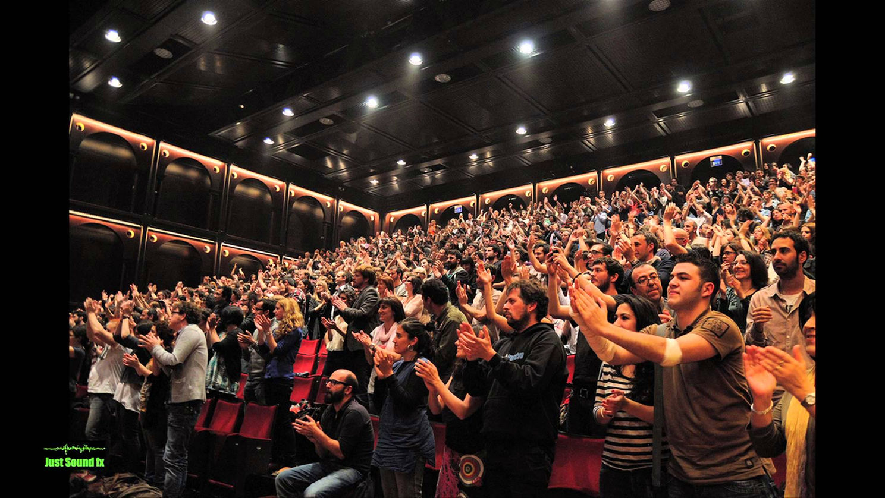
YOU ARE GOING TO BECOME A CHAMP DEBATER!

