Slide 1
Let’s start debate!
Jim Hanson

Slide 2
Instructor timeline
MAKE ARGUMENTS 8 MINUTES
TOPIC OVERVIEW 8 MINUTES
CASE SPEECHES 14 MINUTES
I DISAGREE GAME & RESPONSE SPEECHES 20 MINUTES
QUESTION AND ANSWER 20 MINUTES
FINISH UP 5 MINUTES.

Slide 3
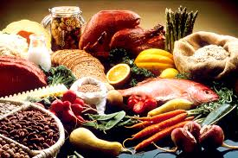

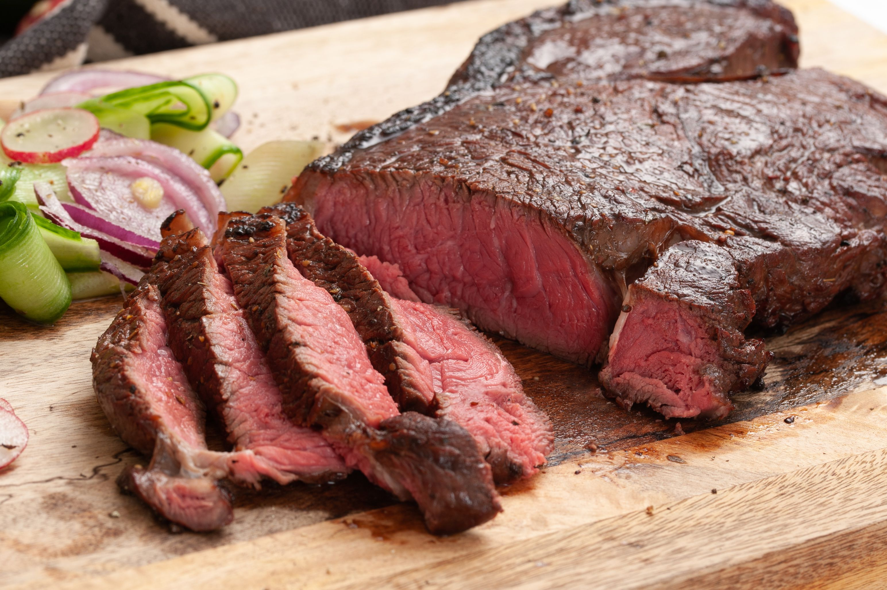
What’s your favorite food?

Slide 4
We have our opinions
We are working together
We are a team and we support each other.

Slide 5
Communicate it!
Each person, tell the class . . .
Your name and anything important to you
Your favorite food
Now get into a small group, tell each other your favorite game.

Slide 6
Preparing the first speeches
Starting with . . .

Slide 7
Making an argument
Claim—Your Point
Support your Point
Sugary beverages harm health
Because the sugar increases the chance of getting diabetes.

Slide 8

THE TOPIC WE USE FOR THE FIRST TWO CLASSES . . .

Slide 9
Students should be allowed to bring phones to school.
What’s your opinion?
Note that you take on both sides in debate.

Slide 10
LET’S ASSIGN SIDES TO START . . .
We need half of you to be Pro (support the topic)
and half of you to be Con (against the topic).
INSTRUCTOR: ASSIGN DEBATERS TO SIDES.

Slide 11
Prepare an argument with claim and support
Students should be allowed to bring phones to school.
Claim—Your Point: ______________________
Support your Point: ______________________
You’ve got 2 or 3 minutes to do this.

Slide 12
Now share your argument with another student(s)
Students can share in groups of 2 or 3.

Slide 13
NOW: ONE STUDENT . . . share out loud your argument
This is for the whole group to hear

Slide 14
TOPIC OVERVIEW

Slide 15

THE TOPIC IS
Students should be allowed to bring cell phones to K-12 schools.

Slide 16
SHARE 2 arguments for the topic.

Slide 17
SHARE 2 arguments AGAINST the topic.

Slide 18
MakE sure YOUR arguments are relevant

Slide 19
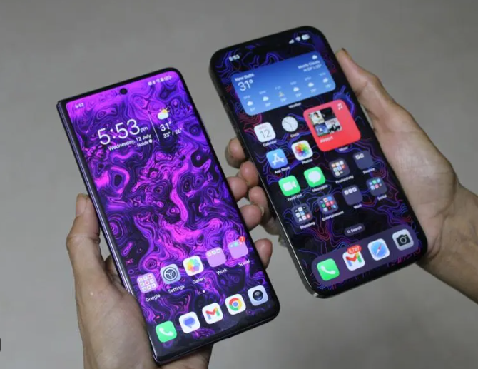
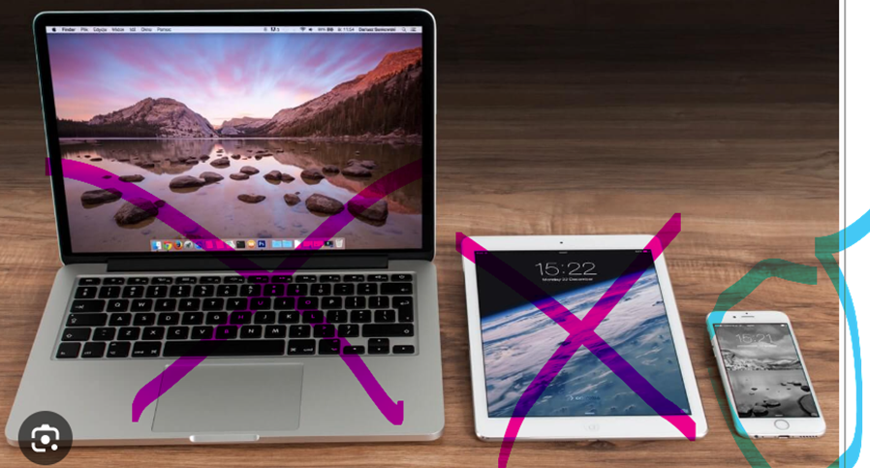
Arguments must be about cell phones
You know cell phones
and that does not include tablets or computers

Slide 20


Arguments must be about k-12 schools
Focus on Elementary, Middle, and High Schools.
Obviously, not Colleges.

Slide 21

One more thing on the Topic . . .
Cell Phones should be allowed in schools – the topic does not cover usage OUTSIDE of school.

Slide 22
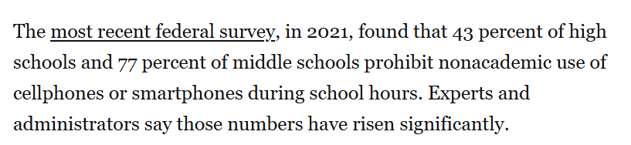
What are school policies on cell phone use?
From the Washington Post . . .

Slide 23
Now—let’s get prepared to debate
I need to assign half of you to the Pro Side
And half of you to the Con Side
Here are the names of the people on the 2 sides.
Get prepared for your side with a case.
To do that . . .

Slide 24

GET YOUR LAPTOP OR TABLET

Slide 25
go to your web browser

Slide 26
OPEN THE CLIMB ELEMENTARY STUDENT PREP PAGE
Climb STUDENT PREP PAGE
https://www.nwforensics.org/climb-program/elementary/index.htm
You can also Google/Bing for “Climb Elementary Student Prep” (look for the current session on the page)
OR
You can also go to the regular Climb web page, scroll to the bottom and on the right, there is a link to the prep pages.

Slide 27
MAKE SURE YOU HAVE THE PREP PAGE BOOKMARKED/FAVORITED
You will use that page each week to prepare before class
You should spend 30 to 45 minutes preparing BEFORE each class
Show your Instructor the page and that you have bookmarked/favorited it.

Slide 28
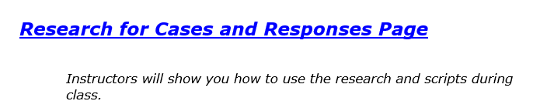
Now—click the research FOR CASES AND RESPONSES LINK

Slide 29
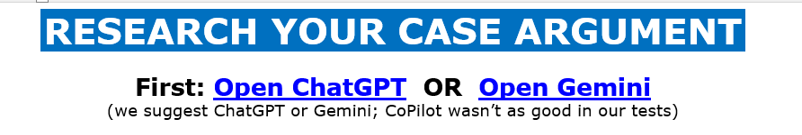


Slide 30
What arguments did you get?
One Pro Person: Tell me one argument you got.
One Con Person: Tell me one argument you got.

Slide 31
Ai doublechecks
As of Summer 2025, ChatGPT and Gemini make pretty good arguments
BUT they make mistakes
--Citations are sometimes wrong, even made up
--Facts/statistic can mix things up
--Very specific details/facts can be very wrong
Doublecheck such aspects.

Slide 32
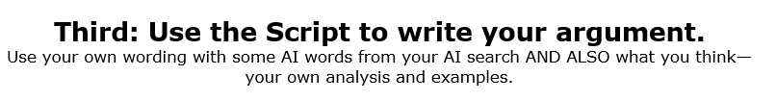
YOUR SCRIPT IS KEY
Your script shows you the arguments you need to make in your speeches
A Script is like a “Training Wheels” for Debate
As time goes on, you’ll be able to rely on the script less and less.

Slide 33
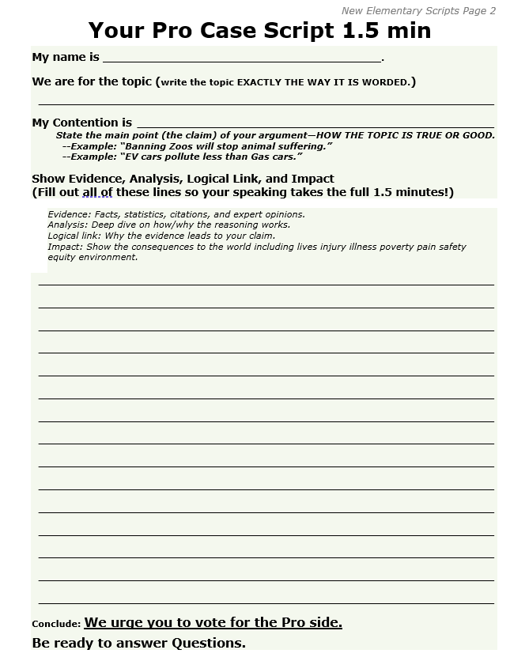
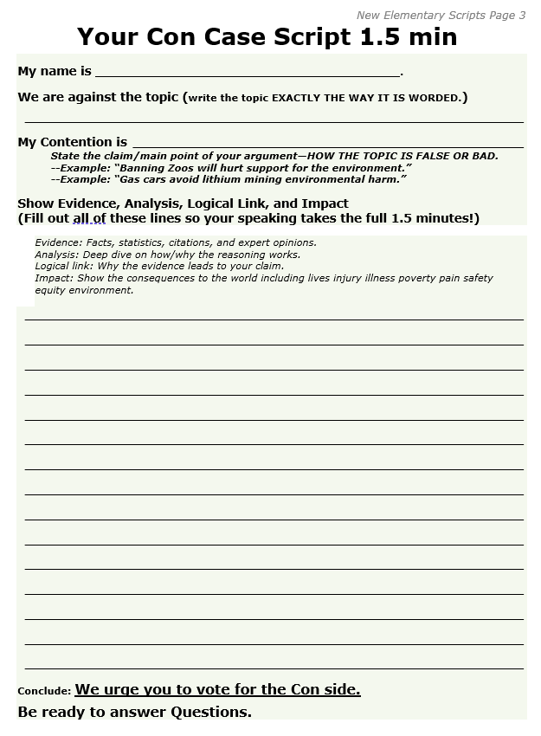
NOW—WE WANT YOU TO DEVELOP A CASE
You are going to fill out the scripts.

Slide 34
FOR YOUR CASE ARGUMENT
Look at what your AI Search came up with
Write down/Type your Contention/Main Claim
Write down/Type your
    Evidence (proof)
    Analysis (explanation)
    Logical link (how you’ve proven your argument)
    Impact (how this argument helps/hurts people).

Slide 35
FOR YOUR CASE ARGUMENT
Use your own words along with the AI words.
Fill up all of the Lines so you have enough material for a 1.5 minutes speech.
You have 10 minutes to get your case done!

Slide 36
How much of YOUR FIRST SPEECH did you get DONE?
Was it hard? (what was the hardest part?)
What was the best part of preparing your first speech?

Slide 37
Preparing the SECOND speeches
Starting with . . .

Slide 38
Debate involves respectful disagreement
When a debater says steak is the best food . . .
You can argue “steak is NOT that good tasting”
You can argue “steak means harming animals—that’s not the best”
You can argue “Sushi is more delicious”

Slide 39
Now . . . I disagree game
One person presents an argument with one sentence claim and support on any topic you want
Then, another person responds to that argument
You have 1 minute to prepare—go!

Slide 40
NoW: RESPONDING IN A DEBATE
One person presents their phone argument
Then, another person responds to that argument
We’ll do that in a moment after I explain how it will work.

Slide 41
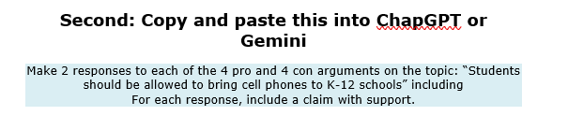
To help do this . . .
Do This Now and Save the Results.

Slide 42
Just like in the I disagree game . . .
Each Person presents their argument
Followed by another person responding
Con person ____ will respond to Pro person ____
Etc
Pro person _____ will respond to Con person ____.

Slide 43
To do this . . .
Use your Second Speaker Script—VERY BRIEFLY write down/type the argument presented
Type/write down your two responses (Use your AI research to help)
You can and should also ask for help.

Slide 44
Let’s go
Each person presents their phone argument
After everyone has presented, everyone will present their 2 responses.

Slide 45
Question and answer!

Slide 46
Ask and answer questions
You will ask questions of your opposing debater
That opposing debater will ask you questions.

Slide 47
YOU DO IT!
One person presents an argument
Another person, ask a question
The presenter answers the question
Now let’s get some tips on doing better question and answering.

Slide 48
Questions you can ask . . .
“Where in your speech did you prove __________?”
EXAMPLE: “Where in your speech did you prove that a soda tax would reduce soda drinking?”
I need one person to ask this kind of question . . .

Slide 49
Questions you can ask . . .
“Wouldn’t your position cause ______(something good/bad)_______?
EXAMPLE: “Wouldn’t a soda tax cause people to just switch to candies and other foods to get their sugar?”
I need another person to ask this kind of question.

Slide 50
ANSWERS YOU CAN GIVE
Answer as soon as you can
USE ARGUMENTS IN YOUR SPEECH TO ANSWER QUESTIONS:
“As I showed, a soda tax would reduce consumption because people don’t want to pay the higher cost.”
Answer briefly—then talk about good arguments for your side:
“Poorer people would switch to cheaper drinks so they would not be hurt AND their health would improve lowering their health care costs.”

Slide 51
Try it out
Answer as soon as you can
USE ARGUMENTS IN YOUR SPEECH TO ANSWER QUESTIONS:
“As I showed, a soda tax would reduce consumption because people don’t want to pay the higher cost.”
Here’s a question—I need an answer.
(Instructor asks a question that student has support for from their speech)

Slide 52
Try it out
Answer as soon as you can
Answer briefly—then talk about good arguments for your side:
“Poorer people would switch to cheaper drinks so they would not be hurt AND their health would improve lowering their health care costs.”
Here’s a question—I need an answer.
(Instructor ask a tough question)

Slide 53
Do it again!
Use the Tips
In teams of two . . .
Present an argument
Ask a question
Answer
Go to the next person.

Slide 54
WRAPPING UP AND HEADED FOR THE FUTURE

Slide 55
We are going to put all this into debating this session
Making arguments with Claims and Support
Disagreeing Respectfully
Asking and answering questions.

Slide 56
YOU’RE GOING TO LEARN . . .
Taking notes in a debate
Defending your arguments
Explaining why your side wins the arguments
And you are going to debate each other!

Slide 57
As we debate, treat each other right
We argue Ideas
We don’t argue against People.

Slide 58
As we debate, treat each other right
Look around the Room
These are your team members—show you support each other
If at anytime you are not being treated right—tell me, your instructor, your parent, or Jim Hanson
If you see someone being mistreated—you are encouraged to put a stop to it. “Hey Stop that.” “Hey, let’s do something else.” “Yep, I’m going to contact Jim Hanson.”

Slide 59
What you need for debates
Pens (Black/Dark Blue)
Scripts (on the Prep Page)
Access to AI for searches of arguments and responses
THESE ARE ALL ON THE ELEMENTARY PREP PAGE.

Slide 60
For next class . . .
Keep your script that you’ve worked on today!
Be thinking of how you will defend your case
Be thinking of why your side’s arguments are stronger
You are most welcome and encouraged to do more research on the topic—we’ll use it again next week.

Slide 61
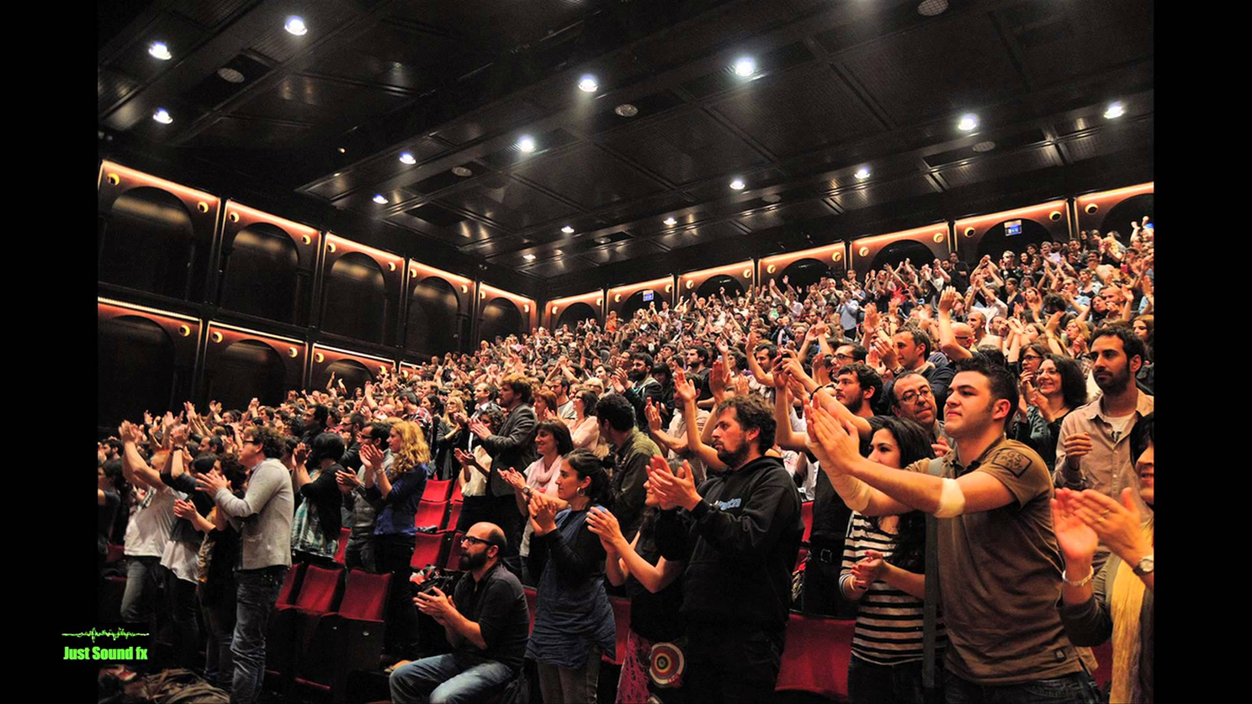

YOU ARE GOING TO BECOME A CHAMP DEBATER!

