Slide 1
STAFF GUIDELINES
This is for Climb Staff in all of our programs (camp, afterschool, tournaments, clinics, etc.)_

Slide 2
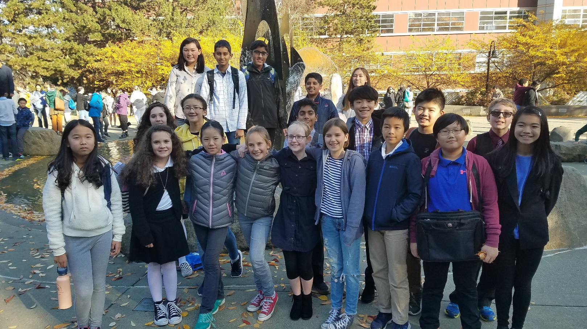
Welcome to our Community
We hope you have a fun and
educational time

Slide 3


Keep your Social Media professional and/or private . . .
All of your social sites
Facebook, Twitter, Instagram, whatever the latest is . . .
If your info is available to the public . . .
  Remove depictions/statements of drinking, explicit sexual activity, swearing, harsh attacks on those you disagree with, etc.
  AND/OR
  Make your Facebook inaccessible to students and consider the harm you can do to yourself by allowing others such as fellow colleagues and potential employers to see your posts that may be deemed offensive, inappropriate, etc.

Slide 4
Professional Presentation
You’re online, viewable by others
Your mind should be alert and sober
Be dressed for public view (note: we do _not_ have a dress code and you should not make comments about others’ dress unless you are 100% certain the comment will be taken positively)
Act appropriately in front of the camera and mic (turn them off if you need privacy).

Slide 5

Be on time
Check Email and Postings
Use Bathroom when
class/debate isn’t happening
Start instruction/the first speech on schedule
Keep the students on task to complete the instruction/round on time
Submit your ballot decision and points nearly immediately after the debate ends.
(Email comments/reason for decision AFTER that by 9pm).

Slide 6
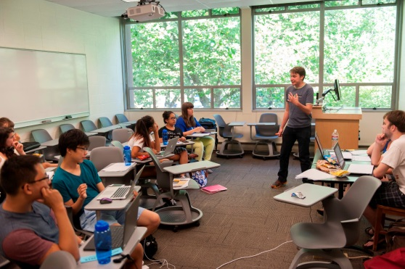

Keep students on task . . .
Make them feel engaged.
Let them have some fun too.
Don’t have breaks over and over again.
Don’t tune out while you check your phone or Facebook. : (
Respect needs for the bathroom and emergencies.

Slide 7
Interact with others professionally
As a Climb staff member, you aren’t a student anymore
Be Professional and caring
Students require you to act like an adult
Please speak professionally, avoiding swearing.

Slide 8
Keep focused on ALL students
It is illegal and wrong to make advances toward a student
NO Paying too much attention to one person
This applies to everywhere: In Online Rooms, Chatting, in Email and Messaging.

Slide 9
Be in rooms with at least 3 people . . .
Do NOT be in a room alone with a student for more than a fleeting moment
If there is a situation with just one student—notify Jim Hanson (or the greeter/program assistant) immediately (we’ll explain what to do)
NOTE: Jim Hanson and other Climb staff will enter rooms unannounced at times.

Slide 10
Avoid/Don’t private message kids
Emails? Sharing Files? Use the Climb Share It!
If a student direct messages you:
Answer their question with the group (without stating their name).
“hey all, I got a great question about flowing . . .”
If the direct message is concerning—immediately contact Jim Hanson or the greeter.

Slide 11
Unknown people in the room?
Don’t know someone in your room?
Contact the Greeter and/or Jim Hanson
Someone trolling/zoom bombing?
Try to stop it and Speak out against it
Contact the Greeter and/or Jim Hanson (we’ll work to get the person removed and blocked)
Get kids out if it is really bad.

Slide 12
Encourage Everyone as participants
  Lesbian-Gay-Straight-Bi-Queer
  Black-White-Latino-Asian-Biracial-
  Multiracial, etc.
  Men-Women-Transgender-Androgynous-Non-binary-etc.
  Republican-Democrat-Libertarian-etc.
  Christian, Agnostic, Catholic, Mormon (LDS), Jewish, Wicca, Muslim, etc.
  Disabilities--diagnosed or otherwise
  Military service
  Other identities.

Slide 13
Encourage Everyone as participants
  Treat every student,coach, and judge with respect and support.

Slide 14

Participants should . . .
express their opinions about issues
not attack groups of people
not attack other individuals.
Argue about ideas—not disrespect people.

Slide 15
As a Climb teacher and judge . . .
Your students look up to you
Other judges, coaches, and observers look up to you.
They are going to emulate you.

Slide 16
Be the judge-coach people talk about as . . .
“Yea, Elda rocks; helped me out a lot with that decision.”
“I respect him a lot. He can explain framework debates like nobody’s business and he reached out to younger debaters and made them feel included.”
“They are wicked smart but also really, really nice—super helpful judge especially for strategic ideas.”

Slide 17
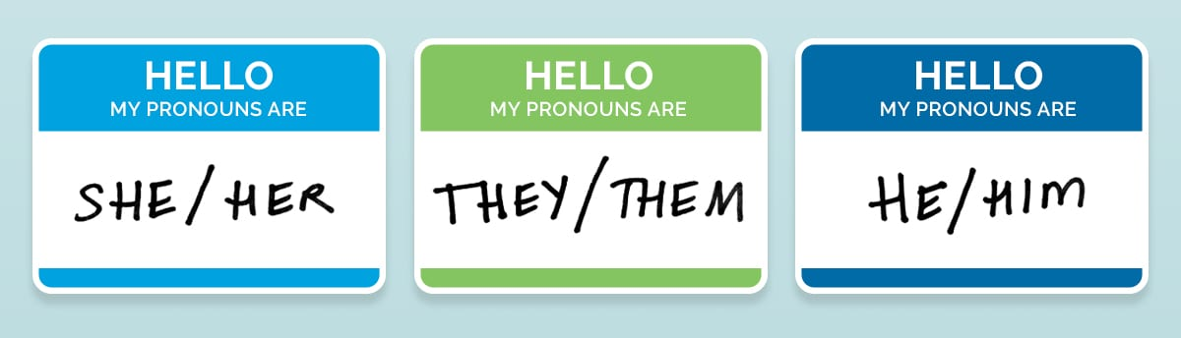
All Genders are part of our community . . .
Don’t assume Betty is “she”
Get out of the habit of “She said . . . He made a good point . . .”
Refer to others by their name “Betty”, speaker position (“First Aff Debater”), or default to “they.”
You should also ask students for names/anything important including pronouns at the beginning of classes and debates.

Slide 18
Don’t assume . . .
A student is a representative of a group
“You know what it’s like right . . . (pointing to student of color).
Don’t assume everyone is white/ middle class/ straight/ liberal/ Hispanic/ non-religious, etc.
“Well, I mean, people can afford that.”
“The people in this room don’t experience discrimination.”

Slide 19
As a teacher and judge watching. . .
You have an obligation to assure a comfortable environment
For _all_ participants.

Slide 20
Have kids preparing in a separate room?
You are REQUIRED to go to that room and check-in with the kids
Including CHECK THE CHAT
And make sure you address any issues/problems promptly—firmly and nicely
If there is a serious problem, contact our greeter or Jim Hanson immediately.

Slide 21
If you see or hear about harassment . . .
Done by ANYONE—coach, student, judge, observer
Stop it if possible
Say “Stop it” or “Hey, let’s move on to . . .”
Share the information about it . . .
with Jim
We’ll work to make things better.

Slide 22
And if you have reasonable suspicion of child abuse . . .
Do NOT investigate
Do NOT ask the student for details on what happened
Always show you care for the student
Report it to Jim Hanson IMMEDIATELY
Report it to Police and/or Child Protective Services IMMEDIATELY
Unclear? Concerned but not certain? Ask Jim as soon as possible
YOU ARE A MANDATED REPORTER and if you fail to report—you are letting down a kid AND you can be charged.

Slide 23
Respect Differing Political Beliefs
Don’t call Republicans, leftists, and any political view you disagree with stupid and other names.
Your students may support that political view and be very hurt.
Instead . . .
Give your opinion in a professional manner and _explicitly_ allow for differing opinions (eg “Anyone disagree?—different viewpoints are respected”).

Slide 24
Sharing your opinions
You can share your opinions especially related to speech/debate arguments
You CANNOT promote a political party nor candidates (student can do that—as long as you don’t prompt/encourage them to do that)
We are a 501c3 educational non-profit and promoting political parties is not legally permitted
If there is a speech/debate argument involving political parties—you should contact Jim Hanson.

Slide 25
What if a student makes an offensive argument?
Explain why the argument is offensive/unpersuasive.
Don’t call the student names nor tell them they are terrible.
If the student has made a threat or expressed hate toward a group of people or individuals, tell them to stop and tell Jim.
If the student slurred or disparaged a group of people—convince them to stop; if the student doesn’t stop, you should inform Jim.
Climb respects free speech but we also want to assure a safe space for all participating.

Slide 26
Kids with issues . . .
Student just isn’t motivated . . .
Student is really shy . . .
Student is easily upset . . .
Don’t call out these students.
Work with them—figure out what works—look for moments of motivation, engagement, and calmness—repeat those moments.
Seek out help from Jim and other staff members.

Slide 27
No Gambling or Making Money off of Students
Enough said. : )

Slide 28
Dealing with Rule Violations
Treat Students with respect EVEN WHEN AND ESPECIALLY WHEN THEY’VE UPSET YOU
Tell students directly and authoritatively to stop
Avoid threats of punishment
Contact Jim if it . . .
  Involves harassment, bullying, or danger
  The misbehavior is not getting solved.

Slide 29
Competition at the Camp . . .
Healthy competition is good—it encourages effort and initiative
Too much is not good; keep it balanced
You can and should be involved in helping students prepare cuttings, evidence, extemp articles, etc.
You should encourage but not force students to run/present certain arguments/pieces.

Slide 30

When a lecture or practice finishes . . .
Be sure to finish on time.
Don’t be late; keep us on schedule.
Give students time between sessions (5ish minutes typically).

Slide 31
Give students helpful feedback
Show respect; they’ve worked hard (respect them even if they haven’t).
Support their efforts to improve.
PROVIDE COMMENTS ABOUT WHAT THEY DID WELL:
YES “Your turns on the disad were really strong.”
YES “Your character has dimension and depth; the voice and gestures work really well.”
DON’T BE NEGATIVE—FOCUS ON IMPROVE.

Slide 32
PROVIDE COMMENTS ABOUT HOW THEY SHOULD IMPROVE
YES “You need to work on your word economy.”
YES “Your piece needs some editing—parts of it aren’t as engaging as they need to be.”
NO “You talked on and on about their kritik. Not impressed.”
Say helpful things—not critical and mean things
Encourage Participation—encourage the students and others to pursue speech and debate.

Slide 33
And of course . . .
Don’t make a decision, comment, nor give speaker points based on . . .
    the race, class, gender, disabilities, etc. of the competitors rather than the arguments communicated in the debates
    That includes comments about clothing, hair, voice, mannerisms, etc. that are part of a person’s identity . . .
    UNLESS it was communicated as part of the arguments AND ALL of the participants heard and understand that.
Help students be the best they can be.

Slide 34
Emergencies/accidents
Serious at all? Call 911 then . . .
Report to Jim/the Greeter immediately
Parents will be notified as soon as possible by the Greeter and/or Jim.

Slide 35
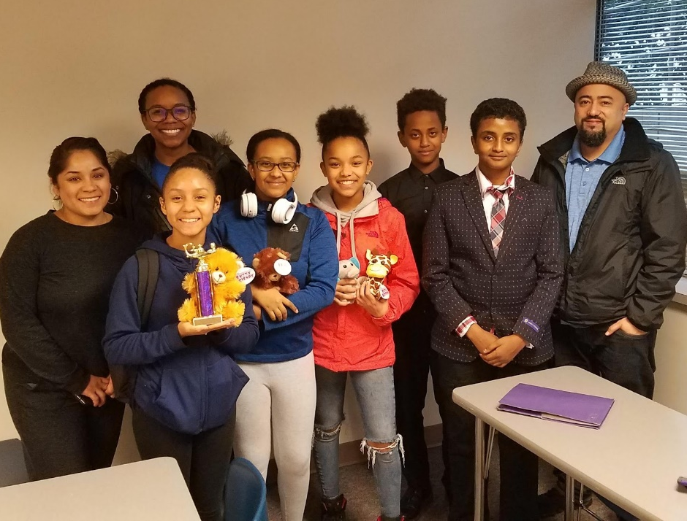
Make this Community Great!
Treat each other with respect
Support each other
Share Information when there is a problem
Promote good interactions
Make your judging a helpful benefit to students . . .
and your community!

