Slide 1
Finalizing your PowerPoint and Presenting it!
Dr. Jim Hanson

Slide 2
Finalizing your PowerPoint/Slide

Slide 3
Create a “Cover” Slide
Include Title of Presentation
Your name
Then have a blank slide . . .

Slide 4
Note: You do NOT use these slides in your speech
You begin speaking with the next slide—the attention getter.

Slide 5
First 5 Speaking Slides (Intro)
Attention Getter Slide
Thesis Slide
Expertise Slide
Audience Connect Slide
Preview Slide.

Slide 6
First Main Point Slides

Slide 7
Then more slides for your additional Points with . . .
Interest Evidence Multimedia Supports
1 line bullets that appear one at a time
Big Pictures that appear one at a time.

Slide 8
Then your 3 Conclusion Slides
Summary Slide
Importance Slide
Finish Slide.

Slide 9
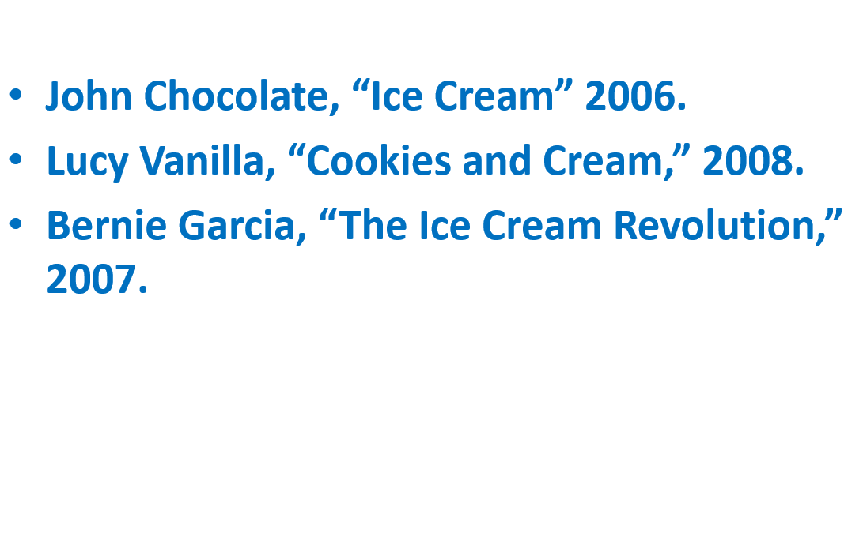
End on a blank slide (shows while you take questions)
Then, your citations (not shown during your presentation).

Slide 10
Reminder in the Slides . . .
Author, Qualifications, Date
Author’s view or direct quotation
EXAMPLE
Ben Sovacool, Director, Danish Center for Energy Technology
Renewable energy is a necessity—we must move to it or we face oil shortages, price spikes, and terrible environmental consequences.

Slide 11
Step 6 Prepare to Deliver the Speech

Slide 12
Speak with us
Be Energetic
Use your Fear
Be Real, Conversational
Don’t memorize.

Slide 13
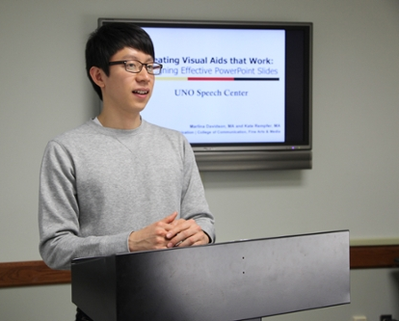
In Person? As you Present
Avoid reading off the PowerPoint screen
Avoid looking at your laptop screen
Stay focused on your audience.

Slide 14
In Person? Don’t get stuck behind the podium . . .

Slide 15
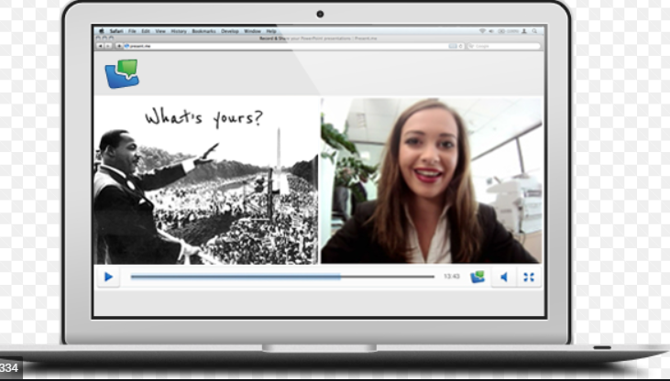
In Zoom—Keep Looking at Class

Slide 16
In Zoom—Show Slides and Class at same time
POWERPOINT: Use View, Reading View
Zoom—use Side by Side View

Slide 17
In Zoom—Show Slides and Class at same time
GOOGLE SLIDES: Use Present
It’s Full Screen—Avoid text on right side of slides.
Zoom: Use Side by Side View

Slide 18
Speak what appears
Bullet pops up—say it.
Picture pops up—talk about it.

Slide 19
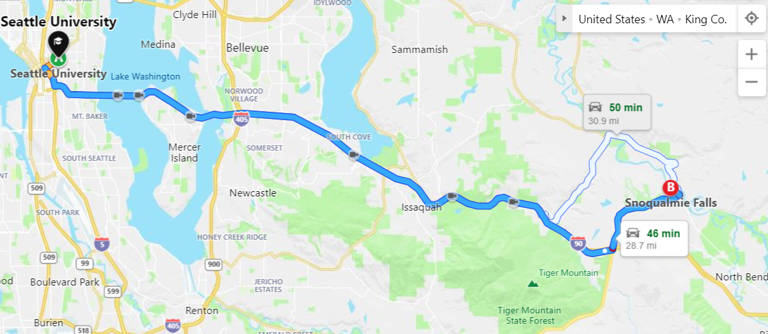
Point to the Screen. . .
To graphs, pictures, maps
Use mouse or better—insert a shape/drawing.

Slide 20
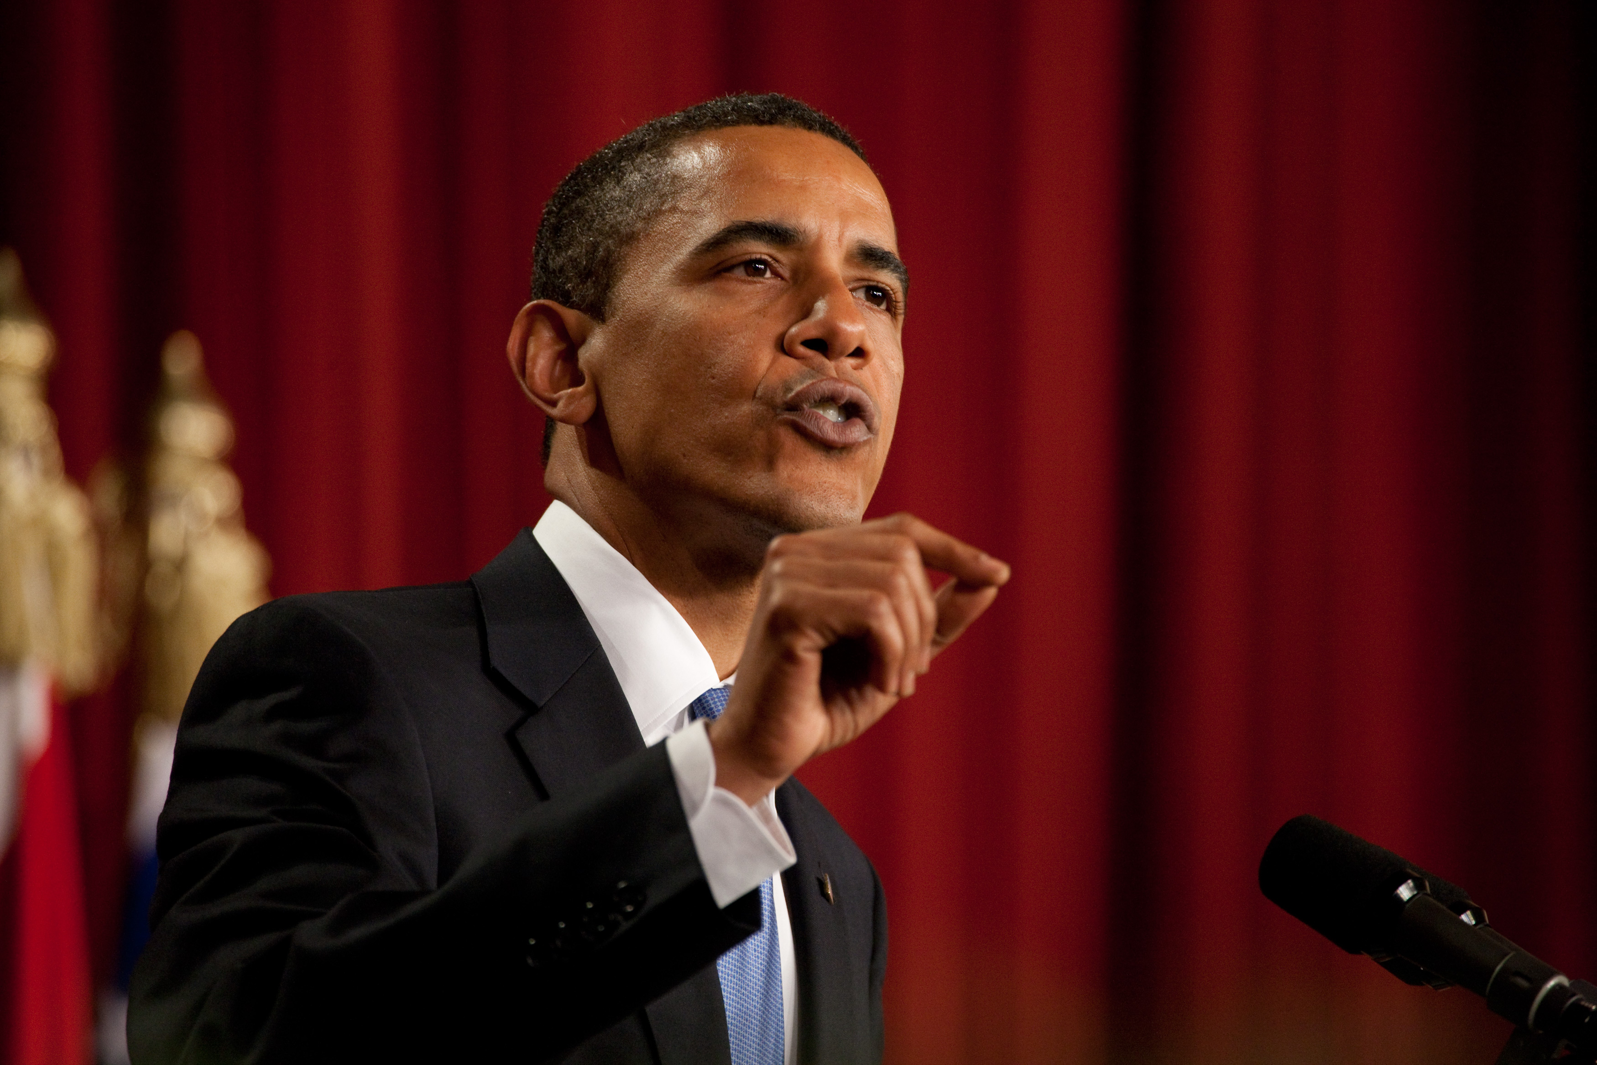
You don’t need notes . . .
Your PowerPoint/Slides are your notes
Separate notes can make you get out of sync.

Slide 21
Speaking the Bullets . . .
Bullets that are just points—say them concisely
Obama was President.
Support bullets—elaborate
When Barak met Michelle for the first time . . .

Slide 22
In your group
Present 2 slides
Speak on what appears on screen
While you keep focused on your listeners.
How did it go?
Two more tips . . .

Slide 23
1. Want to speak with a blank screen for a moment?
Great to get attention on you
To tell a story or show something
Press b on the keyboard
OR and needed for Zoom . . .
Have a blank slide.

Slide 24
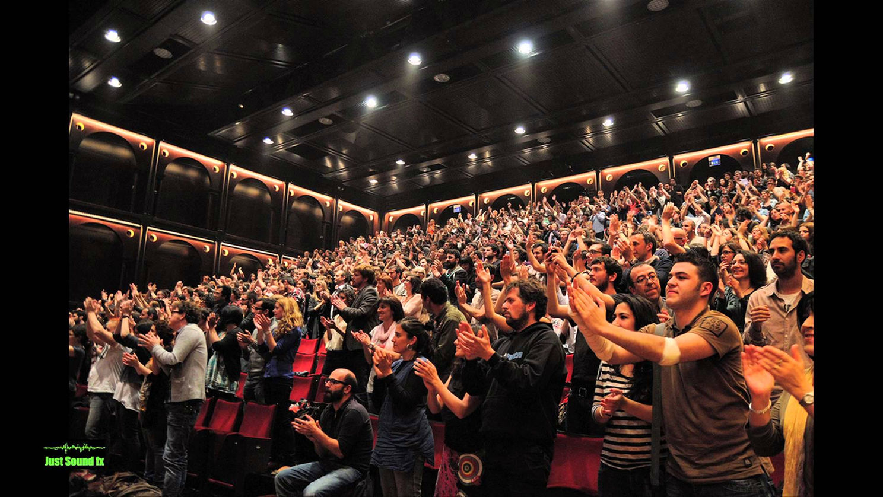
As you get ready to present—we support each other!

Slide 25
Now—Present!

