Slide 1
Prepare PowerPoints or Google Slides

Slide 2
3 STARTERS!
1. Topic
2. Thesis
3. Main Points

Slide 3
Have Google Slides or PowerPoint open and ready to use!
You are going to create a draft of your speech today!

Slide 4
1. TOPIC
Today and next week
You need a Topic
Something you care about
Something others will care about
Talk—and pick one!

Slide 5
2. MAKE A THESIS
The Thesis is the main point you want to make about your topic
Example: “I will show _________”
Example: “The United States should _____”
What’s the thesis for your speech?
Put the Thesis in BIG BOLD TEXT in a slide in PowerPoint/Google Slides.

Slide 6
3. MAKE POINTS
You need to back up your thesis with points
Key reasons/parts of your topic
What are the reasons for or key parts of your topic?
Make a slide for each point!

Slide 7
Now—Let’s talk about doing PowerPoint/Slides well!

Slide 8
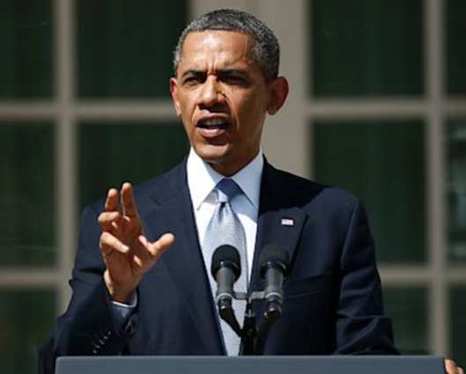
NO!
Obama was president for 8 years and he led the country through a severe recession. Obama is a democrat and please keep reading this long bullet so you aren’t really paying attention to the speaker.
Obama could not run for a 3rd term—the 22nd Amendment does not allow that.
Obama passed legislation providing health care for millions.
This is another bullet about Obama
Obama is a leading figure in the Democratic party
This is the sixth bullet on the slide.
What the heck, how about a 7th bullet?
What’s wrong with this slide?

Slide 9
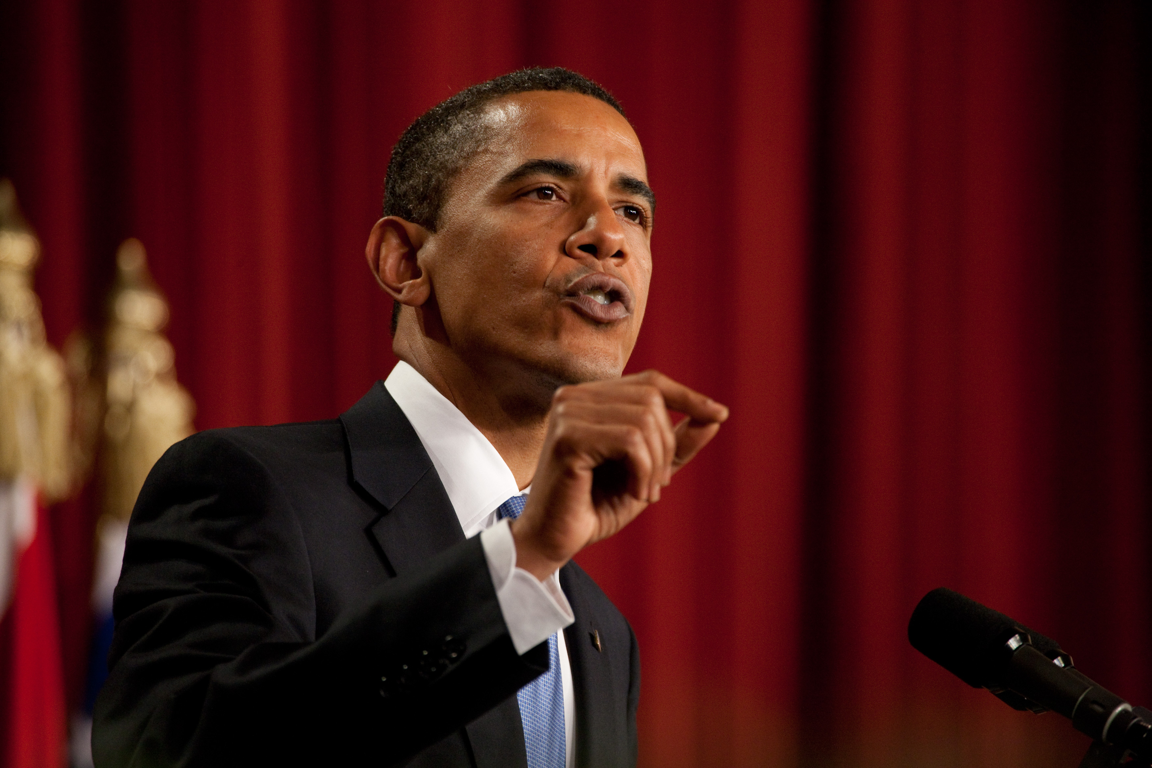
Bullets . . .
Keep bullets to 1 or 2 lines of text
Big Font—28 point is usually the minimum
Use a font color that contrasts with the background
Have bullets appear one at a time
As a bullet appears—say it.

Slide 10
BETTER!
Obama was president for 8 years
He led the country through a severe recession.
Obama is a democrat.
Obamacare provides health care for millions.
Obama could not run for a 3rd term because of the 22nd Amendment.

Slide 11
Keep Slides Simple
Avoid more than 3 or 4 bullets per slide
Ditto with pictures
1 Big Picture is best!
Just make an additional slide if you have too many bullets or a second picture.

Slide 12
EVEN BETTER!
Obama was president for 8 years
He led the country through a severe recession.

Slide 13
President passed . . .

Slide 14
Obama could not run for a third term

Slide 15
Let’s take a look at an Example PowerPoint . . . Does it work well?

Slide 16
How to Make an Ice Cream Cake

Slide 17
Where to Start
Go shopping…
What’s your favorite kind? What’s the cheapest?
2 cartons of ice cream
1 package of Oreos

Slide 18
Tools
Spring form Pan
Large mixing bowl and spoon
Smaller bowl and crushing device

Slide 19
How to Start
Crush up Oreos
Layer bottom
of pan with
Oreos
Freeze Oreo base
Thaw first layer ice cream in fridge
Smooth first layer
ice cream over
Oreo base
Crush Oreos
over first layer
of Ice Cream
Smooth top
layer of Ice
Cream over
second layer
of Oreos

Slide 20
Enjoy!
Friendly Ice Cream Corporation opened the first Friendly's Ice Cream Shoppe in Springfield, Massachusetts in 1935. Friends, family and neighbors have been gathering at Friendly's for 70 years to create magical moments, enjoy delicious, made-to-order food, and delight in premium ice cream using milk from area dairies. Friendly's also manufactures its own ice cream products, including decorated cakes and party rolls, that are distributed to over 4,500 supermarkets and retail locations. Friendly's is proud to be at the heart of warm memories for 70 years, and we're proud to be inspiring more memories for our guests every day.

Slide 21
Here’s a MUCH better version . . .

Slide 22
How to Make an Ice Cream Cake

Slide 23
Go Shopping!

Slide 24
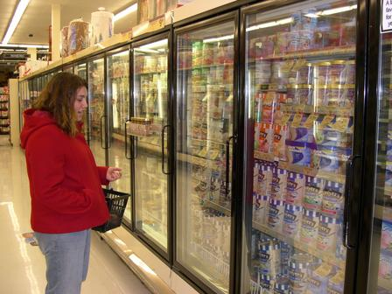
Choose 2 Ice Cream Half Gallons

Slide 25
Get 1 package of Oreos

Slide 26
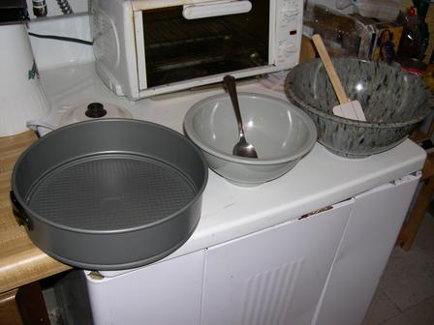
You Need Tools
Large mixing bowl and spatula
Smaller bowl and spoon
Spring form Pan
Spring form Pan
Smaller bowl and crushing device
Large mixing bowl and spoon

Slide 27
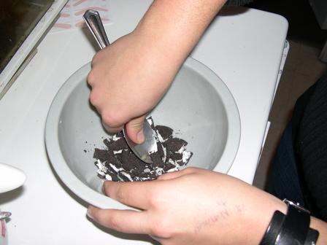
Begin—Crush the Oreos

Slide 28
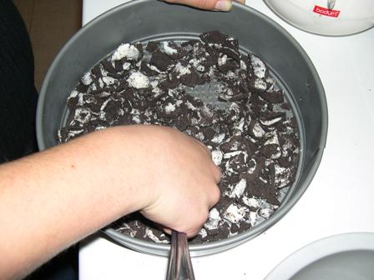
Place into pan bottom

Slide 29
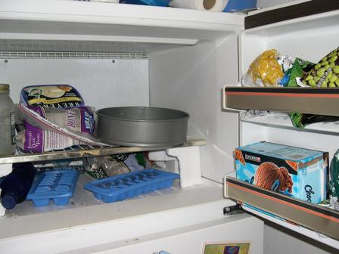
Freeze Oreo Base for 1 hour
PowerPoint Continues . . .

Slide 30
Let’s do it!
Now I want you to do some slides on your speech topic.
Put them as Additional Slides for your Points.

Slide 31
PowerPoint Slide with Bullets

Slide 32
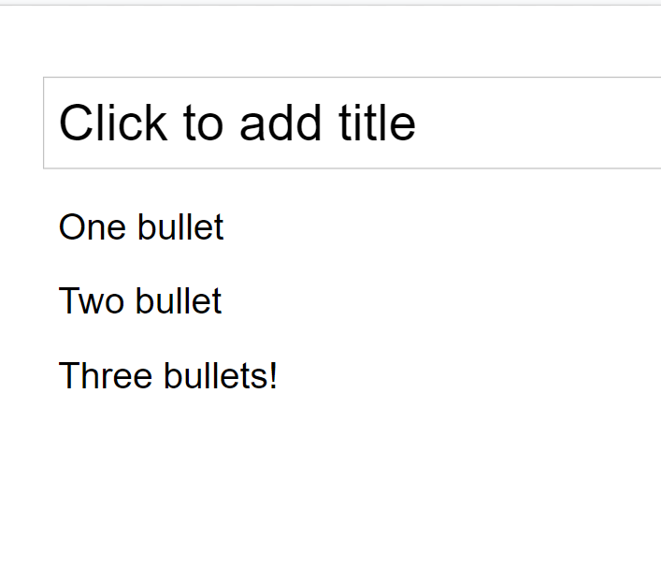
Google Slides Slide with Bullets

Slide 33
Do a Bullets Slide!

Slide 34
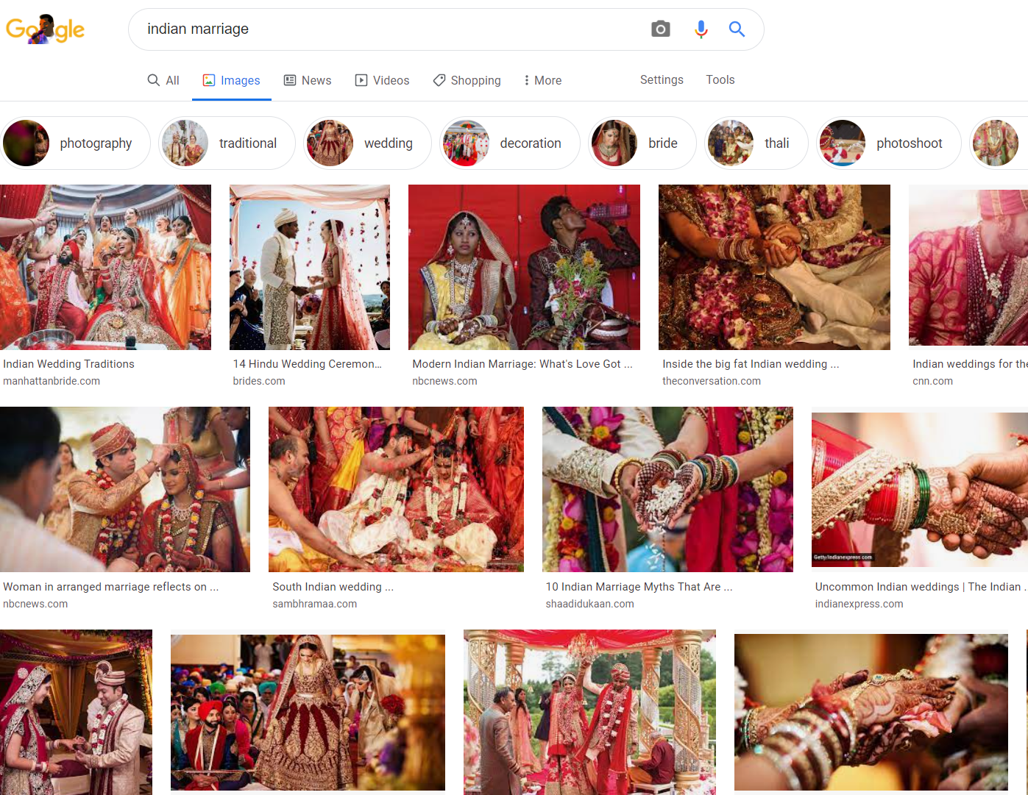
PowerPoint: Slide with Picture

Slide 35
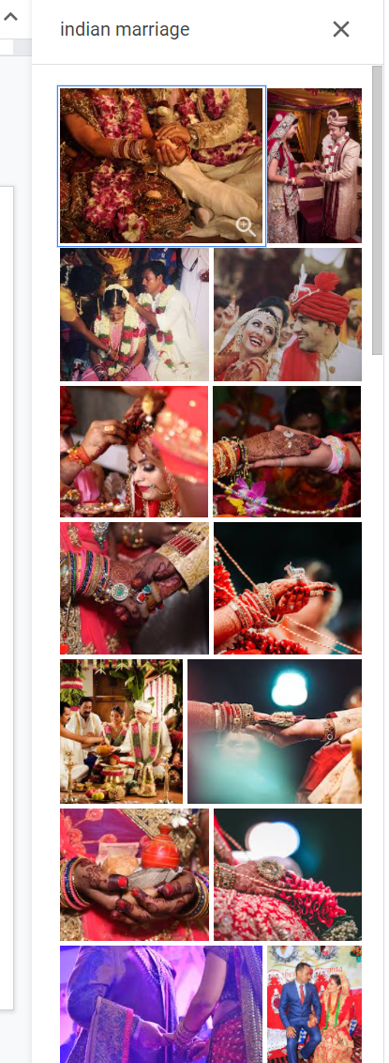
Google Slides Slide with Picture

Slide 36
Do a Picture Slide!

Slide 37
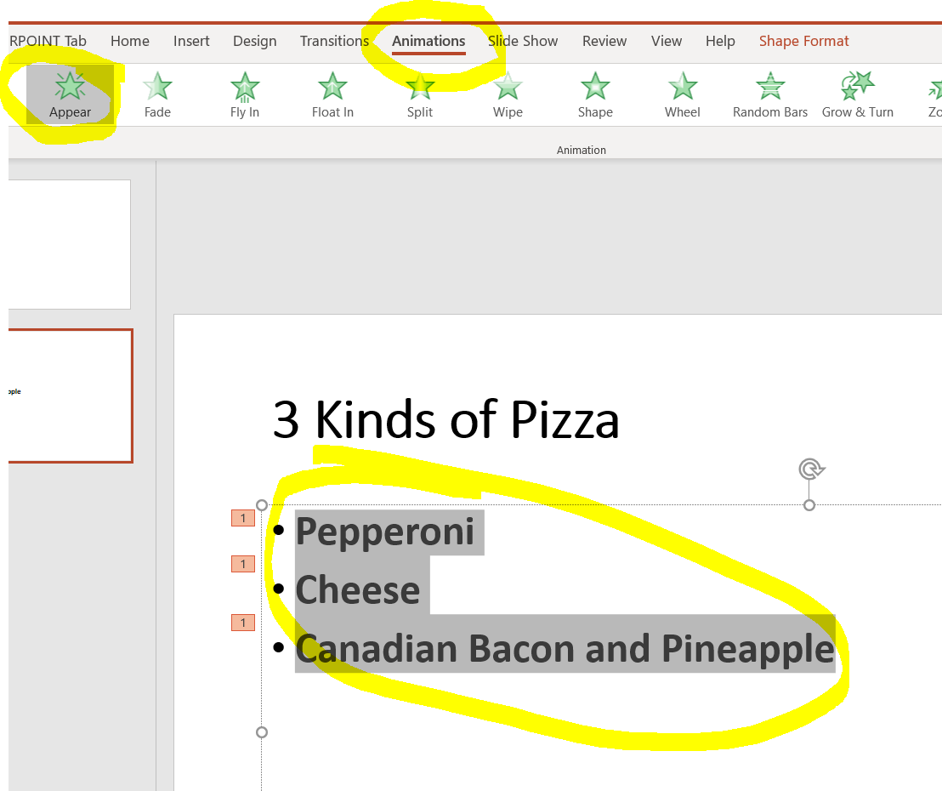
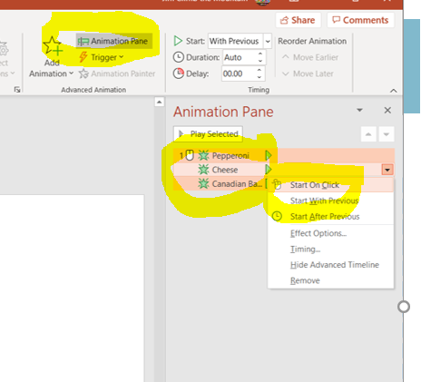
PowerPoint Animate Bullets & Pictures

Slide 38
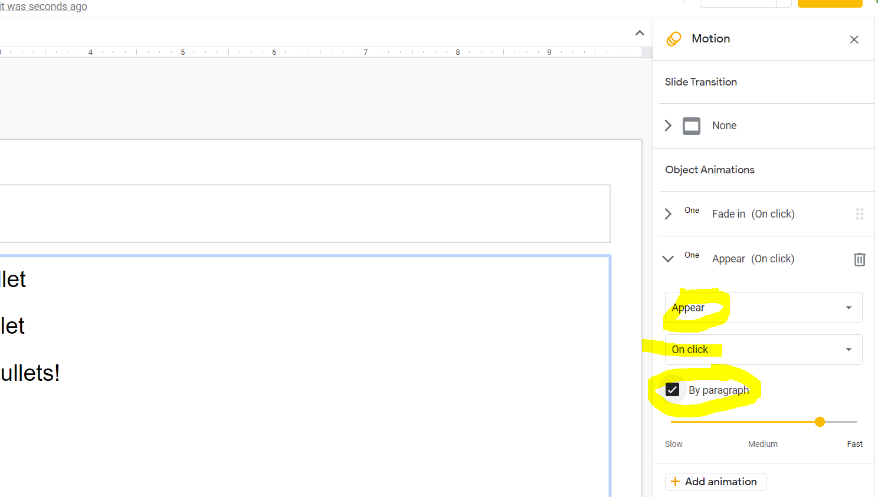
Google Slides Animate Bullets & Pictures

Slide 39
Animate your Pics and Bullets!

Slide 40
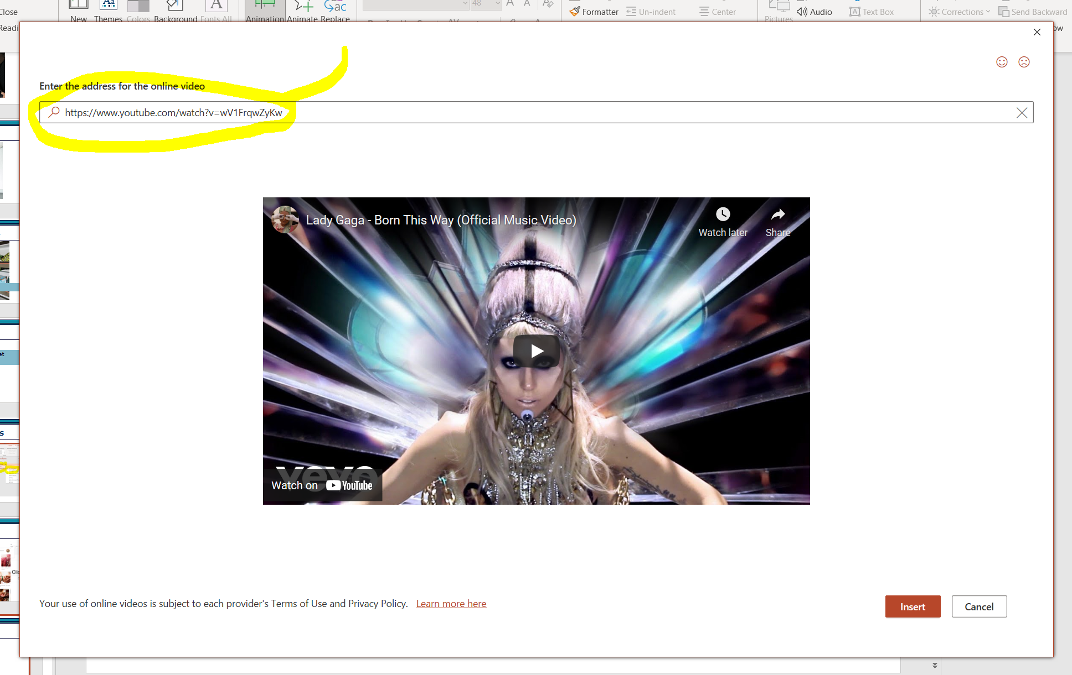
PowerPoint Slide with Video

Slide 41
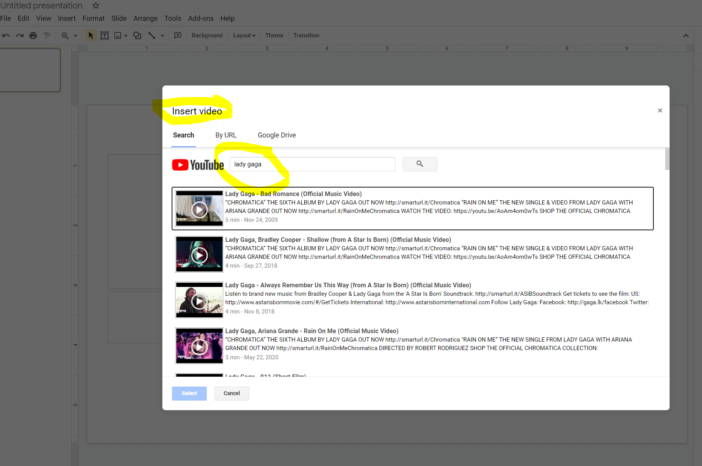
Google Slides Slide with Video

Slide 42
Add a Video to your Slide!

Slide 43
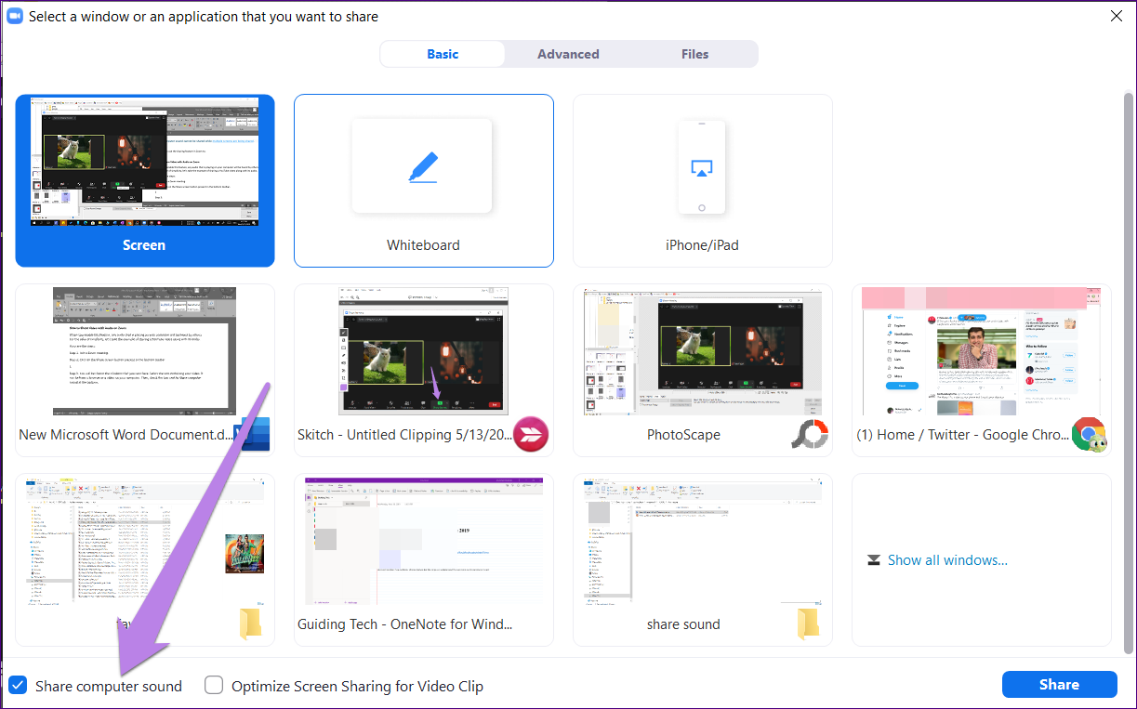
Sound? Zoom . . . Click “Share Computer Sound”

Slide 44
PowerPoint Theme your Slides

Slide 45
Google Slides Theme your Slides

Slide 46
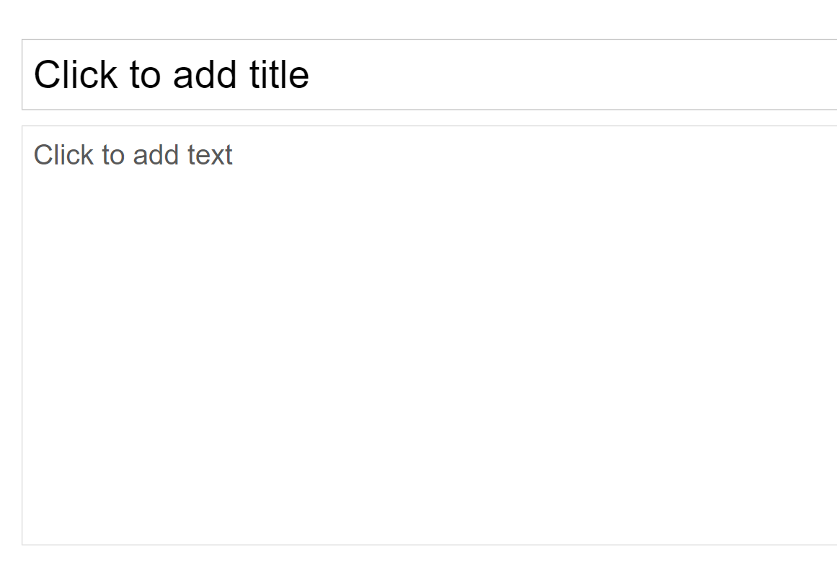

Slide 47
Theme your Slides!

Slide 48
NEXT WEEK!
We’ll get supporting material added in
We’ll get an Intro and Conclusion added in
You should do a bit of research on the topic—look for interesting stories and statistics on the topic!

