Slide 1
Interpretation Events
By: Kelsey D. Phifer
Climb the Mountain

Slide 2
What are Interpretation Events?
Interp events involve “acting” out stories in an “interpretive” manner.
In interpretative events you can increase your understanding of emotions. By learning to find, cut and perform an outstanding piece, you begin to recognize the motivation behind different actions, character traits, personalities etc.
To be successful, you need to create believable and interesting characters, which generally involves acting.

Slide 3
PREPARING YOUR INTERPRETATION PIECE
Find
Find a good Piece
- Find pieces at libraries, coaches, and the internet.
- Avoid pieces with only characters that are outside your cultural heritage.
- Take advantage of your gender or ethnicity.
Identify
Identify a theme in your piece
- Think about the context in which the piece is presented.
-Avoid overly complex themes.
Step 3: Cutting your piece
- Most pieces begin with a 45sec portion of the script-teaser.
- Put lines together from your reading to create a small script.
Make sure your cut has:
Varying emotions and scene intensity.
A central theme and plot.
A clear beginning, middle and conclusion.
4. A sense of resolution.

Slide 4
PREPARING YOUR INTERPRETATION PIECE CONT.
Step 4: Develop your introduction
- The introduction is about four or five sentences written by yourself that tell the audience the theme, author and title of your piece.
Step 5: Performing
- Memorize your piece
- WORK ON CHARACTER POPPING (HI)
- Develop characters
- Incorporate Choreography movements

Slide 5
Kinds of Interp Events
Humorous Interpretation (HI)
Dramatic Interpretation (DI)
DUO Interpretation -DUO Can be Humorous (HDA) or Dramatic (DDA)
Prose/Poetry (PRO/PO)

Slide 6
Take Notes
We will go over each category in detail. I also have example pieces for you to read.
When you hear a piece you like, be sure to write down the title, and event.
At the end of class, you will read your chosen speech with expression and appropriate emotion.
Each speech in the competition will be 5-7minutes long.

Slide 7
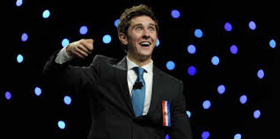
HUMEROUS INTERPRETATION (HI)
For those who have a natural funny bone, Humorous Interpretation (HI) is the right event for you. You do not have to be a stand up comedian, all you need is a little enthusiasm, dynamic style and a funny piece. A 5-7 minute performance of a humorous, published work where the competitor performs ALL characters.
Movement should be restricted so that the performer does not travel outside a two-foot box around him or herself.

Slide 8
TIPS for Humorous Interpretation
Feel free to be creative
You can give your character a voice that is different than yours. For example, think of a cartoon characters voice, or a family members voice, and imitate it as one of your characters.
Sometimes HI will have multiple characters, each character should have a unique voice to help the judge identify which character is speaking.
You can also implement sound effects. For example, if your piece involves opening a door, you can make a squeak sound with your mouth as you open the door. This will bring your piece to life!
**** Here are some tips to get you started. I will give you feedback to help improve your performance as we progress***

Slide 10
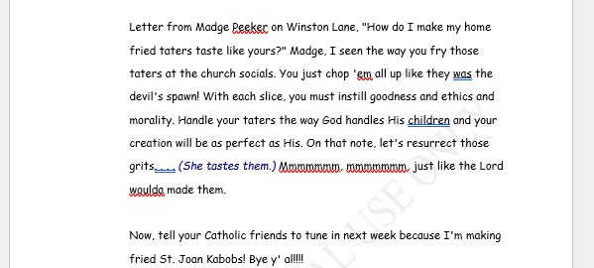

Slide 11
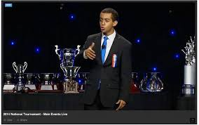
DRAMATIC INTERPRETATION (DI)
Unlink Humorous Interpretation, Dramatic Interpretation is more serious, and meant to be humorous.
This is an 5-7 minute performance of a dramatic, published work of literary merit where the competitor performs all characters. Movement is constricted to about a two-foot radius around the performer.
Dramatic Interpretation is more like narrating a story while also acting as the character.

Slide 12
TIPS for Dramatic Interpretation (DI)
You want to make sure that you are speaking in a manner that reflects the characters feelings in the moment.
Take short pauses in moments that will give dramatic effect.
In DI, you are a character that is telling their own story.
Unlike HI, you may not need to change your voice for your character, unless it is necessary.
EG: If your character in from the southern states, and that is a major detail in your piece, you may want to speak in a southern accent.
**** Here are some tips to get you started. I will give you feedback to help improve your performance as we progress***

Slide 13
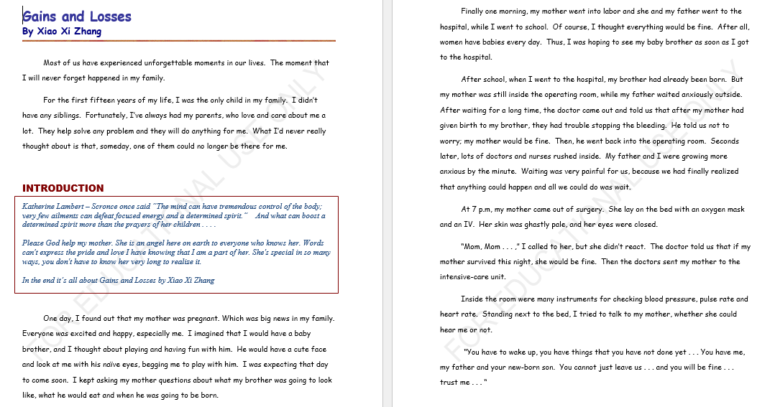

Slide 14
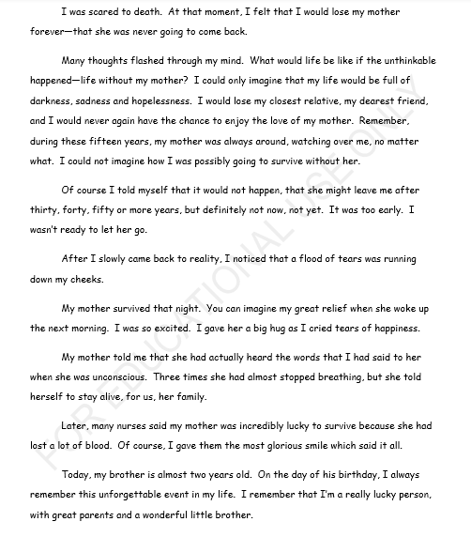

Slide 15
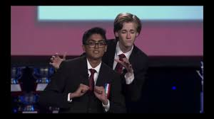
DUO INTERPRETATION
DRAMATIC DUET ACTING (DDA)
HUMOROUS DUET ACTING (HDA)
A 5-7 minute performance of a two person, humorous, published work of literary merit.
Depending on the state, the two performers cannot touch each other, make eye contact and speak directly to one another.
HDA is like Humorous interpretation, except it is done with a partner.
Two competitors get to act or interpret scenes from their favorite plays or stories. The same rules for HDA apply for DDA only the piece is dramatic instead of humorous.
DDA is like Dramatic Interpretation, except it is done with a partner.

Slide 16
TIPS for DUO Interpretation
Choose a partner that you work well with.
Each of you should pick a piece, and decide who would play which character the best.
For A dramatic piece, You want to make sure that you are speaking in a manner that reflects the characters feelings in the moment.
For a humorous piece, use voice distinctions and sound effects.
**** Here are some tips to get you started. I will give you feedback to help improve your performance as we progress***

Slide 17
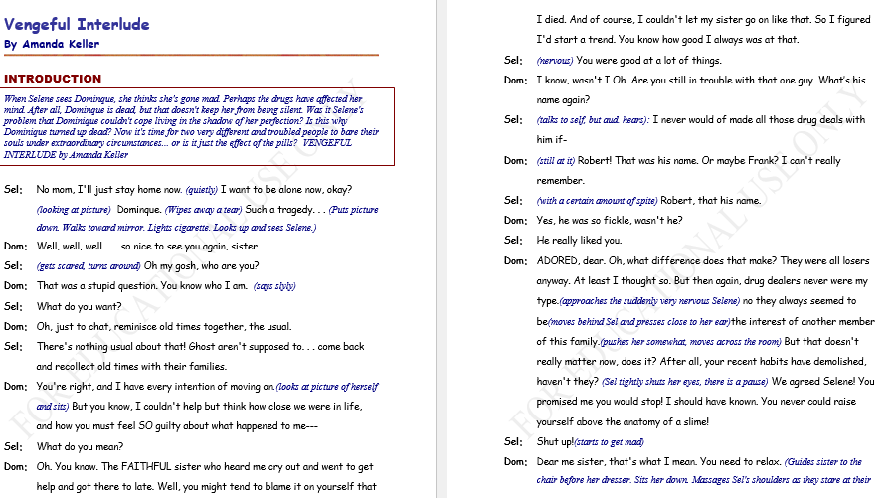

Slide 18
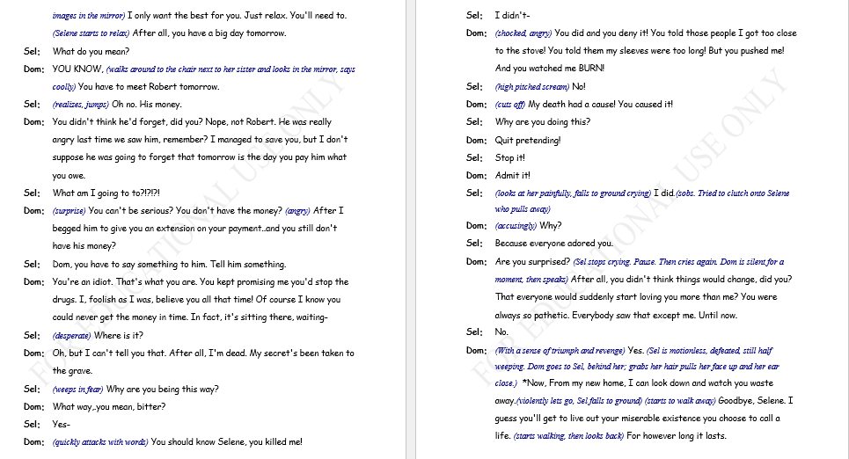

Slide 19
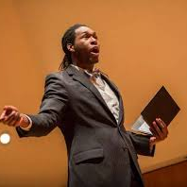
PROSE
Those who love reading will enjoy Prose.
This event is for pieces of fiction and science fiction. If you have a favorite book or story, you might just have a winning Prose piece.
This is an 5-7 minute event where the performer reads a published story. The story can have characters with dialogue but the majority of the piece should be narration. This can be either humorous or dramatic.

Slide 20
TIPS FOR PROSE
In this event you are reading from a book.
Read as if you are a teacher reading to preschoolers.
Use enticing facial expressions, hand gestures, and word coloring.
**** Here are some tips to get you started. I will give you feedback to help improve your performance as we progress***

Slide 23
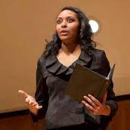
POETRY
Poetry explores the depth of ‘versed’ writing.
Poems designed to tell a story or evoke strong feelings provide an audience with a rhythmic presentation.
Poetry does not have to rhyme it is only limited by the mind of the poet. This is an eight minute collection of published poems of literary merit linked together by a common theme. The poems can be from different authors and of different lengths, humorous or dramatic.

Slide 24
POETRY TIPS
Make sure your voice expression matches the tone of each poem.
Utilize word coloring to hold the attention of your audience/judge.
**** Here are some tips to get you started. I will give you feedback to help improve your performance as we progress***

Slide 26
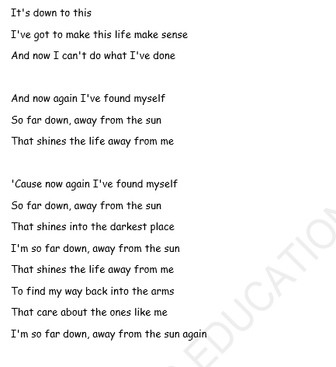

Slide 27
Let’s Practice
Which event and piece was your favorite?
Now its time to read it with interpretation!
Do your best, we are just getting started ☺

Slide 28
Go find some literature for your interp section!
Where to look
What to look for
Libraries
Book Stores
The internet
Books (Can be chapter books or non chapter books)
Children’s books
Poems for the “poetry/prose”
Search online for monologues from plays, tv shows, books, or movie scenes.

Slide 29
How to cut your interp piece
If the literature you find is long, like a chapter book, you will need to “cut” it into a short monologue.
1. Read the entire book. Highlight parts that are funny, touching, or sad while you read. Use post it notes to write down general idea of the scene.
2. Narrow down your cutting to one primary narrative. Choose one central storyline to make into a 5-7 minute speech.
3. Don’t start cutting at the beginning of the piece. Decide what the climax will be and design your cutting around that.

