Slide 1
WE ARE DEBATING TODAY!
It is a “Follow the Flow” Debate
With Contentions
AND
POIs.

Slide 2
YOUR TOPIC . . .
WRITE IT DOWN!

Slide 3
LET’S DO OUR OWN FOLLOW THE FLOW DEBATE
You are in teams!
BE SUPPORTIVE OF EACH OTHER
WHO’S PROP AND WHO’S OPP?

Slide 4
TEAMS—CHOOSE SPEAKER POSITIONS
PROP
1st Prop: MAKE YOUR CASE (Contentions)
2nd Prop: REBUILD CASE, RESPOND TO OPP CASE
3rd Prop: EXPLAIN WHY YOUR PARTNERS’S ARGUMENTS WIN
OPP
1st Opp: MAKE YOUR CASE (Contentions), RESPOND TO PROP CASE
2nd Opp: REBUILD CASE, REBUILD RESPONSES TO PROP CASE
3rd Opp: EXPLAIN WHY YOUR PARTNERS’ ARGUMENTS WIN

Slide 5
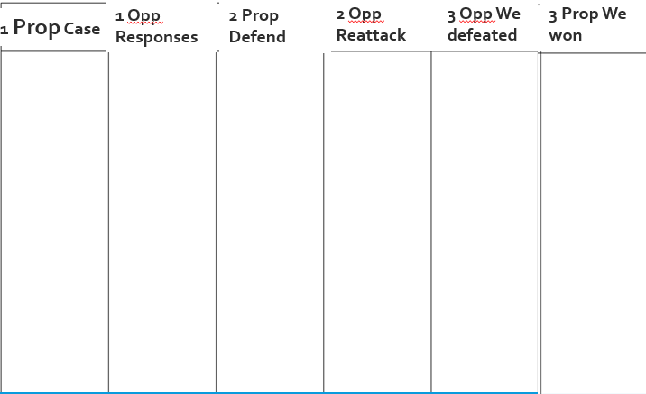
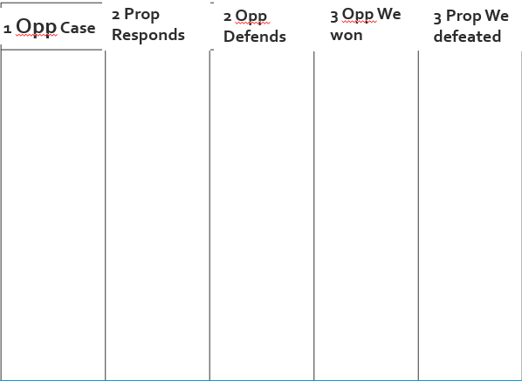
EVERYONE: Prepare your own Flowsheets
Then, Show your Two flowsheets to me.

Slide 6
REMEMBER TO flow right!
Use abbreviations Hurt becomes Hrt Small becomes Smll
Use shorthand Online becomes O Breaks becomes B
When you are next to speak—Remember the 90% Rule!
Example Flowed Argument
Z hrt anmls
Jeffre ‘18
Z gv bad diet
Z too smll spc

Slide 7
POINTS OF INFORMATION
During each speech, you can and should . . .
Ask questions
Make points
When recognized by an opponent giving a speech
For today, 30 seconds after the speech starts and before 30 seconds ends.
Note—you can’t do a POI for 30 seconds after a speaker takes one.

Slide 8
YOU DO IT!
In your teams . . .
One person presents an argument (not a contention)
One of the other two people does a POI
The presenter answers the POI.
Then go to the next person’s argument with a new POI and answer.

Slide 9
TIPS FOR DOING A POI
Ask about weaknesses/missing things in their argument
Avoid asking questions that let your opponent give long, good answers
Best way to ask “Where in your speech did you prove __________?”
Make sure, strong points against what they are saying
“The cost of your proposal is over $30 trillion. That will bankrupt our government ending all social services and protection for our country.”

Slide 10
TIPS FOR RESPONDING TO A POI
Respond as soon as possible
Use arguments in your speech to respond
Respond quickly—then talk about good arguments for your side
AND get back to the next contention/argument you need to address in your speech—as soon as possible.

Slide 11
Do it again!
Use the Tips
In your teams . . .
Present an argument
Do a POI
Respond to the POI
Go to the next person.

Slide 12
THE DEBATE WILL WORK LIKE THIS . . .
15 minutes Prep
4 minute maximum speeches
1st PROP: Present Two Contentions
1st OPP: Present One Contention, Respond to the Prop Contentions
2nd PROP: Respond to Opp Contention, Defend Prop Contentions
2nd OPP: Defend Opp Contention, Reattack the Prop Contentions
3rd OPP: We won our Contention; we defeated their Contentions
3rd PROP: We won our Contentions; we defeated their Contention.

Slide 13
GET YOUR SCRIPTS!
YOU USE THE SCRIPTS TO DO YOUR SPEECHES RIGHT
YOU ARE THE ONE MAKING THE ARGUMENTS!
THE SCRIPT TELLS YOU WHAT YOU NEED TO ADDRESS . . .

Slide 14
DURING PREP, I WILL COME INTO YOUR PREP ROOM
SHOW ME . . .
1ST SPEAKERS: YOUR SCRIPT INTRO AND FLOWS OF YOUR CONTENTIONS
2ND SPEAKERS: YOUR SCRIPT INTRO AND YOUR “RESPONSE PREP SHEETS”
3RD SPEAKERS: YOUR THINKING ABOUT YOUR SPEECH AND THAT YOU ARE HELPING PARTNERS INCLUDING BY NOT INTERRUPTING THEM.

Slide 15
PREP RULES
You can and should look at your prepared materials
But you cannot look at these prepared materials during the debate itself
You can and should work with your teammates
You do NOT work with . . .
The Internet/Google Search
Your Parents nor Friends nor Coaches.

Slide 16
Begin your 15 minutes prep!
Prop: Prep in this Breakout Room
Opp: Prep in Breakout Room +20.

Slide 17
DURING THE DEBATE . . .
BEFORE EACH SPEECH STARTS
I WILL ASK YOU TO SHOW ME . . .
1. You are using the right flowsheet
2. The next speaker is following the 90% Rule
DURING YOUR SPEECH . . .
You use the Scripts.

Slide 18
LET’S FOLLOW THE FLOW!

Slide 19
1 PROP PRESENT YOUR CASE ARGUMENT
1 OPP—FLOW YOUR RESPONSES: 90%!

Slide 20
1 OPP PRESENT YOUR CASE ARGUMENT
2 PROP—FLOW YOUR RESPONSES: 90%!

Slide 21
1 OPP RESPOND TO PROP CASE ARGUMENT
2 PROP—FLOW YOUR REBUILD RESPONSES: 90%!

Slide 22
2 PROP RESPOND TO OPP CASE ARGUMENT
2 OPP—FLOW YOUR REBUILD RESPONSES: 90%!

Slide 23
2 PROP REBUILD PARTNER’S CASE ARGUMENT
2 OPP—FLOW YOUR REBUILD RESPONSES: 90%!

Slide 24
2 OPP REBUILD PARTNER’S CASE ARGUMENT
3 OPP—FLOW WHY YOUR PARTNERS WIN THIS ARGUMENT: 90%!
3 PROP—FLOW WHY YOUR PARTNERS DEFEATED THIS ARGUMENT: 90%

Slide 25
2 OPP REBUILD PARTNER’S RESPONSES TO PROP CASE
3 OPP—FLOW WHY YOUR PARTNERS DEFEATED THIS ARGUMENT: 90%!
3 PROP—FLOW WHY YOUR PARTNERS WIN THIS ARGUMENT: 90%

Slide 26
3 OPP WHY YOUR PARTNERS WON THE OPP CASE ARGUMENT
3 PROP—FLOW WHY YOUR PARTNERS DEFEATED THIS ARG. 90%

Slide 27
3 OPP WHY YOUR PARTNERS DEFEATED THE PROP CASE ARGUMENT
3 PROP—FLOW WHY YOUR PARTNERS DEFEATED THIS ARG. 90%

Slide 28
3 PROP WHY YOUR PARTNERS DEFEATED THE OPP CASE ARGUMENT

Slide 29
3 PROP WHY YOUR PARTNERS WON YOUR PROP CASE ARGUMENT

Slide 30
How did that go?
Judges—reminder to email your ballot (wins/points) right away THEN TALK WITH THE KIDS . . .
What worked well/was most fun?
What was the hardest to do?
Here’s feedback and you redo that part of your speech for 1 to 2 minutes
Judges—AFTER YOU DO THE ABOVE . . . reminder to fill out the online comments form.

