Slide 1
WE ARE DEBATING TODAY!
It is a “Follow the Flow” Debate.

Slide 2
YOUR TOPIC . . .
WRITE IT DOWN!

Slide 3
First speakers need CONTENTIONS
An argument, even with AREI, isn’t as convincing as it could be
So, you prepare contentions . . .
Contentions are Main Arguments that are supported by arguments
The First Prop presents contentions in favor of the topic (all 5 minutes of the speech)
The First Opp presents contentions against the topic (for 2.5 minutes of the speech).

Slide 4
proP CONTENTIONS
PROBLEM-Show a problem exists
THE TOPIC SOLVES-Show the topic solves
IMPACT-Show solving the problem helps people a lot
PROBLEM-20 minute lunch time is too short
THE TOPIC SOLVES-40 minute lunch gives enough time
IMPACT-Longer lunch reduces stress and upset stomachs from eating too fast.
Now you Do it!

Slide 5
opp CONTENTIONS
LINK-THE TOPIC CAUSES OR INCREASES A PROBLEM
IMPACT-Show this problem would hurt people a lot.
LINK-Longer lunch means shorter classes
IMPACT-Shorter classes mean less learning and more stress before tests.
Now you Do it!

Slide 6
First opp and second prop SPEECHES WHERE YOU RESPOND
Predict what the Prop team’s arguments will be
Predict what the Opp team’s arguments will be.

Slide 7
BEST WAYS FOR YOU TO RESPOND …
If they say _____cars are good____
You say . . .
NOT/NO (cars are NOT good)
THEY DON’T SOLVE (better cars WONT help)
WE SOLVE BETTER (buses and light rail are better!)
Let’s try it . . .

Slide 8
Everyone write down 2 responses to . . .
A Prop Contention
Instructor present or have a student present a prop contention
Tell us your responses
Instructor give feedback for making stronger responses
Now Respond to an Opp Contention
Instructor do the same as above.

Slide 9
3rd speeches: SHOWING YOUR PARTNERS WON THE DEBATE!
YOUR JOB IS NOT TO MAKE NEW ARGUMENTS
YOUR JOB IS TO SHOW YOUR PARTNERS WON THE MAIN ARGUMENTS IN THE DEBATE
YOU WILL SAY “AS MY PARTNER SHOWED . . .” AND “WE WON THE SECOND CONTENTION WHEN MY PARTNER RESPONDED ____.”

Slide 10
What do you say in the 3rd speech? YOU ARE PROP . . .
THE PROP ARGUES CONDOS MAY COLLAPSE—THERE AREN’T REQUIREMENTS TO FIX THE CONDOS
THE OPP RESPONDS THAT CONDOS MUST HAVE AN INSPECTION EVERY 40 YEARS
YOU ARE NOW THE 3RD PROP SPEAKER—WHAT DO YOU SAY?

Slide 11
What do you say in the 3rd speech? YOU ARE PROP . . .
THE OPP ARGUES TOUGH NEW CONDO CODES WILL COST TOO MUCH
THE PROP RESPONDS THAT CONDO CODES ENSURE SAFETY AND THAT COMES FIRST PLUS BAD CODES MEANS LOWER VALUE FOR THE CONDOS
YOU ARE NOW THE 3RD PROP SPEAKER—WHAT DO YOU SAY?

Slide 12
LET’S DO OUR OWN FOLLOW THE FLOW DEBATE
You are in teams!
BE SUPPORTIVE OF EACH OTHER
WHO’S PROP AND WHO’S OPP?

Slide 13
TEAMS—CHOOSE SPEAKER POSITIONS
PROP
1st Prop: MAKE YOUR CASE (Contentions)
2nd Prop: REBUILD CASE, RESPOND TO OPP CASE
3rd Prop: EXPLAIN WHY YOUR PARTNERS’S ARGUMENTS WIN
OPP
1st Opp: MAKE YOUR CASE (Contentions), RESPOND TO PROP CASE
2nd Opp: REBUILD CASE, REBUILD RESPONSES TO PROP CASE
3rd Opp: EXPLAIN WHY YOUR PARTNERS’ ARGUMENTS WIN

Slide 14
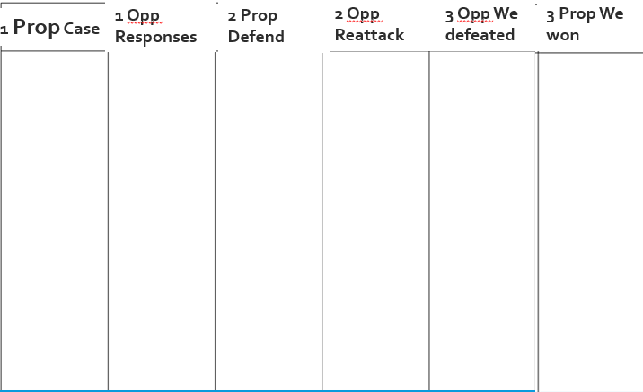
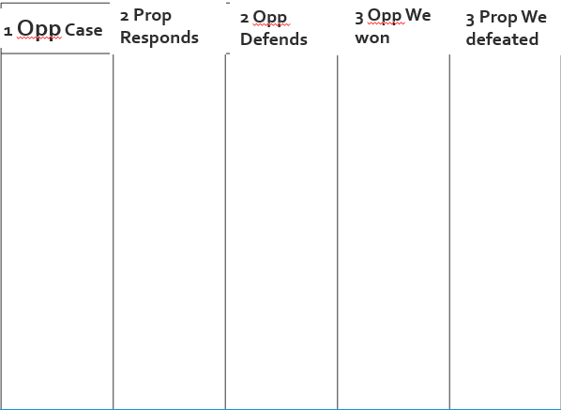
EVERYONE: Prepare your own Flowsheets
Then, Show your Two flowsheets to me.

Slide 15
REMEMBER TO flow right!
Use abbreviations Hurt becomes Hrt Small becomes Smll
Use shorthand Online becomes O Breaks becomes B
When you are next to speak—Remember the 90% Rule!
Example Flowed Argument
Z hrt anmls
Jeffre ‘18
Z gv bad diet
Z too smll spc

Slide 16
THE DEBATE WILL WORK LIKE THIS . . .
15 minutes Prep
Each Speech is 3 minutes
1st PROP: Present Two Contentions
1st OPP: Present One Contention, Respond to the Prop Contentions
2nd PROP: Respond to Opp Contention, Defend Prop Contentions
2nd OPP: Defend Opp Contention, Reattack the Prop Contentions
3rd OPP: We won our Contention; we defeated their Contentions
3rd PROP: We won our Contentions; we defeated their Contention.

Slide 17
GET YOUR SCRIPTS!
YOU USE THE SCRIPTS TO DO YOUR SPEECHES RIGHT
YOU ARE THE ONE MAKING THE ARGUMENTS!
THE SCRIPT TELLS YOU WHAT YOU NEED TO ADDRESS . . .

Slide 18
DURING PREP, I WILL COME INTO YOUR PREP ROOM
SHOW ME . . .
1ST SPEAKERS: YOUR SCRIPT INTRO AND FLOWS OF YOUR CONTENTIONS
2ND SPEAKERS: YOUR SCRIPT INTRO AND YOUR “RESPONSE PREP SHEETS”
3RD SPEAKERS: YOUR THINKING ABOUT YOUR SPEECH AND THAT YOU ARE HELPING PARTNERS INCLUDING BY NOT INTERRUPTING THEM.

Slide 19
Begin your 15 minutes prep!
Prop—stay in this Zoom breakout room
Opp—go to the breakout room numbered 20 higher than your current breakout room (eg if you are in breakout room 8 now, go breakout room 28).

Slide 20
DURING THE DEBATE . . .
BEFORE EACH SPEECH STARTS
I WILL ASK YOU TO SHOW ME . . .
1. You are using the right flowsheet
2. The next speaker is following the 90% Rule
DURING YOUR SPEECH . . .
You use the Scripts.

Slide 21
LET’S FOLLOW THE FLOW!

Slide 22
1 PROP PRESENT YOUR CASE ARGUMENT
1 OPP—FLOW YOUR RESPONSES: 90%!

Slide 23
1 OPP PRESENT YOUR CASE ARGUMENT
2 PROP—FLOW YOUR RESPONSES: 90%!

Slide 24
1 OPP RESPOND TO PROP CASE ARGUMENT
2 PROP—FLOW YOUR REBUILD RESPONSES: 90%!

Slide 25
2 PROP RESPOND TO OPP CASE ARGUMENT
2 OPP—FLOW YOUR REBUILD RESPONSES: 90%!

Slide 26
2 PROP REBUILD PARTNER’S CASE ARGUMENT
2 OPP—FLOW YOUR REBUILD RESPONSES: 90%!

Slide 27
2 OPP REBUILD PARTNER’S CASE ARGUMENT
3 OPP—FLOW WHY YOUR PARTNERS WIN THIS ARGUMENT: 90%!
3 PROP—FLOW WHY YOUR PARTNERS DEFEATED THIS ARGUMENT: 90%

Slide 28
2 OPP REBUILD PARTNER’S RESPONSES TO PROP CASE
3 OPP—FLOW WHY YOUR PARTNERS DEFEATED THIS ARGUMENT: 90%!
3 PROP—FLOW WHY YOUR PARTNERS WIN THIS ARGUMENT: 90%

Slide 29
3 OPP WHY YOUR PARTNERS WON THE OPP CASE ARGUMENT
3 PROP—FLOW WHY YOUR PARTNERS DEFEATED THIS ARG. 90%

Slide 30
3 OPP WHY YOUR PARTNERS DEFEATED THE PROP CASE ARGUMENT
3 PROP—FLOW WHY YOUR PARTNERS DEFEATED THIS ARG. 90%

Slide 31
3 PROP WHY YOUR PARTNERS DEFEATED THE OPP CASE ARGUMENT

Slide 32
3 PROP WHY YOUR PARTNERS WON YOUR PROP CASE ARGUMENT

Slide 33
How did that go?
What worked well/was most fun?
What was the hardest to do?
Here’s feedback and you redo that part of your speech for 1 to 2 minutes.

