Slide 1
CLIMBING review
What is A R E I?
Assertion, Reason, Evidence, Importance
Make your own A R E I now on this topic (different from the zoos topic we are doing now) . . .
Middle Schoolers should not use social media
Two students share you’re A R E I now.

Slide 2
CLIMBING review
What helps you flow an argument (so your writing keeps up with the speaker)?
What is the rule for flowing when you will respond to your opponent’s arguments?

Slide 3
FLOWSHEETS
You MUST USE FLOWSHEETS for your debates
To follow the speakers in the order they present . . .
1 PROP | 1 OPP | 2 OPP | 2 PROP | 3 OPP | 3 PROP

Slide 4
You flow . . .
Your speeches
Your partner’s speeches
Your opponent’s speeches
You take notes on ALL the arguments in the debate!
YES—IRRITATING AT FIRST BUT . . .
YOU GET USED TO IT AND YOU BENEFIT.

Slide 5
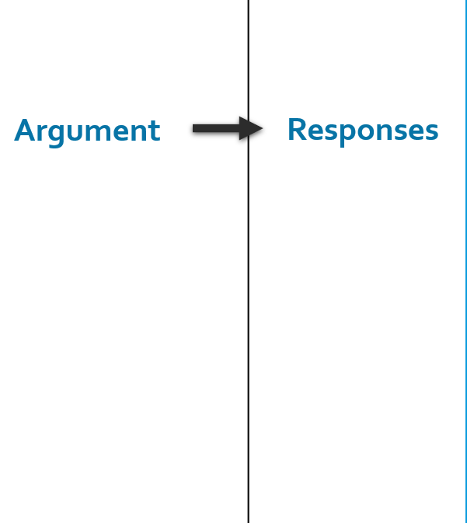
the idea behind flowsheets
You make a column to flow
For each speaker’s arguments
From left to right.
Rebuild
Etc.

Slide 6
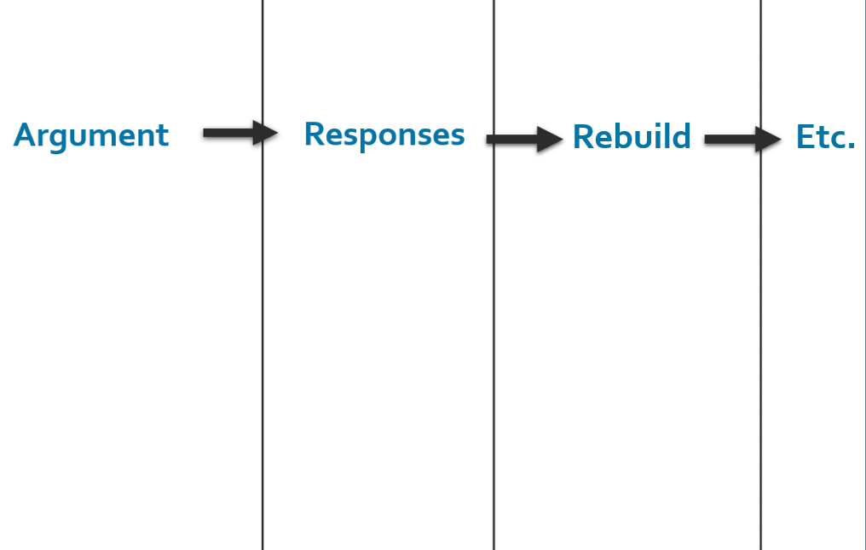
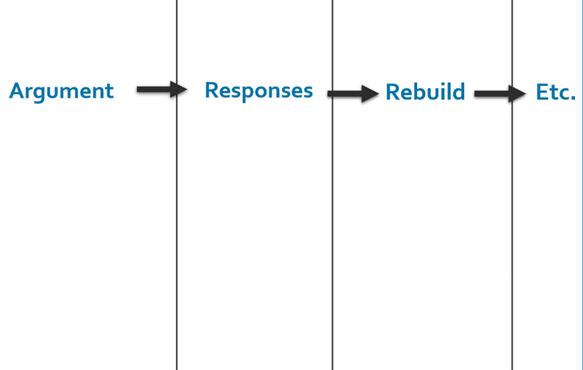
THE DEBATERS MAKE TWO FLOWSHEETS
One for Arguments and Responses about the Prop Case
One for Arguments and Responses about the Opp Case
Prop
Opp
Prop Flowsheet
Opp Flowsheet

Slide 7
In full Here are the two flowsheets . . .

Slide 8
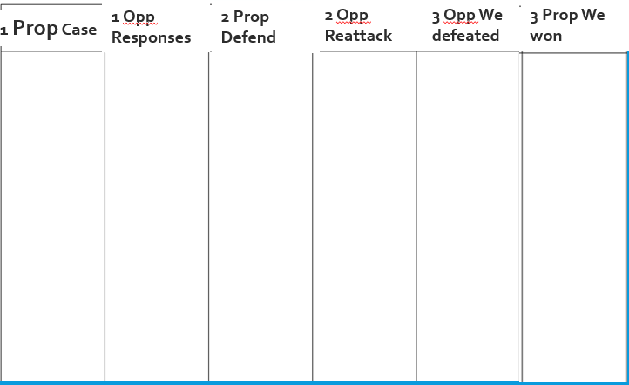
Prop Flowsheet

Slide 9
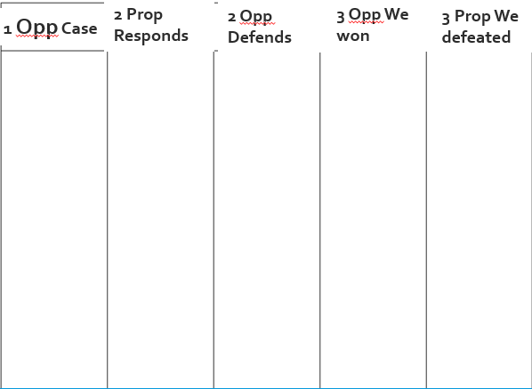
Opp Flowsheet

Slide 10
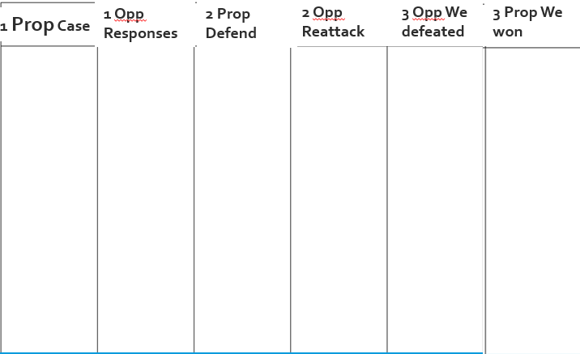
Now Prepare your own Flowsheets
Then, Show your Two flowsheets to me.

Slide 11
And now . . .
Hang on to your two flowsheets
I’m going to show you how the flowsheets get used in a debate
But don’t write on your own flowsheets while I do this.

Slide 12
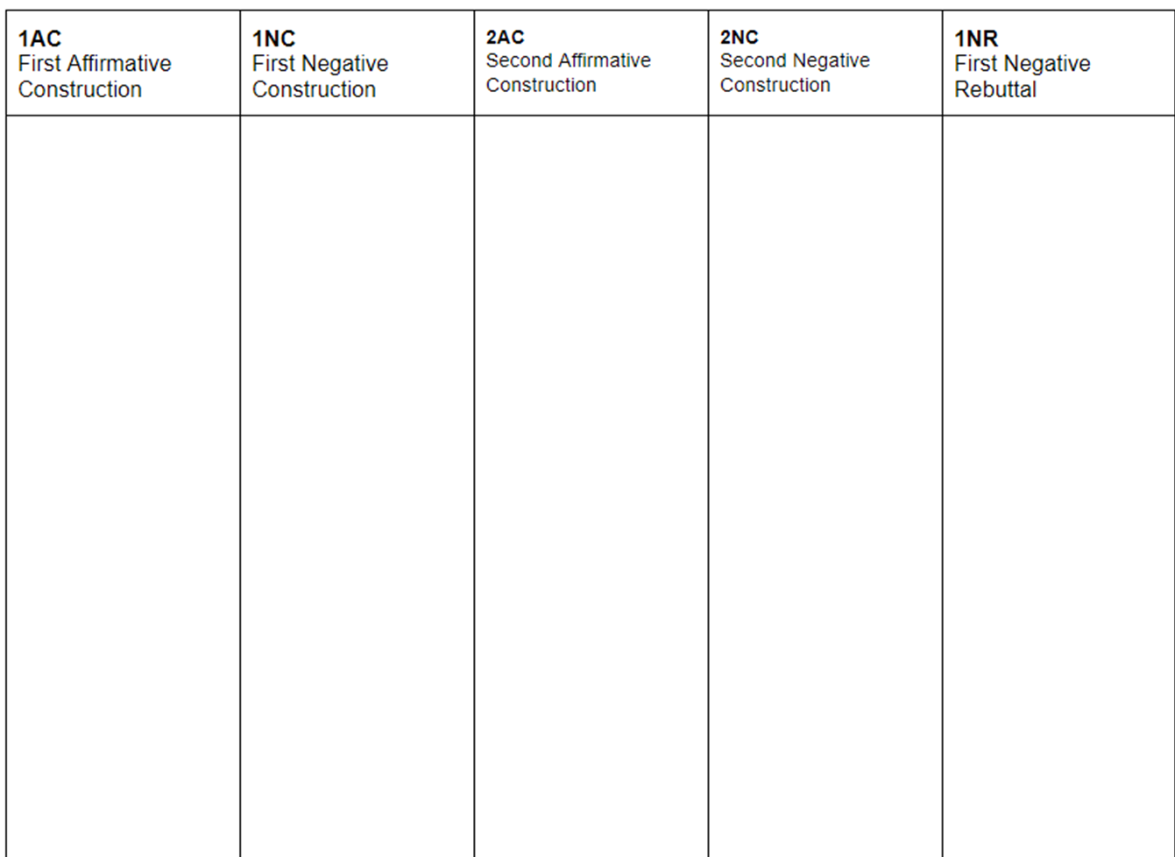
1 Pro
Presents case
Where do you flow the speaker?
1 Prop Case
1 Opp Responses
2 Prop Defend
2 Opp Reattack
3 Opp We defeated
3 Prop We won
1 Opp Case
2 Prop Responds
2 Opp Defends
3 Opp We won
3 Prop We defeated
1. Zoos give animals too little space
2. Zoos don’t feed animals well

Slide 13
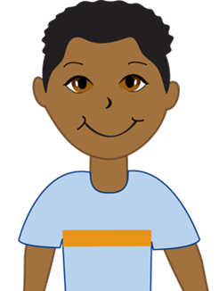
1 Opp
Presents case AND Responds
Where do you flow the speaker?
1 Prop Case
1 Opp Responses
2 Prop Defend
2 Opp Reattack
3 Opp We defeated
3 Prop We won
1 Opp Case
2 Prop Responds
2 Opp Defends
3 Opp We won
3 Prop We defeated
1. Zoos now provide natural, large habitats
2. Zoos provide excellent care and food
1. Zoos protect and repair hurt animals
2. Zoos help endangered animals
1. Zoos give animals too little space
2. Zoos don’t feed animals well

Slide 14
2 Prop
Respond to Opp Case
Defends Prop Case
Where do you flow the speaker?
1 Prop Case
1 Opp Responses
2 Prop Defend
2 Opp Reattack
3 Opp We defeated
3 Prop We won
1 Opp Case
2 Prop Responds
2 Opp Defends
3 Opp We won
3 Prop We defeated
1. Zoos now provide natural, large habitats
2. Zoos provide excellent care and food
1. Zoos new habitats are still too small
2. Zoo food and care is uneven—animals don’t eat well
1. Zoos protect and repair hurt animals
2. Zoos help endangered animals
1. Zoos help very few animals
2. Nature Reserves are better for endangeredanimals
1. Zoos give animals too little space
2. Zoos don’t feed animals well

Slide 15
2 Opp
Defends Opp Case
Reattacks Prop Case
Where do you flow the speaker?
1 Prop Case
1 Opp Responses
2 Prop Defend
2 Opp Reattack
3 Opp We defeated
3 Prop We won
1 Opp Case
2 Prop Responds
2 Opp Defends
3 Opp We won
3 Prop We defeated
1. Zoos now provide natural, large habitats
2. Zoos provide excellent care and food
1. Zoos new habitats are still too small
2. Zoo food and care is uneven—animals don’t eat well
1. Zoos habitats are more than good for animals
2. Zoo food keep animals in good care for years
1. Zoos protect and repair hurt animals
2. Zoos help endangered animals
1. Zoos help very few animals
2. Nature Reserves are better for endangeredanimals
1. Zoos help thousands of animals
2. Zoos and nature reserves can both help endangered animals
1. Zoos give animals too little space
2. Zoos don’t feed animals well

Slide 16
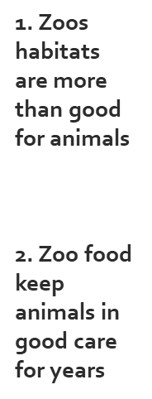
3 Opp
We won Opp Case
We defeated Prop Case
Where do you flow the speaker?
1 Prop Case
1 Opp Responses
2 Prop Defend
2 Opp Reattack
3 Opp We defeated
3 Prop We won
1 Opp Case
2 Prop Responds
2 Opp Defends
3 Opp We won
3 Prop We defeated
1. Zoos now provide natural, large habitats
2. Zoos provide excellent care and food
1. Zoos new habitats are still too small
2. Zoo food and care is uneven—animals don’t eat well
1. Zoo habitats are large and natural good for animals
2. Zoo animals are well fed with good care
1. Zoos protect and repair hurt animals
2. Zoos help endangered animals
1. Zoos help very few animals
2. Nature Reserves are better for endangeredanimals
1. Zoos help thousands of animals
2. Zoos and nature reserves can both help endangered animals
1. Zoos do protect and repair—they are good.
2. Zoos help—nature reserves can’t handle all animals
1. Zoos give animals too little space
2. Zoos don’t feed animals well

Slide 17
3 Prop
We defeated Opp Case
We won Prop Case
Where do you flow the speaker?
1 Prop Case
1 Opp Responses
2 Prop Defend
2 Opp Reattack
3 Opp We defeated
3 Prop We won
1 Opp Case
2 Prop Responds
2 Opp Defends
3 Opp We won
3 Prop We defeated
1. Zoos now provide natural, large habitats
2. Zoos provide excellent care and food
1. Zoos new habitats are still too small
2. Zoo food and care is uneven—animals don’t eat well
1. Zoo habitats are large and natural good for animals
2. Zoo animals are well fed with good care
1. Zoos are too small; animals suffer
2. Zoos don’t feed the animals well—uneven food
1. Zoos protect and repair hurt animals
2. Zoos help endangered animals
1. Zoos help very few animals
2. Nature Reserves are better for endangeredanimals
1. Zoos help thousands of animals
2. Zoos and nature reserves can both help endangered animals
1. Zoos do protect and repair—they are good.
2. Zoos help—nature reserves can’t handle all animals
1. Zoos help is a small percent of all animals
2. Nature Reserves are better for animals including endangered animals
1. Zoos give animals too little space
2. Zoos don’t feed animals well

Slide 18
LET’S DO OUR OWN FOLLOW THE FLOW DEBATE
GET INTO TEAMS (OF 3 USUALLY)
BE SUPPORTIVE OF EACH OTHER
WE’LL SET MORE PERMANENT TEAMS IN A FEW WEEKS
WHO’S PROP AND WHO’S OPP? LET’S SET THAT NOW.

Slide 19
TEAMS—CHOOSE SPEAKER POSITIONS
PROP
1ST PROP: MAKE YOUR CASE
2ND PROP: REBUILD CASE, RESPOND TO OPP CASE
3RD PROP: EXPLAIN WHY YOUR PARTNERS’S ARGUMENTS WIN
OPP
1ST OPP: MAKE YOUR CASE, RESPOND TO PROP CASE
2ND OPP: REBUILD CASE, REBUILD RESPONSES TO PROP CASE
3RD OPP: EXPLAIN WHY YOUR PARTNERS’ ARGUMENTS WIN

Slide 20
FOLLOW THE FLOW DEBATE TOPIC
WRITE THE TOPIC DOWN!
DOING THAT IS A MUST FOR DEBATE!

Slide 21
1 PROP AND 1 OPP: CONCISELY, TELL THE GROUP WHAT YOU WILL ARGUE
OTHER DEBATERS: BE THINKING . . .
HOW YOU WILL DEFEND YOUR PARTNER’S ARGUMENT
AND HOW WILL YOU RESPOND TO YOUR OPPONENT’S ARGUMENT.

Slide 22
1 PROP AND 1 OPP: PRE-FLOW YOUR CASE ARGUMENT
YOU’VE GOT 2 MINUTES.
SHOW ME YOUR FLOWSHEET!

Slide 23
1 PROP PRESENT YOUR CASE ARGUMENT
1 OPP—FLOW YOUR RESPONSES: 90%!

Slide 24
1 OPP PRESENT YOUR CASE ARGUMENT
2 PROP—FLOW YOUR RESPONSES: 90%!

Slide 25
1 OPP RESPOND TO PROP CASE ARGUMENT
2 PROP—FLOW YOUR REBUILD RESPONSES: 90%!

Slide 26
2 PROP RESPOND TO OPP CASE ARGUMENT
2 OPP—FLOW YOUR REBUILD RESPONSES: 90%!

Slide 27
2 PROP REBUILD PARTNER’S CASE ARGUMENT
2 OPP—FLOW YOUR REBUILD RESPONSES: 90%!

Slide 28
2 OPP REBUILD PARTNER’S CASE ARGUMENT
3 OPP—FLOW WHY YOUR PARTNERS WIN THIS ARGUMENT: 90%!
3 PROP—FLOW WHY YOUR PARTNERS DEFEATED THIS ARGUMENT: 90%

Slide 29
2 OPP REBUILD PARTNER’S RESPONSES TO PROP CASE
3 OPP—FLOW WHY YOUR PARTNERS DEFEATED THIS ARGUMENT: 90%!
3 PROP—FLOW WHY YOUR PARTNERS WIN THIS ARGUMENT: 90%

Slide 30
3 OPP WHY YOUR PARTNERS WON THE OPP CASE ARGUMENT
3 PROP—FLOW WHY YOUR PARTNERS DEFEATED THIS ARG. 90%

Slide 31
3 OPP WHY YOUR PARTNERS DEFEATED THE PROP CASE ARGUMENT
3 PROP—FLOW WHY YOUR PARTNERS DEFEATED THIS ARG. 90%

Slide 32
3 PROP WHY YOUR PARTNERS DEFEATED THE OPP CASE ARGUMENT

Slide 33
3 PROP WHY YOUR PARTNERS WON YOUR PROP CASE ARGUMENT

