Slide 1
Let’s debate!
Jim Hanson

Slide 2
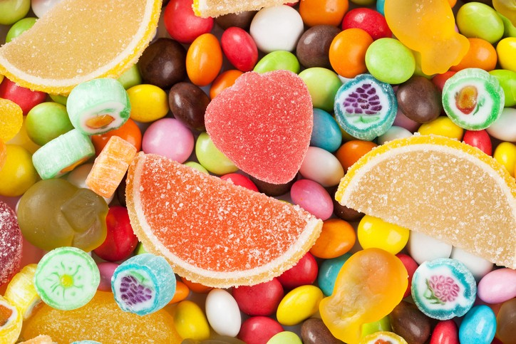
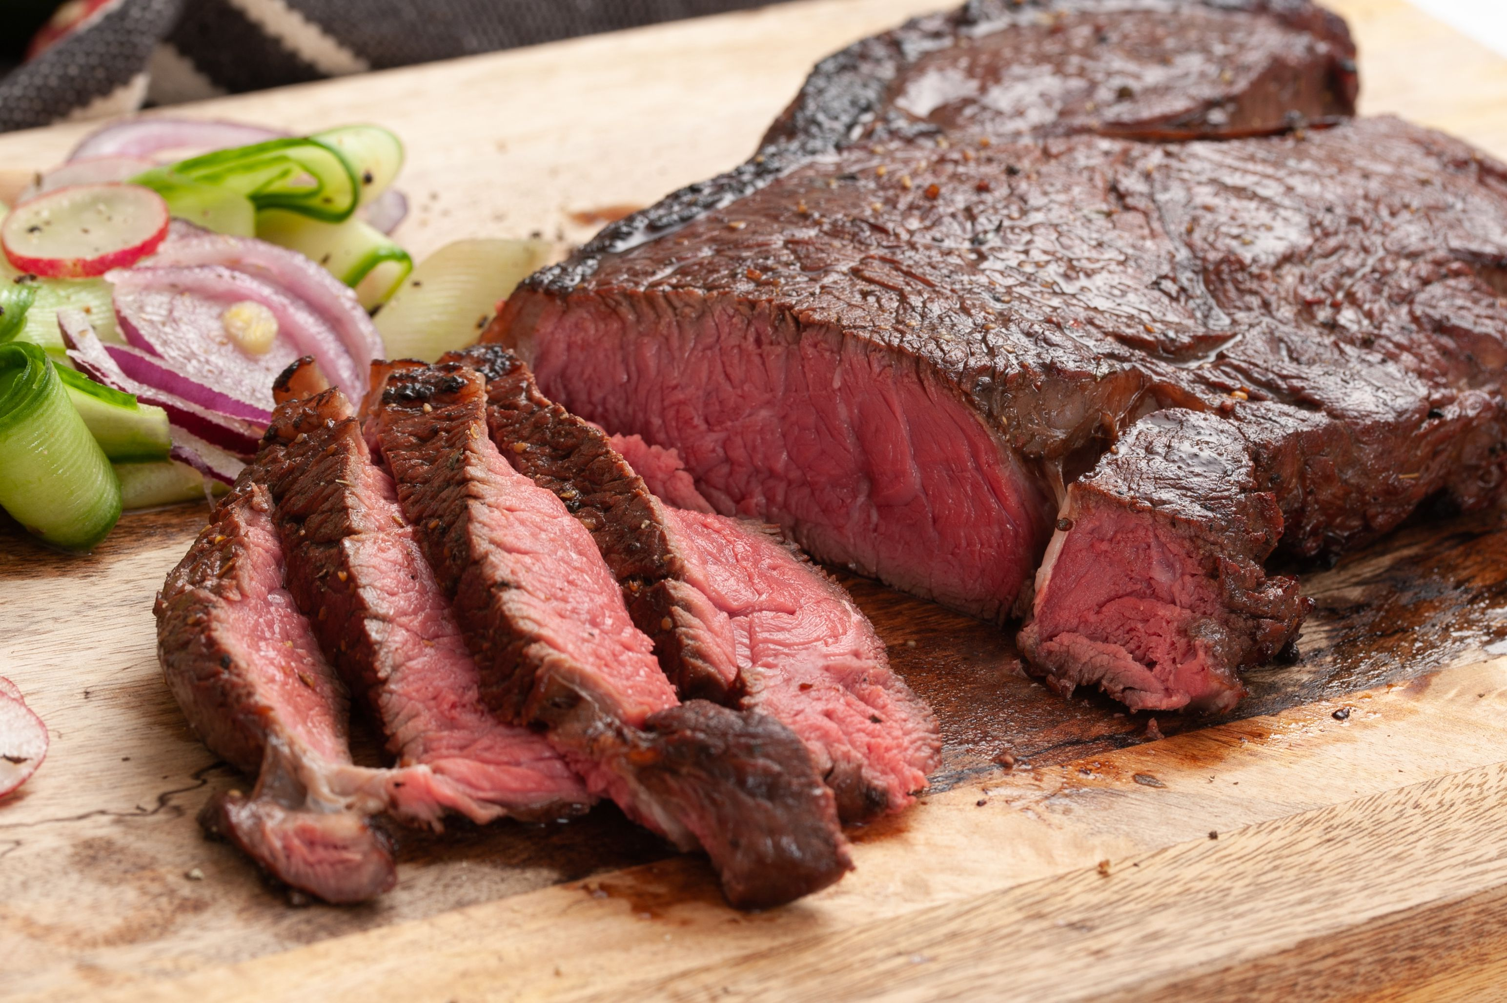
What’s your favorite food?

Slide 3
We have our opinions
We are working together
We are a team and we support each other.

Slide 4
Communicate it!
Each person, tell your group . . .
Your name and anything important to you
Your favorite food.

Slide 5
Making an argument
Assertion-your point
Reason-because ___
Evidence-proof
Importance-why this matters
Sugary beverages harm health
Because they increase diabetes
High sugar consumption is linked to diabetes in studies
So, we should try to reduce consumption of sugary beverages.

Slide 6
Ready to make an argument about . . .
Your favorite show?
School start times?
The best Video Game?
Something else?

Slide 7
Now . . . Make your argument in your group
Assertion—your point
Reason—because ___
Evidence—show proof
Importance—why this matters

Slide 8
Debate involves respectful disagreement
When a debater says steak is the best food . . .
You can argue “steak is NOT that good tasting”
You can argue “steak means harming animals—that’s not the best”
You can argue “Sushi is more delicious”

Slide 9
Now . . . I disagree game
In teams of two . . .
One person presents their argument
The other person then says “I disagree because ____________”
Then reverse roles.

Slide 10
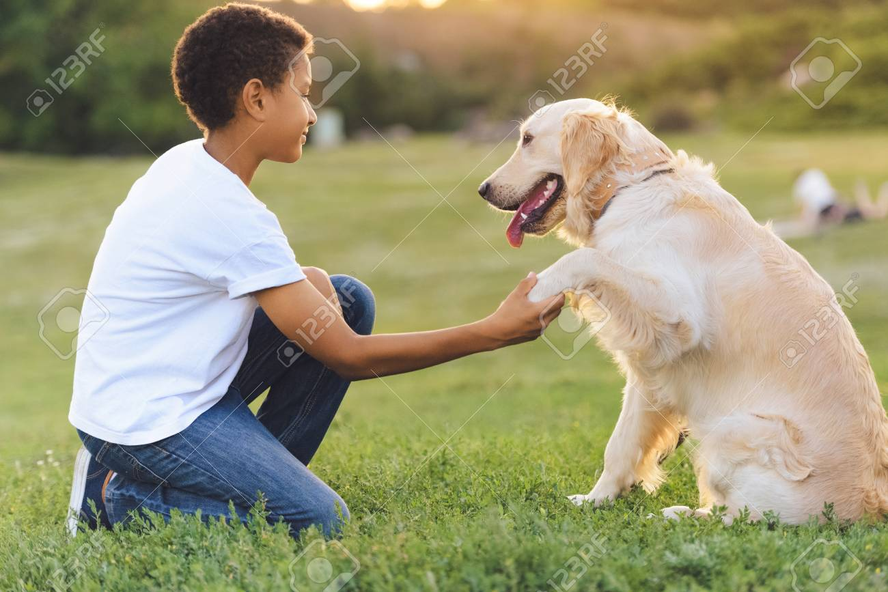
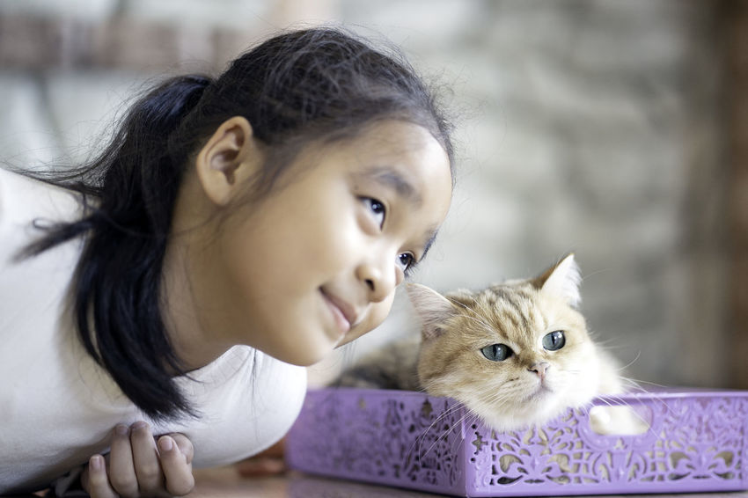
Dogs or cats?
Some people love dogs
Some people love cats

Slide 11
Some people don’t like either

Slide 12
TOPIC: dogs are better than cats
One debater is Proposition—and favors the topic.
The other debater is Opposition—and is against the topic
Pick now which side you will be on (in most rooms—3 debaters are aff, 3 debaters are neg)
Sometimes, you don’t get your preferred choice.

Slide 13
TOPIC: dogs are better than cats
PROP prepare an argument (AREI) for the topic—and be ready to disagree with arguments the con might present.
OPP prepare an argument (AREI) against the topic—and be ready to disagree with arguments the pro might present.
You will present 1 minute speeches in a short debate with each other.

Slide 14
NOW: MINI-DEBATE ONE ON ONE
1 minute Prop Speech (present your argument using AREI)
1 minute Opp Speech (present your argument using AREI AND respond to the Prop Arguments)
1 minute Prop Speech (respond to the Opp arguments and defend your arguments)
1 minute Opp Speech (defend your arguments and respond again to the Prop arguments)

Slide 15
How did it go?

Slide 16
WHAT IS THE FIRST TOPIC FOR THE CAMP?
Zoos should be banned.
What arguments will come up?

Slide 17
Get your google/bing on!
Search for the answer to these questions:
Name a zoo that has had problems? What were the problems?
Name an expert that supports ending zoos? Why does this expert think this?
Name an expert that believes zoos are good? Why does the expert think this?

Slide 18
Now—prepare an argument!
Half of Lab: Prepare an argument with 2 AREIs for why homework should be banned
Other Half of Lab: Prepare an argument with 2 AREIs for why homework should NOT be banned
One Person—tell us your Should Ban Argument
One Person—tell us your Should NOT Ban Argument.

Slide 19
WHEN A DEBATER PRESENTS AN ARGUMENT, YOU Take notes . . .
TAKING NOTES IN DEBATE IS CALLED FLOWING
FLOW MY ARGUMENT . . .
When I say stop, you have to stop—drop your pen!

Slide 20
flowing better
Flow the tagline/claim
Flow the source
Flow the support for the tagline/claim.
Example Flowed Argument
Zoos save animals
National Geographic 2020
Zoos protect hurt injured animals and allow animal to engage in breeding

Slide 21
ABBREVIATE
Shrtn wrds w/o vwls
Endgrd Spcs
Or just the first letters of longer words
Treat Dang Qual
Example Flowed Argument
Zs sv anmls
Nat Geog 2020
Prtct hrt anmls, allw brding

Slide 22
Shorthand
Endangered Species = ES
Zoos = Z
Increases = ↑
Solves = S
Example Flowed Argument
Z = encg bd view of anmls
Pro Anml Rts 2022
↑Viewing, ↓ Rspct for anmls in the wld
NOTICE: How much less you have to write!

Slide 23
EXAMPLE FLOWED ARGUMENT
Z hrt anmls
Jeffre ‘18
Z gv bad diet
Z too smll spc
TRY FLOWING AGAIN—Here is another argument.

Slide 24
Now—let’s do it real!
Someone present their SHOULD BAN argument
Flow it!

Slide 25
Now, it gets tougher!

Slide 26
Flowing WHEN RESPONDING
Create two columns
I will present an argument
You write responses
TRY IT . . .
How many responses did you get?
Argument
Responses

Slide 27
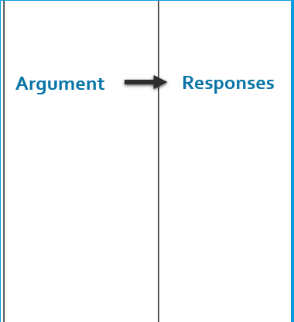
BETTER Flowing WHEN RESPONDING
Flow just the assertion
Then spend 90% of your time writing your responses
TRY IT AGAIN.
I’ll will present an argument—WRITE RESPONSES!
90%
10%

Slide 28
Now—let’s do it real!
Someone present their Should require argument
Flow your Responses!
How many Responses did you get?
Who’s willing to present their responses?

Slide 29
As we debate, treat each other right
We argue Ideas
We don’t argue against People
Look around the Zoom Room
These are your team members—show you support each other
If at anytime you are not being treated right—tell the lab leader, your parent, or Jim Hanson
If you see someone being mistreated—you are encouraged to put a stop to it. “Hey Stop that.” “Hey, let’s do something else.” “Yep, I’m going to contact Jim Hanson.”

Slide 30
What you need for debates
Pens (Black/Dark Blue)
Flowsheets (Print Paper 8.5 x 11 or larger)
Printed Scripts
Let’s look at each step of preparing on the Climb Middle School Prep Web Page.

