Slide 1
Chapter 3: Disadvantages

Slide 2
What is a disadvantage?
A disadvantage (disad for short) is an argument that says the other side’s advocacy will cause something bad to happen.
A few important things to note:
Usually focuses on a problem to other side doesn’t bring up.
Usually needs an impact as big or bigger than the gov’s case.
It’s a reason why the plan is BAD, not a reason why the plan isn’t perfect.

Slide 3
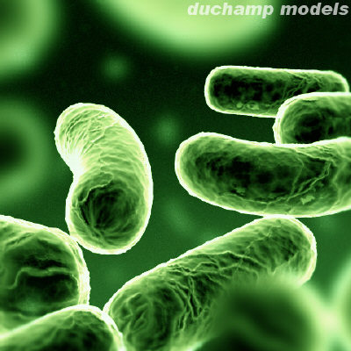
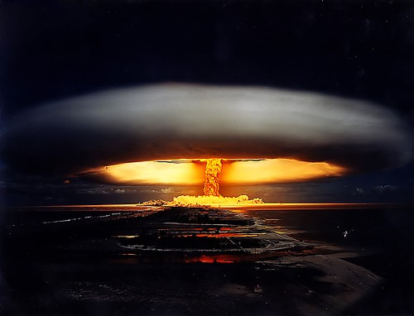
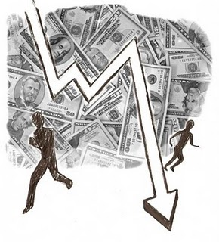
Preparing a disadvantage

Slide 4
Elements of a disadvantage
Uniqueness: The impact of the disadvantage is not going to happen in the status quo.
Links: The government’s advocacy would cause the disadvantage to happen.
Impacts: Causing the disadvantage to happen would be very, very bad.

Slide 5
Practice
Prepare a disadvantage to this plan: The United States Federal Government should implement a 10 cent per ton tax on carbon emissions.
Example Disadvantage:
The economy is stable and slowly recovering now.
US GDP grew 5.7% last quarter.
Companies added 300,000 new jobs last month.
The plan would destroy the economy.
Would cause large businesses to cut jobs.
Would raise gas prices, so people would have less income.
Hurting the economy causes death and suffering.
Starvation: The US would cut its food aid, causing millions to starve.
Medical Care: People would lose their health insurance and die from preventable disease.

Slide 6
Responding to disadvantages

Slide 7
Types of responses
Non-Unique: The disadvantage will happen anyway.
No Link: The plan won’t cause the disadvantage.
No Impact: The disadvantage is much smaller than they say.
Link Turn: The plan stops the disadvantage from happening.
Impact Turn: The disadvantage is actually a good thing.

Slide 8
Example Responses
Opp’s Disadvantage
Gov’s responses
The economy is stable/recovering now.
US GDP grew 5.7% last quarter.
Plan hurts the economy.
Would cause large businesses to cut jobs.
That causes starvation/no health care.
Starvation: The US would cut its food aid, causing millions to starve.
Non-Unique: Economy is terrible now—deficit growing rapidly.
No Link: Alternatives to carbon are available, cheap.
Turn: Plan brings in tax dollars, reduces the deficit.
No Impact: Only a few people would be affected.

Slide 9
DEFENDING A disadvantage

Slide 10
Responding to arguments
5 KEY THINGS IN DEFENDING A DISAD
Start by restating the title of the DA and _very_ briefly the link and impact
Respond to each opponent response to the DA
Point out key points in your DA that your opponent did not respond to (“they dropped ____”)
Always list out the reasons the link is still there
Always list out the impacts and explain why the DA impact wins the debate.

