Slide 1
LD Cases!
Climb the Mountain Speech and Debate
LD Lab Day 1
Created By Lucas Watson and Jim Hanson

Slide 2
RESEARCHING IS NOT EASY
Over time, you will get better and better
And have an amazing skill that will give you a HUGE heads up over others
Here’s how to do it . . .

Slide 3
SEARCH FOR AN ARGUMENT
Go to Google
Don’t just type in the topic e.g. “Standardized Testing”
Instead type in words from your argument
Example: You are looking for “Standardized testing is racist”
Type in: Standardized testing racist
What did you find?
But you can and should also try . . .

Slide 4
SYNONYM SEARCHES
But you can and should also try . . .
Standardized testing racist discriminatory equity bias
Tip: Type the word into MS Word/Google Docs and look for synonyms.
ALSO Think: How would you word a sentence that made your argument? Use those words in your search
What did you find?

Slide 5
MAKING THE QUOTATION READY FOR YOUR CASES/RESPONSES
Copy and Paste the section you found (that makes the argument and gives reasons for the argument) into your document
Then include the citation/source ABOVE what you copied and pasted
Author, qualifications, Date
Web page address
Doing the citation/source is irritating but it is required. You’ll do it faster after you get used to it.

Slide 6
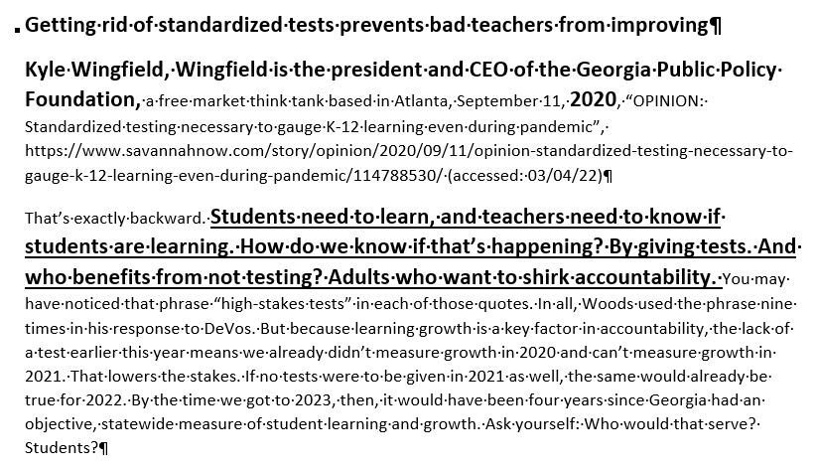
YOUR WORK SHOULD LOOK SOMETHING LIKE THIS
Note that you want to bold and underline the part you will read
But you don’t need to do that now.

Slide 7
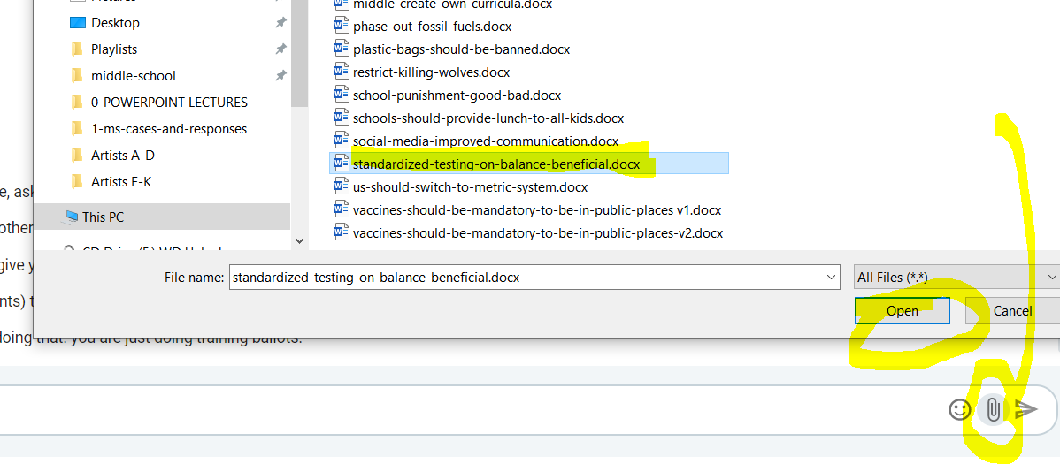
RIGHT NOW: SHARE YOUR WORK ON PUMBLE
Share a link to a Google Doc
or
Upload a Word file.

Slide 8
Case Construction (Affirmative)
Affirm the Resolution
Definitions
Framework (Value/Criterion)
Contention One and Two (maybe Three if time)
Subpoint A (Card 1)—Tag
Subpoint B (Card 2)—Tag
Have clear links with reasons
Have Impacts!
Link the Contention to your Framework
Repeat for Contention Two and Three if have a 3.

Slide 9
Contention Construction (Affirmative)
Introduce a problem
Show that the resolution SOLVES this problem
Give impacts – show how this is a net benefit
Connect it to your framework
Climate change will eventually cause mass global extinction.
Implementing taxes that scale proportionately with wealth will allow the government more funding for environmental research. (here is some evidence to prove this)
This is important because climate change is guaranteed to happen if we don’t find a way to stop it, inevitably killing off humanity.
The wealthy are morally obligated to help find a way to stop extinction because life takes priority above all else, and only through the redistribution of wealth can this be accomplished.

Slide 10
Case Construction (Negation)
Negate the Resolution
Definitions
Framework (Value/Criterion)
Contention One
Subpoint A (Card 1)—Tag
Subpoint B (Card 1)—Tag
Make sure the contention has impacts and link to Framework
Keep your Negative Case to 3.5 minutes
About HALF THE LENGTH of the Aff Case
Why? So you can spend HALF of your 1NC reading quotations and making analysis refutations against the affirmative.

Slide 11
Contention Construction (Negation)
Introduce a problem
Show that the resolution CAUSES or is LINKED TO this problem
Give impacts – show how this is a net harm
Connect it to your framework
The super wealthy get their net worth from things that cannot be taxed.
Implementing taxes that scale proportionately with wealth will hit the non-wealthy harder because they have liquid assets that can be taxed. (here is some evidence to prove this)
This is important because the super rich wouldn’t actually have to give anything up, while everyone else would be forced to pay more, leading to increased poverty.
This naturally does not promote equality, and goes directly against the idea of utilitarianism because 99% of people aren’t super wealthy.

Slide 12
Framework Overview
Value/Criterion Format
Value: What do you (and the judge, hopefully) value—What matters?
Morality
Justice
Democracy
Life
Criterion: How do we evaluate (measure)?
Utilitarianism
Deontology

Slide 13
What is a value?
The reason you give the judge to vote for you. It’s the concept you base the moral “right”ness of your case on.
Example: My value is preventing death because death is objectively bad, and as such we want to avoid things that cause a lot of death. (Implication: the Aff world will have significantly less deaths than the Neg, so therefore the Aff should win.)
Usually a concept or objective.
What kind of values might apply to the following statements?
In a democracy, voting ought to be compulsory.
A just government ought to prioritize civil liberties over national security.
The United States ought to provide a universal basic income.

Slide 14
What is a criterion?
A standard to measure something. Used in a case to determine how/if its value can be achieved.
Example: My criterion is the reduction of exploitation because overexploitation of the environment causes extinction. (Explain it in a way that relates to the topic.)
Usually a philosophical or ethical concept.
What kind of criteria might be useful for the following topics and values?
Vigilantism is justified when the government has failed to enforce the law. (Value: Justice)
Just governments ought to require that employers pay a living wage. (Value: Health)
States ought not possess nuclear weapons. (Value: Life)

Slide 15
Two ways to approach Value/Criterion
Pick a value/criterion and create contentions that can support them
Example: I value privacy, which can be achieved through decentralization, so here are three contentions proving that.
This is the easier method, BUT you can technically also do this:
Create contentions, then pick a value/criterion and edit the contentions to fit
Example: A common theme between my three contentions is equality, and I’m able to prove that it can be achieved through the free market economy.
*Now let’s brainstorm some frameworks!*

Slide 16
Let’s Work on Cases!
Ask me if you have any questions—I’m here to help!

