Slide 1
Let’s debate!
Jim Hanson

Slide 2
PREPARING FOR DEBATES!
Do the Prepare Steps on the Web Page before each class.

Slide 3
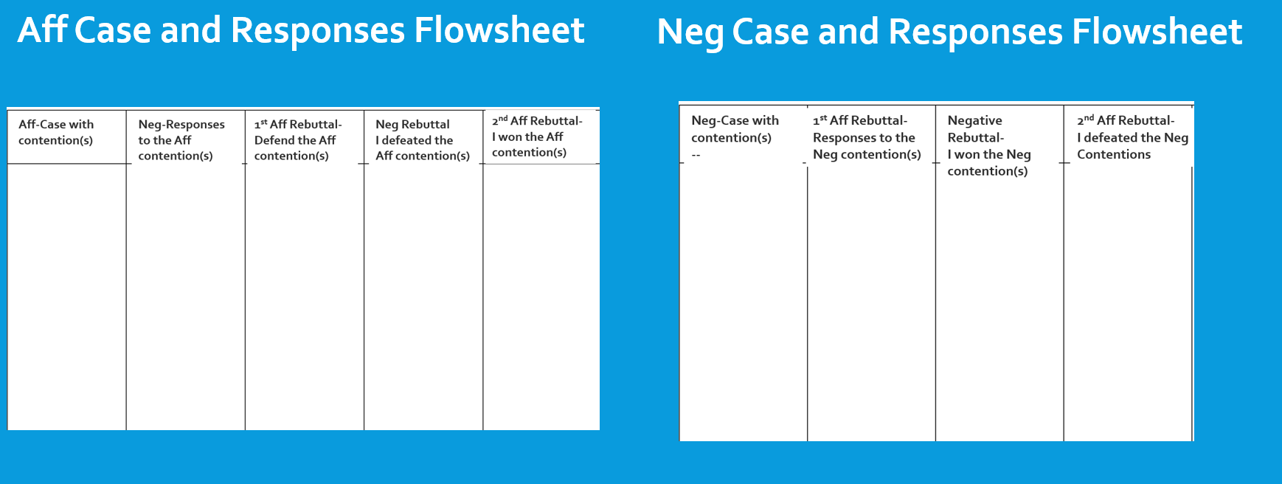
1. SHOW YOUR FLOWSHEETS!

Slide 4
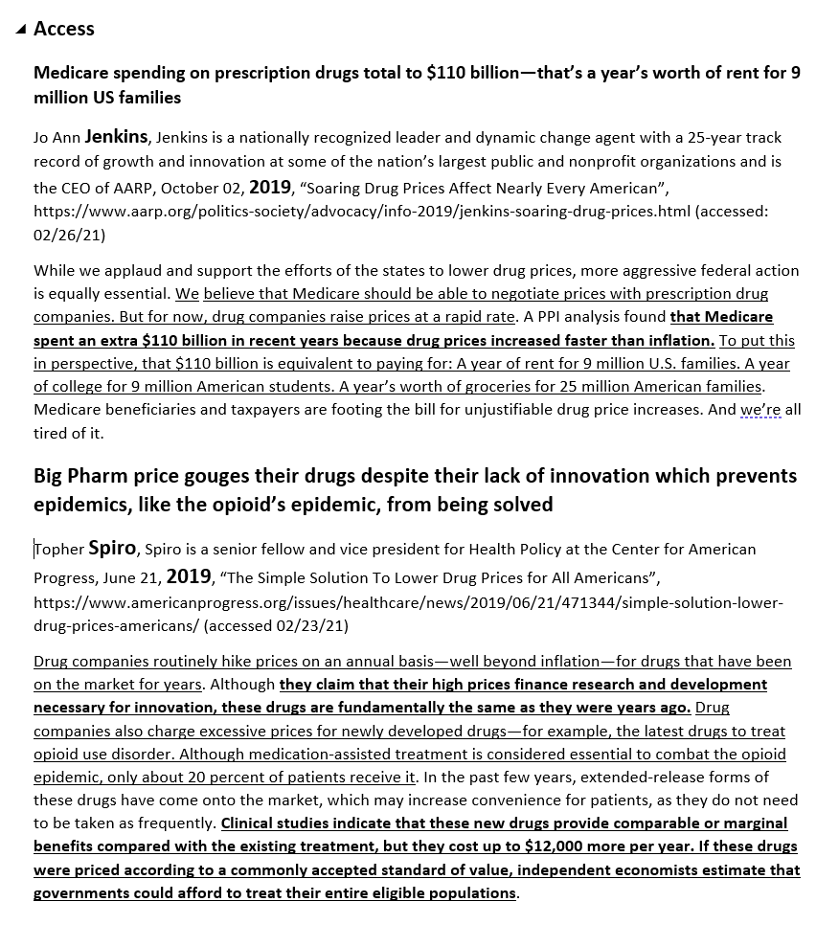
2. SHOW YOUR CASES AND REBUTTALS!
Not done?
Get the Short File—you are hereby using the Contentions and Rebuttals in that file.

Slide 5
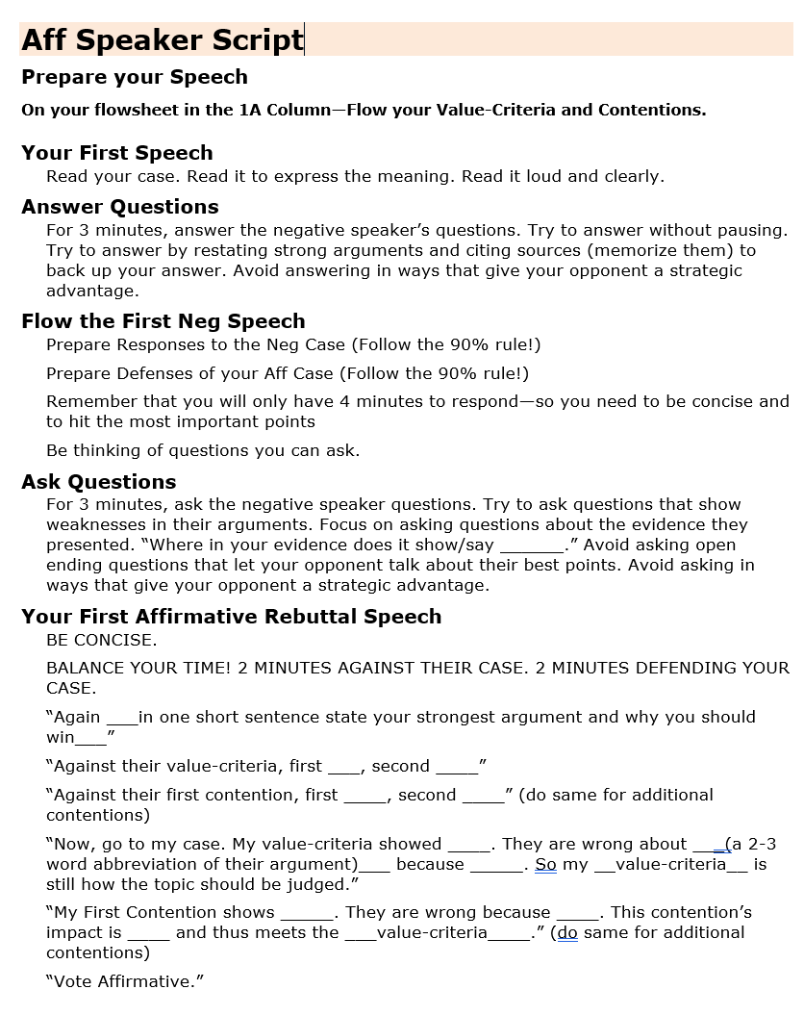
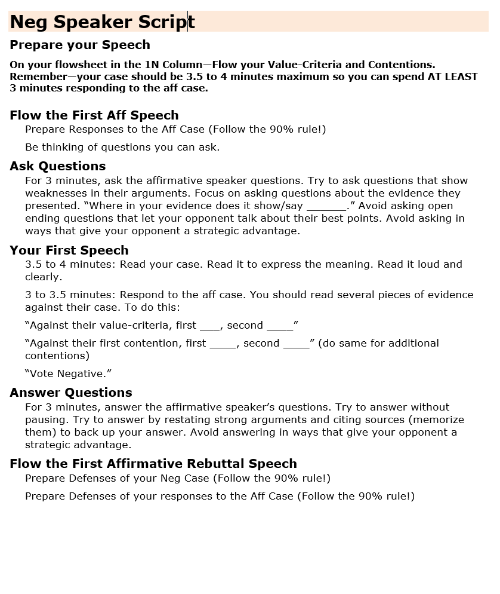
3. SHOW YOUR SCRIPTS!

Slide 6
BEFORE WE START THE FOLLOW THE FLOW DEBATES . . .
WE ARE GOING TO LEARN AND PRACTICE CROSS-EXAMINATION.

Slide 7
CROSS-EXAMINATION IS TIME TO Ask and answer questions
3 minutes where . . .
The Neg asks the Aff speaker questions
Then
The Aff asks the Neg speaker questions.

Slide 8
YOU’RE GOING TO DO IT!
1 Aff—present one argument (not contention) . . .
Then the Neg asks questions
For this group activity—everyone but the Aff speaker can and should ask questions.

Slide 9
HOW TO DO IT!
Ask your question
The debater answers
YES—ask a follow-up question.

Slide 10
Now--DO IT!
Someone ask a question!

Slide 11
TIPS FOR ASKING
Ask about weaknesses/missing things in their argument
“You don’t have proof testing harms students in your speech do you?”
Avoid asking questions that let your opponent give long, good answers
NO: “Why is testing a good idea.”
Best way to ask “Where in your speech did you prove __________?”

Slide 12
TIPS FOR answering
Answer as soon as possible (long pauses often imply lack of knowledge or hesitancy)
Use arguments in your speech to answer questions
“Yes, Deena Jones in our first contention showed ______”
Tough Question? Answer quickly—then talk about good arguments for your side
“I don’t think so. What I do know is our second contention showed ______________.”

Slide 13
Do it again!
Someone present their Neg Case
Then everyone else asks questions as if they were the Aff debater.

Slide 14
DO A FOLLOW THE FLOW LD DEBATE! USING FLOWSHEETS AND SCRIPTS.
Regular Length speeches
What are the times?
Get your Scripts—they show you what you are supposed to do during the debate.

Slide 15
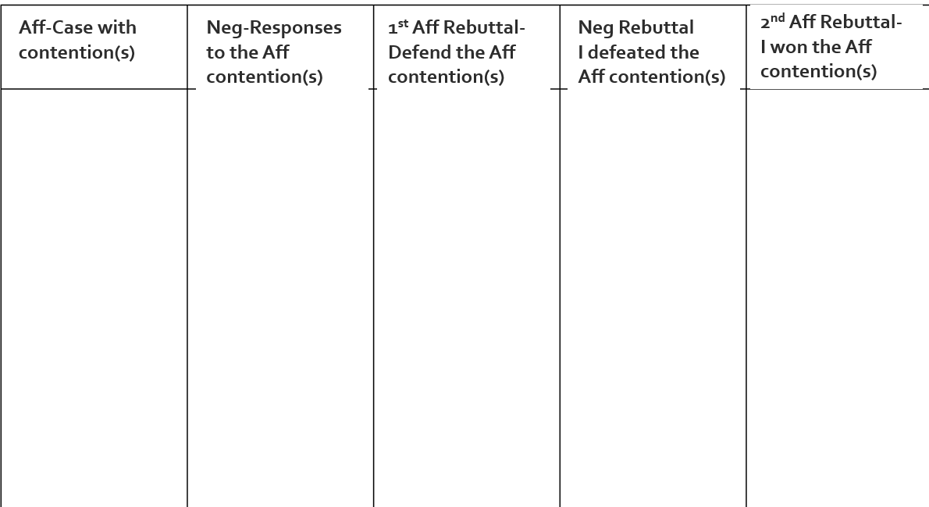
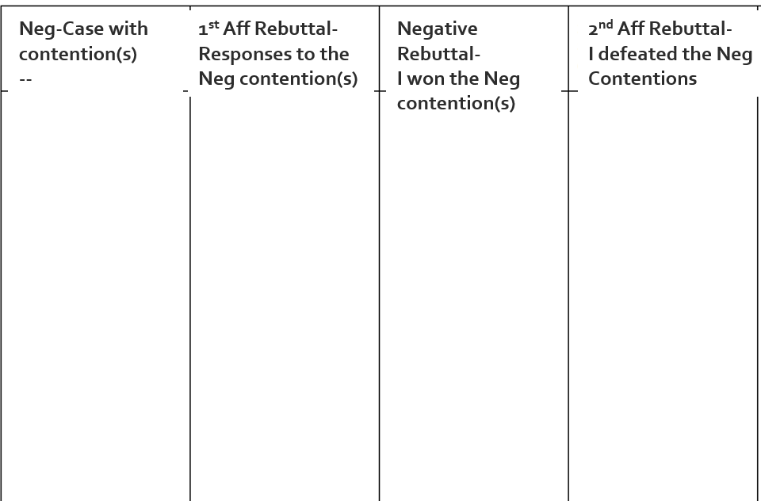
1 AFF PRESENT YOUR AFF CONTENTION
while NEG—FLOW YOUR RESPONSES: 90%!
Read your Contention
You read the bolded words.

Slide 16
NEG SPEAKER: ASK THE AFF SPEAKER QUESTIONS.
3 minutes.

Slide 17
1 NEG PRESENT YOUR CONTENTION AND RESPONSES TO THE AFF CONTENTION
While AFF—FLOW YOUR RESPONSES: 90%!
“Against the Aff Contention . . .” (respond)
Read your Contention
You read the bolded words.

Slide 18
AFF SPEAKER: ASK THE NEG SPEAKER QUESTIONS.
3 minutes.

Slide 19
1 AFF REBUTTAL RESPOND TO NEG CASE AND DEFEND AFF CASE
While NEG PREPS RESPONSES: 90%!
“Against their __________ Contention” (respond)
My aff contention ____ still stands (respond to neg args and defend your contention)

Slide 20
NEG REBUTTAL SHOW YOU WON NEG CASE AND DEFEATED AFF CASE
While AFF PREPS RESPONSES: 90%!
My Name is _____________
“I won our contention because I showed _____”
“I defeated the Aff contention because I showed _____”

Slide 21
2 AFF REBUTTAL SHOW YOU WON AFF CASE AND DEFEATED NEG CASE
My Name is _____________
“I won the aff contention because I showed _____”
“I defeated the neg contention because I showed _____”

Slide 22
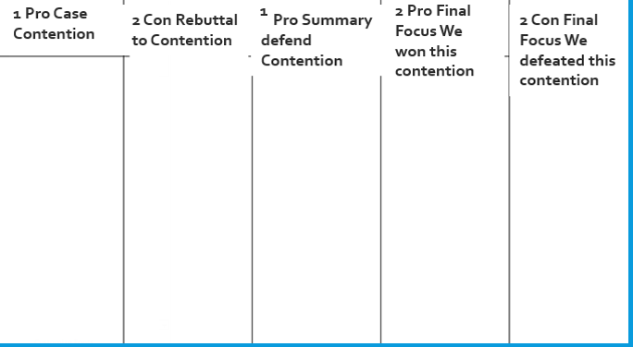
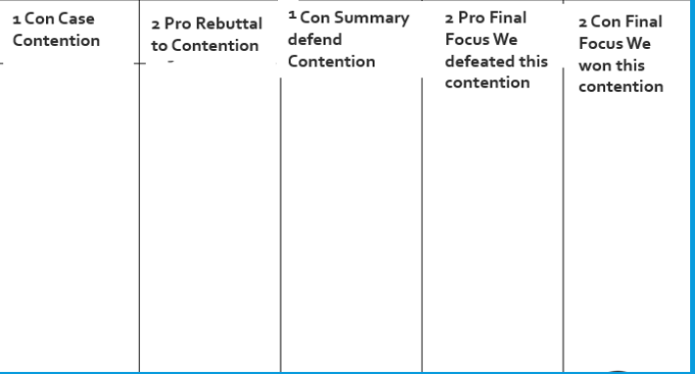
1 PRO DEFEND YOUR PRO CONTENTION
2’S—FLOW SO YOU CAN RESPOND
Note Everyone should continue to flow all of the speeches to the very end!

Slide 23
1 CON DEFEND YOUR CON CONTENTION
2’S—FLOW SO YOU CAN RESPOND

Slide 24
2 PRO SHOW YOUR PREVIOUS ARGUMENTS WIN EACH CONTENTION (avoid new arguments)
2 CON—FLOW SO YOU CAN RESPOND

Slide 25
2 CON SHOW YOUR PREVIOUS ARGUMENTS WIN EACH CONTENTION (avoid new arguments)

Slide 26
TIME FOR FEEDBACK!
THEN—LET’S DO A SECOND DEBATE WITH THOSE WHO DIDN’T DO DEBATE IN THIS FIRST DEBATE.

