Slide 1
LET’S MOVE TO LD DEBATE!
Jim Hanson

Slide 2
WE ARE STILL CLIMBING TOGETHER!
We are working together
We are a team and we support each other
Share your names and something important to you.

Slide 3
You will be doing LD debate
This debate format is used throughout the United States
It focuses on
values and philosophies
on current issues
well researched arguments
And . . .

Slide 4
Ld debate is similar
Sides in a Debate? Aff and Neg
Flowing? Yes
Contentions? Yes
Weighing? Yes
So . . .

Slide 5
What is different about ld DEBATE?
1. Teams are ONE PERSON
2. Speaking Order is different
3. Debate Arguments are like Public Forum (No more AREI—it is tag/claim and support/evidence)
4. The Topic
5. Cross-Examination instead of POIS and Crossfire
6. What your Cases need to include.

Slide 6
1. ONE person teams
You debate on your own against another debater
The Aff (Prop/Pro) Debater gives 3 speeches
The Neg (Opp/Con) Debater gives 2 speeches
Here are the 2 debaters doing questions and answers at the 2019 High School Nationals Finals.

Slide 7
2. LD speaking order
Affirmative Constructive: Present Aff Case (6 min)
Cross-Examination: Neg speaker questions Aff speaker (3 min)
Negative Constructive: Present Neg Case, Respond to Aff Case (7 min)
Cross-Examination: Aff speaker questions Neg speaker (3 min)
1st Affirmative Rebuttal: Respond to Neg Case, Defend Aff Case (4 min)
Negative Rebuttal: Defend Neg Case, Responses to Aff Case, and why you win (6 min)
Affirmative Rebuttal: Defend Aff Case, Responses to Neg Case, and why you win. (3 min).

Slide 8
3. LD DEBATE arguments
AREI is still used but it isn’t called that
TWO KINDS OF LD ARGUMENTS
Documented Arguments (used mostly in the speeches in the first half of the debate)
Analysis Arguments (used mostly in the speeches in the second half of the debate)

Slide 9
Documented Arguments in LD debate
Tag (Claim)
Source (Citation)
Evidence (Quotation)
Importance (Impact)
Student don’t forget lessons with Year Round Schools
Grace Chen, educator and researcher, April 06, 2018
Students forget knowledge and skills they acquired during the previous academic year. Several studies support this notion, as children show losses in math and language arts knowledge over the long summer break. . . . (Y)ear-round school increases retention rates, as students in year-round schools have demonstrated higher scores on some standardized tests.
So, year round school helps learning.

Slide 10
TRY IT!
Check out the quotation on the next page . . .
Add a tag/claim which is
4 to 9 word complete (noun and verb) sentence
that says what the evidence says (often using words in the quotation itself)
Then show us your work.

Slide 11
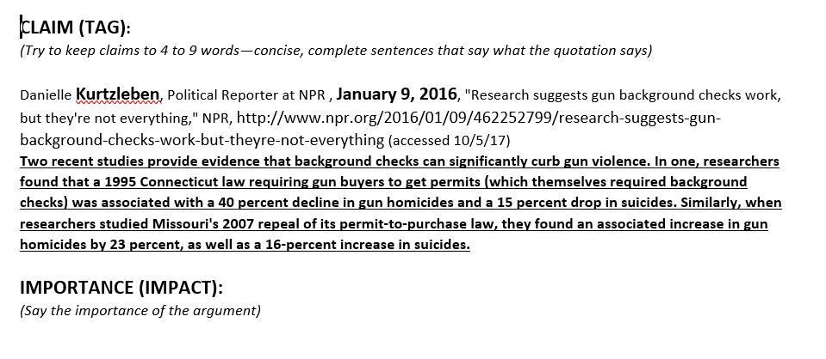
TAG IT! 4 TO 9 WORD SENTENCE THAT ACCURATELY SUMS UP THE EVIDENCE
What did you get?

Slide 12
NOW IMPACT IT—WHAT MAIN POINT DOES IT PROVE?
What is the importance?

Slide 13
Analysis Arguments in ld debate
Claim
Support (Warrant)
Importance (Impact)
Year Long Schooling makes school less stressful
It means not cramming everything in 9 nearly non-stop months; instead, you get 9 weeks of classes and then a 3 week break four times a year
That’s important to get time off and reduce school stress

Slide 14
TRY IT!
Give a logical argument for why background checks would be good (or bad)
Include a Claim, Support, Importance
What did you get?

Slide 15
4. The topic
The Topic is chosen by coaches voting across the U.S.
Used in all LD debates for two months
You go into depth and different angles.

Slide 16
What is The topic?
It gets announced October 1!!!
We’ll email you
It will be something on worker/labor rights.

Slide 17
5. cross-examination
No more 3 on 3 Parli POIs—you don’t speak during opponent speeches
No Pub Forum Crossfire—you don’t go back and forth questioning and answering
In LD . . .
After the Affirmative Constructive—the Negative Speaker asks the Affirmative questions
After the Negative Constructive—the Affirmative Speaker asks the Negative questions.

Slide 18
WHAT YOU NEED FOR LD DEBATE

Slide 19
You need CASES . . .
YOU WILL NEED DOCUMENTED CONTENTIONS
YOU WILL NEED VALUE-CRITERIA
YOU WILL NEED DOCUMENTED RESPONSES.

Slide 20
AFF CONTENTIONS
PROBLEM-Show a problem exists
THE TOPIC SOLVES-Show the topic solves
IMPACT-Show solving the problem helps people a lot
PROBLEM-20 minute lunch time is too short
THE TOPIC SOLVES-40 minute lunch gives enough time
IMPACT-Longer lunch reduces stress and upset stomachs from eating too fast.
Now you Do it!

Slide 21
NEG CONTENTIONS
LINK-THE TOPIC CAUSES OR INCREASES A PROBLEM
IMPACT-Show this problem would hurt people a lot.
LINK-Longer lunch means shorter classes
IMPACT-Shorter classes mean less learning and more stress before tests.
Now you Do it!

Slide 22
Check out the evidence packet
IT IS ON THE PREPARE SECTION ON THE CLIMB AFTERSCHOOL WEB PAGES
https://tinyurl.com/climb-afterschool-hs
Everybody confirm you are there!

Slide 23
CASES AND VALUE-CRITERIA
Look at the Affirmative Case
Notice it has Value-Criteria
Value-Criteria shows how to weigh a debate including:
1) the goal/the ideal (value)
2) the way to achieve that value (criteria)
3) the importance of meeting that value
Your Contentions should link/impact to that Value-Criteria.

Slide 24
VALUE-CRITERIA—LET’S TRY IT!
Your Topic: The government has a responsibility to reduce poverty.
You want to argue that the government can reduce malnutrition among children.
1) the goal/the ideal (value)
2) the way to achieve that value (criteria)
3) the importance of meeting that value
Your Contentions should link/impact to that Value-Criteria.

Slide 25
VALUE-CRITERIA—answer!
Your Topic: The government has a responsibility to reduce poverty.
You want to argue that the government can reduce malnutrition among children.
1) the goal/the ideal (value) REDUCE MALNUTRITION
2) the way to achieve that value (criteria) GOVERNMENT ACTION
3) the importance of meeting that value MALNUTRITION IS PAINFUL, HARMS HEALTH, CAN CAUSE DEATH.

Slide 26
You need rebuttals
You need documented responses to your opponents’ contentions
Check out the rebuttals in the evidence packet
When you respond you use analysis and documented arguments
1 minimum analysis, 2 minimum documented.

Slide 27
FLOWSHEETS
You MUST USE FLOWSHEETS for your debates
To follow the speakers in the order they present . . .
1 Aff | 1 Neg | 1 Aff Rebuttal | Neg Rebuttal | 2nd Aff Rebuttal

Slide 28
You flow . . .
Your speeches
Your partner’s speeches
Your opponent’s speeches
You take notes on ALL the arguments in the debate!

Slide 29
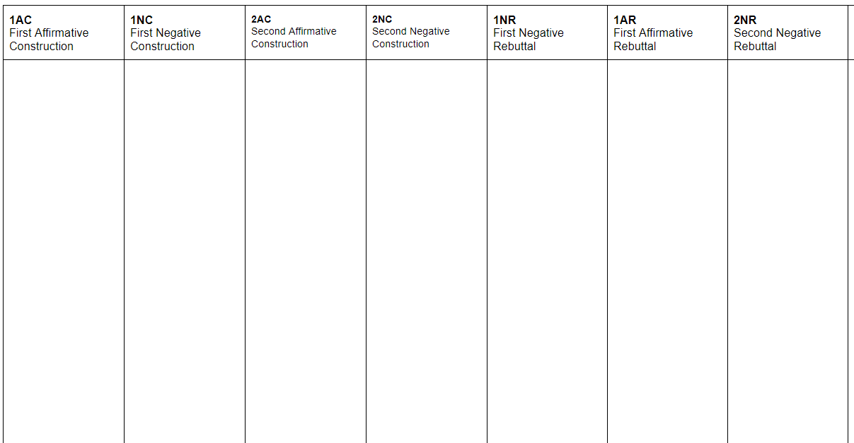
1 Aff
Case with Value-Criteria
Contention(s)
1 Neg
Respond to Aff Case
1 Aff Rebuttal
Defend Aff Case
Neg Rebuttal
I defeated the aff case
2 Aff Rebuttal
I win the aff case
Aff Case - Neg Responses Flowsheet
For Aff Case
And
Neg Responses to the Aff arguments

Slide 30
1 Neg
Neg Case with Value-Criteria and One Contention
--
1 Aff Rebuttal
Respond to Neg Case
Neg Rebuttal
Defend and show I won the Neg Case
2 Aff Rebuttal
I defeated the Neg Case
Neg Case - Aff Responses Flowsheet
For Neg Case
And
Aff Responses to the Neg Case

Slide 31
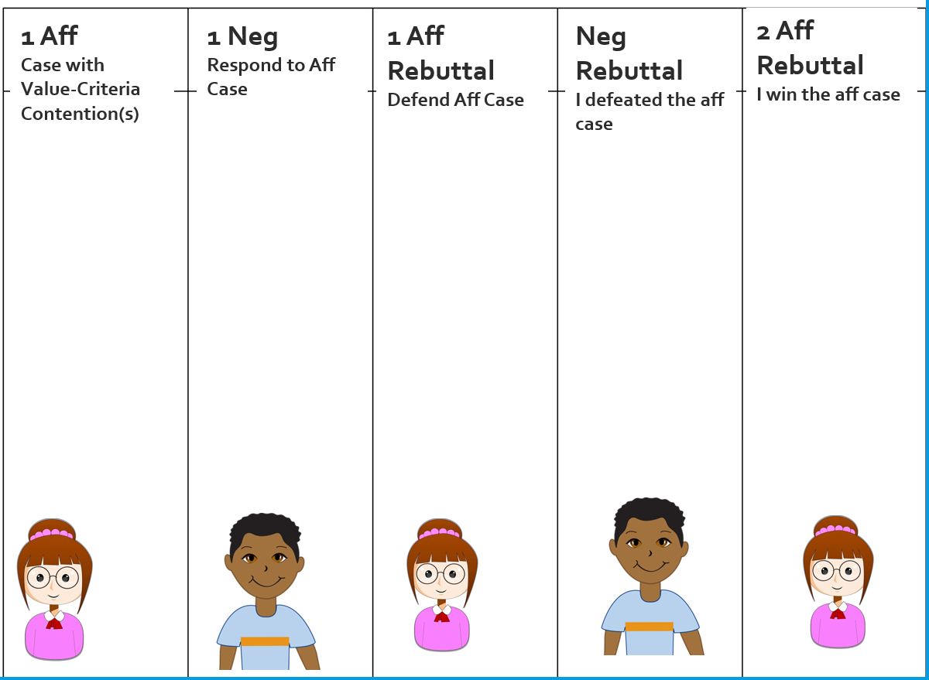
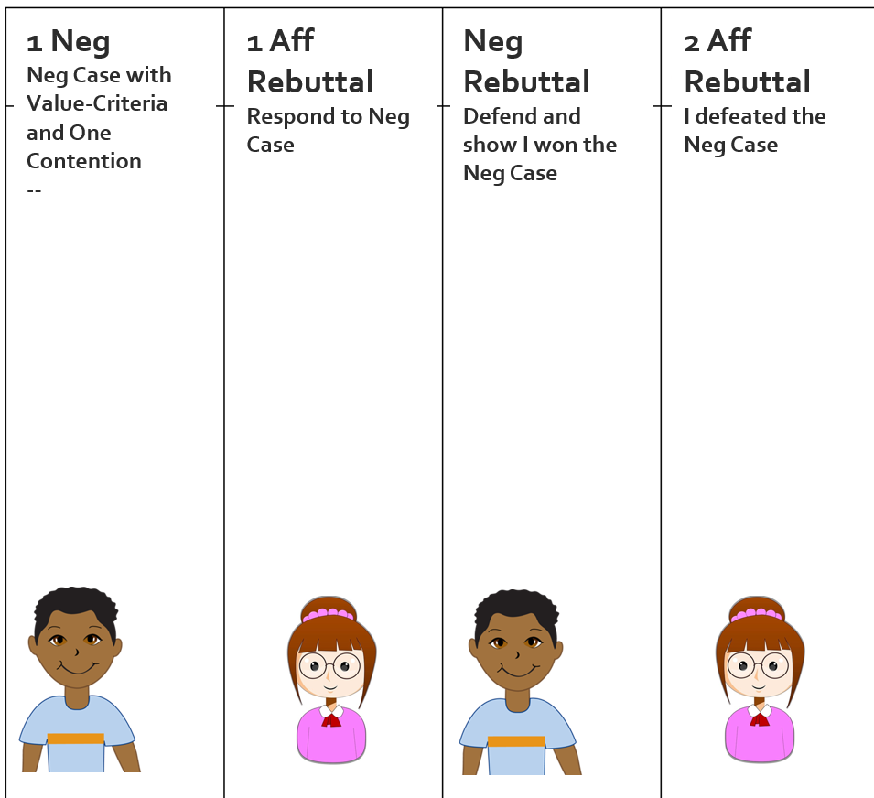
SET UP YOUR FLOWSHEETS!
Aff Case Flowsheet
Neg Case Flowsheet

Slide 32
NOW—HAVE A SHORT LD IMPROMPTU DEBATE
TOPIC: Civil Disobedience is justified in a democracy.
What is Civil Disobedience?
We’ll have a VERY short impromptu debate ---one minute speeches and cross-examinations
Who will be Aff? Neg?
3 minutes to prepare
Everyone flows!

Slide 33
WE WANT YOU TO DEBATE!
WE WANT YOU TO ATTEND THE HIGH SCHOOL TOURNAMENTS!
You’ll debate other high schoolers
Meet some great people
Really improve your speaking and debating!
We’ll announce the tournaments soon but expect debates in November and December
Friday afternoon-evening and Saturday all day.

