Slide 1
MAKING STRONGER CASES & RESPONSES WITH QUALITY MATERIAL
Jim Hanson

Slide 2
Open the case-responses file
What’s the topic for the first three weeks?
What are the Pro Arguments?
What are the Con Arguments?
Do you see an argument that could be stronger?
You will want to make that argument stronger with better research.

Slide 3
RESEARCHING IS NOT EASY
Over time, you will get better and better
And have an amazing skill that will give you a HUGE heads up over others
Here’s how to do it . . .

Slide 4
SEARCH FOR AN ARGUMENT
Go to Google
Don’t just type in the topic e.g. “Soda tax”
Instead type in words from your argument
Example: You are looking for “Soda tax reduces type 2 diabetes”
Type in: Soda tax diabetes
What did you find?
But you can and should also try . . .

Slide 5
SYNONYM SEARCHES
But you can and should also try . . .
Soda tax sugary drink tax Carbonated beverage tax Coke tax
Tip: Type the word into MS Word/Google Docs and look for synonyms.
ALSO Think: How would you word a sentence that made your argument? Use those words in your search
What did you find?

Slide 6
USING WHAT YOU FIND
Copy and Paste the section you found (that makes the argument and gives reasons for the argument) into your document
Then include a citation/source ABOVE what you copied and pasted
Author, qualifications, Date
Web page address
Doing the citation/source is irritating but it REALLY HELPS. You’ll do it faster after you get used to it.

Slide 7
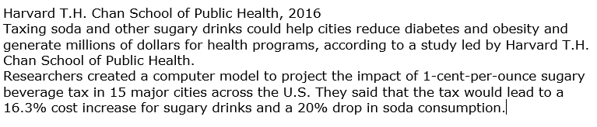
YOUR WORK SHOULD LOOK SOMETHING LIKE THIS

Slide 8
RIGHT NOW, RESEARCH THEN . . . SHARE YOUR WORK in the chat

Slide 9
NOW, WORK WITH YOUR PARTNERS
TALK ABOUT YOUR CASES, RESPONSES, ETC.

Slide 10
NOW, HOW ABOUT QUALITY RESEARCH?
There is a LOT of misinformation on the Internet
Debaters look for quality research
How can you tell the difference?

Slide 11
Is this true?
Milk and Benadryl stop Covid
https://m.ufhealth.org/news/2021/two-common-compounds-show-effectiveness-against-covid-19-virus-early-testing
“The protein from Milk and Benadryl cut virus replication by 99%”
IT IS TRUE BUT IT IS NOT A PROVEN WAY TO STOP COVID
That’s nice but the study just used petri dishes—not an actual test of people taking milk protein and Benadryl. Many substances in petri dishes can kill covid.
https://www.poynter.org/fact-checking/2022/more-research-is-needed-on-a-potential-benadryl-and-milk-protein-treatment-for-covid-19/

Slide 12
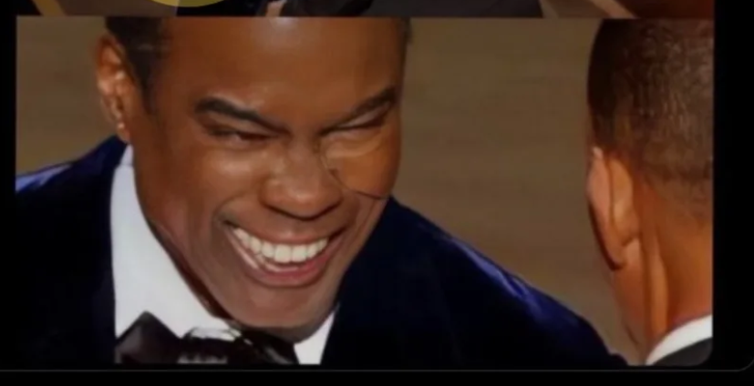
Lesson: if it sounds too good to be true—it probably isn’t true
So how about this . . . Chris Rock was wearing a cheek pad when Will Smith slapped him.

Slide 13
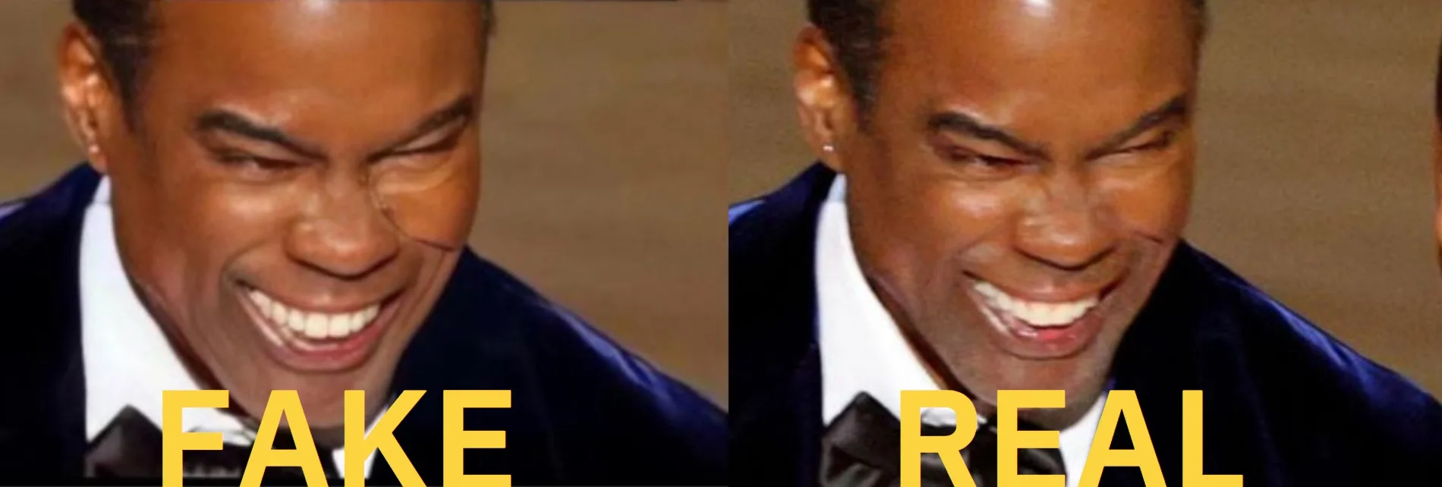
FALSE!
Check Snopes. Someone photoshopped Chris’s cheek.

Slide 14
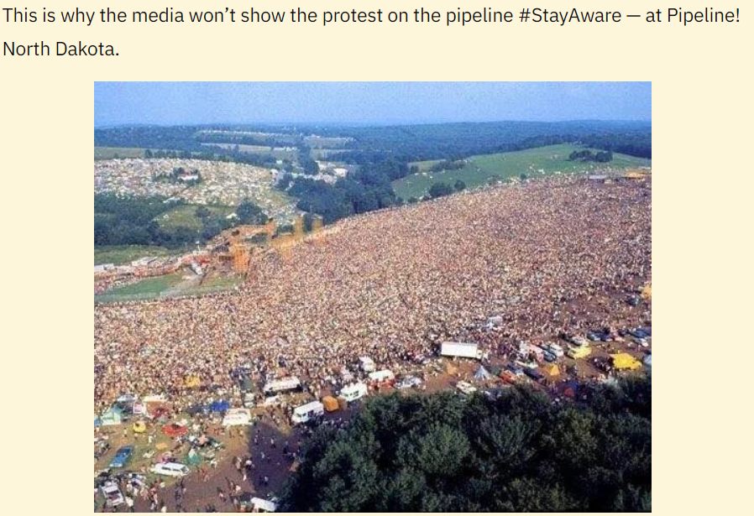
LESSON: CHECK SNOPES WHEN IT SOUNDS FISHY
What about this concerning the Keystone Pipeline?

Slide 15
FALSE again
The picture is of a Woodstock Musical Festival from 1969—forty years before the Keystone Pipeline became controversial
LESSON: If you feel strongly about an issue—and a message plays on that feeling
QUESTION IT—Go Research it.
The person who made the message is trying to play on your feelings.

Slide 16
Smoking doesn’t cause cancer
FALSE!
See this page: https://www.cancer.org/cancer/cancer-causes/tobacco-and-cancer/is-any-type-of-smoking-safe.html
But . . . Studies etc.
Many (though not all) of these studies were funded by tobacco growers and cigarette/cigar manufacturers.

Slide 17
lesson
Heavily Doubt Information funded or provided by Anyone with a “Vested” Interest
A “Vested” Interest means they will personally benefit—usually with money
Research from independent sources that don’t make money.

Slide 18
QUALITY RESEARCH
Debaters should look for quality research
And question arguments other brought up—even with a citation
Take a look at the research you did
Did you use quality material?
An important note—nearly all arguments have some kind of flaw
You can’t have perfection—just avoid glaringly bad material.

