Slide 1
Stronger Support for Arguments

Slide 2
Rhetorical Triangle: Ethos, Pathos, and Logos

Slide 3
Ethos

Slide 4
What is Ethos?
Ethos = Ethical Appeal
Convince the audience of your source’s credibility
Examples
Academic authors are more credible than bloggers
Advocacy organizations might be biased
What are your sources qualifications?

Slide 5
How to strengthen Ethos
Have better sources!
Search Engines: Google Scholar + JSTOR
If you can’t access an article, copy the “DOI number” or use SciHub
Explain your source’s qualifications in case
Not “Dr. Hayes,” but “Dr. Joseph Hayes, who is a professor of economics at Cornell University

Slide 6
Pathos

Slide 7
What is Pathos?
Pathos = Emotional Appeal
Persuade the audience by appealing to their emotions and personal interests
Examples
Death is bad and we should avoid it
Homeless people are suffering and so we should help them
Everybody knows what a difference having more money would make in their life

Slide 8
How to strengthen Pathos
Make your examples true
Hypothetical examples can be easily dismissed, but it's harder to dismiss lived experiences.
Connect the big-picture to relatable things
Regular people don’t care about the national debt - Tell the judge how it affects their day-to-day life

Slide 9
Logos

Slide 10
What is Logos?
Logos = Logical Appeal
Convince the audience by using facts and reasoning
Examples
This statistic proves that our side decreases poverty
In Switzerland, Universal Basic Income programs increased people’s happiness
According to the Seattle Times, more ferry crossings increased tourism

Slide 11
How to strengthen Logos
Provide commentary for your evidence
Don’t just say “40%,” explain why that’s relevant.
On this note, make sure to explain your evidence if its complicated
Use better sources (again!)
Academic sources will be more specific
Newer sources are almost always better

Slide 12
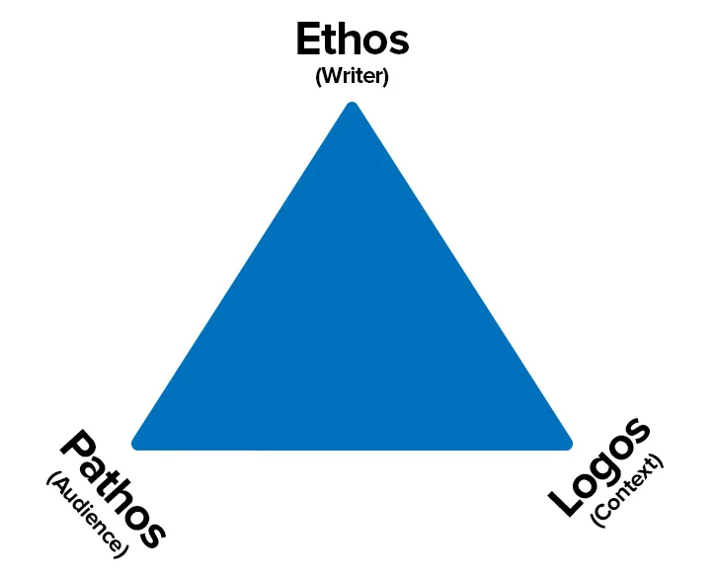
These form the rhetorical triangle

Slide 13
Activity
Make an argument (about anything) and use all three parts of the triangle in your AREI to make the strongest argument
After this we will pair off and read/respond to each argument
Make sure your response attacks all three parts, and use the triangle for form your own responses

