Slide 1
fLOWING REVIEW
You flow your speeches, your partners, your opponents, ALL the speeches.
You should write down the arguments they make for each contention
You should write down any evidence they have
You should also write down your arguments you want to use to answer their case

Slide 2
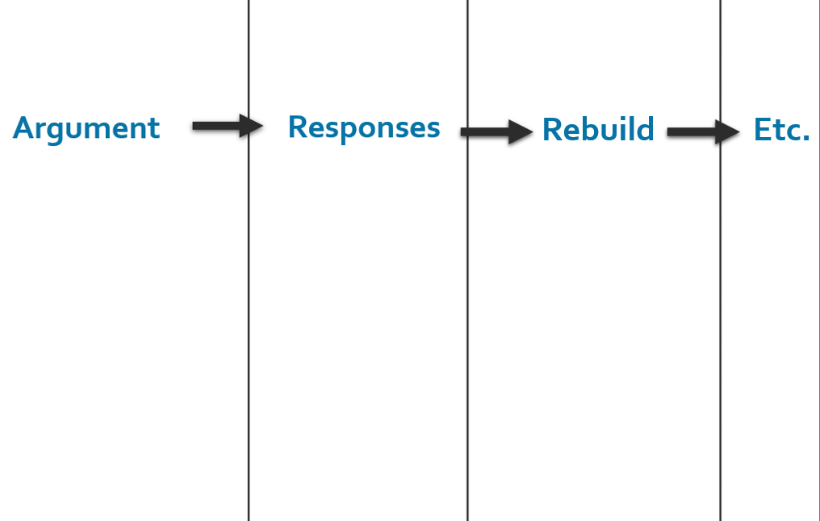
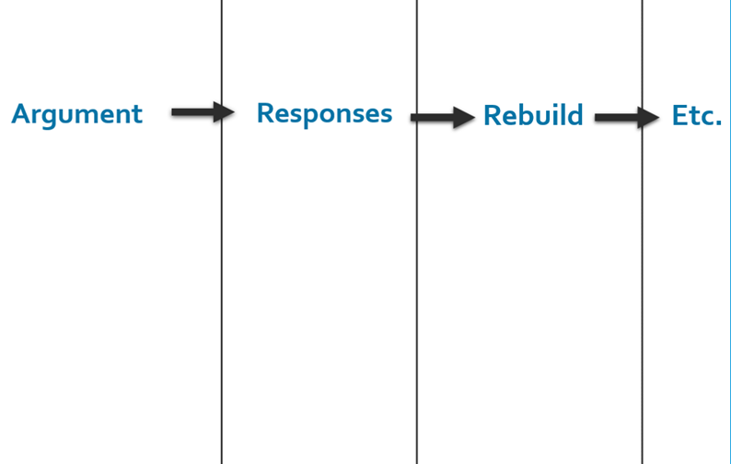
THE DEBATERS MAKE TWO FLOWSHEETS
One for Arguments and Responses about the Prop Case
One for Arguments and Responses about the Opp Case
Prop
Opp
Prop Flowsheet
Opp Flowsheet

Slide 3
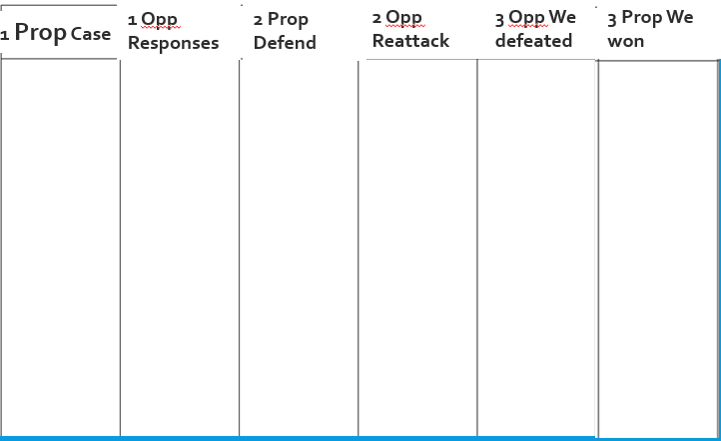
Prop Flowsheet

Slide 4
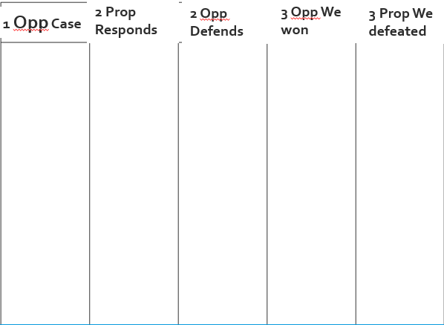
Opp Flowsheet

Slide 5
Deck of cards drill
Set up some flow sheets
I’m going to tell you a card (google deck of cards) and then you are going to flow each card I say
Then I will switch sides and you will flow that
Do this slow, and then do it again but faster

Slide 6
MINI SPAR DEBATE
You pick a topic! It can be fun
Focus on writing down your arguments for the next speech while you flow
How are you going to respond to your opponents arguments- write it while they say it
2 min speeches each instead of 5

