Slide 1
Debates on topic 2 Doing the 1, 2 and 3 speeches
Jim Hanson

Slide 2
instructors
Doing the 1, 2 and 3 Speeches well 40 minutes.
Debate 1: 10 minutes Prep, 20 minutes Debate
(2 min speeches, 1 minute question and answer)
Judges should direct the student—prompting for direct use of the scripts!
Feedback 5 minutes.

Slide 3
What is your topic?
Afterschool Program begins a new topic this week!
The Topic is _____________________.

Slide 4
1st speeches: Making a strong case
An argument, even with AREI, isn’t as convincing as it could be
So, you prepare contentions . . .
Contentions are arguments supported by arguments.

Slide 5
pro CONTENTIONS THE TOPIC WOULD SOLVE A PROBLEM
PROBLEM-Show a problem exists
THE TOPIC SOLVES-Show the topic solves
IMPACT-Show solving the problem helps people a lot
PROBLEM-20 minute lunch time is too short
THE TOPIC SOLVES-40 minute lunch gives enough time
IMPACT-Longer lunch reduces stress and upset stomachs from eating too fast.
Everyone Make a Pro Contention on your Topic!

Slide 6
con CONTENTIONS THE TOPIC WOULD CAUSE/INCREASE A PROBLEM
LINK-THE TOPIC CAUSES OR INCREASES A PROBLEM
IMPACT-Show this problem would hurt people a lot.
LINK-Longer lunch means shorter classes
IMPACT-Shorter classes mean less learning and more stress before tests.
Everyone Make a Con Contention on your topic!

Slide 7
2nd speeches: Making strong responses
Predict what the Pro team’s arguments will be
Predict what the Con team’s arguments will be.

Slide 8
Now let’s talk about responding
BEST WAYS TO RESPOND
If they say _cars are good________
You say . . .
NOT/NO (cars are NOT good)
THEY DON’T SOLVE (better cars WON’T help)
WE SOLVE BETTER (buses and light rail are better!)
Let’s try it . . .

Slide 9
Everyone write down 2 responses to . . .
A Pro Contention
Tell us your responses (instructors—give suggestions for stronger responses)
Now Respond to a Con Contention
Tell us your responses.

Slide 10
3rd speeches: SHOWING YOUR PARTNERS WON THE DEBATE!
YOUR JOB IS NOT TO MAKE NEW ARGUMENTS
YOUR JOB IS TO SHOW YOUR PARTNERS WON THE MAIN ARGUMENTS IN THE DEBATE
YOU WILL SAY “AS MY PARTNER SHOWED . . .” AND “WE WON THE SECOND CONTENTION WHEN MY PARTNER RESPONDED ____.”

Slide 11
3rd speeches: SHOWING YOUR PARTNERS WON THE DEBATE!
THE PRO ARGUES CONDOS MAY COLLAPSE—THERE AREN’T REQUIREMENTS TO FIX THE CONDOS
THE CON RESPONDS THAT CONDOS MUST HAVE AN INSPECTION EVERY 40 YEARS
YOU ARE NOW THE 3RD PRO SPEAKER—WHAT DO YOU SAY?

Slide 12
3rd speeches: SHOWING YOUR PARTNERS WON THE DEBATE!
THE CON ARGUES TOUGH NEW CONDO CODES WILL COST TOO MUCH
THE PRO RESPONDS THAT CONDO CODES ENSURE SAFETY AND THAT COMES FIRST PLUS BAD CODES MEANS LOWER VALUE FOR THE CONDOS
YOU ARE NOW THE 3RD PRO SPEAKER—WHAT DO YOU SAY?

Slide 13
Now IT IS TIME for your first DEBATE!
One at a time turn on your Webcam
Show me your
Flowsheets
Scripts
and Cases-Responses File
Do we support each other?

Slide 14
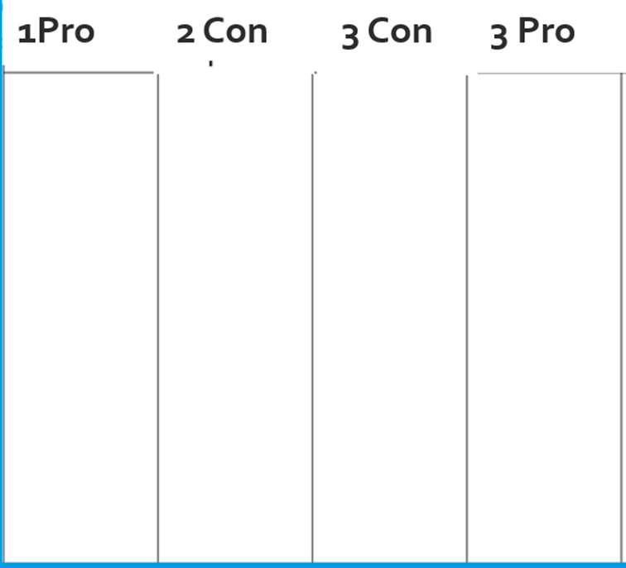
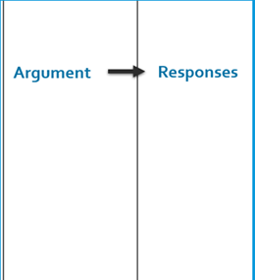
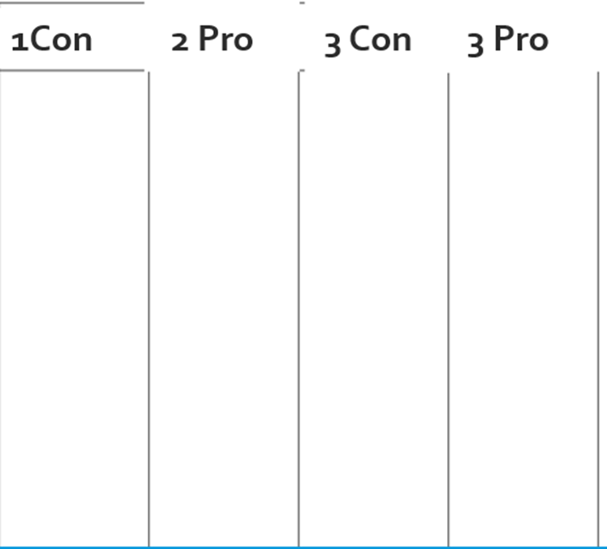
Prepare! YOU HAVE 10 MINUTES.
1st Speakers: Flow your Contention in the first column
2nd Speakers:
On a Separate sheet of paper from the flowsheet
write down responses to possible Con contentions
3rd Speakers: Help your Partners if asked
Con team can go to Room ____.

Slide 15
Let start debating!
Each Speech is 2 minutes today
This is a challenge
But we’re here to support each other to do this!
Do we Support Each Other?

Slide 16
1st Pro Speaker
Everyone—FLOW on Pro Case Sheet
Con 2 Speaker 90% Rule—Flow Responses!
Everyone clap for the Pro 1 Speaker
Pro 1 Speaker Present
--Say “My name is ______”
--State the topic
--State your one argument
--Say “You should vote for the pro side.”

Slide 17
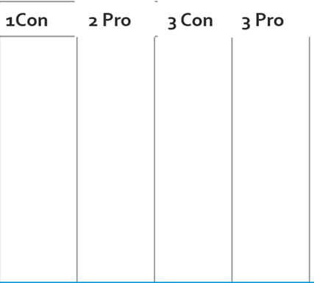
1st con goes now
Everyone—FLOW on Con Case Sheet!
Pro 2 Speaker 90% Rule—Flow Responses!
Everyone clap for the Con 1 Speaker
Con 1 Speaker Present
--Start by saying “My name is ______”
--State your one argument
--Finish by saying “You should vote for the con side”
NOW 1 minute QUESTION AND ANSWER BETWEEN 1ST SPEAKERS.

Slide 18
2nd con goes now
Everyone—FLOW on the PRO Case Sheet
Pro 3 Speaker 90% Rule—Flow Responses/ Reasons your Pro Argument still wins
Everyone clap for the Con 2 Speaker
Con 2 Speaker Present
--Start by saying “My name is ______”
--Say “I disagree with the Pro’s argument ____ because ______”
--Finish by saying “You should vote for the con side.”

Slide 19
2nd pro goes now
Everyone—FLOW on the CON Case Sheet!
Con 3 Speaker 90% Rule—Flow Responses/ Reasons your Con Arguments still win!
Everyone clap for the Pro 2 Speaker
Pro 2 Speaker Present
--Start by saying “My name is ______”
--Say “I disagree with the First Con’s argument ___ because ____”
--Say “You should vote for the pro side.”
NOW 1 minute QUESTION AND ANSWERS BETWEEN THE 2ND SPEAKERS.

Slide 20
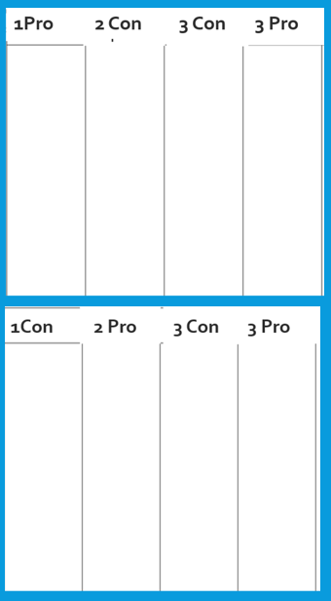
3rd CON goes now
Everyone else—FLOW
Pro 3 Speaker 90% Rule—Flow Responses/ Reasons your Pro Arguments still win!
Everyone clap for the Con 3 Speaker
Con 3 Speaker Present
--Start by Saying “My name is _______”
--Say: “My partners won our argument because _______”
--Say “My partners defeated the pro’s argument because __”
--Finish by saying “You should vote for the con side.”

Slide 21
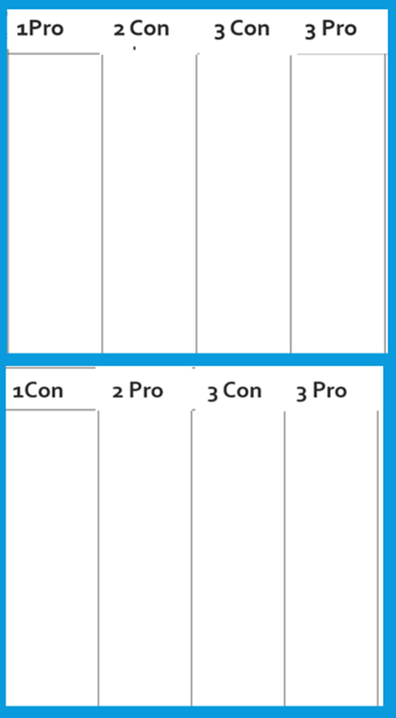
3RD pro goes now
Everyone—FLOW
Everyone clap for the Pro 3 Speaker
Pro 3 Speaker Present
--Start by saying “My name is ______”
--Say “My partners won our first argument because ____”
--Say “My partners defeated the con’s first argument because ____”
--Finish by saying “You should vote for the pro side.”
NOW, 1 minute QUESTION AND ANSWER BETWEEN THE 3RD SPEAKERS.

Slide 22
4th CON goes now
Everyone else—FLOW
Pro 3 Speaker 90% Rule—Flow Responses/ Reasons your Pro Arguments still win!
Everyone clap for the Con 3 Speaker
Con 3 Speaker Present
--Start by Saying “My name is _______”
--Say: “My partners won our argument because _______”
--Say “My partners defeated the pro’s argument because __”
--Finish by saying “You should vote for the con side.”

Slide 23
4th pro goes now
Everyone—FLOW
Everyone clap for the Pro 3 Speaker
Pro 3 Speaker Present
--Start by saying “My name is ______”
--Say “My partners won our first argument because ____”
--Say “My partners defeated the con’s first argument because ____”
--Finish by saying “You should vote for the pro side.”
NOW, 1 minute QUESTION AND ANSWER BETWEEN THE 4th SPEAKERS.

Slide 24
How did that go?
JUDGE: Email Reply to the Ballot with Winner and Points
THEN . . .
What was the hardest thing?
What was the most fun?
Here is what each of you did well and how you can improve
JUDGE: Be sure to fill out the online ballot comments form.

Slide 25
GET PREPARED FOR THE NEXT CLASS
Remember You will go Pro and Con—will change each week
Look at the Postings on the Climb Web Page (Pro team on the left) and Con (team on the right)
What are your Speaker Positions?

Slide 26
Each week, DO THE PREP!
Prepare
1. Have Black/Blue Pens
2. Print the Flowsheets
3. Print your Scripts
4. Review and have open Cases-Responses
Again, look at the Postings to see which side you are on.

