Slide 1
Flowing Ppoint scripted debates and questions
Jim Hanson

Slide 2
Instructor timeline
FLOWING 12 MINUTES
PREP TIME FOR STUDENTS 5 MINUTES
SHORT FOLLOW THE FLOW DEBATE 15 MINUTES
TALK/FEEDBACK 10 MINUTES.
QUESTIONS/ANSWERS 15 MINUTES.

Slide 3
You flow . . .
ALL the arguments in the debate!
YES—IRRITATING AT FIRST BUT . . .
YOU GET USED TO IT AND YOU BENEFIT.

Slide 4
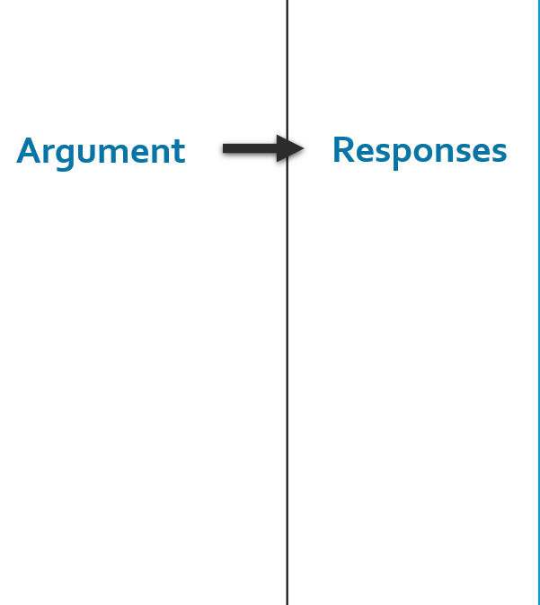
the idea behind flowsheets
You make a column to flow
For each speaker’s arguments
From left to right.
Rebuild
Etc.

Slide 5
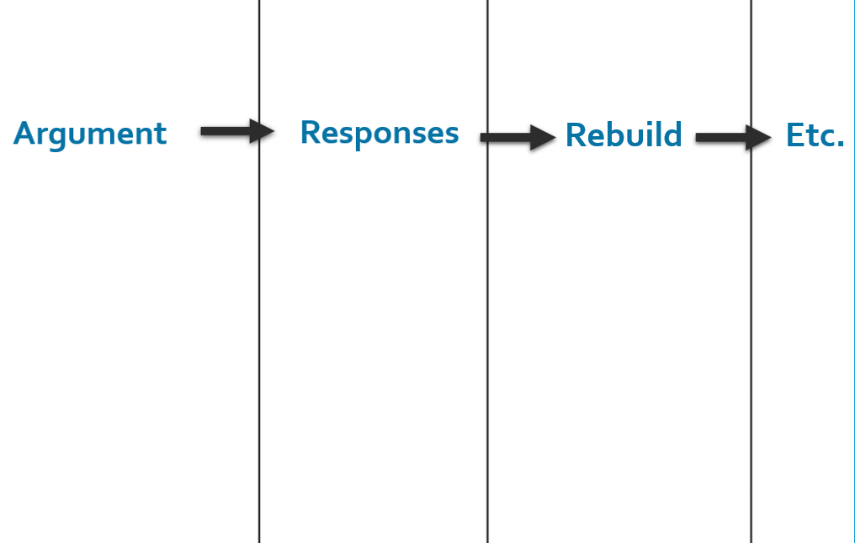
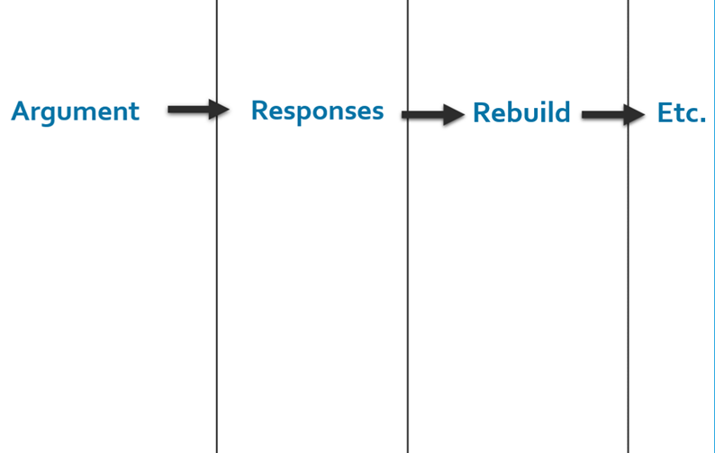
DEBATERS MAKE TWO FLOWSHEETS
One for Arguments and Responses about the Pro Case
One for Arguments and Responses about the Con Case
Pro
Con
Pro Flowsheet
Con Flowsheet

Slide 6
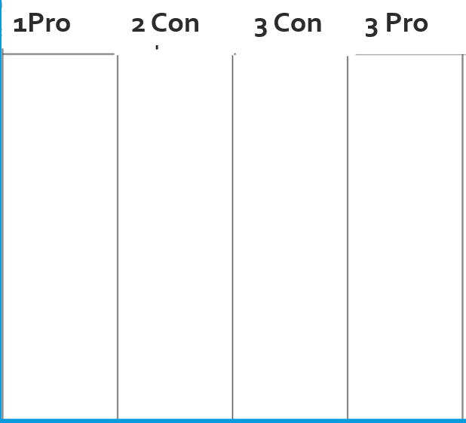
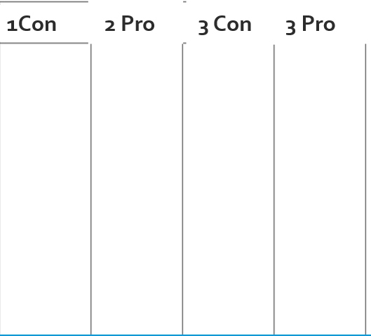
Now Prepare your own Flowsheets
Then, Show your Two flowsheets to me.
Pro Case Flowsheet
Con Case Flowsheet

Slide 7
And now . . .
Hang on to your two flowsheets
I’m going to show you how the flowsheets get used in a debate.

Slide 8
Flowing in action again!
We need to create two teams

Slide 9
TEAMS!
Be supportive of each other
“I want to work with you”
“I’m glad I’m partners with you”
“Yes! We are going to win!”

Slide 10
Now—let’s assign speaker positions
Pro 1 Speaker Present one argument for the topic
Pro 2 Speaker Respond to Con argument
Pro 3 Speaker Explain Why Your Partners won the arguments
Con 1 Speaker Present one argument against the topic (topic is bad)
Con 2 Speaker Respond to Pro argument
Con 3 Speaker Explain Why your Partners won the arguments

Slide 11
What’s our topic? Someone say it!

Slide 12
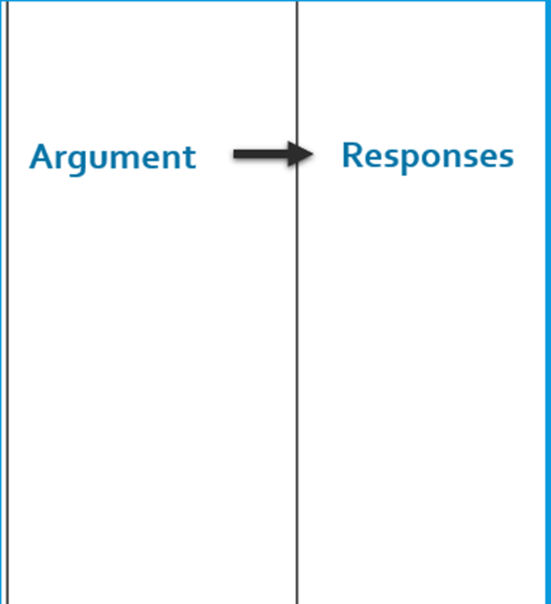
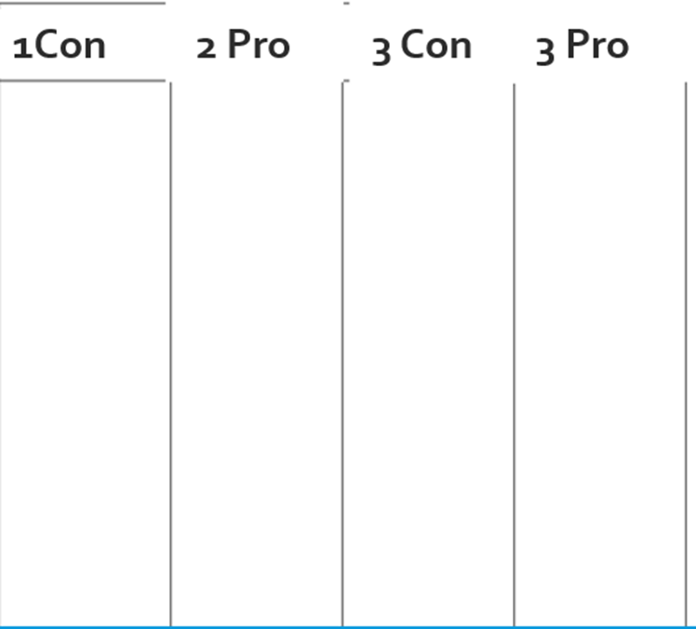
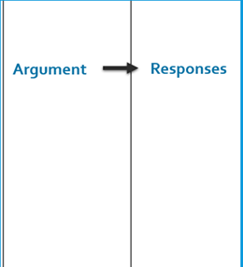
Prepare! Do this in 5 minutes (CON TEAM CAN GO TO Room __):
Pro 1 FLOW one argument for the topic in the 1Pro Column
Pro 2 WRITE DOWN Responses to possible Con arguments (separate sheet of paper from the flowsheet)
Pro 3 Help your Partners if asked
Con 1 FLOW one argument saying the topic is bad in the 1Con Column
Con 2 WRITE DOWN Responses to possible Pro arguments (separate sheet of paper from the flowsheet)
Con 3 Help your Partners if asked.

Slide 13
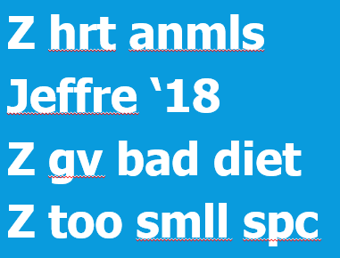
Flowing reminder
Flow the assertion and reason/evidence
Abbreviate (skip vowels or just first letters)
Shorthand (Z for zoos, for increases)

Slide 14
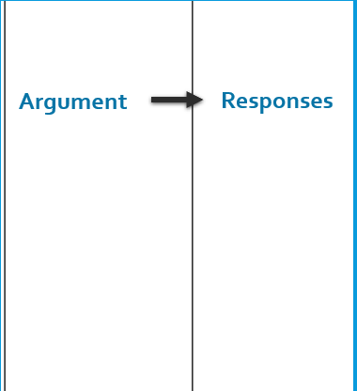
RESPONSE FLOWING REMINDER
If you are the next speaker and you are responding . . .
Flow just the assertion (spend 10% of your time doing that)
Then spend 90% of your time writing your responses.
90%
10%

Slide 15
Let start debating!
Each Speech is 1 minute
This is a challenge
But we’re here to support each other to do this!
Do we Support Each Other?

Slide 16
1 Pro Speaker
Everyone—FLOW on Pro Case Sheet
Con 2 Speaker 90% Rule—Flow Responses!
Everyone clap for the Pro 1 Speaker
Pro 1 Speaker Present
--Say “My name is ______”
--State the topic
--State your one argument
--Say “You should vote for the pro side.”

Slide 17
1st con goes now
Everyone—FLOW on Con Case Sheet!
Pro 2 Speaker 90% Rule—Flow Responses!
Everyone clap for the Con 1 Speaker
Con 1 Speaker Present
--Start by saying “My name is ______”
--State your one argument
--Finish by saying “You should vote for the con side.”

Slide 18
2nd con goes now
Everyone—FLOW on the PRO Case Sheet
Pro 3 Speaker 90% Rule—Flow Responses/ Reasons your Pro Argument still wins
Everyone clap for the Con 2 Speaker
Con 2 Speaker Present
--Start by saying “My name is ______”
--Say “I disagree with the Pro’s argument ____ because ______”
--Finish by saying “You should vote for the con side.”

Slide 19
2nd pro goes now
Everyone—FLOW on the CON Case Sheet!
Con 3 Speaker 90% Rule—Flow Responses/ Reasons your Con Arguments still win!
Everyone clap for the Pro 2 Speaker
Pro 2 Speaker Present
--Start by saying “My name is ______”
--Say “I disagree with the First Con’s argument ___ because ____”
--Say “You should vote for the pro side.”

Slide 20
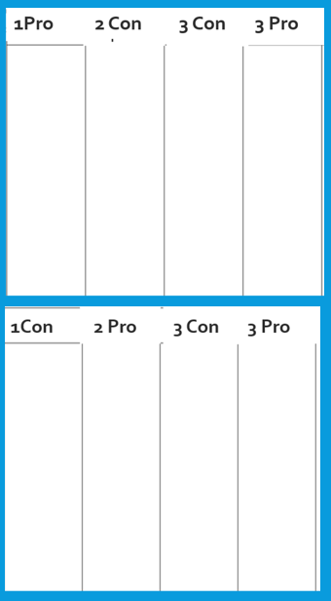
3RD CON goes now
Everyone else—FLOW
Pro 3 Speaker 90% Rule—Flow Responses/ Reasons your Pro Arguments still win!
Everyone clap for the Con 3 Speaker
Con 3 Speaker Present
--Start by Saying “My name is _______”
--Say: “My partners won our argument because _______”
--Say “My partners defeated the pro’s argument because __”
--Finish by saying “You should vote for the con side.”

Slide 21
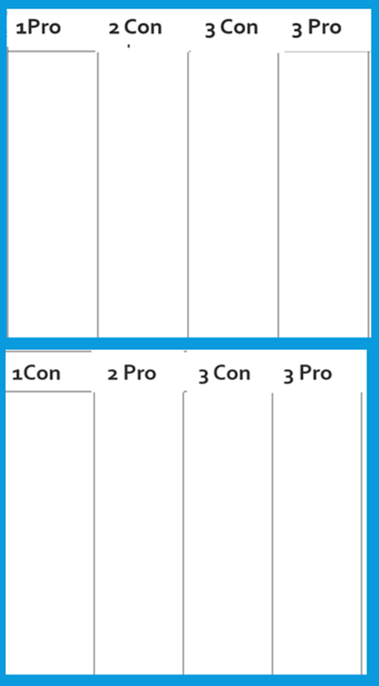
3RD pro goes now
Everyone—FLOW
Everyone clap for the Pro 3 Speaker
Pro 3 Speaker Present
--Start by saying “My name is ______”
--Say “My partners won our first argument because ____”
--Say “My partners defeated the con’s first argument because ____”
--Finish by saying “You should vote for the pro side.”

Slide 22
How did that go?
What was the hardest thing?
What was the most fun?
Now . . .

Slide 23
Question and answer!

Slide 24
Ask and answer questions
Three Q and A times in a debate
The 1’s ask and answer each other’s questions
The 2’s ask and answer each other’s questions
The 3’s do the same thing.

Slide 25
YOU DO IT!
One person presents an argument (not a contention)
One of the other two people asks a question
The presenter answers the question
Then go to the next person—for an argument, question, answer.

Slide 26
TIPS FOR ASKING
Ask about weaknesses/missing things in their argument
Avoid asking questions that let your opponent give long, good answers
Best way to ask “Where in your speech did you prove __________?”

Slide 27
TIPS FOR answering
Answer as soon as possible
Use arguments in your speech to answer questions
Answer briefly—then talk about good arguments for your side.

Slide 28
Do it again!
Use the Tips
In your teams . . .
Present an argument
Ask a question
Answer
Go to the next person.

Slide 29
FOR NEXT WEEK . . .
YOU WILL HAVE A NEW TOPIC!
You need to do the “Prepare before Class”:
Pens
Flowsheets (just the lines for the columns)
Printed Scripts (you don’t have to fill them out but you can)
Let’s look at each step of preparing on the Climb Elementary Prep Web Page.
Note: Students can do their scripts for these first debates during class—not at home.

