Slide 1
Debate!
Jim Hanson

Slide 2
What is the first debate topic?
Zoos should be banned
What arguments might come up?

Slide 3
Get your google/bing on!
Search for the answer to these questions:
Has any city banned or shut down their zoos? Did it work?
Name an expert that supports ending zoos? Why does this expert think this?
Why might zoos be good?

Slide 4
Now—prepare an argument!
Half of Lab: Prepare an argument with 2 AREIs for why zoos should be banned
Other Half of Lab: Prepare an argument with 2 AREIs for why zoos should NOT be banned
Con Team—you can go to Room _______ (room number plus 20)
One Person—tell us your Should Ban Argument
One Person—tell us your Should NOT Ban Argument.

Slide 5
WHEN A DEBATER PRESENTS AN ARGUMENT, YOU Take notes . . .
TAKING NOTES IN DEBATE IS CALLED FLOWING
FLOW MY ARGUMENT . . .
When I say stop, you have to stop—drop your pen!

Slide 6
flowing better
Flow the tagline/claim
Flow the source
Flow the support for the tagline/claim.
Example Flowed Argument
Zoos save animals
National Geographic 2020
Zoos protect hurt injured animals and allow animal to engage in breeding

Slide 7
ABBREVIATE
Shrtn wrds w/o vwls
Endgrd Spcs
Or just the first letters of longer words
Treat Dang Qual
Example Flowed Argument
Zs sv anmls
Nat Geog 2020
Prtct hrt anmls, allw brding

Slide 8
Shorthand
Endangered Species = ES
Zoos = Z
Increases = ↑
Solves = S
Example Flowed Argument
Z = encg bd view of anmls
Pro Anml Rts 2022
↑Viewing, ↓ Rspct for anmls in the wld
NOTICE: How much less you have to write!

Slide 9
EXAMPLE FLOWED ARGUMENT
Z hrt anmls
Jeffre ‘18
Z gv bad diet
Z too smll spc
TRY FLOWING AGAIN—Here is another argument.

Slide 10
Now—let’s do it real!
Someone present their SHOULD BAN argument
Flow it!

Slide 11
Now, it gets tougher!

Slide 12
Flowing WHEN RESPONDING
Create two columns
I will present an argument
You write responses
TRY IT . . .
How many responses did you get?
Argument
Responses

Slide 13
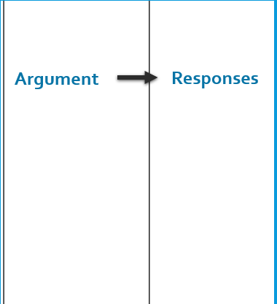
BETTER Flowing WHEN RESPONDING
Flow just the assertion
Then spend 90% of your time writing your responses
TRY IT AGAIN.
I’ll will present an argument—WRITE RESPONSES!
90%
10%

Slide 14
Now—let’s do it real!
Someone present their Should NOT Ban argument
Flow your Responses!
How many Responses did you get?
Who’s willing to present their responses?

Slide 15
FOR NEXT WEEK . . .
You need to do the “Prepare before Class”:
Pens
Flowsheets (just the lines for the columns)
Printed Scripts (you don’t have to fill them out but you can)
Let’s look at each step of preparing on the Climb Elementary Prep Web Page.
Note: Students do their scripts for these first debates during class—not at home.

