Slide 1
Let’s debate!
Jim Hanson

Slide 2
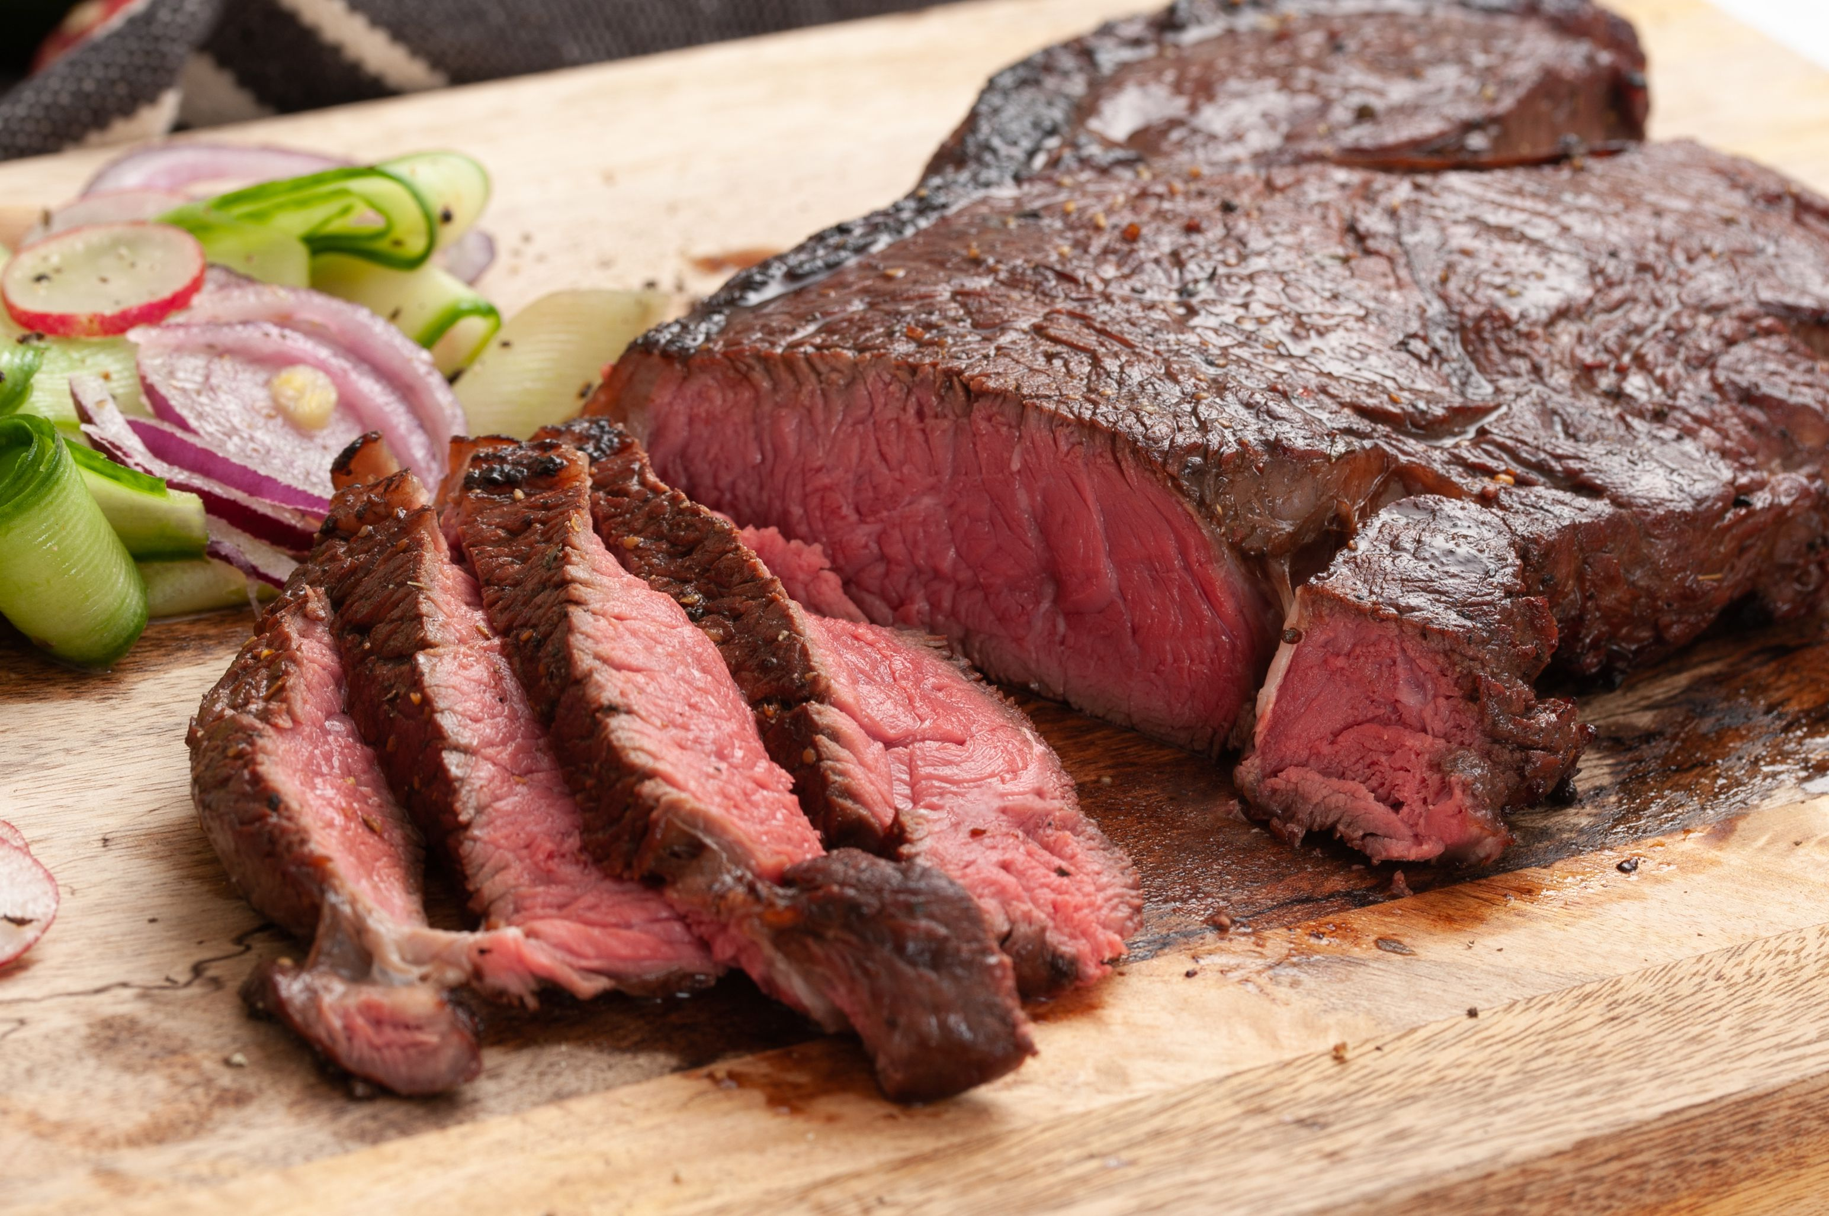
What’s your favorite food?

Slide 3
We have our opinions
We are working together
We are a team and we support each other.

Slide 4
Communicate it!
Each person, tell your group . . .
Your name and anything important to you
Your favorite food.

Slide 5
Making an argument
Assertion-your point
Reason-because ___
Evidence-proof
Importance-why this matters
Sugary beverages harm health
Because they increase diabetes
High sugar consumption is linked to diabetes in studies
So, we should try to reduce consumption of sugary beverages.

Slide 6
Ready to make an argument about . . .
Your favorite show?
School Uniforms?
The best Video Game?
Something else?

Slide 7
Prepare an argument
Assertion—your point
Reason—because ___
Evidence—show proof
Importance—why this matters

Slide 8
Now . . . prepare your argument
Assertion—your point
Reason—because ___
Evidence—show proof
Importance—why this matters

Slide 9
One person—share outloud your argument

Slide 10
Debate involves respectful disagreement
When a debater says steak is the best food . . .
You can argue “steak is NOT that good tasting”
You can argue “steak means harming animals—that’s not the best”
You can argue “Sushi is more delicious”

Slide 11
Now . . . I disagree game
One person presents their argument
The next person I call then says “I disagree because ____________”
We’ll hear an argument and a response from each person.

Slide 12
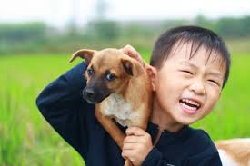
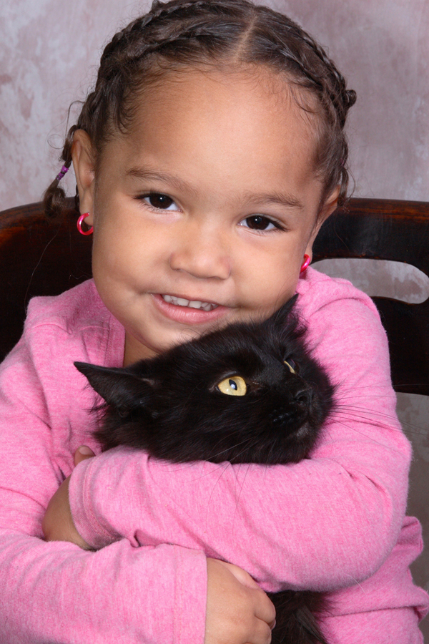
Dogs or cats?
Some people love dogs
Some people love cats

Slide 13
Some people don’t like either

Slide 14
TOPIC: dogs are better than cats
One debater is Pro—and favors the topic.
The other debater is Con—and is against the topic
Pick now which side you will be on
Sometimes, you don’t get your preferred choice.

Slide 15
TOPIC: dogs are better than cats
PRO prepare an argument (AREI) for the topic—and be ready to disagree with arguments the con might present
CON prepare an argument (AREI) against the topic—and be ready to disagree with arguments the pro might present
Con team you can go to Room ____ (room number plus 20).
You will present 1 minute speeches in a short debate with each other.

Slide 16
NOW: MINI-DEBATE ONE ON ONE
1 minute Pro Speech (present your argument using AREI)
1 minute Con Speech (present your argument using AREI AND respond to the Pro Arguments)
1 minute Pro Speech (respond to the con arguments and defend your arguments)
1 minute Con Speech (defend your arguments and respond again to the pro arguments)

Slide 17
How did it go?

Slide 18
As we debate, treat each other right
We argue Ideas
We don’t argue against People
Look around the Zoom Room
These are your team members—show you support each other
If at anytime you are not being treated right—tell the lab leader, your parent, or Jim Hanson
If you see someone being mistreated—you are encouraged to put a stop to it. “Hey Stop that.” “Hey, let’s do something else.” “Yep, I’m going to contact Jim Hanson.”

Slide 19
The next sessions
You will learn more about good arguments
You will engage in debating
At a higher level of knowledge!

Slide 20
What you need for debates
Pens (Black/Dark Blue)
Flowsheets (Print Paper 8.5 x 11 or larger)
Printed Scripts
Let’s look at each step of preparing on the Climb Middle School Prep Web Page.

