Slide 1
LET’S BE A
GREAT TEAM!
This is for ALL CLIMBERS!

Slide 2
Treat each other right Pt. 1
Treat people kindly
Support an inclusive tournament environment
Avoid mean comments
Don’t be disrespectful toward/argue with judges.

Slide 3
Treat each other right Pt 2
Avoid sexualized comments and inappropriate conduct
Don’t be mean to others
Treat others kindly and equally.

Slide 4
Encourage Everyone as participants
  Lesbian-Gay-Straight-Bi-Queer
  Black-White-Latino-Asian-Biracial-
  Multiracial, etc.
  Men-Women-Transgender-Androgynous-Non-binary-etc.
  Republican-Democrat-Libertarian-etc.
  Christian, Agnostic, Catholic, Mormon (LDS), Jewish, Wicca, Muslim, etc.
  Disabilities--diagnosed or otherwise
  Military service
  EVERYONE
  Treat every student,
  coach, and judge with respect.

Slide 5
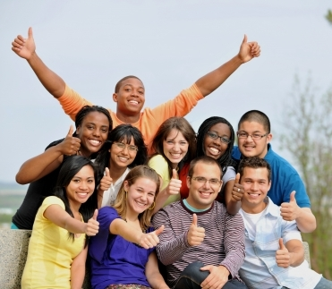
Participants should . . .
express their opinions about issues
not attack groups of people
not attack other individuals.
Argue about ideas—not disrespect people.

Slide 6
If you see or hear someone mistreating someone. . .
BY ANYONE—coach, observer, student, judge
Stop it if possible
Share the information about it . . .
with your parent, your instructor and/or Jim Hanson
We’ll work to make things better.

Slide 7
Share the Information ASAP Pt 1
Don’t delay; communicate . . .
  “I don’t want to get someone in trouble”
  Our goal is to work out the problem in a constructive manner. Please share it.
  “It wasn’t that big of a deal”
  It might have been; we need to make sure. Please share it.
  “People need to get over their sensitivity”
  Please show support for people’s feelings; there may be a good reason they are sensitive to what happened. Please share it.
  “I got it worked out”
  That’s great but we need to check and make sure. Please share it.
  TRY TO STOP IT and SHARE THE INFORMATION WITH YOUR PARENTS, INSTRUCTOR, OR JIM HANSON SO WE CAN ADDRESS IT.

Slide 8
Share the Information ASAP Pt 2
Don’t delay; communicate . . .
  “I’m scared to report”
  Understood. We’re here to support you. Take that step and help make our community a safer place. Please share it.
  “Not a debater”
  It still affected someone at the event. Show support for all people, not just speech and debate community members. Please share it.
  “I’m not a top ten debater; the person is. I don’t have the clout to share this information.”
  Yes, you do. Everyone participates at our programs and everyone has a right to a safe, comfortable, supportive environment. Please share it.
  TRY TO STOP IT and SHARE THE INFORMATION WITH YOUR PARENTS, INSTRUCTOR OR JIM HANSON SO WE CAN ADDRESS IT.

Slide 9
Sharing Information Means . . .
We’ll work to make things better.

Slide 10
As a speaker and debater . . .
People look up to you.
You are setting the stage for this Speech and Debate Community.
Other speakers and debaters are going to emulate you.

Slide 11
Be the speaker people talk about as . . .
“Yea, Mick’s cool; gave a great rebuttal.”
“I respect them a lot. They can argue like nobody’s business and they reached out to younger debaters and made them feel included.”
“She’s wicked smart but also really, really nice.”

Slide 12
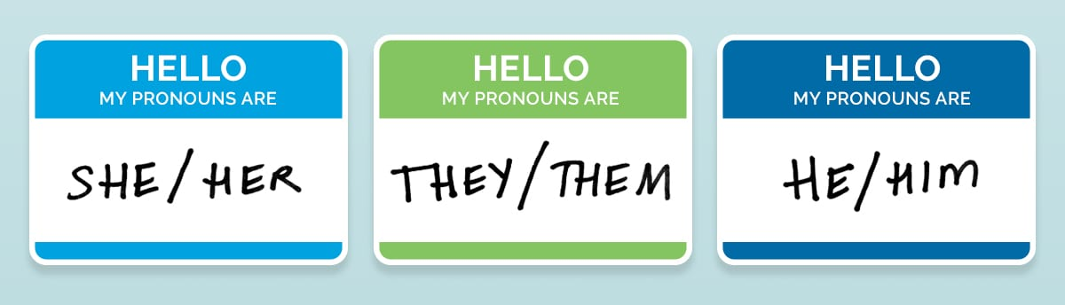
All Genders are part of our community . . .
Don’t assume Betty is “she”
Refer to others by their name “Betty”, speaker position (“First Aff Debater”), or default to “they.”
You can also ask students for names/anything important including pronouns at the beginning of the debate.

Slide 13
Don’t assume . . .
A participant is a representative of a group
“You know what it’s like right . . . (pointing to student of color).
Don’t assume everyone is white/ middle class/ straight/ liberal/ Hispanic/ non-religious, etc.
“Well, I mean, people can afford that.”
“The people in this room don’t experience discrimination.”

Slide 14
SOCIALIZE—CONNECT! : )
Please socialize—talk with your teammates/coaches in your debate room!
Though don’t interrupt other people : )
AND IT IS OKAY TO BE SHY! (many debaters are!)

Slide 15
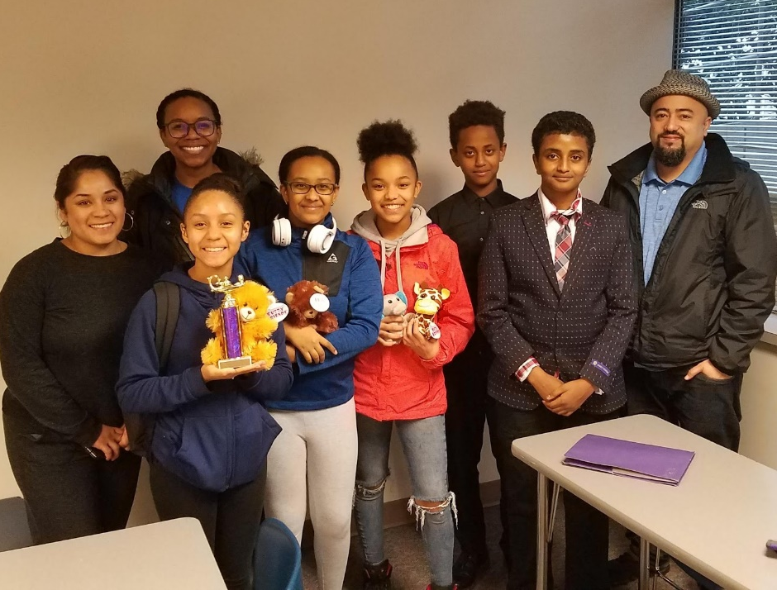
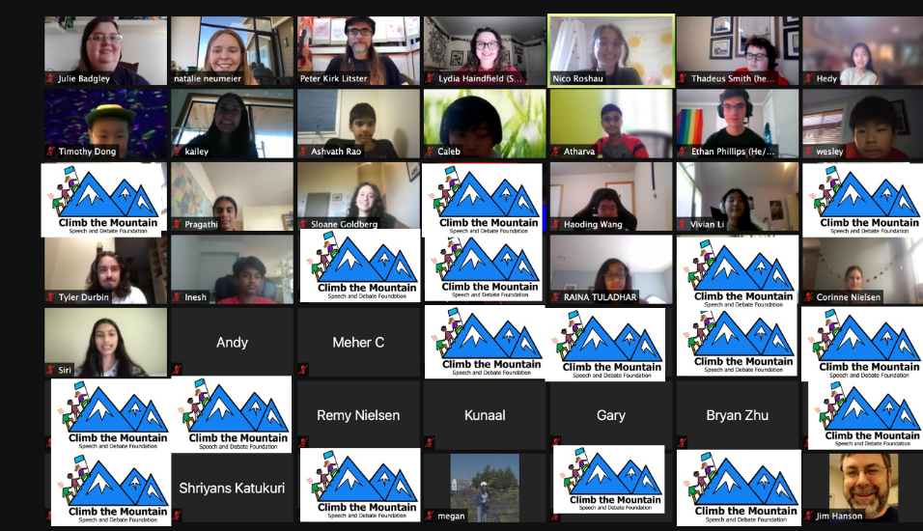
Make this Community Great!
Treat each other with respect
Support each other
Share Information when there is a problem
Promote good interactions
Be a great debater who cares for others
and your community!

