Slide 1
JUDGING GUIDELINES
This is for Judges and Coaches at our Online Tournaments

Slide 2
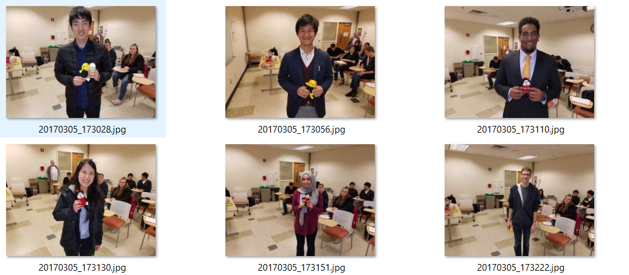
Welcome to our Community’s Tournament
We hope you have a fun and
educational tournament

Slide 3
Professional Presentation
You’re online, viewable by others
Your mind should be alert and sober
Be dressed for public view (note: we do _not_ have a dress code and you should not make comments about others’ dress unless you are 100% certain the comment will be taken positively)
Act appropriately in front of the camera and mic (turn them off if you need privacy).

Slide 4

Be on time
Check Email and Postings
Use Bathroom when debate isn’t happening
Stop coaching to get to room on time
Start the first speech on schedule
Keep the students on task to complete round on time
Email your ballot decision and points on time, asap.

Slide 5
Interact with others professionally
As a judge, you aren’t a student anymore
Be Professional—NOT Romantic
NO Sexual questions, pictures, date/meet up requests
NO Paying too much attention to one person
This applies to everywhere: In Online Rooms, Chatting, and in Email and Messaging.

Slide 6
Encourage Everyone as participants
  Lesbian-Gay-Straight-Bi-Queer
  Black-White-Latino-Asian-Biracial-
  Multiracial, etc.
  Men-Women-Transgender-Androgynous-Non-binary-etc.
  Republican-Democrat-Libertarian-etc.
  Christian, Agnostic, Catholic, Mormon (LDS), Jewish, Wicca, Muslim, etc.
  Disabilities--diagnosed or otherwise
  Military service
  Other identities
  Treat every student,
  coach, and judge with respect.

Slide 7
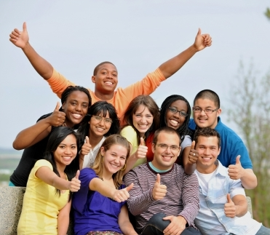
Participants should . . .
express their opinions about issues
not attack groups of people
not attack other individuals.
Argue about ideas—not disrespect people.

Slide 8
As a judge . . .
Other judges, coaches, students, observers look up to you.
Other judges, coaches, speakers, and debaters are going to emulate you.

Slide 9
Be the judge-coach people talk about as . . .
“Yea, Elda rocks; helped me out a lot with that decision.”
“I respect him a lot. He can explain T and theory debates like nobody’s business and he reached out to younger debaters and made them feel included.”
“They are wicked smart but also really, really nice—super helpful judge especially for strategic ideas.”

Slide 10
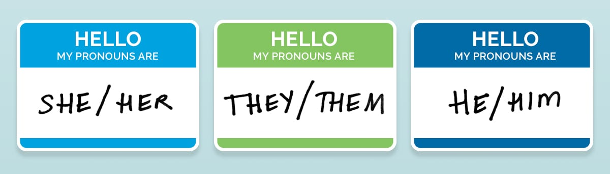
All Genders are part of our community . . .
Don’t assume Betty is “she”
Refer to others by their name “Betty”, speaker position (“First Aff Debater”), or default to “they.”
You can also ask students for names/anything important including pronouns at the beginning of the debate.

Slide 11
Don’t assume . . .
A student is a representative of a group
“You know what it’s like right . . . (pointing to student of color).
Don’t assume everyone is white/ middle class/ straight/ liberal/ Hispanic/ non-religious, etc.
“Well, I mean, people can afford that.”
“The people in this room don’t experience discrimination.”

Slide 12
As a judge watching. . .
You have an obligation to assure a comfortable environment
For _all_ participants.

Slide 13
If you see or hear about harassment . . .
Done by ANYONE—coach, student, judge, observer
Stop it if possible
Say “Stop it” or “Hey, let’s move on to . . .”
Share the information about it . . .
with Jim or your coach
We’ll work to make things better.

Slide 14

Make this Community Great!
Treat each other with respect
Support each other
Share Information when there is a problem
Promote good interactions
Make your judging a helpful benefit to students . . .
and your community!

